Slide 1
AI-Powered Healthcare Management System
A role-based web application for clinic appointment booking, AI-assisted healthcare support, prescription management, and patient records.
Vocational Training Project
2025–2026
Submitted by: Majji Lokesh Krishna
College: Bhilai Institute of Technology, Durg
Under the guidance of: Dr. Archana Sharma

Slide 2
The Problem: Small Clinics Are Still Running on Paper
Scheduling Conflicts
Fragmented History
Lost Documents
No live view of availability leads to double-bookings and unnecessary phone calls.
Doctors lack quick access to past prescriptions and notes from earlier visits.
Paper lab reports and scans are easily misplaced between visits, forcing repeat tests.
These small failures compound over time — wasted staff time, repeated tests, and a worse patient experience. Existing alternatives either target large hospitals (enterprise HIS), require subscriptions (Practo Ray), or demand heavy technical setup (OpenMRS).

Slide 3
Proposed Solution: The HealthCare Portal
A single web application with three role-based dashboards – Patient, Doctor, and Receptionist – backed by a database where appointments, prescriptions, notes, and uploads are all linked to the correct patient and doctor.
Self-Hostable
Role-Separated
AI-Enhanced
Generative AI assists doctors and patients.
No recurring subscription. No vendor lock-in.
Each dashboard shows only what that role needs.

Slide 4
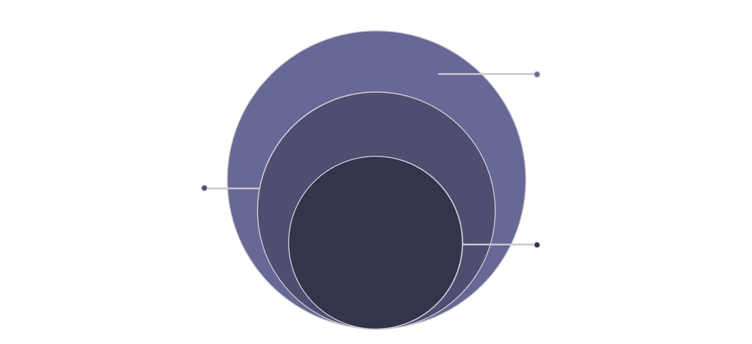
System Architecture
Data Layer
MongoDB via Mongoose storing users, appointments, prescriptions
Server Layer
(Node.js/Express API, JWT): auth, file upload, Gemini AI
Client Layer
Browser UI (HTML/CSS/JS): dashboards, Ask AI chat
The browser never talks to MongoDB directly — every request passes through the Express API where JWT authentication and role-based access control are enforced in one place.

Slide 5
Technology Stack
Frontend
Backend
Database
HTML, CSS, JavaScript
Node.js, Express.js
JSON Web Token, bcrypt, Multer
MongoDB
Mongoose ODM
Why These Choices?
Node + Express: Same language (JavaScript) on frontend and backend; minimal framework suited to a bounded feature set.
MongoDB: Medicines are naturally embedded arrays within prescriptions — reducing the need for complex joins.
JWT: Stateless auth; no server-side session storage required.
bcrypt: One-way password hashing — even a full database breach doesn't expose usable passwords.

Slide 6
Database Design
Five Mongoose collections linked by ObjectId references keep each schema narrow and queryable without loading unnecessary data.
Users
Appointments
Prescriptions & Notes
Uploads
All three roles in one collection, distinguished by a role field.
References patient, doctor, date, slot, status enum, and fee fields.
Linked to the originating appointment — not just the patient — for visit-level history.
File metadata stored in DB; files saved to disk via Multer, tagged by type.

Slide 7

Appointment Lifecycle
Reception Review
Book Slot
Patient Arrival
Doctor Notes
Mark Done
Reserve time; status shows availability and next action.
Check status; reschedule or confirm if slot unavailable.
Update status to waiting so provider is notified.
Record findings; status guides follow-up or billing.
Close appointment
The status field drives the entire flow — each actor's next action depends on reading that status. If the slot is unavailable, the receptionist can reschedule or cancel, freeing the slot for another booking.

Slide 8

AI Integration: Generative AI Module
The system leverages generative AI in two key areas:
For Doctors
For Patients
Generate concise summaries of a patient's medical history by analysing previous prescriptions, consultation notes, and uploaded documents — enabling faster review before consultations.
Interact with an AI assistant that explains medical terminology, summarizes reports in simple language, and answers basic healthcare questions.
Clinical Responsibility
All AI features are supportive tools only. All clinical decisions remain the responsibility of qualified healthcare professionals.

Slide 9
Conclusion & Future Scope
What Was Achieved
Future Scope
A small, self-hostable tool – built with Node.js, Express, MongoDB, and well-documented libraries – that directly closes the gap between paper registers and expensive enterprise HIS for small clinics.
Payment Gateway: Razorpay/Stripe integration with server-side webhook
Password Reset: Token-based email recovery flow
Email Notifications: Auto-reminders on appointment status changes
Mobile App: React Native or Flutter reusing the same REST API
Audit Trail: Soft-delete and log collection for clinical accountability
Three role-based dashboards with enforced access control
Linked patient history: prescriptions and notes tied to visits
Document upload permanently attached to patient records
Generative AI module for summaries and patient assistance

