Slide 1


Presentation on:- Time Management
-:Presented By:-
Mayuri S. Mahadik
Lokesh V. Bamnodkar
Mayuri G. Kurhe
Nikhil A. Kundgar
Mayuri U. Takle
Group No:- 05

Slide 2
-:Contents:-
What is Time Management ?
Why do we need time management ?
Time management matrix
Tackle Time Wasters
Steps to follow for managing time
Advantages
Conclusion

Slide 3
What is Time Management ?
Time Management refers to managing time effectively so that the right time is allocated to right activity.

Slide 4

Why do we need Time Management ?
To save time
To reduce stress
To function effectively
To increase our work output

Slide 5
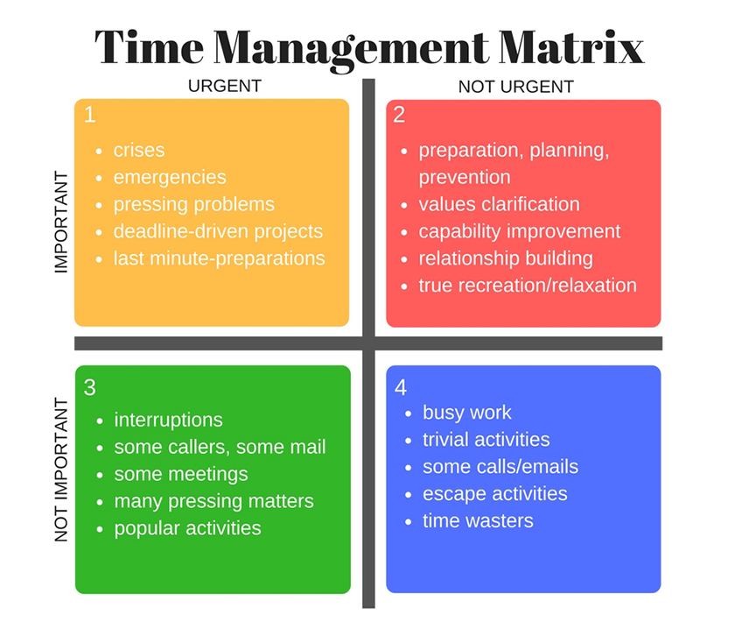
Time Management Matrix

Slide 6

Rainbow Activity

Slide 7

Tackle Time Wasters

Slide 8
Learn to recognize when you’re wasting time.
Decide what you need to do and realistically do.
Learn how to say “NO” when you don’t have time.
Ask yourself, “Do I really need to do this or not ?”

Slide 9

Steps to follow for Managing Time
Set goals
Make a schedule
Set Priorities
Achieve Goals

Slide 10
Advantages of Time Management:
Less Stress
Get More time
Increase more productivity and efficiency.
Less effort

Slide 11
Conclusion
Time management is a very important skill to be learned and be mastered in order to have a better life style.
.

Slide 12
Thank you !!!

