Slide 1
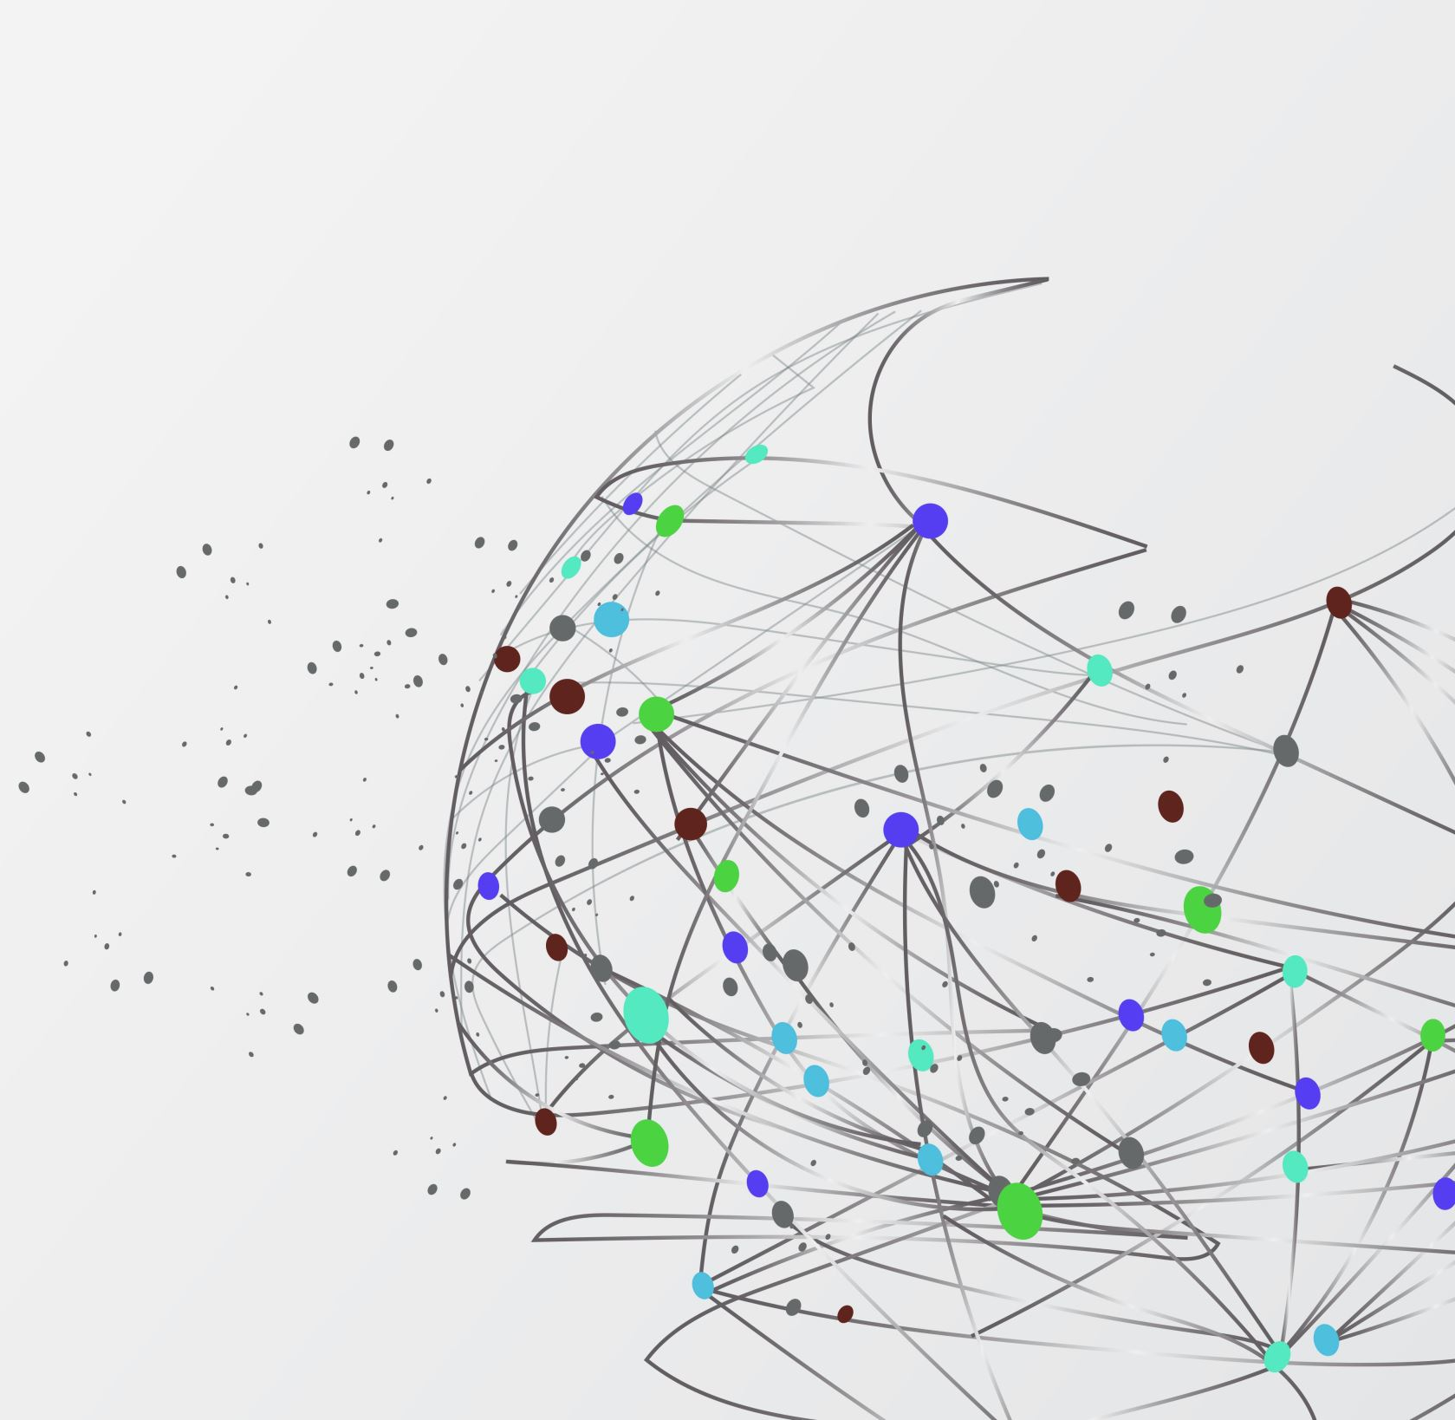
Liver Disease Prediction Using Machine Learning
By : Kannikanti Kranthi Kumari
Lokesh Bathala

Slide 2
- Liver disease is a major global health concern, affecting millions of people worldwide. Approximately 1.8% of U.S. adults (4.5 million adults) have liver disease. It causes about 57,000 U.S. deaths a year. Globally, it causes about 2 million deaths per year, or 4% of all deaths. Deaths are mostly from complications of cirrhosis, with acute liver failure accounting for a small portion. Liver disease affects men and people Assigned male at Birth (AMAB) twice as often as women and people assigned female at birth (AFAB). - Early diagnosis and treatment are crucial for improving patient outcomes. Traditional diagnostic methods can be time-consuming and expensive. - The need for more accurate and efficient diagnostic tools
Introduction

Slide 3
-Develop a machine learning-based model for predicting liver disease. - Improve early diagnosis of liver disease, leading to timely interventions and better patient outcomes. - Reduce healthcare costs associated with late-stage liver disease complications. - Enhance decision-making capabilities for healthcare professionals in liver disease management. - Contribute to the advancement of ML applications in healthcare.
Statement of the Project Objective

Slide 4
Data Acquisition and Preprocessing: - Python programming language with libraries such as pandas, NumPy, and scikit-learn. - Missing value imputation techniques (e.g., mean, median, mode). - Data normalization and standardization techniques (e.g., min-max scaling, z-score normalization). Machine Learning Model Development: - Machine Learning Algorithms (Random Forest, Adaptive boosting etc..) - User friendly InterFace will be developed using the Hyper Text markup Language.
Approach to the Project :
- Tools and Techniques used to achieve the Project Objectives

Slide 5
Data Acquisition Liver Patient Dataset from the UCI Machine Learning Repository. https://archive.ics.uci.edu/dataset/225/ilpd+indian+liver+patient+dataset Data Preprocessing and EDA - Impute Missing Value - Identify the correlation Factors - balance the data using smote on training set - pca analysis for feature selection - preprocessing data by sklearn standard scalar Training and Evaluate the models - comparing 5 ML models to find the best fit for predicting liver disease based on accuracy. We will be comparing five machine learning models namely random forest, gradient boosting, Adaboost classifier, random search CV and grid search CV
METHODOLOGY

Slide 6
ML Algorithms
Data
Pre-processing
Feature Extraction
Machine Learning Models
Dataset
Result
Comparing and Selection of ML Model
Classifier
Test Data Samples
System Architecture

Slide 7
- Developed machine learning models for liver disease prediction. A Web Application- which is User-friendly interface for inputting patient data and receiving predictions. - A Video demonstration on explanation of the project and How it works.
Deliverables : - Items we will submit upon Completion of the Project

Slide 8
- The Performance of the Model : The Accuracy of the model and consider the F1 score which provides the comprehensive measure of the model’s performance. - clinical evaluation : compare it’s performance with traditional diagnostic methods to assess it’s potential impact on patient care.
Evaluation Methodology

