Slide 1
LIFE!
Chance for Being human!
Group 5:
Lokesh Naidu Jalagam
Shourya Reddy Katkam
Sooraj Srirangam
Meghana Madugula
Nirush Bhimireddy

Slide 2
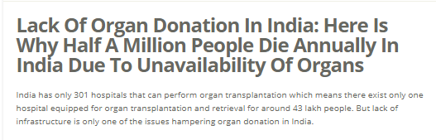
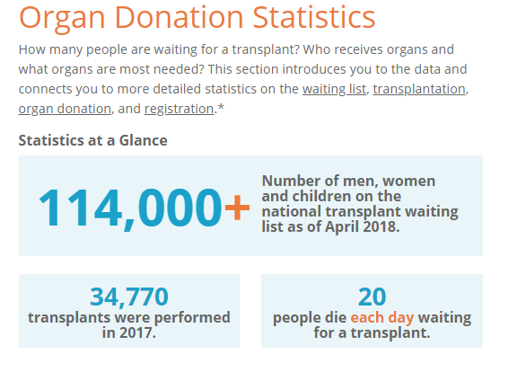

Slide 3
Millions of LIFE’s Lost Every Year
About 200,000 people die of liver diseases in India and only 1,000 get liver transplant
Nearly 220,000 people await kidney transplant, of which around 15,000 end up receiving a kidney
114,000+ Number of men, women and children on the national transplant waiting list as of April 2018.
Why? - Organ Transplantation, and other such life saving opportunities is an uneven, broken and lengthy process largely influenced by Money and prioritizes riches.
Lack Of Education And Awareness
Regulations - Biggest Hurdle to resolve
Not enough incentives for the Donors
Lack Of Brain Death Declaration
Lack Of Organ Transplant And Retrieval Centers
Source1, Source2

Slide 4
Motto - THRIVE and Move Forward
WE DON’T Intend to extract value, we intend to be the CATALYST
Even if people aren’t ready – we want them still to list themselves – show that you are part of the community – IT HELPS!
Following on the footsteps of the early standards we believe to see in Web 3.0
Technology and Information sharing – Open Source, API’s
All other details that is required to streamline this process both from regulatory stand points as well as maintaining the privacy & confidentiality of the stakeholders involved
This is against the pre-conceived notion of how we look up to every other organization that has come in this space.

Slide 5
Solution
Life! aims to make the discovery and connection with the right match and thereby also preserving the confidentiality of both Donors and Receivers
A global database that is decentralized and finds the right match in a secure way
Donors are validated & authorized using uPort’s open identity system
Hospitals are brought on the platform using the partnership program
Matches are made in the vicinity of the Recipient's and Donor’s location using foam.space (secure location services provider independent of external centralized sources)
At no point – any PPI information w.r.t the Donor or Recipient is entered in the system
Intend is to perform the preliminary checks and connect the Hospital with a suitable match for a recipient.
On hospital’s final approval – we remove the recipient and donor from the active list

Slide 6
Platform Business Flow
Partnered Hospitals enters the requirement by providing just the Blood Group and other required info of the Recipients
Each time an entry is made, a recipient id & Rank is shared with the hospital
Communication details of the partnered hospitals already with us
Every time a new donor is added, it’s matched to the list of unmatched Recipient’s list based on the Recipient current rank (chronological order)
Every time a new recipient is added, it’s matched to the list of active donors
In case of a match, the donor is sent a notification and he/she has to accept the request
On accepting - Email id of the hospital & Recipient Id is shared with the donor to contact with the hospital
Hospital is notified of the match and informed that donor will be contacting soon
If the donor doesn’t connect within next 2 days, Recipient goes back to the pool and all the stakeholders are notified

Slide 7
Business Model
Charge hospitals for the right match
Share 80% of the revenue with the donor
Annual Partnership fee from the hospitals
Place ads on the available website/mobile real-estate

Slide 8
Distant Future!
Social Funding – For Pro-bono cases
Verification via uPort and stakeholders are informed once the objective is achieved – Kickstarter Model
Global level donor matches – Figure out the logistics and cost bearing

Slide 9
THANK YOU!

