Slide 1

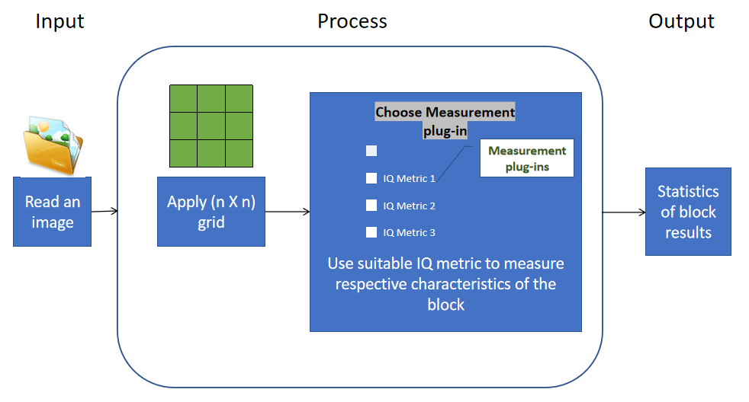
Grid based image quality measurement framework GUI (Mini)
Context: Need to analyze sub-areas of image to evaluate performance and look for specific artifacts
Problem Statement: Develop a framework GUI for grid based image quality measurement
Deliverables/KPI :
GUI for IQ measurement framework
Measurement plug-ins
Summary stats of block results for each image
Training / Pre-Requisites:
Fundamental concepts of Image processing like image channels, luminance, chrominance, contrast, dynamic range etc.
Understanding on MATLAB programming and usage of image processing toolbox
Starter Reference Material
Dogan Bor et. al, “Investigation of grid performance using simple image quality tests”
Varga, D. “Full-Reference Image Quality Assessment Based on Grünwald–Letnikov Derivative, Image Gradients, and Visual Saliency”. Electronics 2022.
Jeon, H.-S. “Grid-Based Low ComputationvImage Processing Algorithm of Maritime Object Detection for Navigation Aids”. Electronics 2023
Introduction to MATLAB with Image Processing Toolbox Video - MATLAB (mathworks.com)
Image Processing Made Easy Video - MATLAB (mathworks.com)
Queries:
Appropriate grid size (n)?
Specific image or any images ?
Comparision method- Full (compare with reference image)/Reduced (compare features extracted from both images)/No reference method ?
Timeline
Kick Off < 1st Month >
Milestone 1 < 2nd Month >
Milestone 2 < 3rd & 4th Month
Hands on learning image processing algorithms
Exploring different quality metric
Building an application/ GUI to generate grid based quality report
Testing, retuning, validation for bulk processing
Documentation and report generation

