Slide 1

Very low exposure simulator
Team Members:
Pralhad Yadawad
Nitish Kumar Pathak
Aryan Kamat
Aditya Phatak
Lokesh Pandey
Robin Jenkin | Ujwala Patil | April 2024

Slide 2
Worklet-Very low exposure simulator
Use Monte Carlo to generate very low-exposure images.
Bulk processing of input distributions.
INPUT: Luminance distribution image.
OUTPUT: Low light distribution of photons as image.
CONTEXT: Very low light levels can also affect the resolution of images as well as SNR as expected. This is designed to help investigate this phenomenon.
The total number of connects that we had with the NVIDIA mentor is 5.

Slide 3
Background of the Current Worklet
Motivation
To simulate low-exposure images.
To know the effect of low exposure on image resolution.
To explore the neural network capabilities concerning exposure.
Literature survey
R. Jenkin and C. Zhao, “Radiometry and Photometry for Autonomous Vehicles and Machines - Fundamental Performance Limits,” NVIDIA Corporation, Santa Clara, California, USA, S&T International Symposium on Electronic Imaging 2021 Autonomous Vehicles and Machines 2021.
S. Raychaudhuri, “INTRODUCTION TO MONTE CARLO SIMULATION,” Proceedings of the 2008 Winter Simulation Conference, S. J. Mason, R. R. Hill, L. Mönch, O. Rose, T. Jefferson, J. W. Fowler eds., Oracle Crystal Ball Global Business Unit, 390 Interlocken Crescent, Suite 130, Broomfield, CO 80021, U.S.A., 2008.
R. B. Jenkin, “On the Application of the Modulation Transfer Function to Discrete Imaging Systems,” University of Westminster, 2001. pg. 78-82
Dainty, J.C. and Shaw, R. (1974) Image Science. Academic Press Inc., New York.

Slide 4
Objectives
Propose a framework to estimate the low exposure distribution of photons from luminance distribution image.
Use random sampling technique (ex Monte Carlo simulation) to generate low exposure image.
Propose a technique to estimate the minimal illumination required to detect an object in the space of autonomous driving.

Slide 5
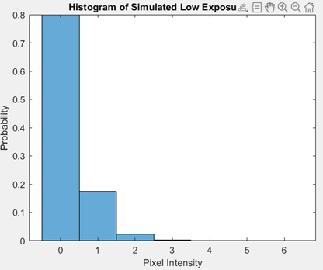
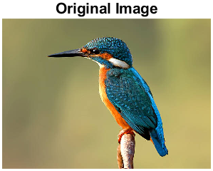
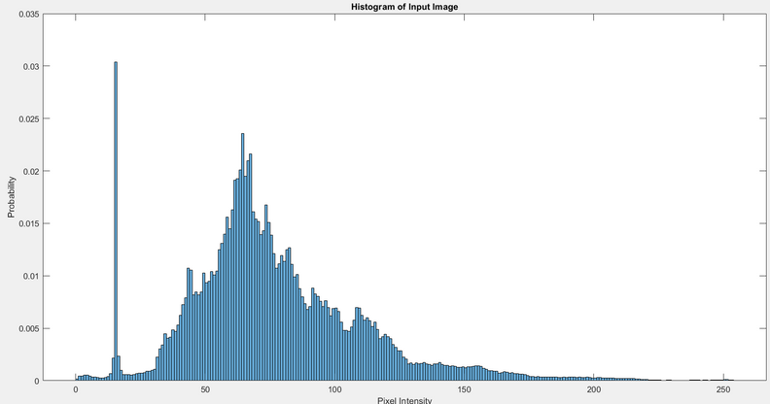
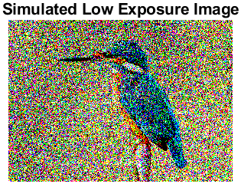
Proposed framework
Framework for Low exposure simulation
Normalize Image
Update Array Size
Monte Carlo Siulation
Initialize Low Light Image
Simulation Loop
Generate Random Coordinates
Get Pixel Intensity
Simulate Photon Detection
Original Image
Define Parameters
Array Size
Number Of Quanta
Visualization
Input Image
Image Processing
Simulated low exposure image

Slide 6
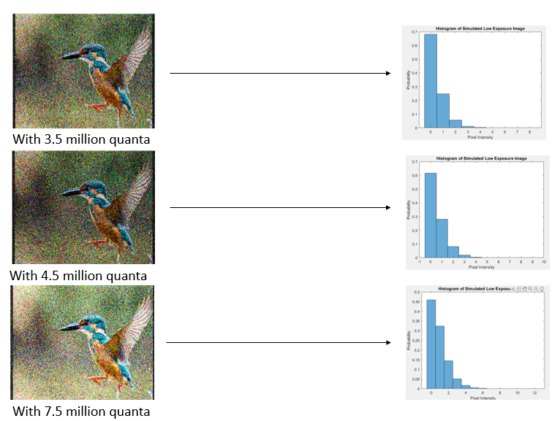
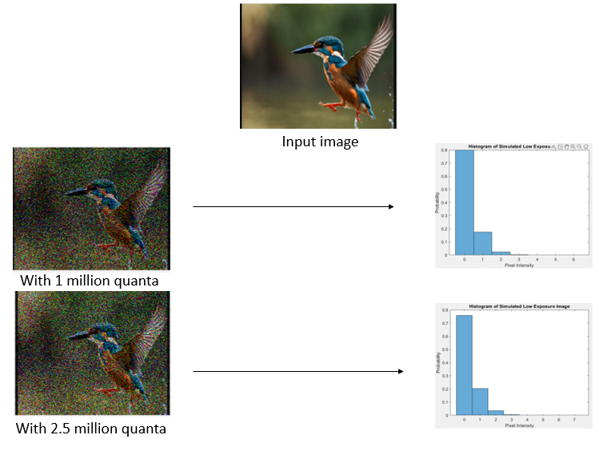
Results: Early indicators of success

Slide 7
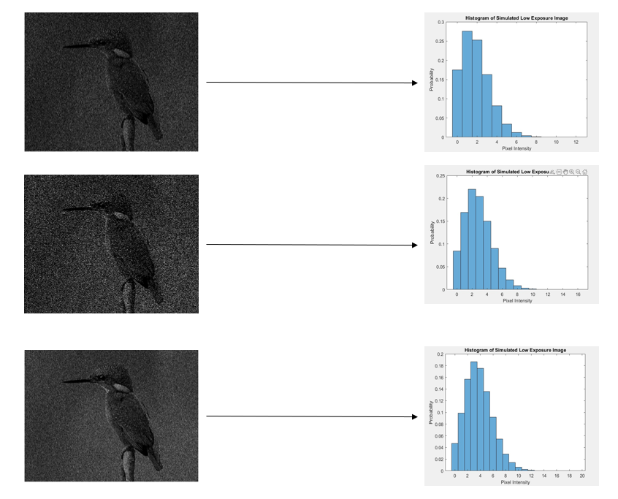
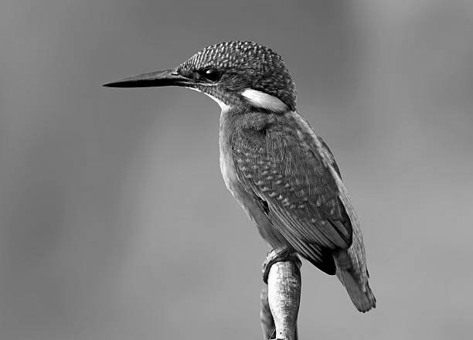
Results: Early indicators of success
1 million quanta
Original image
1.5 million quanta
2 million quanta

