Slide 1
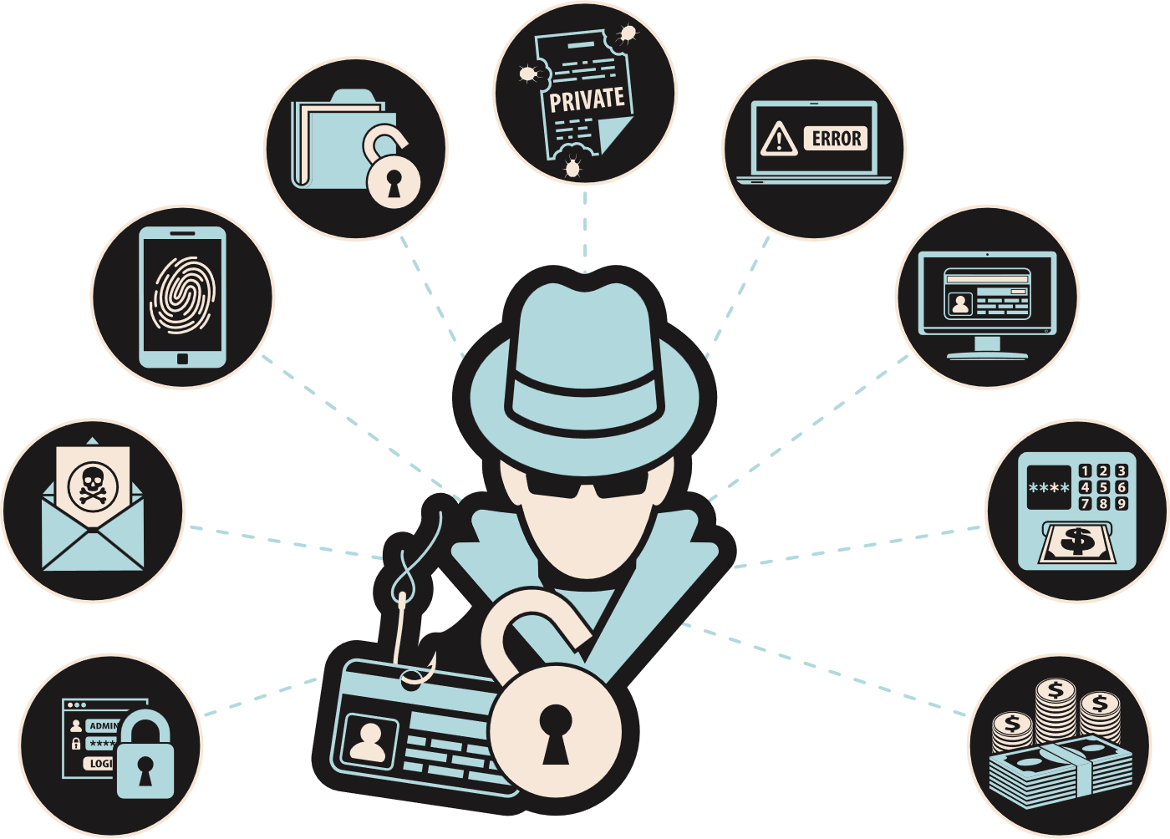
DIGITAL CITIZENSHIP LESSON
PHISHING AWARENESS
Think Before You Click!

Slide 2
OBJECTIVES
By the end of this session, employees will be able to:
1
2
3
Define phishing and identify common methods used by scammers
Recognize red flags in phishing emails, messages, or posts
Develop critical thinking skills to discern legitimate requests from potential phishing attempts

Slide 3
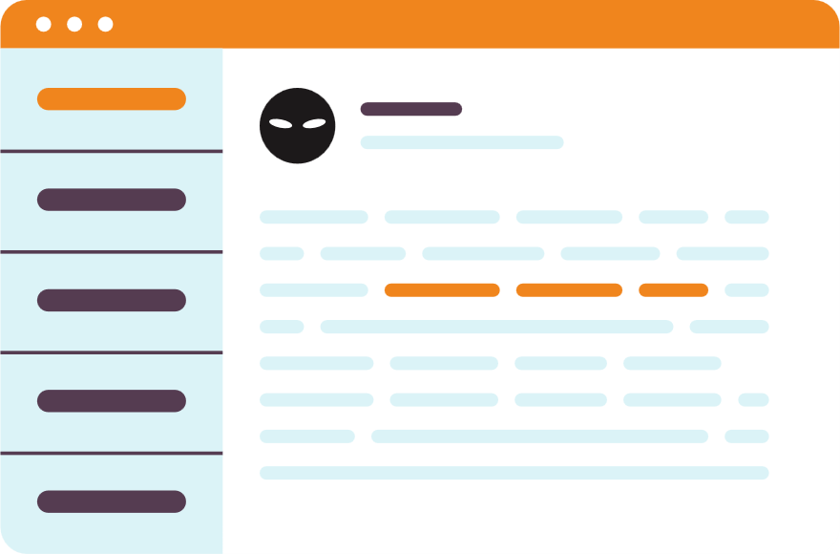
WHAT IS PHISHING?
Phishing is when someone tries to trick you into revealing personal information like your password, credit card numbers, or social security number.
Phishing can happen through emails, text messages, or other online platforms.
Think of an email or message you received that asked for personal information. What made it suspicious?

Slide 4



TYPES OF PHISHING
Phishing attacks come in different forms
EMAIL PHISHING
SMS PHISHING
SOCIAL MEDIA PHISHING
Scammers send fake emails pretending to be a trustworthy organization
Scammers send text messages with fake links or requests for personal information
Scammers create fake profiles or posts to trick you into clicking on links or sharing personal informaion

Slide 5
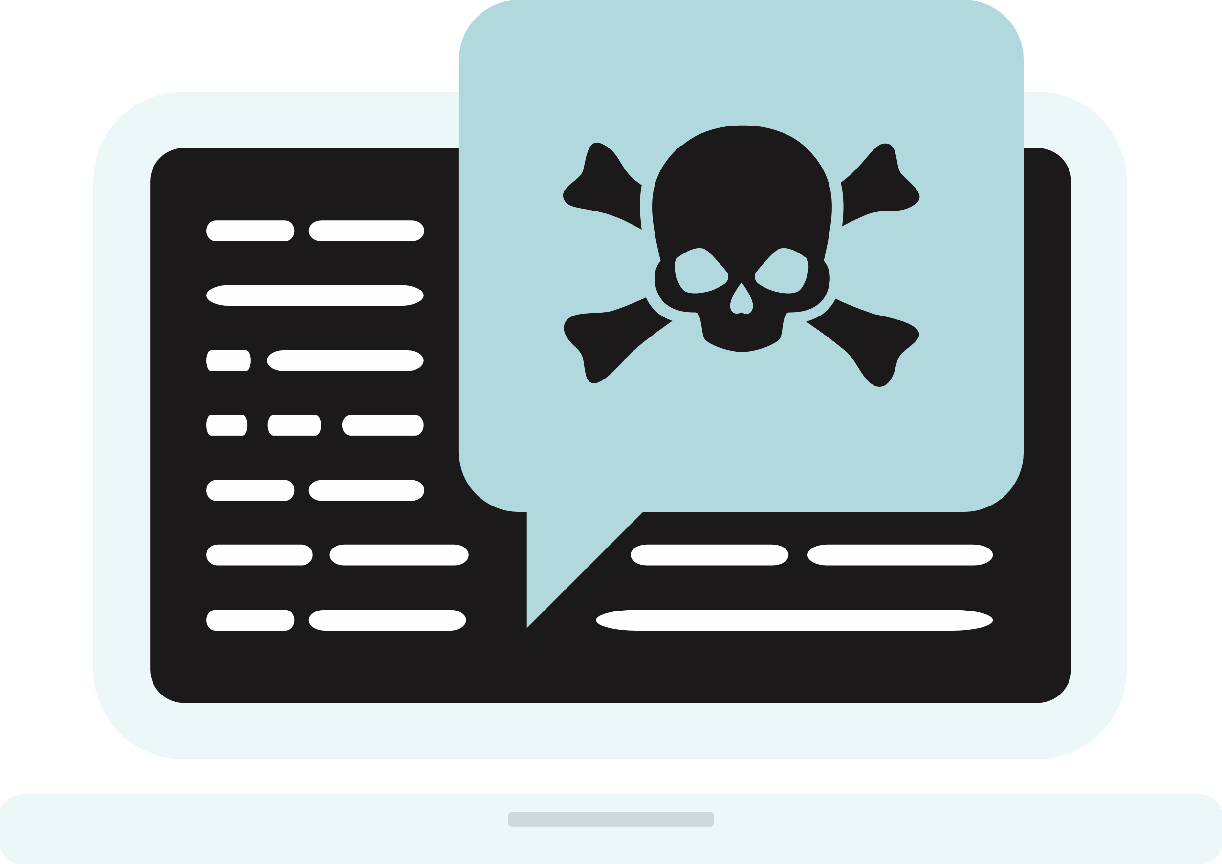
RED FLAGS
Red flags in phishing attempts are warning signs or indicators that help individuals identify potential scams. Some common read flags in phishing include:
1
Urgent or threatening language
2
Suspicious sender information
3
Requests for personal information
4
Misspellings or grammatical errors
5
Suspicious links or attachments
6
Generic greetings
7
Too good to be true

Slide 6

01
URGENT OR THREATENING LANGUAGE
03
REQUESTS FOR PERSONAL INFORMATION
Phishing attempts often create a sense of urgency or use threatening language to prompt immediate action. Phases like "urgent action required," "account suspended," or "your account will be deleted" may indicate a phishing attempt.
Legitimate organizations do not request personal information, such as usernames, passwords, or credit card numbers, via email, social media, or other online means. Be cautious of any request for personal information.
02
SUSPICIOUS SENDER INFORMATION
04
MISSPELLINGS OR GRAMMATICAL ERRORS
Check the sender's email address or social media profile. Phishing emails or messages often use generic or suspicious email addresses that do not match the legitimate entity they claim to represent.
Phishing emails or messages may contain misspellings, grammatical errors, or awkward phrasing. Legitimate organizations usually have professional communications and do not contain obvious errors.

Slide 7
05
SUSPICIOUS LINKS OR ATTACHMENTS
07
TOO GOOD TO BE TRUE
Be cautious of links or attachments in emails or messages from unknown or untrusted sources. Hover over links to check their actual destinations, and do not click on suspicious links or download attachments that you were not expecting.
Phishing attempts may lure individuals with enticing offers, such as winning a prize or getting a huge discount. If an offer seems too good to be true, it may be a phishing attempt.
06
GENERIC GREETINGS
Which of the seven red flags do you think is the hardest to detect? What makes you say that?
Phishing emails may use generic greetings like "Dear Customer" instead of addressing you by your name. Legitimate organizations often personalize their communications with your name or other relevant information.

Slide 8
DO THIS TO BE SAFE
Red flags in phishing attempts are warning signs or indicators that help individuals identify potential scams. Some common read flags in phishing include:
1
Enable MFA on all accounts
2
Keep OS, Apps and firewall up to date
3
Use a password manager.
4
Use unique and strong passwords.
5
Report suspicious links or attachments
6
Never share credentials via anything.
7
Too good to be true

Slide 9
CONSIDER THESE REAL-WORLD EXAMPLES
CEO FRAUD
Spoofed executive email requested urgent wire transfer; employee complied, funds lost.
COVID-19 SCAM
Fake health alert with malicious link installed ransomware after click.
JOB OFFER SCAM
Fraudulent recruiter requested personal documents and bank details.
Read the examples and then identify which form of phishing it is and what red flags make it a phishing attempt.

Slide 10

RECAP
Phishing exploits trust and urgency; always verify before acting.
Look for sender, link, and site anomalies; hover to preview links.
Use MFA, keep systems updated, and report incidents promptly

Slide 11

REPORT PHISHING ATTEMPTS
If you suspect a phishing attempt, report it to Company’s IT department. Please don't forward the phishing email or message to another user. You can show them on your device. Forwarding phishing emails could lead to others being phished.
Reporting phishing attempts helps protect others from falling victim to the scam.

Slide 12

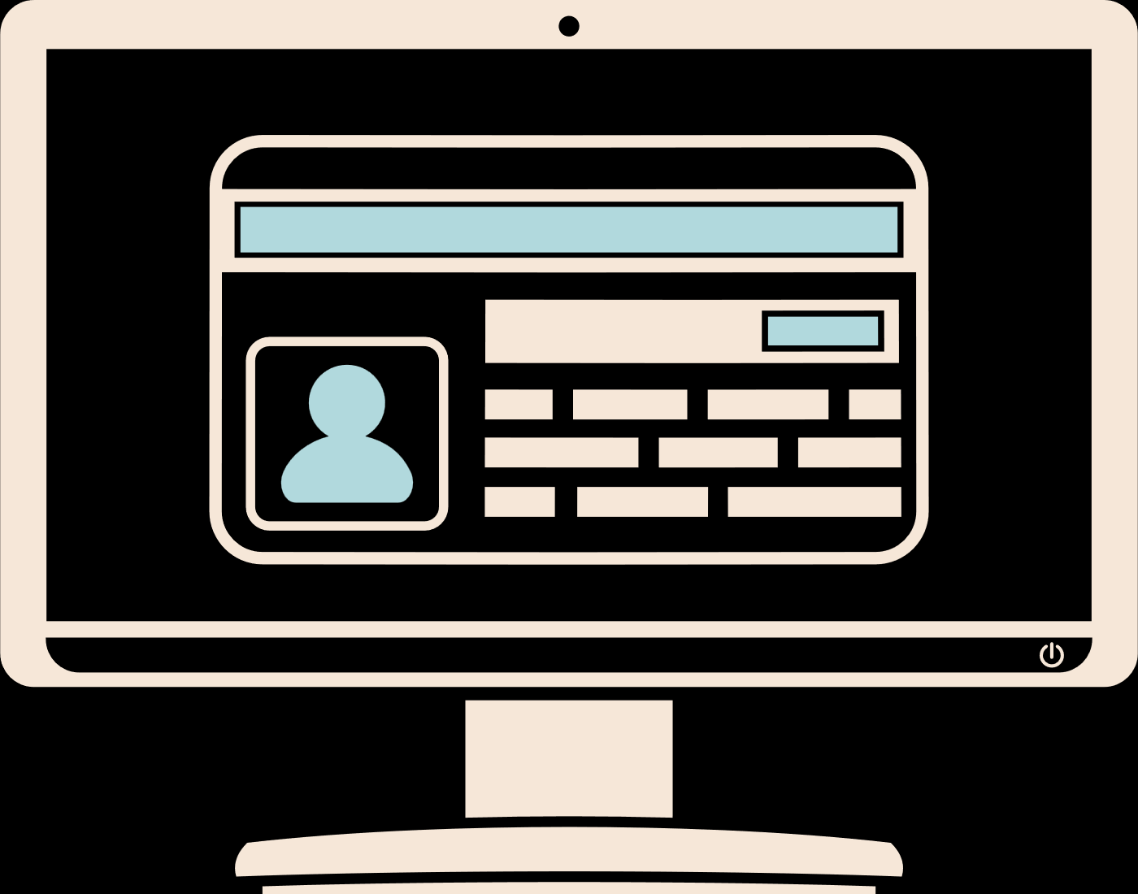
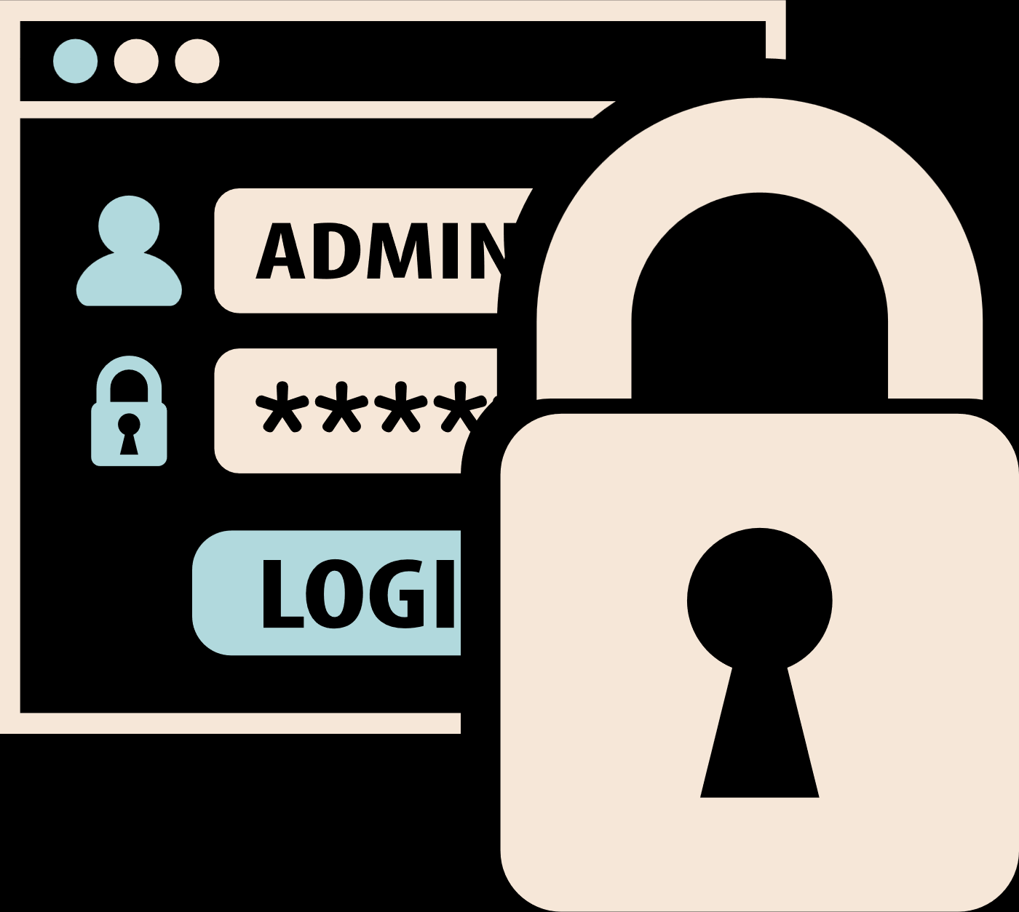
THINK CRITICALLY
Be skeptical of emails, messages, or posts that seem too good to be true or too urgent. Remember, if it sounds too good to be true, it probably is!
Think before clicking on any links, sharing personal information online, or opening any suspicious attachments. Ask yourself if it seems legitimate and if you were expecting it.
Verify the authenticity of the sender and the information provided before taking any action. Trust your instincts and be cautious when sharing information online.

Slide 13
THINK BEFORE YOU CLICK!
PROTECT YOURSELF FROM PHISHING
Don't share your personal information online!

