Slide 1

Indian Institute of Technology Guwahati
(ME – 543)
Computational Fluid Dynamics
Coordinator :- *
Prof. Amaresh Dalal LOKESH KUMAR VERMA
ROLL. 224103314
Mechanical (FTE)

Slide 2
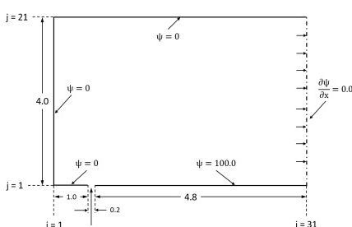
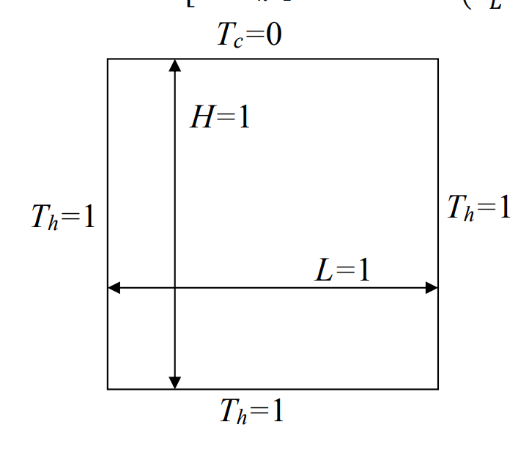


Assignment -i
PROBLEM-1
$\frac{∂²φ}{∂x²} + \frac{∂²φ}{∂y²}$ = 0
PROBLEM-2
$\frac{∂^{2}T}{∂x²} + \frac{∂^{2}T}{∂y²}$ = 0

Slide 3
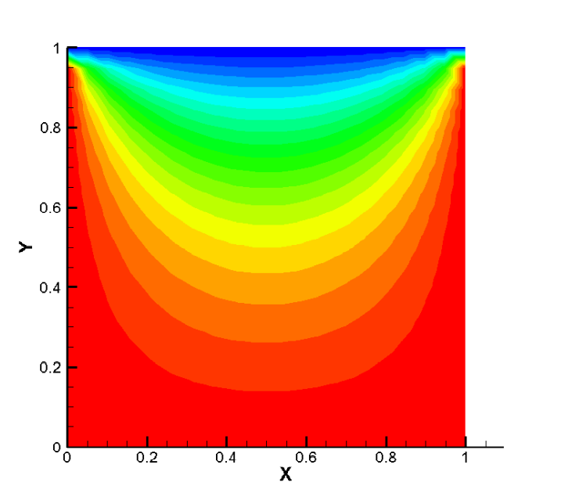
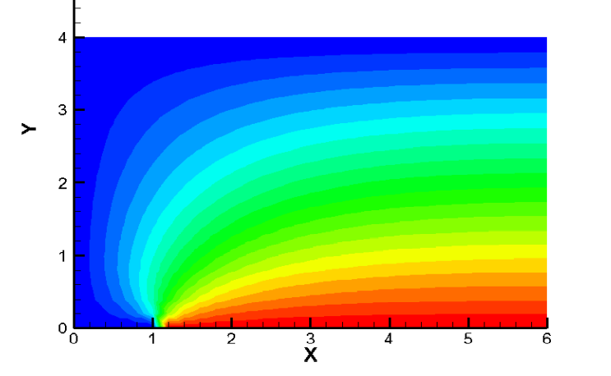
CONTOUR PLOT RESULTS
PROBLEM-1
PROBLEM-2

Slide 4
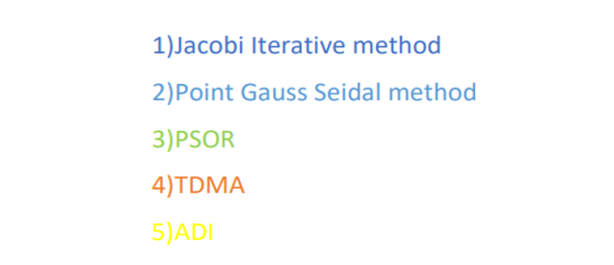
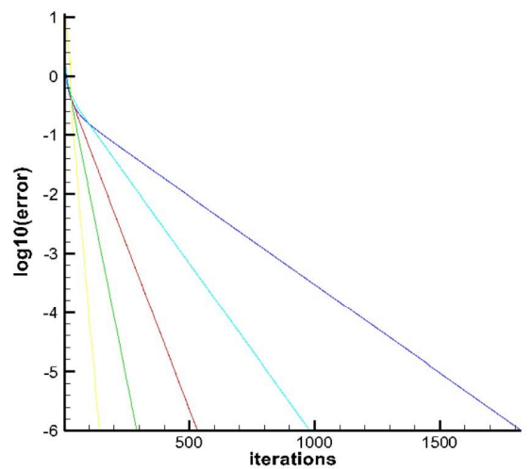

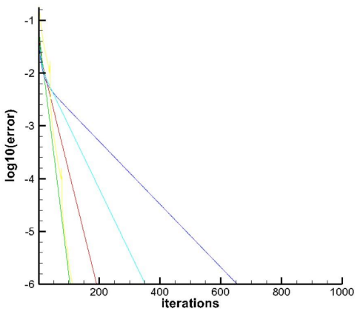

Graph comparison for various methods
PROBLEM-1
PROBLEM-2

Slide 5
Graph comparison for various methods
JACOBI : old values are considered.
POINT GAUSS : If the new values available are immediately used for other points.
TDMA : Line methods facilitate exchange of information quickly, therefore we can converge faster.
ADI : The iteration cycle has two parts.
PSOR : overrelaxation factor is used for faster convergence.

Slide 6
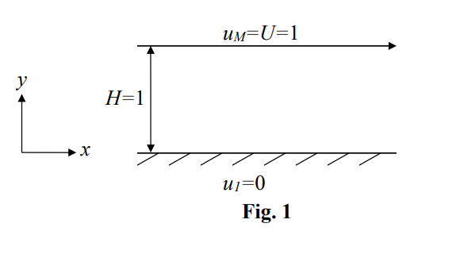
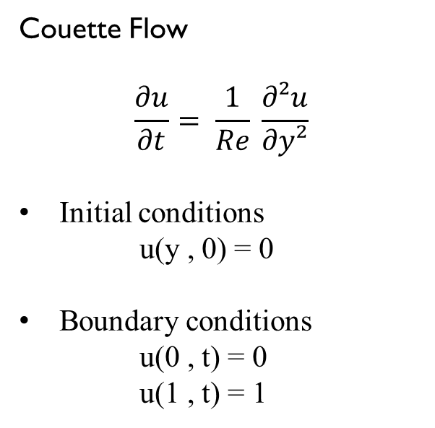
ASSIGNMENT - II
Couette Flow
$$\frac{∂u}{∂t}= \frac{1}{Re} \frac{∂²u}{∂y²}$$
Initial conditions
u(y , 0) = 0
Boundary conditions
u(0 , t) = 0
u(1 , t) = 1

Slide 7
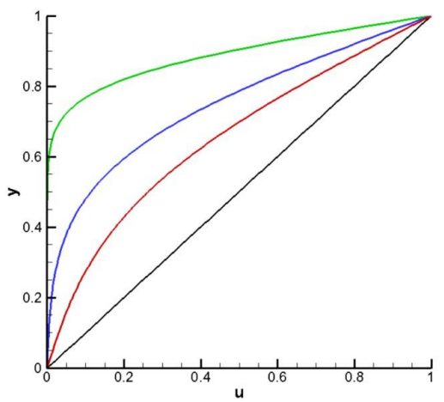
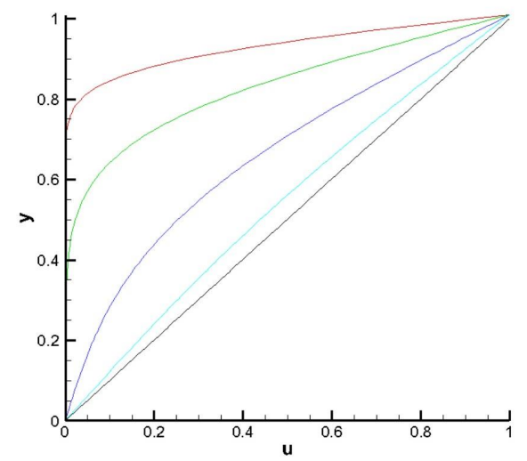
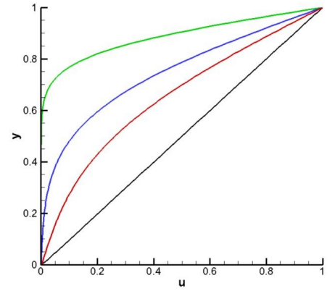
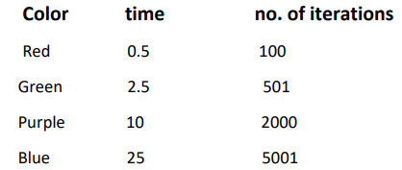
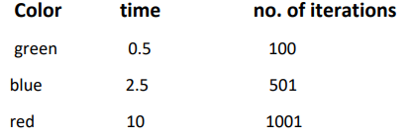
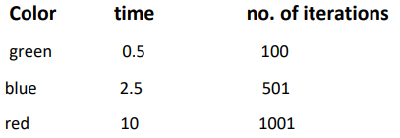
GRAPHS FOR DIFFERENT TIME

Slide 8
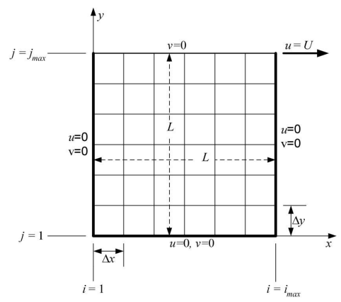
ASSIGNMENT-III
LID DRIVEN CAVITY PROBLEM
Velocity boundary equations
stream function boundary conditions
Vorticity boundary conditions

Slide 9
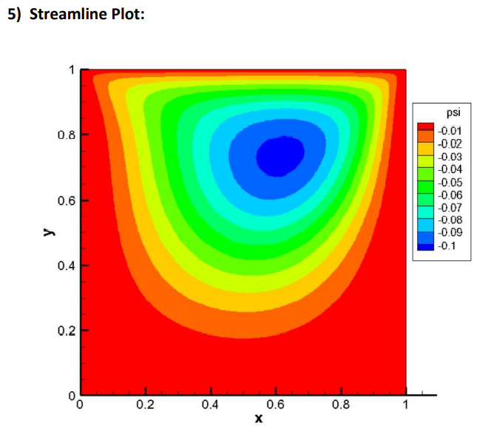
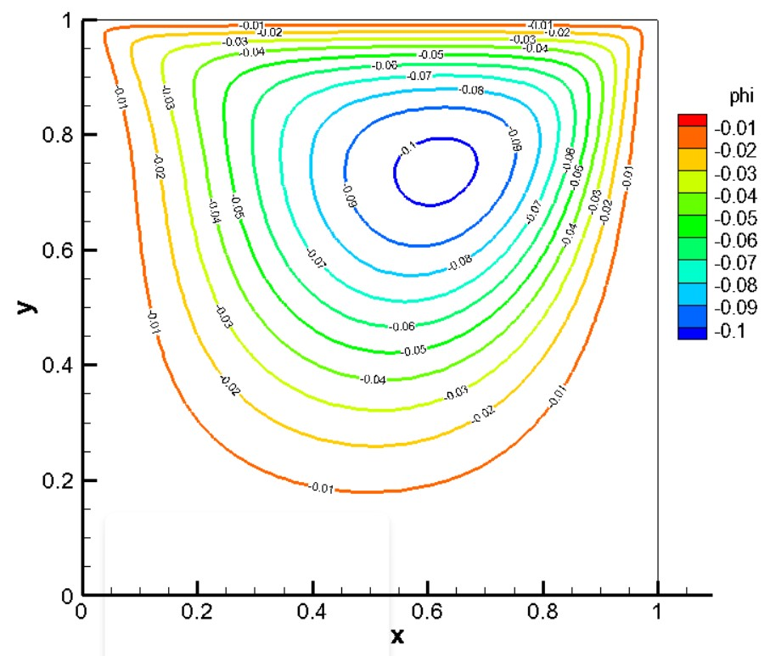
Reynolds number = 100

Slide 10
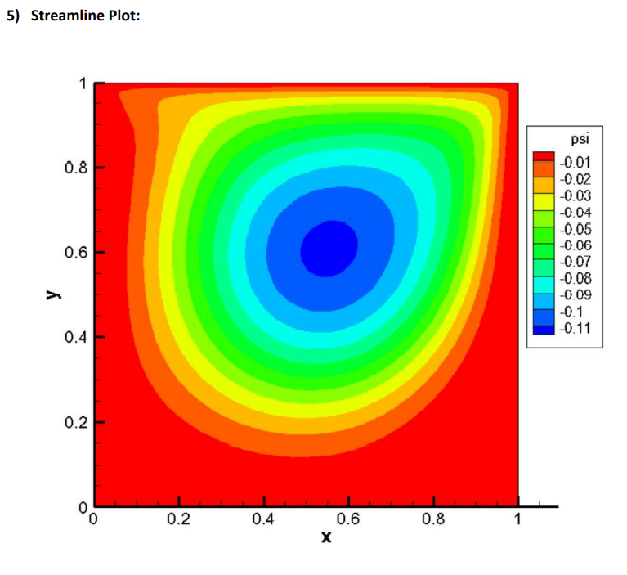
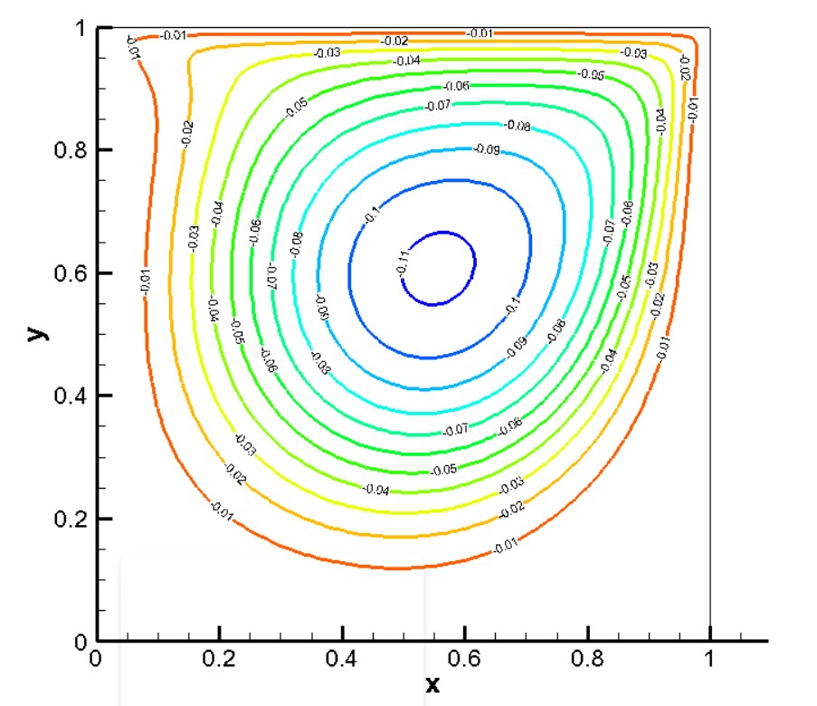
Reynolds number = 100

Slide 11
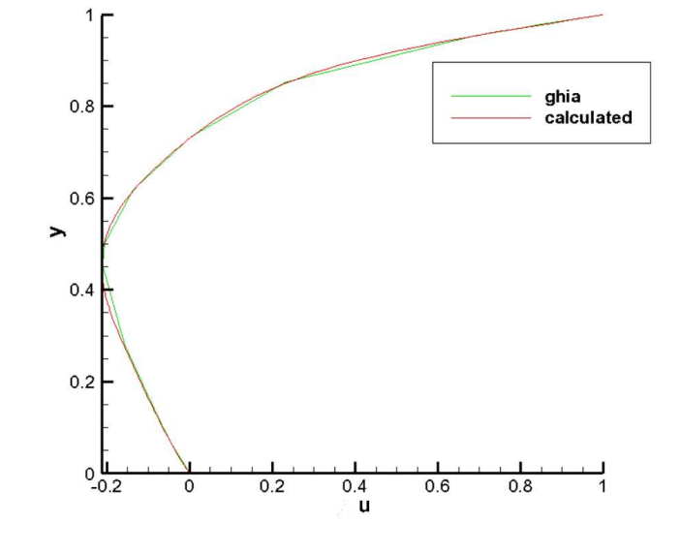
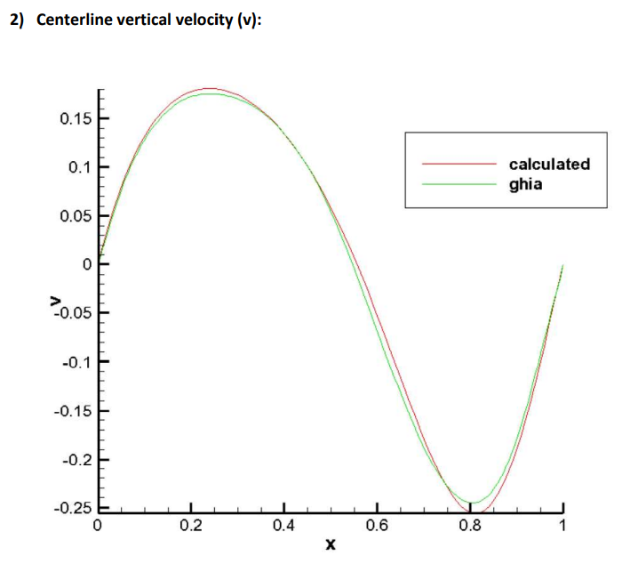
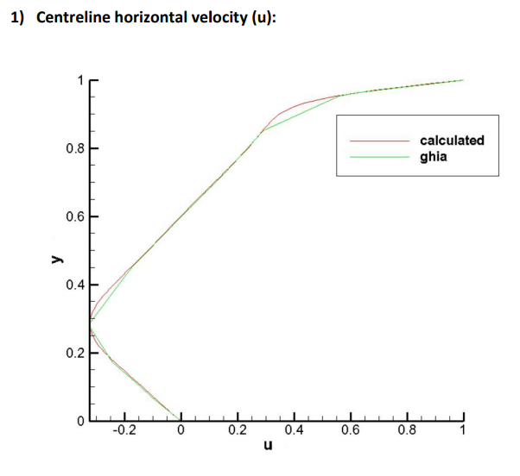
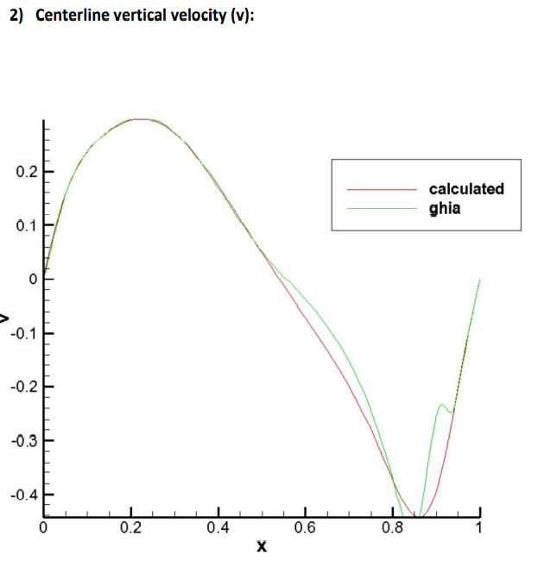
Reynolds number =100
Reynolds number = 400

Slide 12
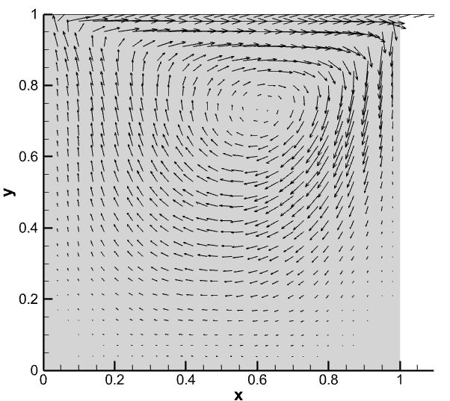
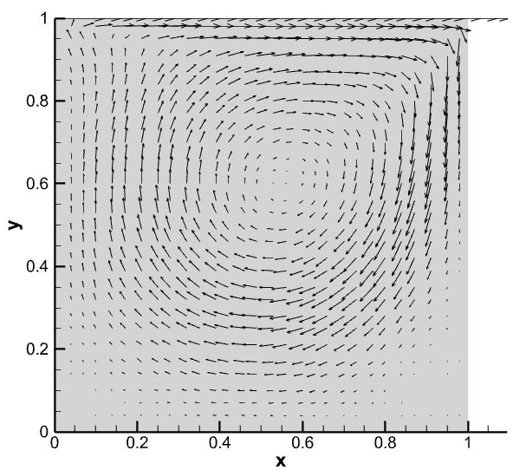
Velocity vector plot
Re =100
Re =400

