Slide 1

Azure-Based Web Application Monitoring and Availability Dashboard
Real-Time Application Performance, Availability and Operational Monitoring

Slide 2


Problem Statement
Continuous Monitoring Gap
Web applications require uninterrupted monitoring for optimal performance — manual checks simply cannot keep pace.
User-Facing Failures
Users experience failures, slow response times, and unexpected downtime with no early warning system in place.
Scattered Data Sources
Monitoring data is fragmented across multiple tools and platforms, making root-cause analysis slow and error-prone.
Need: Centralized Dashboard
A single, unified dashboard is essential to assess application health at a glance and act before users are impacted.

Slide 3
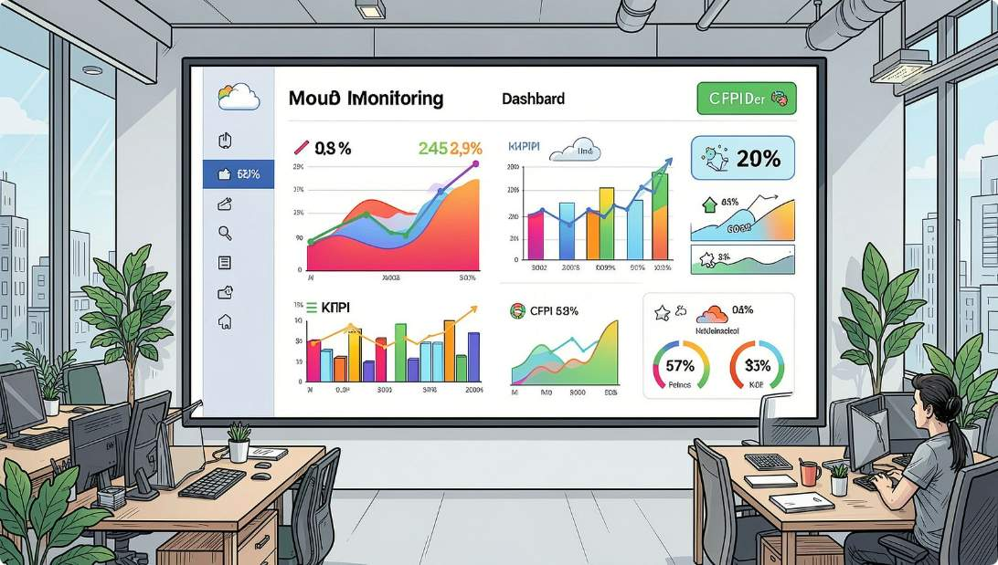
Project Objectives
1
Real-Time Availability Monitoring
Track application uptime and availability continuously across regions.
2
Request Tracking & Performance
Measure successful/failed requests, response time, and latency trends.
3
Multi-Region Testing
Perform availability tests from multiple geographic locations simultaneously.
4
Interactive Centralized Dashboard
Enable filtering by time range and team with real-time telemetry visualization.

Slide 4






Technology Stack
Azure App Service
Application Insights
Hosts and serves the web application in a managed cloud environment.
Automatically collects telemetry, performance data, and exceptions.
Azure Monitor
Log Analytics Workspace
Centralized monitoring platform aggregating signals across all services.
Stores and queries all monitoring data using KQL for deep analysis.
Availability Tests
Azure Workbooks + KQL
Periodic health checks from multiple global regions via Azure.
Interactive dashboards with charts, KPI cards, tables, and filters.

Slide 5
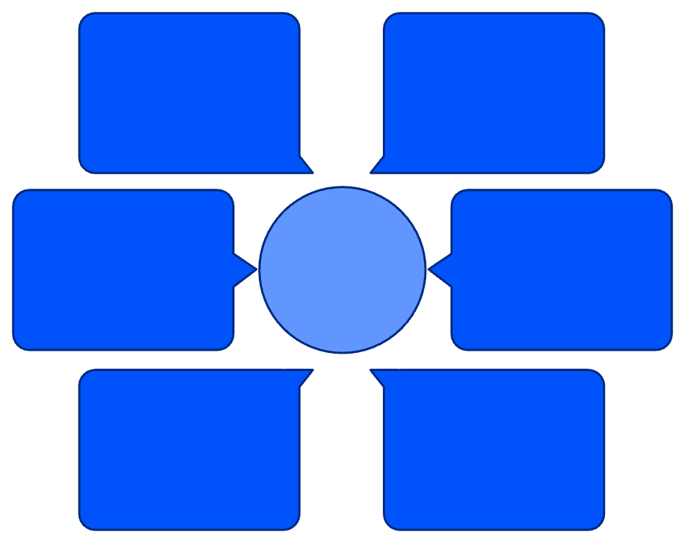
System Architecture
AppAvailabilityResults → Log Analytics
Azure App Service
Users → App Service
Hosts and serves the web application to end users.
Availability records stored
End-user requests to web app
Application Insights
Availability Tests → AppAvailabilityResults
App Service → Application Insights
Auto-collects telemetry and performance metrics from the app.
Monitoring Data Flows
Telemetry and performance metrics
Log Analytics
Synthetic test outcomes
Central repository for all monitoring and availability data.
Log Analytics → Azure Workbook
Application Insights → Log Analytics
Azure Workbook
Dashboards and visualizations
Centralized monitoring data
Visualizes data with interactive, real-time dashboard views.

Slide 6
Application Monitoring Flow
01
Key Metrics Tracked
User Opens Application
Request Count
Success / Failure Rate
Request is received by Azure App Service.
Volume and frequency of incoming requests.
Ratio of successful vs. failed requests.
02
Telemetry Collected
Application Insights captures data automatically.
Response Time
HTTP Status Codes
Average latency and performance trends.
Distribution of 2xx, 4xx, and 5xx responses.
03
Data Transmitted
Telemetry flows into Log Analytics Workspace.
04
KQL Aggregation
Queries process and aggregate the raw data.
05
Dashboard Renders
Azure Workbook displays real-time results, updating on time range selection.

Slide 7
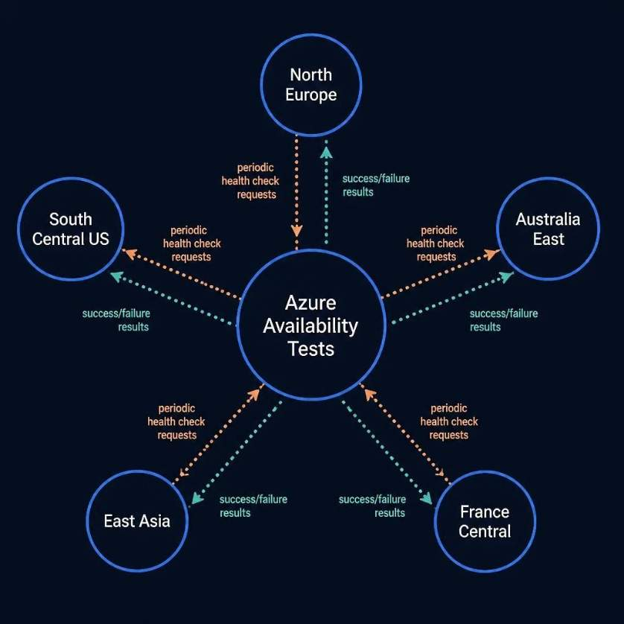





Availability Monitoring
Azure Availability Tests periodically send requests to the application from multiple geographic locations and record whether the application responds successfully.
Test Locations
North Europe
South Central US
Australia East
East Asia
France Central
Primary Data Table: AppAvailabilityResults
TimeGenerated
Name
Location
Timestamp of the test execution
Test name identifier
Geographic origin of the test
Success
Properties
Boolean: test passed or failed
Metadata and response details

Slide 8
KQL Queries
Availability Calculation
Test Count by Name
AppAvailabilityResults
| summarize Availability =
100.0 * countif(Success == true) / count()
by bin(TimeGenerated, 1h)
| order by TimeGenerated asc
AppAvailabilityResults
| summarize count() by Name
Identifies the number of availability-test records for each test name — useful for verifying test coverage and frequency.
countif(Success == true) — counts successful tests
count() — counts total tests performed
Result expressed as percentage (0–100%)
bin(TimeGenerated, 1h) — groups results by hour
KQL (Kusto Query Language) is the core analytical engine powering all dashboard visualizations in Azure Workbooks.

Slide 9




Dashboard Features
Visualizations
Interactive Controls
Availability Trend Chart
Hourly and daily availability percentage over selected time range.
Time Range Selector
Team Selector
Request & Failure Counts
Filter all dashboard data by custom date and time range — updates all charts instantly.
Display monitoring data scoped to a specific project team — enables multi-team deployments.
Volume of total requests and failed requests plotted over time.
Response Time & Latency
Average response time trends to identify performance degradation.
HTTP Status Distribution
Breakdown of 2xx, 4xx, 5xx codes and top requested URLs.
Recent Requests Table
Detailed log of recent requests with timestamps and status.

Slide 10

Team-Based Dashboard Filtering
Interactive Team Parameter: Allows the dashboard to display monitoring data specific to each project team dynamically.
Update Parameter
Inject into KQL
Show Team Data
Select Team
Example Teams
T038
T140
T242
Our Team
Team 140
Team 242
Primary project team — Manne Lakshmi Balaji
Peer team with independent monitoring scope
Peer team with independent monitoring scope
The Team filter maps to the appropriate application/resource field in Log Analytics, enabling dynamic filtering across all dashboard visualizations simultaneously.

