Slide 1

Image caption generator
Harshavardhan Manne
Sri Ram Relangi
Ikshwak Varma Alluri
Lokesh Madem

Slide 2
Abstract
The "Automatic Image Captioner" is a computer vision and natural language processing project designed to bridge the gap between visual information and textual description. Our goal is to empower users, regardless of their technical expertise, to effortlessly create rich and engaging captions that enhance the understanding and accessibility of visual media.

Slide 3
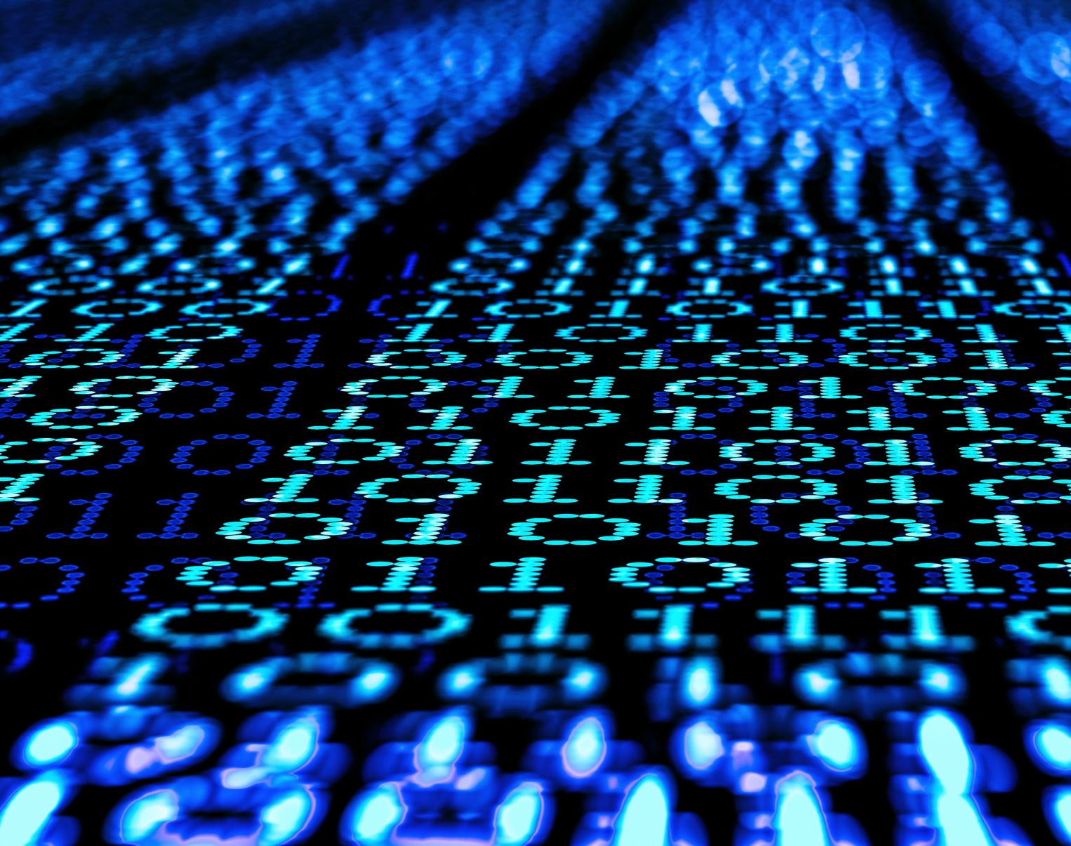
Data Abstraction
We want to use Flickr 8k dataset from Kaggle for our Automatic Image Captioner. This dataset consists of 8,000 high-resolution images sourced from the photo-sharing website Flickr. These images cover a wide range of scenes, objects, and activities. Each of the 8,000 images is paired with multiple human-generated captions. This diversity of captions is useful for training models to generate varied and nuanced descriptions. Each image is stored in jpeg format and captions are usually encoded as strings.

Slide 4
Methodology
Data Collection and Preparation
Feature extraction
Model design and Architecture
Model Creation
Model Training
Evaluation
Inference
Post processing
integration
Testing and Validation

Slide 5
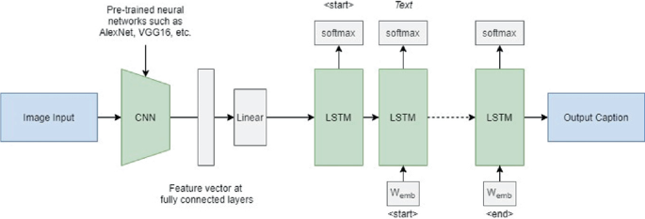
Methodology

Slide 6
Implementation
Upload image
Image processing
Model/Automatic Caption Generator
Image Feature Extraction (CNN)
Context Initialization
Caption Generation (RNN/Transformer)
Probability Distribution
Sampling Strategy
Termination
Post-processing
Feedback loop

Slide 7

State of the art
Image caption generation has changed a lot during the last decade. At first, it relied on rule-based systems and handwritten models, but these have scaling and adaptation issues. But the emergence of deep learning, particularly CNNs and RNNs, has prompted a change to data-driven strategies. We have listed few developments and challenges below.
Enhancements:
Encoder-Decoder designs: Contemporary methods employ encoder-decoder designs. While RNNs or Transformers create captions, CNNs extract picture features.
Attention techniques: These techniques improve the fluency and relevancy of captions. Large Pre-trained Models: Captioning performance is enhanced by transfer learning using models like VGGNet, ResNet, and BERT.
Large-scale datasets (like COCO and Flickr) are what propel research forward.
Metrics for evaluation include BLEU and CIDEr, which rate the accuracy of captions. Human centered appraisal is becoming more significant
Challenges:
Rare Ideas: Dealing with uncommon or unknown items or settings is a constant struggle.
Fusion across many modes of communication is difficult to do.
Fairness and prejudice: It is an ethical problem to address fairness and prejudice in captions.

Slide 8
Milestones
Data Collection and Preprocessing:
Milestone 1: Obtain a diverse dataset for text summarization and keyword extraction.
Milestone 2: Perform data cleaning and preprocessing, including text tokenization and dataset division.
Text Generation and Image Extraction Implementation:
Milestone 3: Construct Image extraction models like DenseNet to provide image embeddings and train the LSTM-based text generation model.
Milestone 4: Integrating above two components to create a cohesive image captioning system.
Evaluation and Optimization:
Milestone 5: Define and calculate evaluation metrics, including Accuracy and BLEU scores.
Milestone 6: Optimise the similarity function to enhance summarization and keyword extraction accuracy.

Slide 9
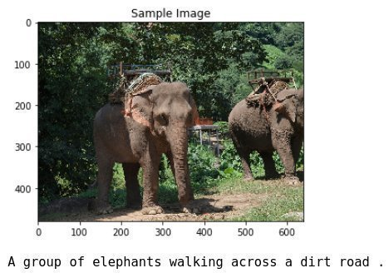
Expected Result

Slide 10
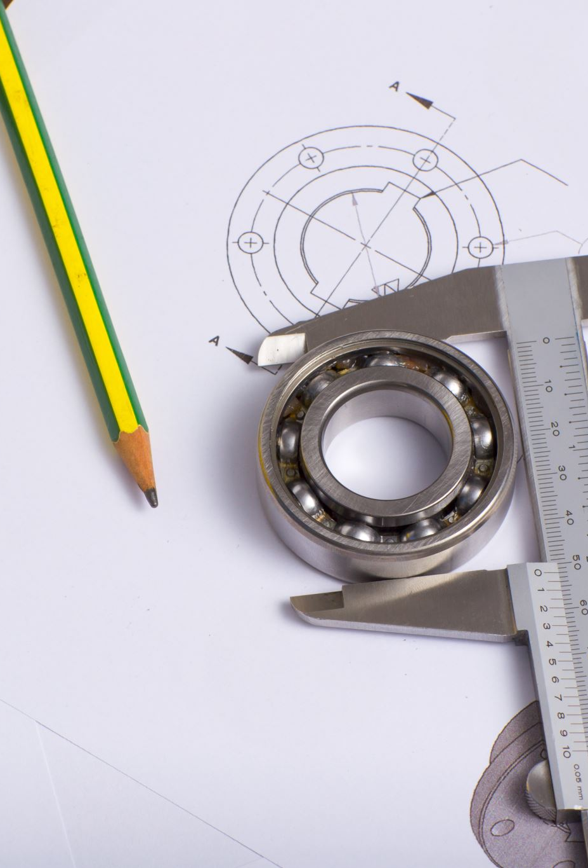
Scope of the project
creating models that show commonsense reasoning at the human level.
improving cross-modal comprehension to provide captions that are more appropriately contextualised.
addressing moral issues with unfairness and partiality.
More accessibility for people who are blind and visually impaired by implementing read out caption functionality.

Slide 11

Thank You

