Slide 1
EXCEL FINAL ASSEMESSMENT
NAME:A.LOKESH
EMP ID:4290

Slide 2
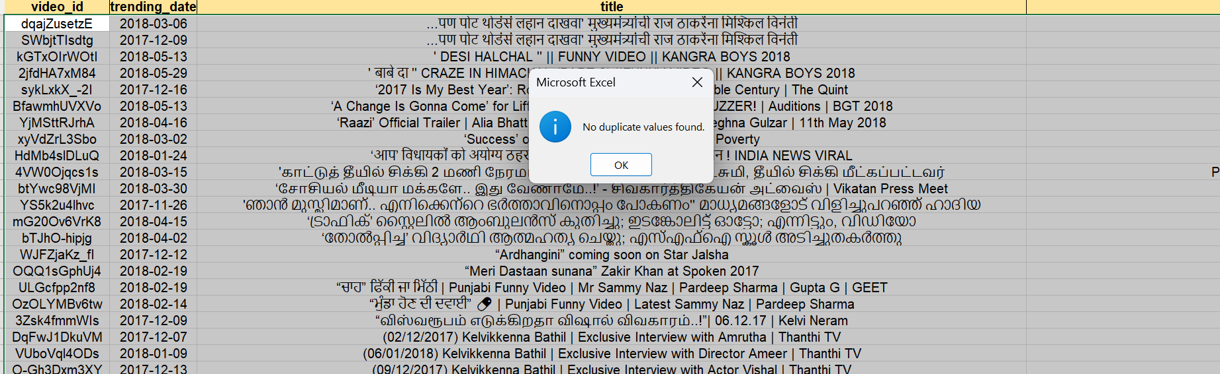
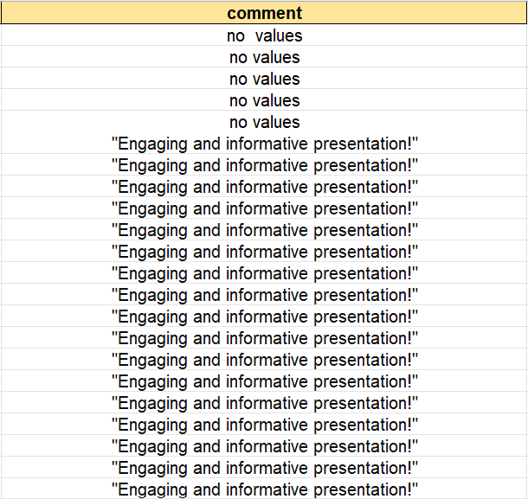
Q1
For data cleaning we have to remove duplicates and remove the null values so we used the option remove dupliacates from the data tab and therefore there were no duplicates found and replacing null values we have filled the cell and for non cells we put no values

Slide 3
Q2

Slide 4
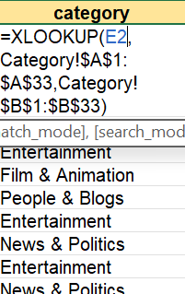
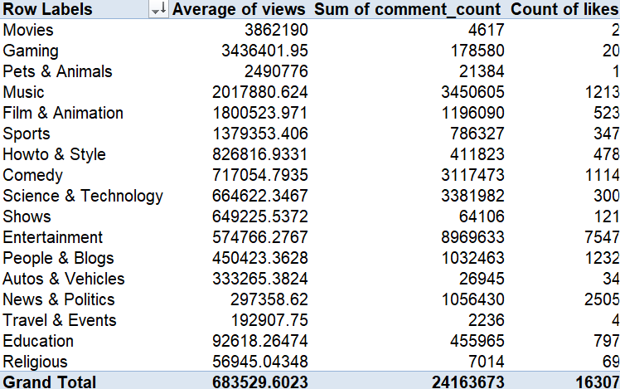
Q3
Using xlookup we got the values for category name for each category id
Movies has the number of views compared to other categories

Slide 5
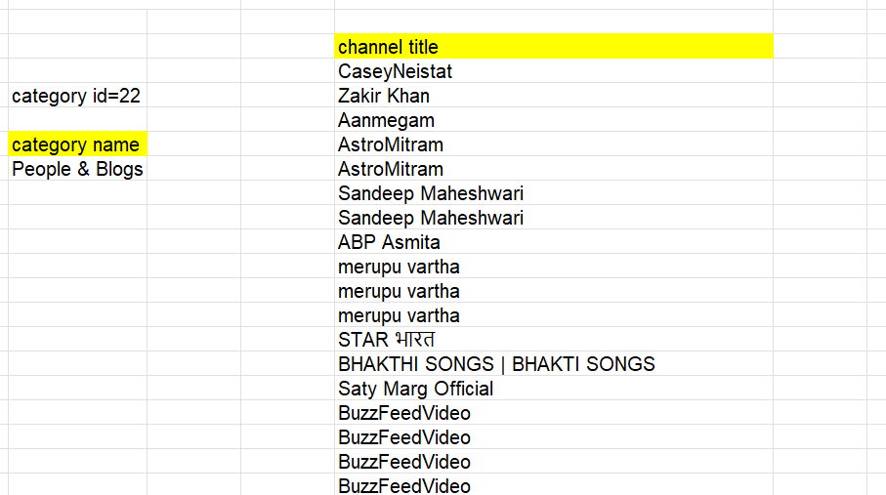
Q4
First I filtered based on category and then based on the category id I used the xloolup function to get th category name which is people and blogs

Slide 6
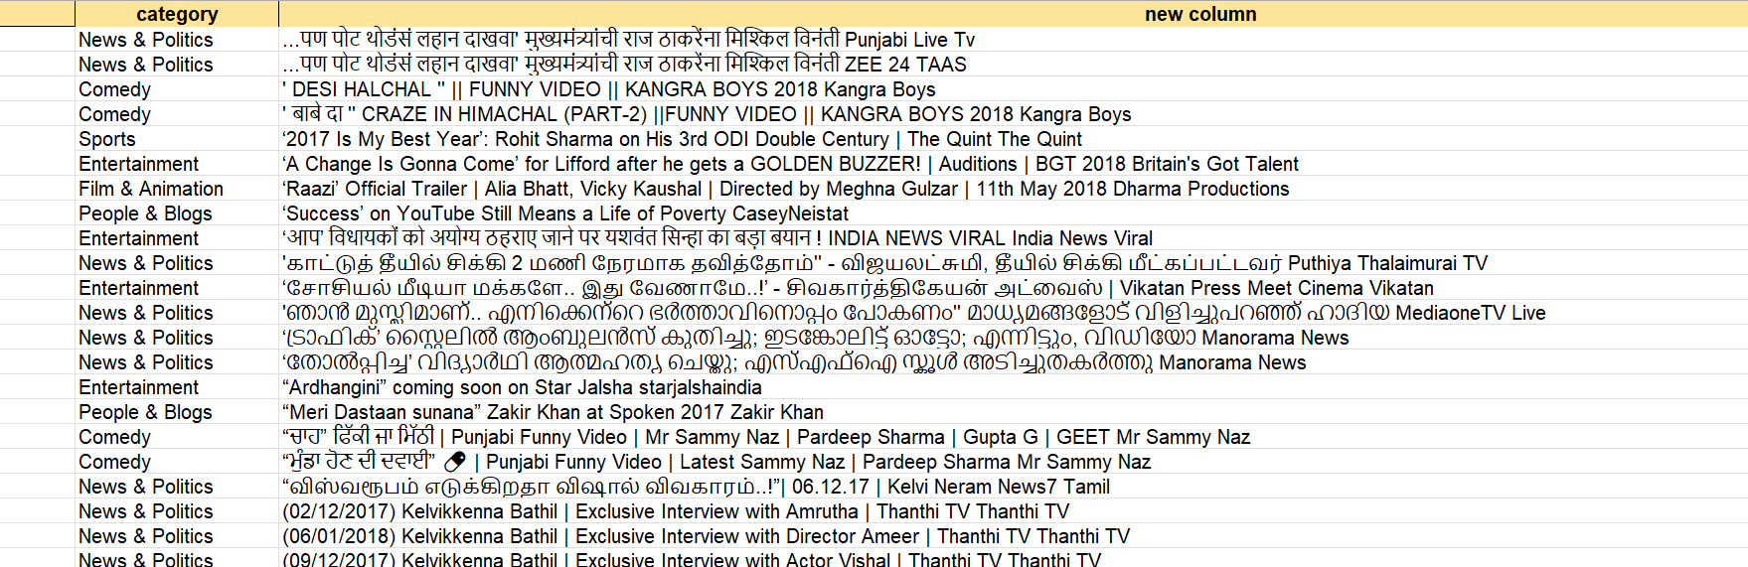
Q5
Used concat function to join title and channel title and then used text join to put it In a single cell

Slide 7
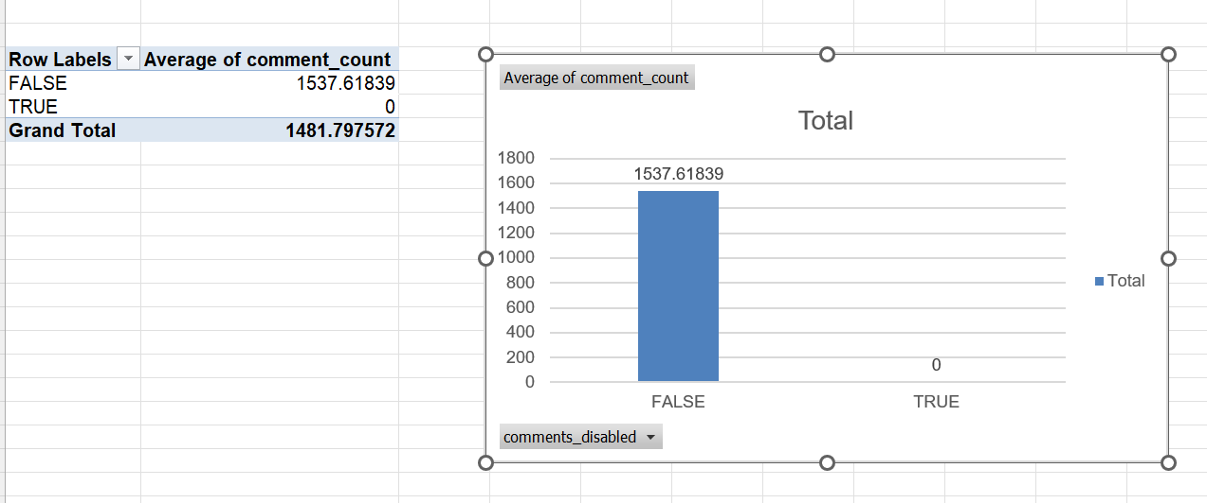
Q6
As you can see the comment Average count for comments disabled is 1537.61839
and whereas the comment count 0 for enabled and there is a huge significance difference

Slide 8
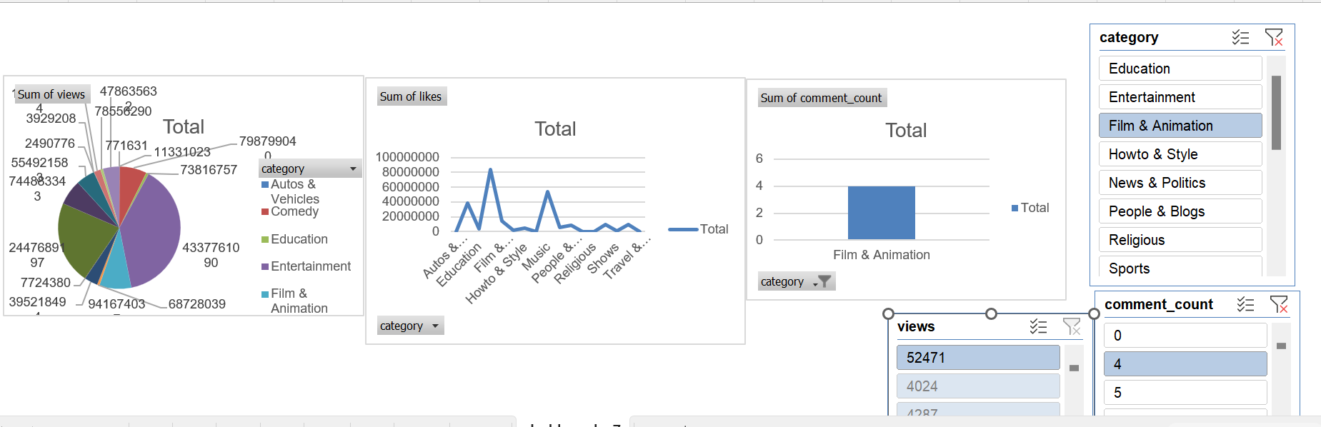
Q7
Created a dashboard based on a category and from here we can infer that entertainment industry has the most number of views and sum of likes also goes to entertainment industry and the sum of comment count is more for film and animation

Slide 9
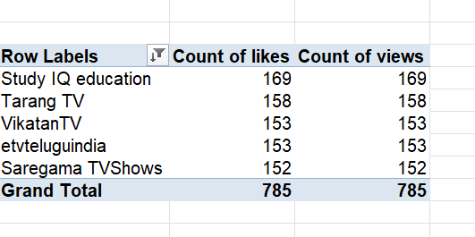
Q8
From the table we can infer that study iq , tarang tv vikatan tv etvteluguindia saregama tv shows are the top 5 videos which has the more number of likes and views

Slide 10
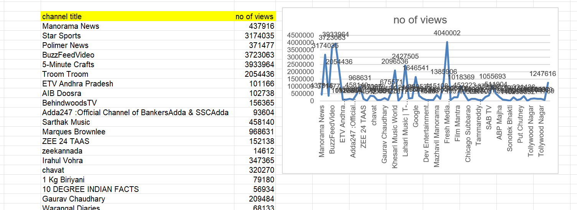
Q9
So I have filtered the channel title based on publish date which was released in 4-1-2018 and their corresponding views using xlookup from here we can infer that fresh media has more number of views compared to the other channel title

Slide 11
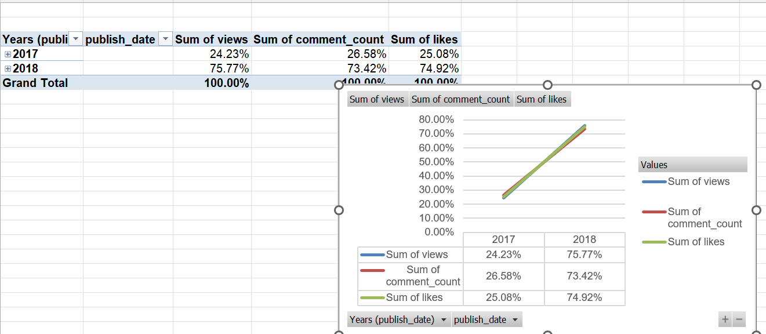
Q10
As you can see from the graph that sum of views , comment count , likes increased 50% from 2017 to 2018

Slide 12
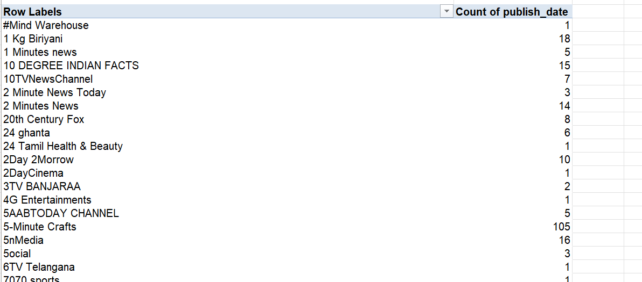
Q11

Slide 13
Q12

Slide 14
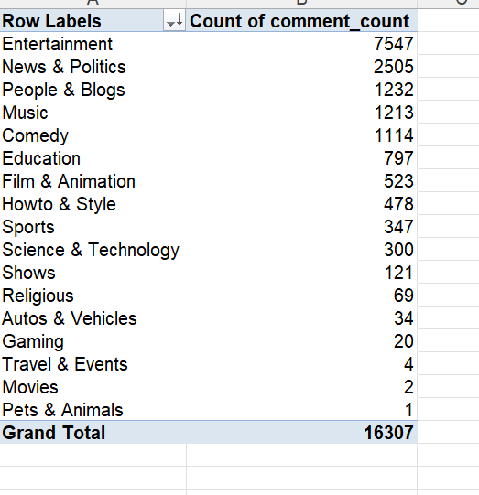
Q13
From this we an infer that entertainment has the more number of comment count compared to other categories

Slide 15
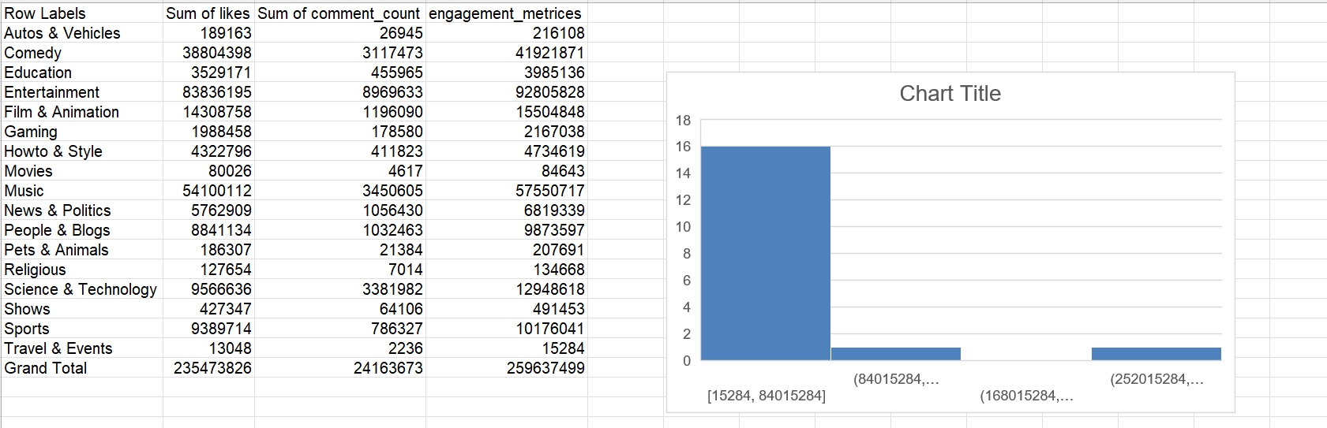
Q14

Slide 16
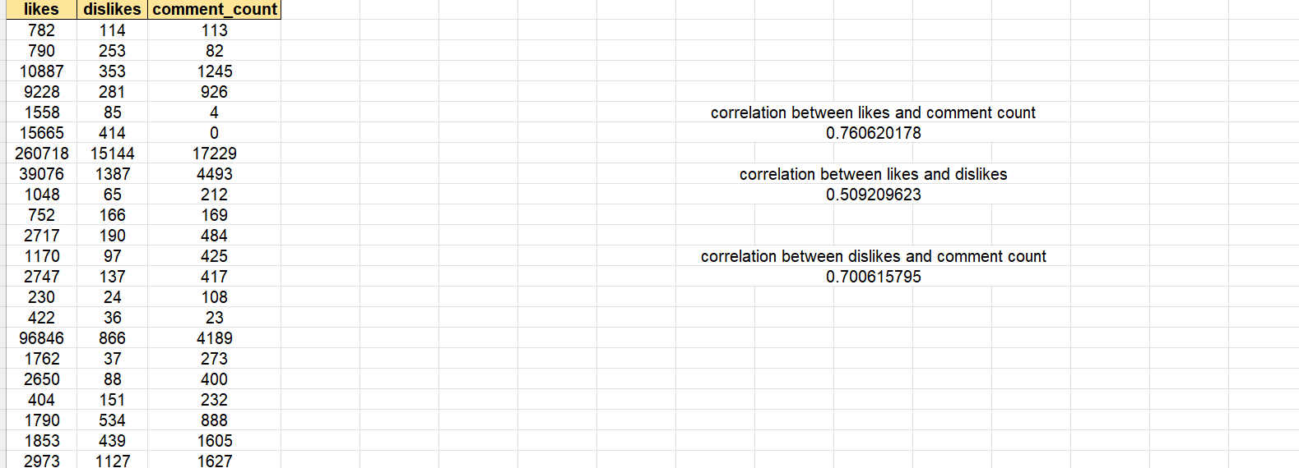
Q15
We have used correlation formula for each of the column from this we can infer
That relation between likes and comment count is more compared to the other columns

Slide 17
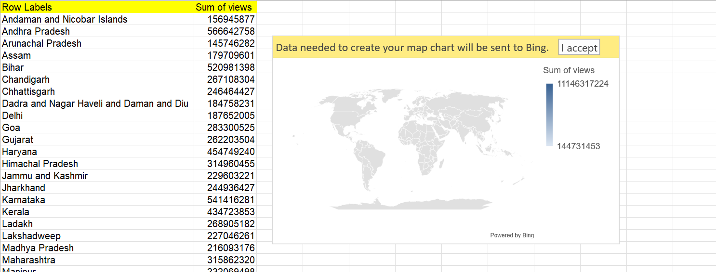
Q16
Created the map for the different states across the country

Slide 18
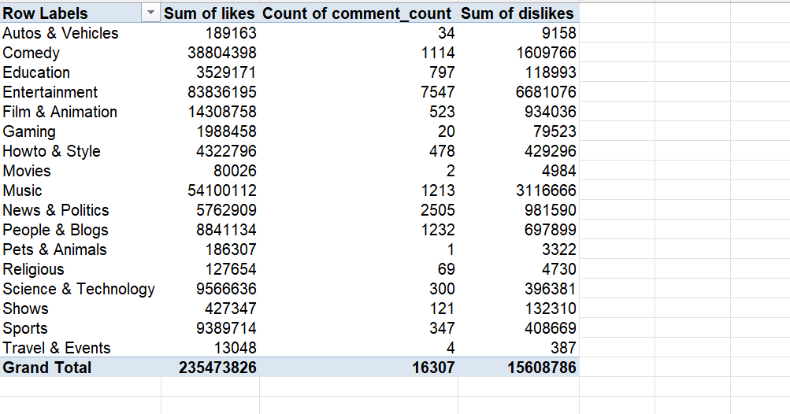
Q17

Slide 19
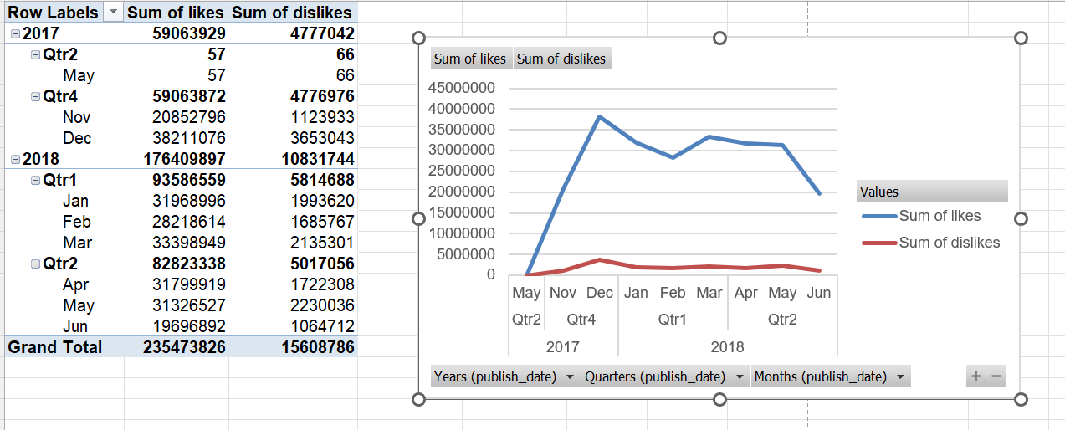
Q18
From this we can infer that in 2017 likes were growing constantly and there is a sudden change in 1st quarter wheres dislikes is constant in both the years

Slide 20
Q19

Slide 21
Q20

