Slide 1
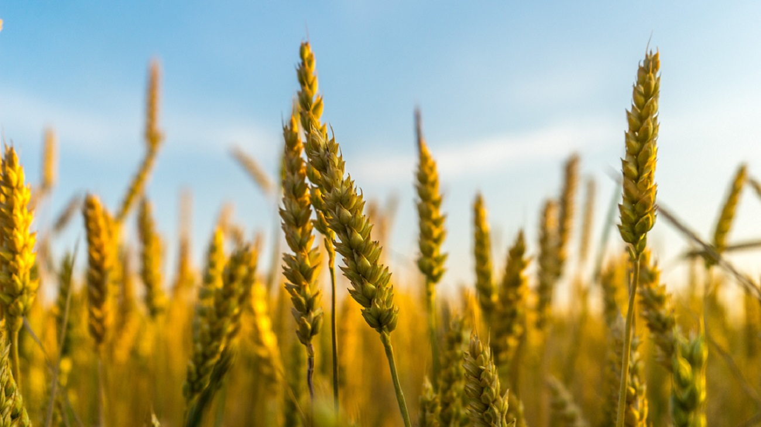
Analysis on
Agricultural crops

Slide 2

Crops datset
In crops dataset it consists
State name
District name
Year
Crop name
season
Production
area

Slide 3

Suicides data set
It consists of following
State name
Year
Gender
Age group
Number of deaths

Slide 4
Analysis on top 10 production of crops
By this we conclude that
Coconut has highest production
Followed by coconut sugar has highest production

Slide 5
Season wise top 10 crops
It shows for every season top 10 producing crops
By this we can see that which crop grows highest in a season

Slide 6
Season wise production
From this chart we can conclude that
Compare to all seasons whole year production is very high.
Because that crops grows through out the year.

Slide 7
Year wise production
By this chart ,there would be increase in production by year by year.
It has highest production in 2011

Slide 8
Year wise area
Every year there would be loss of some area as population increases deforestation also increases.

Slide 9
State wise sucides
By this analysis Maharashtra has highest number of sucides.
Chandigarh has lowest number of deaths.

Slide 10
Age and Gender wise deaths
The age group between 30-44 has highest number of deaths
While compareto gender male has highest number of deaths

Slide 11
Year wise deaths
In year 2004 it has highest number of deaths

Slide 12

For detail result click on the button
Detail analysis

Slide 13



