Slide 1
Simulation of a Cognitive Radio System By Using MATLAB
MADE BY
LOKESH (2K19/EC/101)
MOHAMMAD SAMEER (2K19/EC/110)

Slide 2
WHAT IS A COGNITIVE RADIO?
Cognitive radio is a form of wireless communication in which a transceiver can intelligently detect which communication channels are in use and which are not.
It instantly moves into vacant channels while avoiding occupied ones. It does not cause any interference to the licensed user.
It is an intelligent, aware, adaptive radio that ‘senses’ its operational environment and dynamically adjusts radio operating parameters to modify system such as maximizing throughput, mitigating interference and facilitating interoperability.
Since , there is already shortage of spectrum , the important challenge is to shared the licensed spectrum without interfering with the transmission of other licensced users. The cognitive radio enables the usage of temporarily unused spectrum, which is referred to as spectrum hole or white space

Slide 3
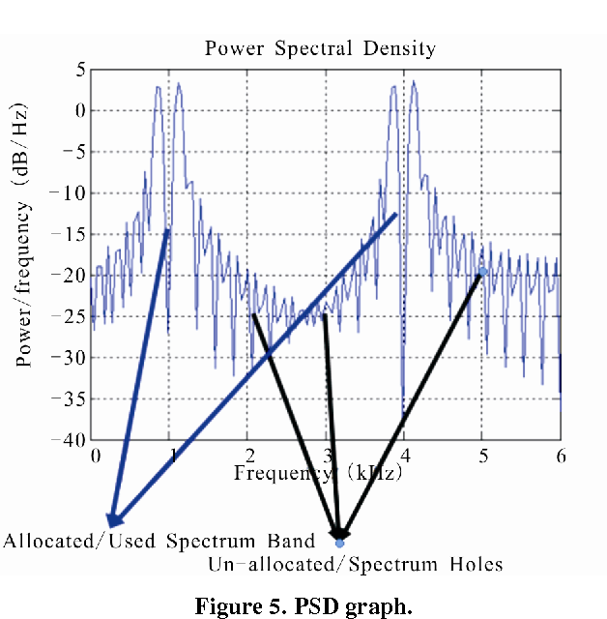
WHAT IS A SPECTRUM HOLES?
A spectrum hole in frequency is technically defined as a frequency band in which a secondary user can transmit message without interfering with any primary receivers (across all frequencies).
A frequency band that is unoccupied by a primary user. Secondary users use spectrum sensing technique to find spectrum holes.
These are the vacant spectrum band which is not in use by any user.

Slide 4
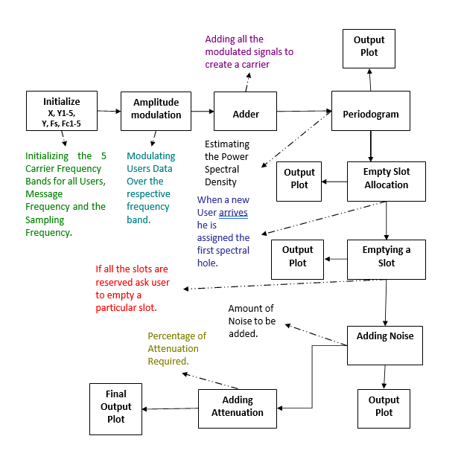
FLOW CHART OF SIMULATION

Slide 5
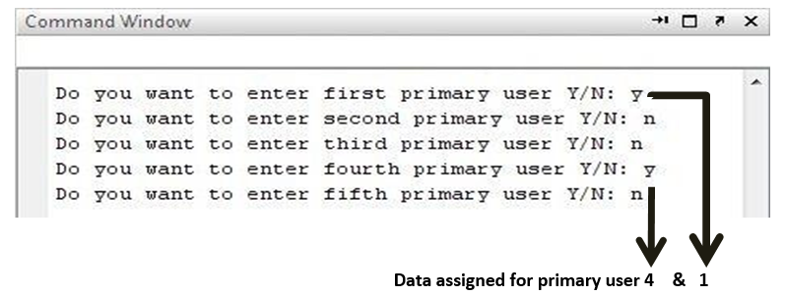
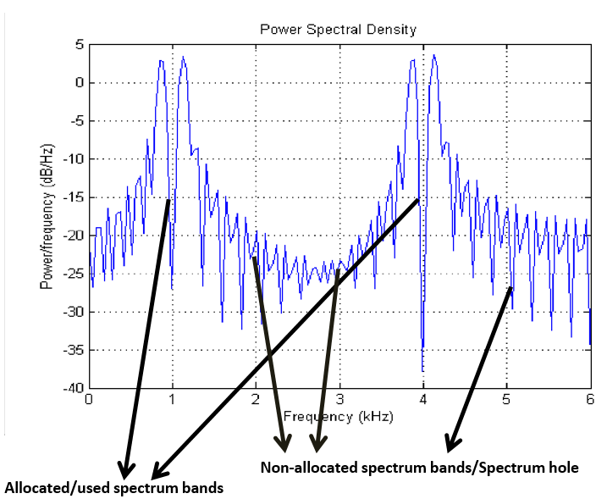
Assigning Primary User to the Frequency Spectrum
We’ve designed our system to have 5 different frequency channels and each User is assigned a particular frequency band. Once we run our program it’ll ask to add a User and assign it a particular band in ascending order.
Here we haven’t entered User 2, 3 & 5, thus their respective bands are still un-allocated. We can see them below in the power spectral density graph of our carrier signal.

Slide 6
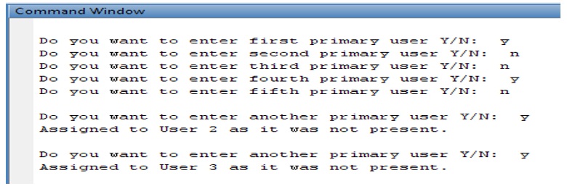
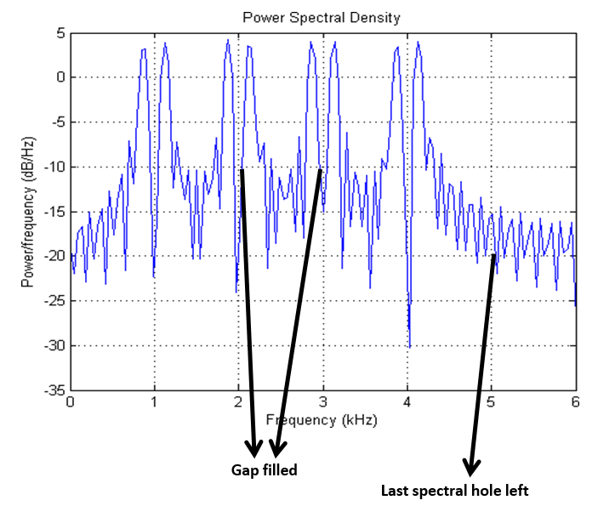
Assigning new user to the Spectrum Holes
Now we’re adding another User, the system will search the first available gap in the spectrum and automatically assign it to the new user. As the first available gap was after User-1 as User-2 was not sending any data so the band reserved for User-2 at start is now assigned to this new User.
Here we can see that the first spectral gap has been filled by assigning the new incoming User’s data. The first spectral gap belonged was that of User-2.

Slide 7
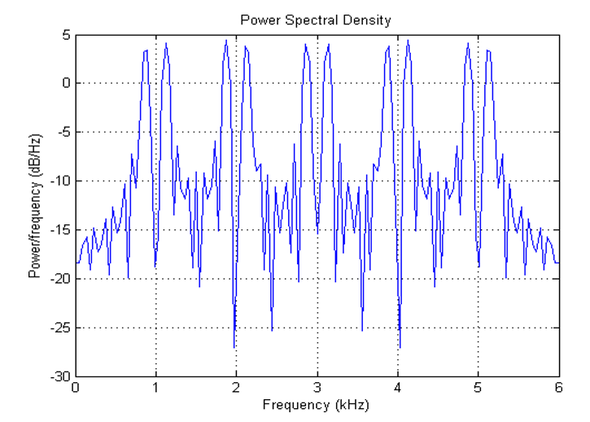
Efficient frequency Band width
Now we’ve just one empty slot left which will get filled by addition of another Primary User.
The power spectral density curve of the signal shows us that all of the frequency bands are efficiently in use after the addition of the last incoming user.
All of the Spectrum bands are in use

Slide 8
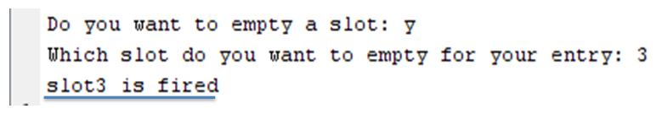
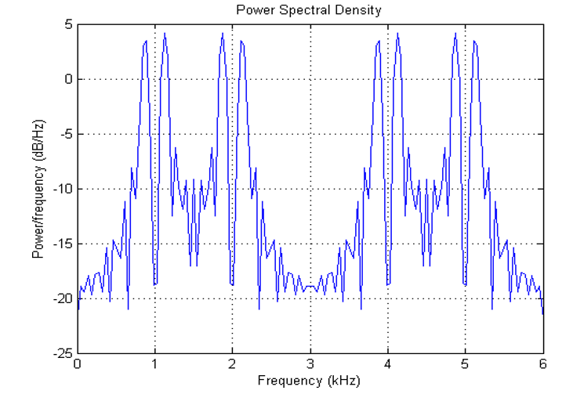
Elimination of a Slot
Once all the slots are being assigned, our system will entertain no other User and will be able to free up the slots one by one as shown below.
If we ask it to empty a slot, it will remove the data of that slot and make it ready for the next assignment.
Here , Spectrum band at 3khz and user at slot 3 is fired

Slide 9
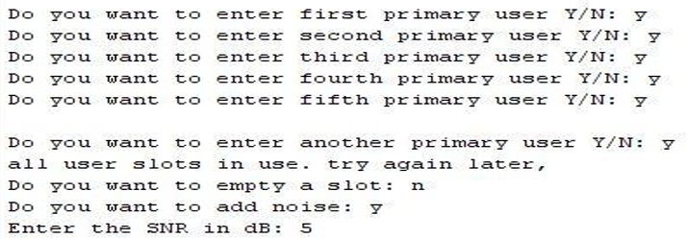
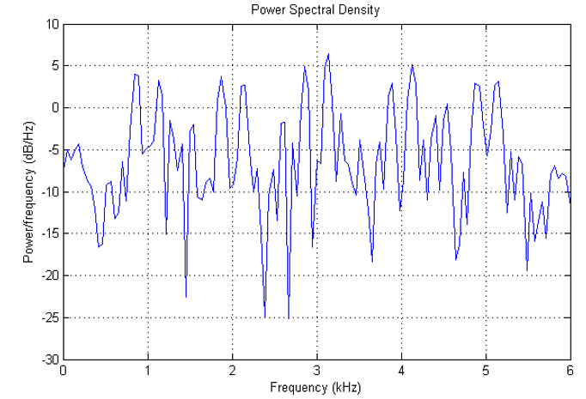
Addition of Noise Parameters to Analyze the Channel Characteristics
Now we can add noise in our carrier and the system will ask for the SNR (Signal to Noise Ratio) required in dB.
Here we’ve added noise to our signal. The resulting noisy carrier’s power spectral graph is given below.
Figure (b ) SNR = 5dB

Slide 10
To analyze the channel characteristics we can add noise and attenuation parameter. Now
if the Signal to Noise Ratio (SNR) is 5dB, 15dB. Then, the following results are shown in
the Figure (a) and Figure (b). The disturbance in the spectrum can be observed to
decrease with the increase in SNR. This means that the noisy channel will increase the
probability of error in the received signal.
Figure (b ) SNR = 10dB

Slide 11
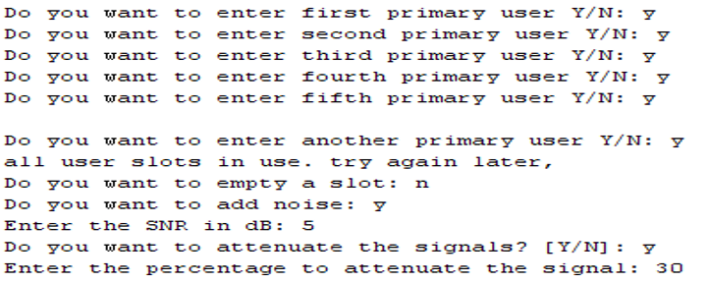
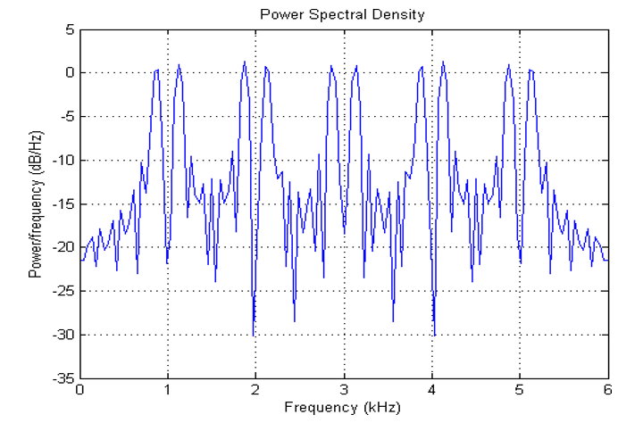
Attenuation of the Signal
Now we’re attenuating our carrier and the system will ask for the percentage of attenuation required.
The attenuated signal is shown below.
Here the signal peaks are
proportionately reduced with increasing attenuation thus attenuation in the channel will
reduce the signal power which in essence impairs the proper signal reception.

Slide 12
CONCLUSION
We’ve simulated the basics of a cognitive radio systems enabling dynamic spectrum access to the user at run time. Mobile multimedia downloads emergency communications services, broadband wireless networking, “hot spot” services; multimedia wireless networking services are the best applications of Cognitive radio system. Cognitive radios are still in research pipelines as cognitive science is in its infancy. By using MATLAB, we intend to come out with a simpler and efficient simulating technique.
The consequences on the basis of power spectral density of the channel is that ,it is used cognitively to find out the available gaps and those gaps can be assigned to new incoming users thus improving the overall channel’s output.
Cognitive radios have the potential to jump in and out of un-used spectrum gaps to increase spectrum efficiency and provide wideband services. We’ve shown the simulation of a Cognitive Radio System by using MATLAB where maximum utilization and efficiency of the frequency spectrum have been ensured and the noisy signal has also been attenuated.

Slide 13
THANK YOU

