Slide 1
Dashboard Overview – Ticket Management System
Created by: Bainaboina Lokesh

Slide 2
Project Introduction
This project demonstrates a complete Ticket/Case Management Workflow designed using Microsoft Excel.
→ It simulates how internal support teams (like Learning Operations, IT Support, and Service Desk teams) manage requests, track SLAs, monitor overdue cases, and report status through dashboards.

Slide 3
The project includes:
➔A Ticket Tracking System with realistic fields such as Priority, Status, SLA, Assigned To, and Overdue checks.
➔ Automated formulas for SLA due dates, overdue detection, and performance metrics.
A Dashboard sheet showcasing key KPIs like Total Tickets, Overdue Tickets, Priority Distribution, Status Breakdown, and Agent Workload.
Data visualizations including pie charts, bar charts, and KPI cards similar to Jira/ServiceNow dashboards.
An end-to-end workflow that reflects how a ticket moves from
New → Assigned → In Progress → Completed → Closed.
➔ Overall, this project highlights Excel’s ability to perform process automation, SLA monitoring, and dashboard reporting, making it useful for operational, administrative, and analytics roles.

Slide 4
Dashboard Highlights ⭐
📊 Displays real-time ticket metrics using Excel formulas
📌 Shows Status, Priority, Overdue vs On-Time breakdown
👥 Visual comparison of tickets assigned to each agent
🔄 Automatically updates when new tickets are added
📑 Designed in a separate dashboard sheet for clarity
🎨 Professionally color-coded KPI cards

Slide 5
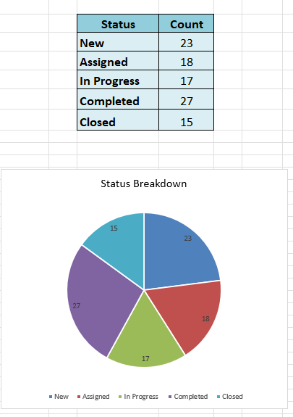
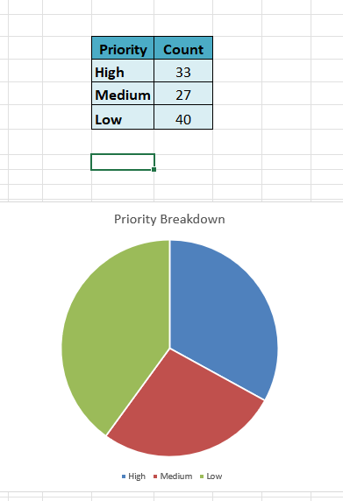
Pie-Charts

Slide 6
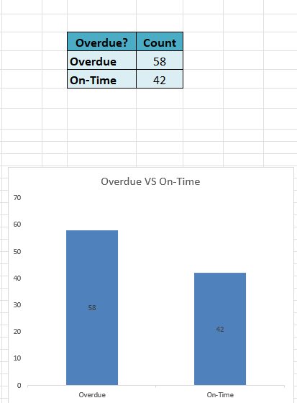
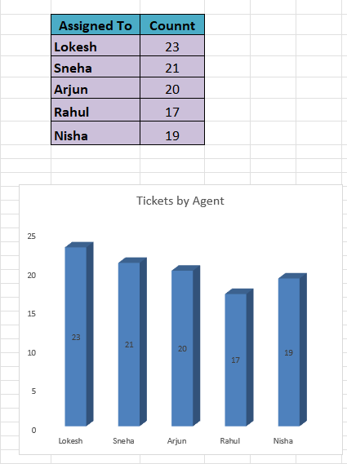
Bar - Charts

Slide 7
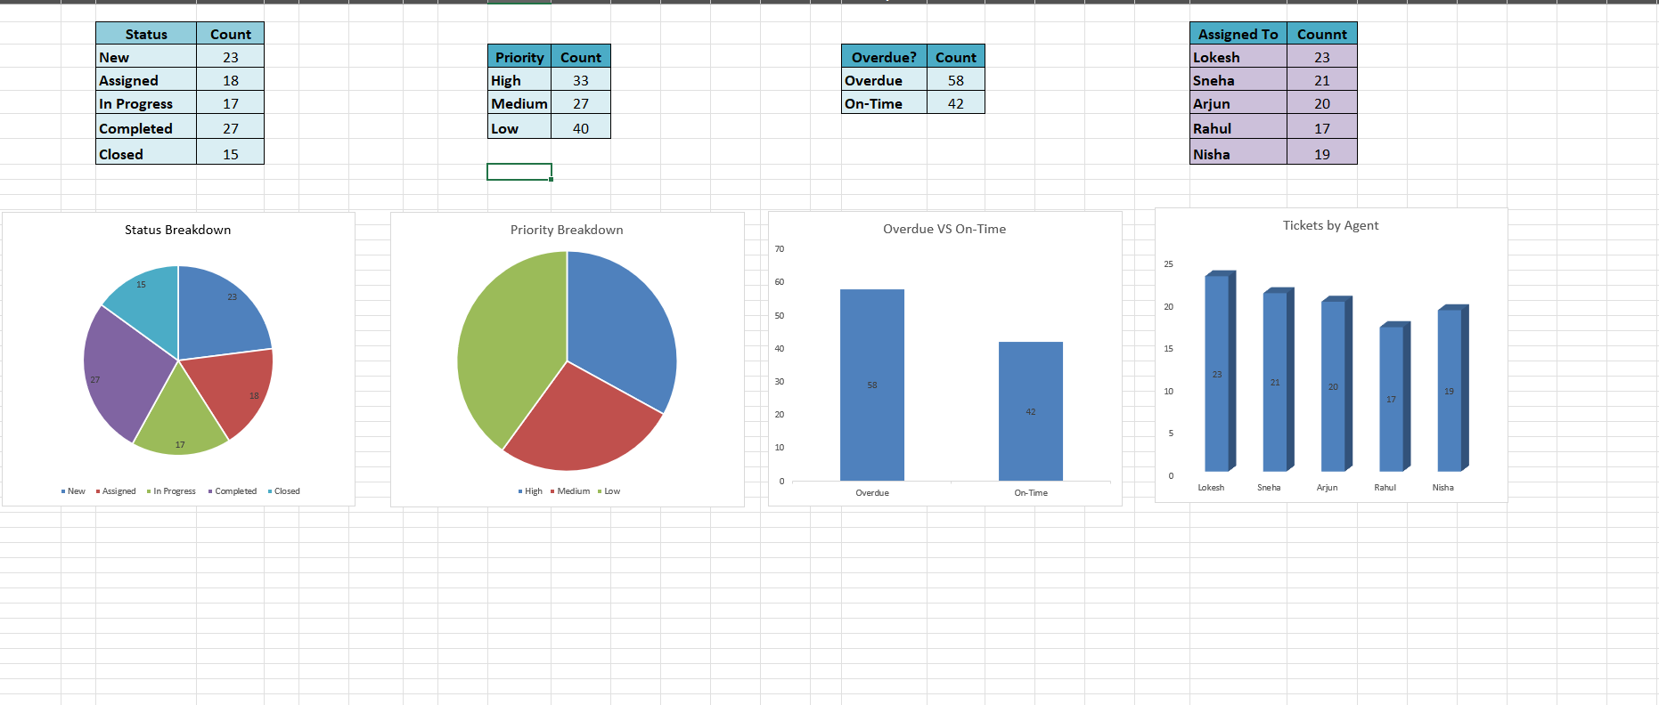
Dashboard Visual

Slide 8
All Excel Formulas Used
Category | Purpose | Formula
Ticket ID | Auto-generate unique IDs | "TCK-" & TEXT(ROW()-1,"000")
SLA Due Date | Add SLA hours to Created Date | =IF(G2="","", G2 + (F2/24))
Overdue Check (Basic) | Mark ticket as overdue if past SLA | =IF(G2="","", IF(AND(D2<>"Completed", D2<>"Closed", NOW() > H2), "Overdue", "On-Time"))
Overdue Check (Improved) | Prevent marking Completed/Closed as overdue | =IF(G2="","", IF(OR(D2="Completed", D2="Closed"), "On-Time", IF(NOW()>H2,"Overdue","On-Time")))
Total Tickets | Count all ticket rows | =COUNTA(A:A)-1

Slide 9
Overdue Tickets | Count tickets marked as "Overdue" | =COUNTIF(J:J,"Overdue")
Completed Tickets | Count all completed tickets | =COUNTIF(D:D,"Completed")
High Priority Tickets | Count high-priority records | =COUNTIF(C:C,"High")
Tickets With Comments | Count non-empty comments | =COUNTIF(K:K,"<>")
Status Count – New | Count New tickets | =COUNTIF(D:D,"New")
Status Count – Assigned | Count Assigned tickets | =COUNTIF(D:D,"Assigned")
Status Count – In Progress | Count In Progress tickets | =COUNTIF(D:D,"In Progress")
Status Count – Closed | Count Closed tickets | =COUNTIF(D:D,"Closed")
Priority Count – High | Count High priority | =COUNTIF(C:C,"High")
Priority Count – Medium | Count Medium priority | =COUNTIF(C:C,"Medium")
Priority Count – Low | Count Low priority | =COUNTIF(C:C,"Low")
Overdue Group – Overdue | Count Overdue | =COUNTIF(J:J,"Overdue")

Slide 10
Overdue Group – On-Time | Count On-Time | =COUNTIF(J:J,"On-Time")
Agent Workload – Lokesh | Count tickets assigned to Lokesh | =COUNTIF(E:E,"Lokesh")
Agent Workload – Sneha | Count tickets assigned to Sneha | =COUNTIF(E:E,"Sneha")
Agent Workload – Arjun | Count tickets assigned to Arjun | =COUNTIF(E:E,"Arjun")
Agent Workload – Rahul | Count tickets assigned to Rahul | =COUNTIF(E:E,"Rahul")
Agent Workload – Nisha | Count tickets assigned to Nisha | =COUNTIF(E:E,"Nisha")

