Slide 1
2048
CREATED BY
K.BHAVYA
K.MANOJ KUMAR

Slide 2
ABSTRACT
In this presentation, we describe an engaging puzzle game called 2048 and outline a variety of exercises that can leverage the game’s popularity to engage student interest, reinforce core CS concepts, and excite student curiosity towards undergraduate research. Exercises range in difficulty from CS1-level exercises suitable for exercising and assessing 1D and 2D array skills to empirical undergraduate research in Monte Carlo Tree Search methods and skilled heuristic evaluation design.

Slide 3
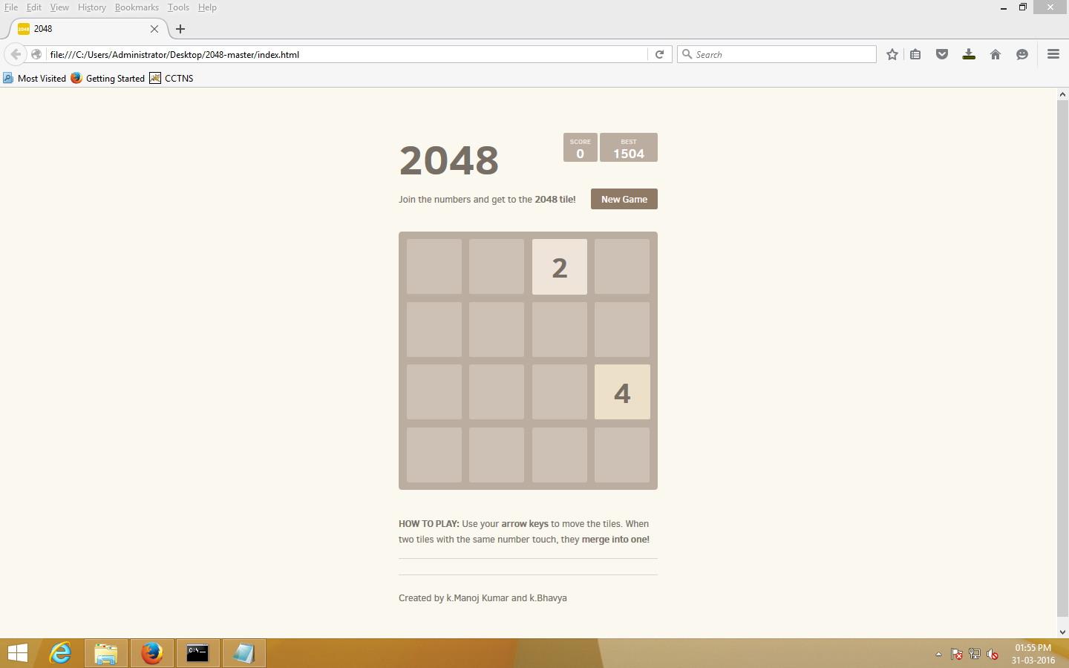

Slide 4


