Slide 1
EASY JOURNY
By
Creators1234

Slide 2
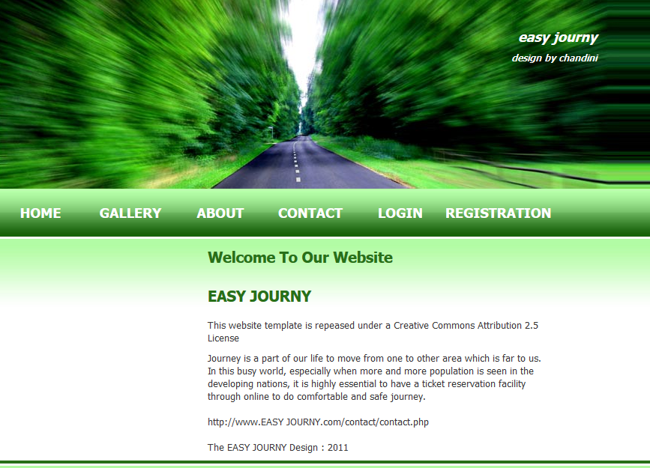

Slide 3
Abstract
Introduction:
Journey is a part of our life to move from one to other area which is far to us. In this busy world, especially when more and more population is seen in the developing nations, it is highly essential to have a ticket reservation facility through online to do comfortable and safe journey.
Existing System:
In this busy world every person is busy with their work. When ever a passenger wants to reserve a ticket he has to spend a lot of time by standing in a queue.
Time consuming process to reserve a ticket.
Proposed System:
Through online the person can reserve the seats for the specified bus. It makes the user to get the work done just with a mouse click.
A person can select the source and destination points along with the date and type of bus he wants.
The Passenger can select the seats based on their interest. He can pay the amount through the credit card/debit card. The ticket is generated on the new window and the passenger can take a printout of it. The same ticket can be presented at the time of journey.

Slide 4
Modules of an application:
Travels:
User:
This module provides the details of various travels to the
Passengers. It allows passenger to select the best travels.
Admin:
Add Travels
View Travels
Delete Travels
Routes:
View Routes from one area to another area including journey date, fare, and availability of seats, no. of pick up points, arrival & departure time of bus

Slide 5
User:
View Routes.
Admin:
Add Routes
View Routes
Delete Routes
Reservation:
This Reservation provides the details of cost of the ticket, seat no, type of the travels.
User:
Booking Tickets
Cancellation of tickets
Testimonials:
Users of this website can give their opinions, complaints, suggestions regarding this site & provided services which leads to growth of this site. So that the site provide the better service to the passengers.

Slide 6
Thank You

