Slide 1

Title: Prediction for Credit Card Approval
Subtitle: Machine Learning Internship Program
E LOKESH
MENTORNESS

Slide 2
Introduction to the Project: Embarking on a cutting-edge journey, this project stands at the forefront of blending advanced machine learning algorithms with the dynamic needs of the financial sector. Our mission is to revolutionize how credit card approvals are determined, making the process smarter, faster, and more reliable.
Objective: To craft a predictive model that enhances the accuracy of credit card application outcomes, streamlining approval processes while minimizing financial risks and maximizing customer satisfaction.
The Challenge: The project challenges participants to unravel and model the complex web of factors that influence credit card approval decisions, using data to predict outcomes with precision.

Slide 3
Business Case:
Financial Efficiency: Streamlined approvals reduce manual review costs and lower default risks, driving profitability.
Customer Experience: Quicker, more accurate decisions elevate the application experience, fostering loyalty and attracting new customers.
Risk Management: Improved decision-making accuracy aids in managing credit risk effectively, ensuring regulatory compliance and a robust financial portfolio.
Innovation and Competitive Edge: Adopting a data-driven decision process enhances the institution's reputation as an industry leader, providing a significant edge in the digital finance arena.

Slide 4
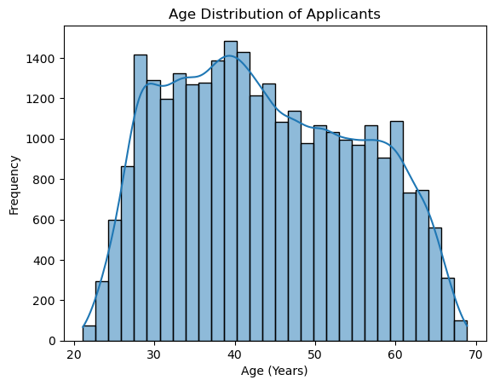
Applicant Age Distribution Insights
Visualization Overview: This chart showcases the age distribution of credit card applicants, converting ages from days to years for clarity.
Key Insights:
The histogram, enhanced with a Kernel Density Estimate (KDE), reveals the age spread among applicants, using 30 bins for granularity.
Highlights predominant age groups applying for credit cards, aiding in demographic analysis and strategic planning.
Strategic Importance:
Essential for tailoring marketing strategies, product development, and risk assessment to meet the needs of key demographic segments.

Slide 5
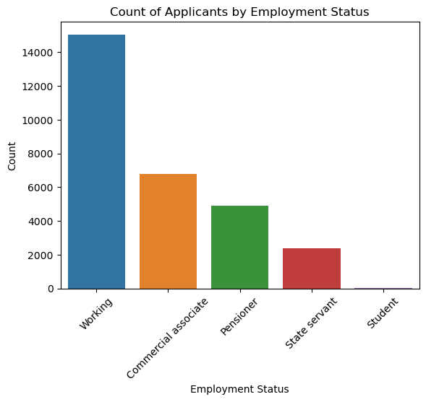
Analysis of Applicants by Employment Status
Chart Overview: This visualization presents the distribution of credit card applicants categorized by their employment status.
Insights:
Displays the number of applicants for each employment category, highlighting which employment statuses are most common among applicants.
Useful for understanding the employment diversity within the applicant pool and tailoring financial products or services accordingly.
Implications:
Helps in identifying trends in credit card application rates among different employment groups.
Can inform risk assessment strategies and marketing approaches by aligning them with the employment profiles of applicants.

Slide 6
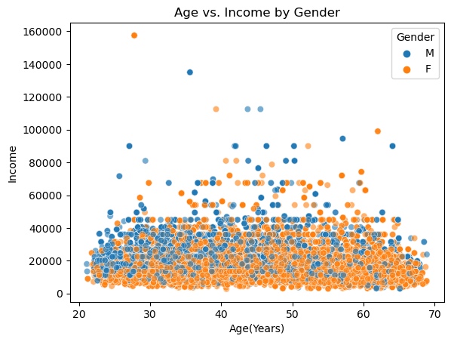
Age vs. Income Analysis by Gender
Visualization Summary: This scatter plot examines the relationship between age (in years) and income (scaled down for visualization), with a color-coded distinction between genders.
Key Insights:
Illustrates how income levels correlate with age among credit card applicants, providing a visual differentiation by gender.
Strategic Implications:
Enables targeted marketing strategies by understanding income trends across different age groups and genders.
Supports tailored product offerings, especially if certain age and income brackets show clear preferences or needs that vary by gender.

Slide 7
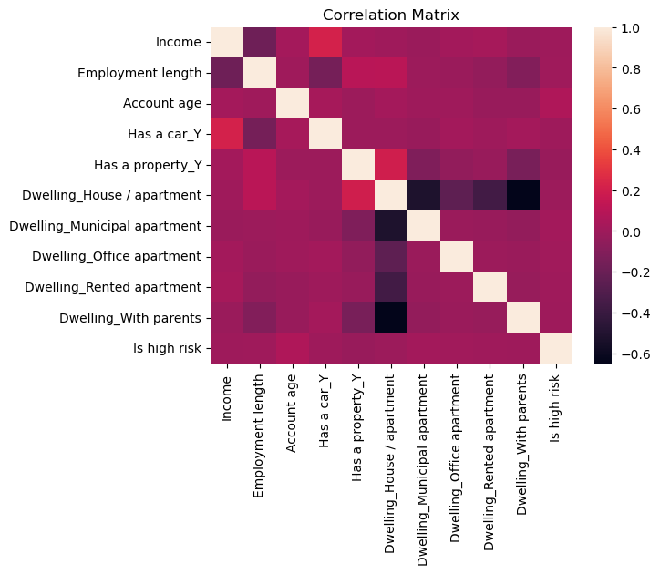
Key factors positively influencing credit card approval:
Income: Strongest positive correlation
Employment length: Longer history increases approval chances
Account age: Established accounts are more favorable
Car ownership: Indicates financial stability
Dwelling type has a weaker influence:
Rented apartments show slightly lower approval rates
Other dwelling types have minimal impact

Slide 8
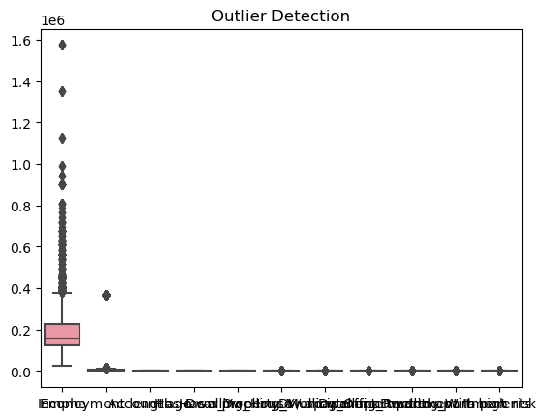
Insights from Boxplot Analysis
Overview of Boxplot Visualization: A boxplot provides a graphical representation of the central tendency, dispersion, and skewness of the dataset, also highlighting outliers.
Key Insights:
Central Tendency and Spread: The boxplot's central box shows the median, quartiles, and interquartile range (IQR), offering insights into the data's central tendency and variability.
Outliers Detection: Points outside the whiskers are considered outliers, indicating exceptions or anomalies in the dataset.
Symmetry and Skewness: The symmetry of the box and whiskers around the median can indicate the distribution's skewness.
Strategic Implications:
Data Quality and Anomalies: Identifying outliers helps in assessing data quality and potential anomalies that may affect analysis and decision-making.
Decision Making: Understanding the distribution of data supports better decision-making by highlighting typical values, variability, and extremes.

Slide 9
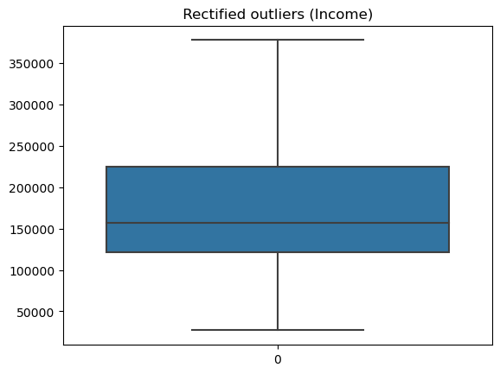
Enhancing Data Quality: Income Outlier Adjustment
Objective of Data Cleaning: Improve dataset reliability by detecting and addressing outliers in the Income data, ensuring accurate analysis and predictions.
Methodology Overview:
Outlier Detection: Utilized the Interquartile Range (IQR) method to identify outliers. Outliers are defined as values below the lower bound (Q1 - 1.5 * IQR) or above the upper bound (Q3 + 1.5 * IQR).
Adjustment Strategy: Instead of removing outliers, which can lead to loss of valuable data, outliers in the Income column are replaced with the mean income. This approach mitigates the impact of extreme values on the dataset's overall analysis.
Implications for Data Analysis:
Improved Accuracy: Adjusting outliers helps in reducing skewness and variance in the Income data, leading to more reliable statistical and machine learning models.
Data Integrity: Maintains the dataset's integrity by preserving the number of entries, essential for comprehensive analysis and model training.

Slide 10
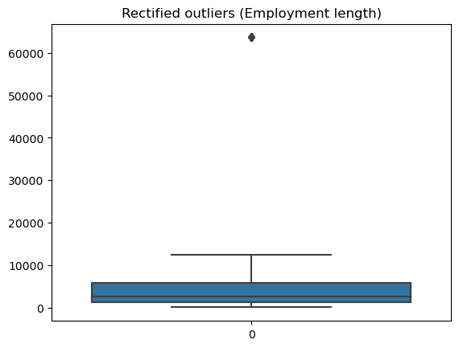
Refining Employment Length Data
Data Cleaning Goal: Enhance the reliability of employment length data by identifying and correcting outliers, facilitating more accurate analyses.
Outlier Handling Technique:
Identification: Employed the Interquartile Range (IQR) to spot outliers in employment length—values falling below Q1 - 1.5 * IQR or above Q3 + 1.5 * IQR.
Correction Method: Replaced outliers with the average employment length, ensuring the distribution remains representative without the extreme values skewing the data.
Benefits to Data Quality:
Consistency and Accuracy: This adjustment method maintains the dataset's size while improving the consistency and accuracy of employment length data, critical for subsequent analyses.
Balanced Analysis: By addressing outliers, we ensure that employment length data contribute to a more balanced and realistic analysis of employment trends among the dataset's subjects.

Slide 11
Implementing Decision Tree Classifier for Risk Prediction
Model Selection: Chosen Model Decision Tree Classifier. A machine learning algorithm that creates a model based on simple decision rules inferred from the data features, ideal for classification tasks.
Key Parameters :
Random State (2): Ensures reproducibility of results by providing a fixed seed to the random number generator.
Criterion ('Entropy'): Utilizes entropy as a measure for splitting the decision nodes, aiming to maximize information gain.
Max Depth (10): Limits the depth of the tree to 10 levels to prevent overfitting, ensuring the model remains generalizable to new data.
Model Training:
The Decision Tree Classifier is trained with a subset of the dataset (`X_train` for features and `Y_train` for the target variable), learning to predict the risk level of credit applications.
Implications for Risk Prediction:
By applying these specific parameters, the model aims to strike a balance between learning detailed patterns and maintaining a broad applicability to various applicant profiles, enhancing its predictive accuracy while minimizing the risk of overfitting.

Slide 12
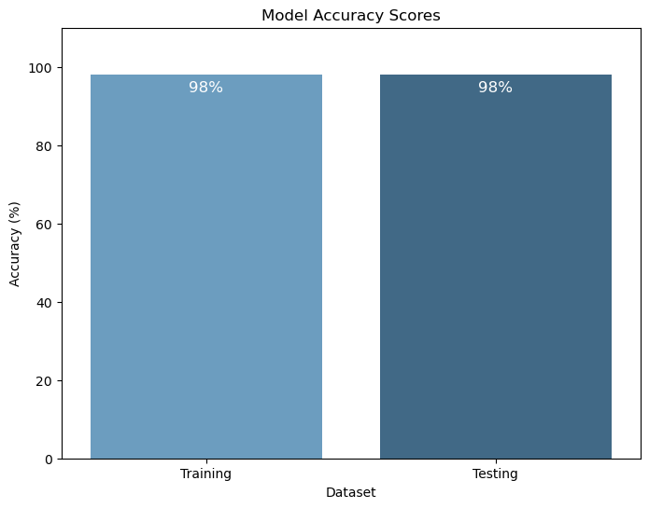
Model Performance Evaluation
Achieving a 98% accuracy rate on both training and testing sets is indicative of a robust model with high predictive power.
This balance in performance underscores our model's ability to generalize well from training data to unseen data, a key indicator of its reliability.
Concurrently, we'll explore advanced analytical techniques to further refine accuracy, focusing on areas like feature engineering and model ensembling

Slide 13

THANK YOU

