Slide 1


Final Presentation
Notes:
Jim

Slide 2
Contents
Timeline
Exploratory Data Analysis
Business Proposal
Data Analysis First Iteration
Data Analysis Second Iteration
Conclusion
Notes:
Jim

Slide 3
Timeline
September
November
January
Data Cleaning, Exploratory data analysis
Finding related data with existing dataset,
1st Data Analysis Report
Final data analysis report,
The final presentation
October
December
Making model to better fit our goals
Business Proposal
Notes:
Jim

Slide 4
Datasets used
Pharmacy Dataset from Informa
Belgium Open Data (Statbel)
Containing a massive amount of pharmacy sales data on Belgium pharmacy from the year of 2017 until July 2020. This dataset also has been extended to gain more detail using the information from postcode to determine where its located and ATC code to determine what type of medicine being sold.
Containing a lot of data about Belgium but we are focusing on getting the population data on each province of Belgium to add more information to our model.
Notes:
Martin

Slide 5
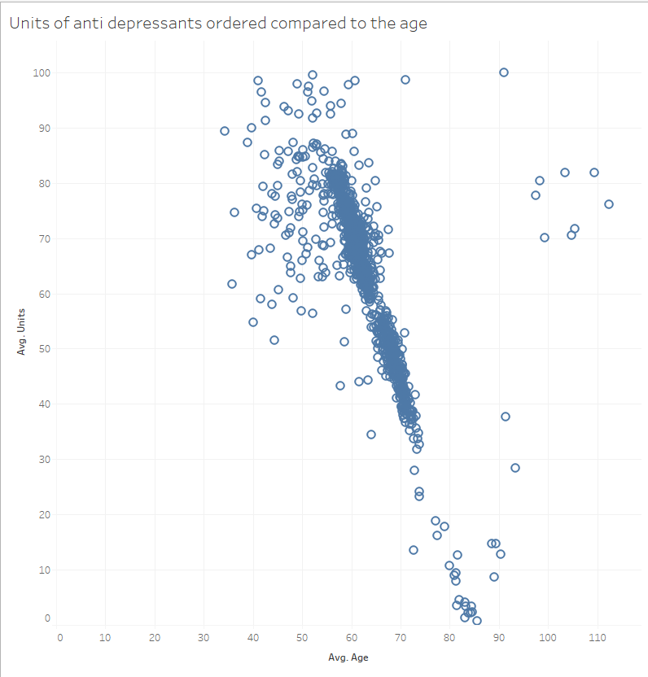
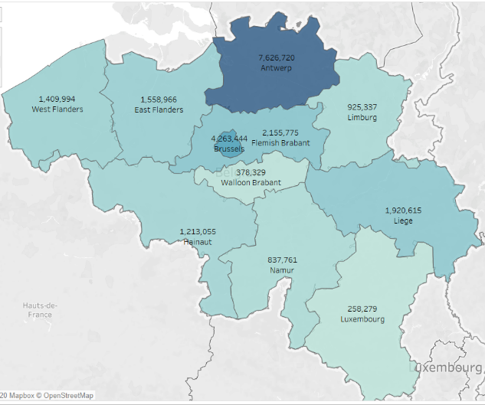
Exploratory Data Analysis
Antwerp residence order the most medicine compared to any other province combined.
The more people, the more orders.
Some medication types have a strong correlation with age.
Notes:
Martin

Slide 6
Business Proposal
The trend in the amount of medicine order increases by age.
Predict the amount of medicine ordered per medicine type.
By using belgium’s population.
To improve stock management.
Notes:
Lokesh

Slide 7
Data Analysis First Iteration
Added a dataset of Belgium’s population by age group.
Tried out 4 algorithms.
Tried out different features.
Population and age.
Very accurate, we’ll come back to that later.
Next -> Make it more specific by including provinces.
Notes:
Lokesh

Slide 8
Data Analysis Second Iteration
Added a new dataset of Belgium’s population by age group and province.
Tried out 4 algorithms.
Made sure that it was not overfitted.
Now -> We can predict the units ordered based on population and age.
Accuracy -> Model does not work well for all medication types!
It depends strongly on the correlation between age and the units ordered for the type.
E.g., wouldn’t work that well for vitamins
Notes:
Rafael

Slide 9
Conclusion
We can use data of Belgium’s population to predict the ordered units per province
This is helpful for stock management and medicine distribution
It doesn’t work as well for all medicine types because it strongly depends on the correlation between age and the units ordered
E.g., it works well for anti depressants, only people between ages 55-75 take these.
Doesn’t work well on vitamins, almost everyone takes these.
Notes:
Rafael

