Slide 1

Pronunciation Trainer
Lokesh Agnihotri

Slide 2
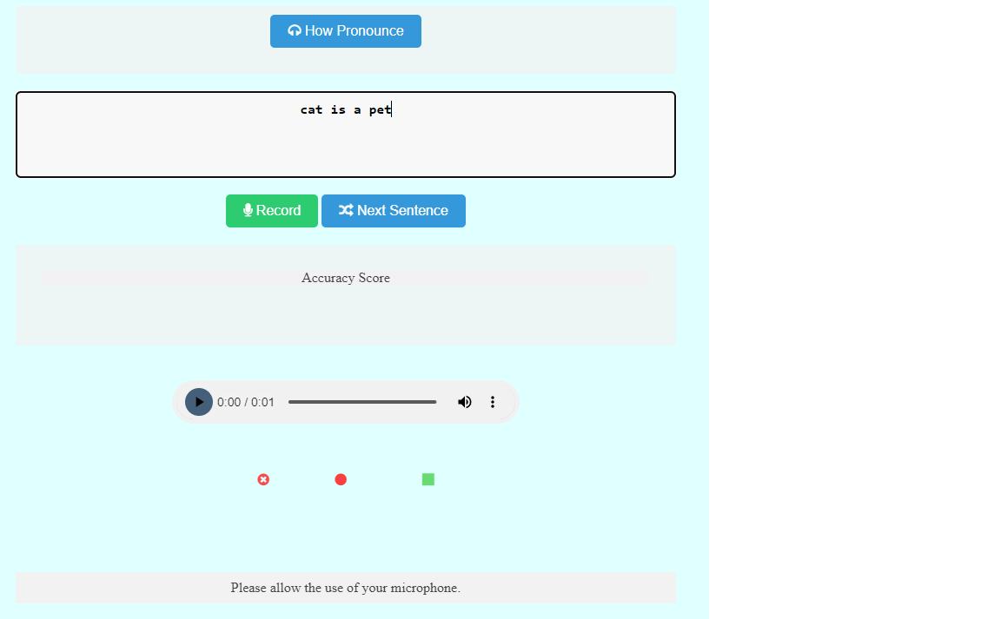
Agenda
Objective
Methodology
Result
Conclusion

Slide 3
Introduction
Practoraat Interactieve Technologie van ROC Tilburg, wants a tool to help them in teaching English and it’s correct pronounciation to the MBO students.
A tool that can help them:
To listen to correct pronunciation
Practice the correct pronunciation
Get feedback on their pronunciation
Improve by practice.

Slide 4
Objective

Slide 5
Create an application to help improving the pronunciation with continuous feedback and option to practice and improve.

Slide 6
Team
Lokesh Developer
Martijn Coach
Erdinc Stakeholder

Slide 7
Timeline
5th May
Project assigned
Advice and Analyze
Worked on Analyzing the requirement and creating an advice on how it should be done
Design
Creating a design for system that can work together with all the technologies chosen to deliver the result
Realize
Creating the designed application and fixing the bugs.
7th July
Presentation

Slide 8
Methodology
Scrum with each sprint of 3 days.
After every sprint an hour for retrospection.
Regular feedbacks via meetings/emails/teams.
Peer feedback
Unit tests
GitHub FOR MANAGE AND control

Slide 9
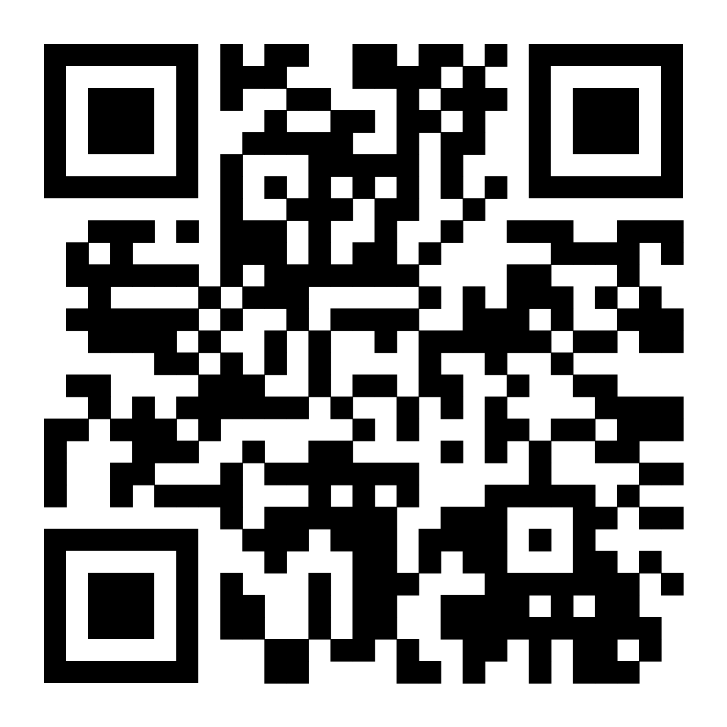
Results
Pronunciation Trainer
Speaks correct pronunciation
Allows user to record and practice
Visual Feedback
Practice and Improve

Slide 10

DEMO

Slide 11
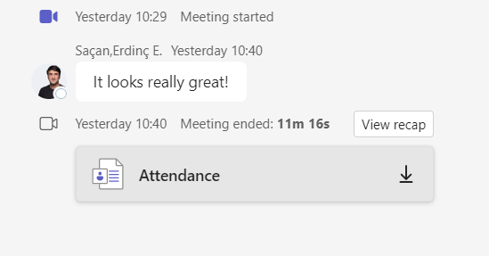
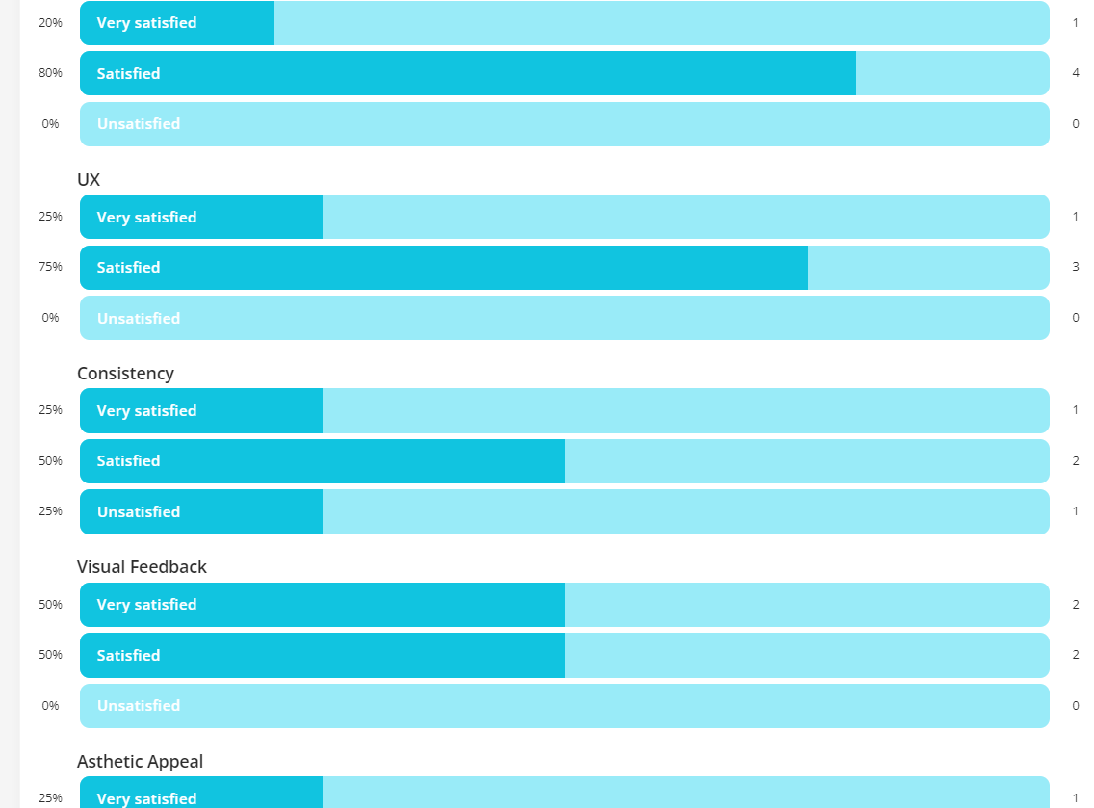
User Test Results
Form Result | forms.app

Slide 12

Learning
Process
Taking responsibility
Problem solving
Taking and applying feedback
Continuous learning and improvement

Slide 13




Thank you
Lokesh Agnihotri
Lokesh.Agnihotri@outlook.com
https://pronunciationtrainer.azurewebsites.net/

