Slide 1
Python Exception Handling:

Slide 2
Introduction
What Are Exceptions in Python?
Types of Exceptions in Python
Difference between Syntax Error and Exceptions
What Is Exception Handling in Python?
Advantages of Exception Handling
Disadvantages of Exception Handling
Common Exceptions in Python

Slide 3
Introduction:
We all know that Python is considered a powerful programming language. However, do you know what makes it powerful? Yes, it is its endless capabilities, but it is also how the language equips programmers to handle unexpected situations, including errors and exceptions.
An exception in Python is an event that occurs during program execution and disrupts the normal flow of a program. Exception handling allows programmers to handle these unforeseen errors and ensures the program runs smoothly without hampering user experience.
This ppt will uncover different types of exceptions, ways to handle exceptions, the advantages and disadvantages of exception handling in Python, and more.

Slide 4
What Are Exceptions in Python?
Errors are inevitable in programming. Programmers can spare no effort to write meticulous code, but they may encounter errors that hamper their journey. Even a trivial error can cause major disruptions, demanding immediate action. Although Python is considered a simple and powerful programming language, there are still chances of errors and exceptions while writing code.
A Python exception is an event that occurs during the execution phase of a program and can potentially hamper the normal flow of execution. Such exceptions indicate that something unexpected has occurred while executing a program and can terminate the program abruptly, so they require immediate attention.
Exceptions, such as unexpected behavior and errors, create an exception object that contains all the details regarding the type of exception and its context. Therefore, developers can handle the situation efficiently, respond to the error, and prevent the program from crashing.

Slide 5
Types of Exceptions in Python:
Python has several built-in exceptions catering to different types of errors. They are raised whenever there is an error while executing a program. You must understand these exceptions to handle them effectively. We have explained the most common exceptions in Python.
1. IOError
It is raised when an I/O operation, such as writing or reading a file, fails because of an input/output error.
2. ValueError
It is an exception that occurs when a method is an invalid argument or input. For example, executing a program to convert a string to an integer, but the string doesn’t represent a valid integer.
3. AttributeError
This exception occurs when the reference of an attribute or method fails. It means when we try to access an attribute that doesn’t exist.
4. TypeError
The TypeError is raised when an operation is applied to an object of the wrong or inappropriate type. For example, adding a string to an integer.
5. AssertionError
It is raised when an assert statement fails. We use assert to test if a condition is true. If not, it raises an AssertError.

Slide 6
6. ImportError
This exception occurs when an import statement fails to find a module.
7. NameError
It is raised when a function or variable is not found in the current scope.
8. SyntaxError
This exception occurs when the interpreter encounters an issue with the code's syntax and can’t parse it correctly, such as a missing colon, unbalanced parentheses, or a misspelled keyword.
9. KeyboardInterrupt
This is an exception that occurs when a user interrupts the execution of a program by pressing Ctrl+C.
10. IndexError
This exception occurs when we try to access an element from a tuple, list, or string using an out-of-range index.
11. KeyError
We encounter this exception when we try to access a key that doesn’t exist in the dictionary.
12. ZeroDivisionError
The ZeroDivisionError occurs when we try to divide a number by zero.
13. MemoryError
This exception is found when an operation runs out of memory.

Slide 7
These are the top Python exceptions that occur during program execution. We must handle these exceptions carefully using try-except and other exception-handling methods to ensure our program runs smoothly without crashing.
Difference between Syntax Error and Exceptions
Syntax Error is caused due the wrong syntax of the code and can terminate the program.
Example:
# Missing colon at the end of the if statement
if 5 > 3
print("5 is greater than 3")
Output:
File "example.py", line 2
if 5 > 3
^
SyntaxError: invalid syntax
Exceptions occur due to a syntactically incorrect program and throw an error in the result. An exception doesn’t stop program execution but hampers the normal flow of the program.
Example
# Attempting to divide by zero
x = 10 / 0
Output:
ZeroDivisionError: division by zero

Slide 8
What Is Exception Handling in Python?
A Python exception represents an error raised during program execution. It can be a simple error like dividing a number by zero or a complex situation like attempting to access a file that doesn’t exist. Such exceptions can disrupt the normal flow of a program and lead to the program crashing or halting. They can also terminate the program. That is where Python exception handling comes into play. It helps us avoid errors by ensuring that the program runs smoothly even in case of an error.
Exception handling allows programmers to manage and respond to runtime errors or exceptional situations during a program's execution. We usually handle exceptions through try and except blocks. The try block encloses the code that may encounter an exception, whereas the except block handles the exception. If there is an exception in the try block, the program moves on to the except block to handle the situation rather than stopping the program.
Catching Exceptions with try and except Statements
We use the try and except statements in Python to handle exceptions that may occur during program execution. We place statements that may raise exceptions within the try block and place statements to handle exceptions in the except clause. They enable us to handle errors efficiently without crashing the program.

Slide 9
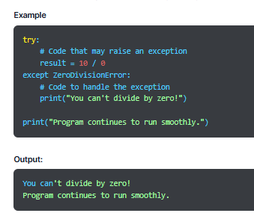
Syntax of Exception Handling in Python
The syntax of a try-except block in Python is:
try:
# code that may raise an exception
except:
# code to handle the exception

Slide 10
Catching Specific Exceptions in Python:
We can use the try and except statements to identify specific exceptions. We can have zero or more except blocks for a try statement. With multiple except blocks, we can handle each exception differently based on its type. The argument type of every except block shows the exception type that it can handle.
Syntax
try:
# statement(s)
except IndexError:
# statement(s)
except ValueError:
# statement(s)
In the given syntax,
try block is used to anticipate an exception that may occur.
except is executed when a specific type of error occurs. The except block may also include the type of exception to catch.
The try and except blocks must be written together to handle exceptions gracefully and efficiently. If we write either the try block or the except block, it will raise an error.

Slide 11
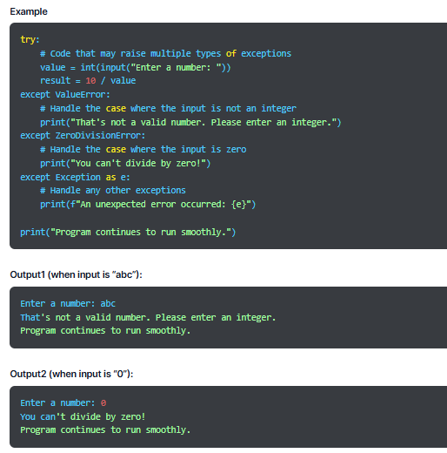

Slide 12
Try with Else Clause
If the code block within the try block runs without errors, we can run a certain code block in a few situations. We use the else clause in such cases with the try and except statements. The code in the else block is executed only when no exception occurs in the try block.
Syntax
try:
# Code that can raise an exception
except ExceptionType:
# Code to handle exception
else:
# Code to execute when no exception occurs

Slide 13
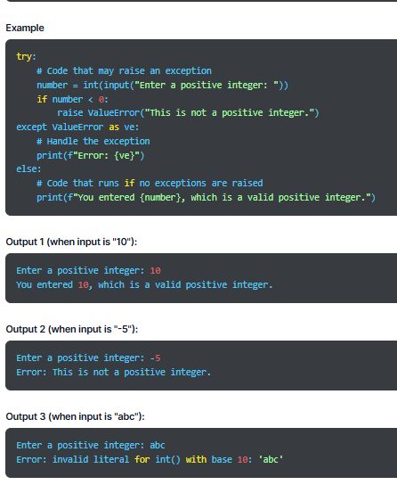

Slide 14
Finally Keyword in Python:
In Python, we use the finally keyword with try and except when we have code that is executed regardless of whether try raises an exception. The code within finally runs after try and except blocks. It is useful for tasks like resource cleanup.
Syntax
try:
# Code that may raise an exception
except:
# optional block
# Code to handle the exception (if required)
finally:
# Code that always executes, regardless of exceptions

Slide 15
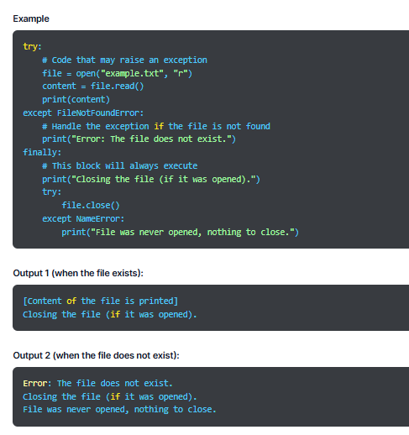

Slide 16
Raising an Exception
We use the raise statement when we forcefully want a specific exception to occur. It helps us raise an exception manually and explicitly signal an error condition. The sole argument in the raise statement shows the exception we want to raise, which can be an exception instance or exception class.
Syntax
raise ExceptionType("Optional error message")
In the given syntax,
raise is the keword to raise an exception.
ExceptionType mentions the type of exception to raise.
Optional error message provides additional information regarding the exception.

Slide 17
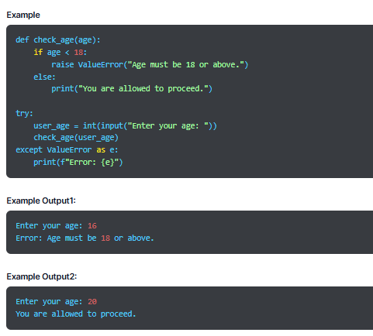

Slide 18
Assert Statement in Python
We use the assert statement for debugging and testing. It helps us check if the condition is true. If it’s not, it raises an exception.
Syntax
assert condition, "Optional error message"
In the given syntax,
The keyword assert performs an assertion check.
condition specifies the expression to be tested if it’s true or not.
Optional error message is displayed if the condition is false.

Slide 19
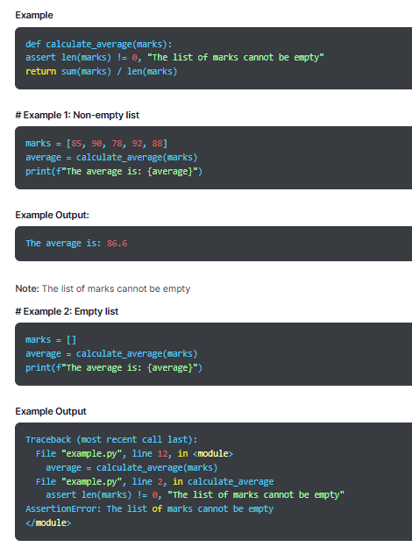

Slide 20
Advantages of Exception Handling:
Cleaner Code- Exception handling helps you avoid complex conditional statements when finding errors, making the code cleaner and more readable.
Code Reliability- Exception handling mitigates the chances of incorrect results or any other hampering caused due to unexpected errors.
Easier Debugging- The Python interpreter prints a traceback in case of an exception, indicating the exact location of the exception, which makes it easier to debug the code.
Simpler Error Handling- With exception handling, you can separate error-handling code from regular program logic, which enhances code maintainability and readability.

Slide 21
Disadvantages of Exception Handling:
Hidden Bugs- If you handle bugs improperly, it can hide a few bugs and make them more difficult to find.
Code Complexity- Exception handling can increase code complexity, especially in the case of handling different types of exceptions or applying complex error handling logic.
Security Risks- If you fail to handle exceptions efficiently, it can potentially reveal sensitive information and lead to security vulnerabilities in the code. Hence, it is crucial to handle exceptions meticulously.
Performance Overhead- Exception handling is slower than using conditional statements to detect errors because the interpreter has to find and handle exceptions, which adds to its work.

Slide 22
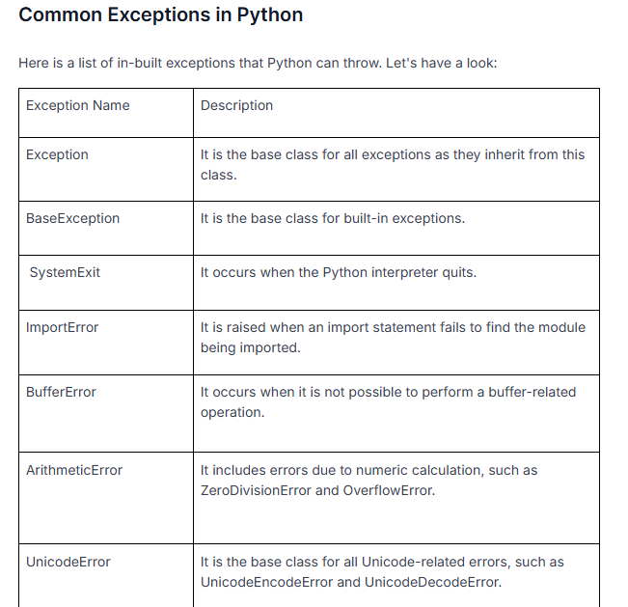

Slide 23
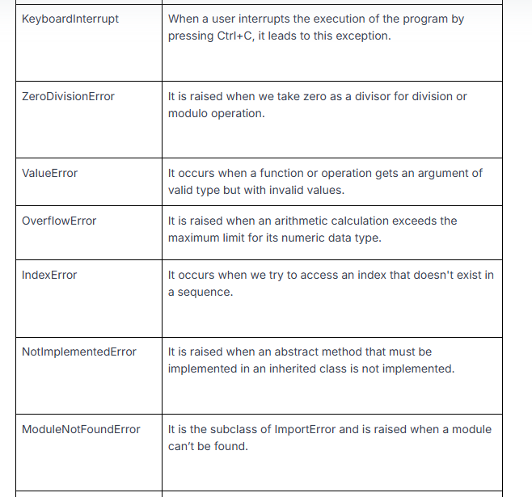

Slide 24
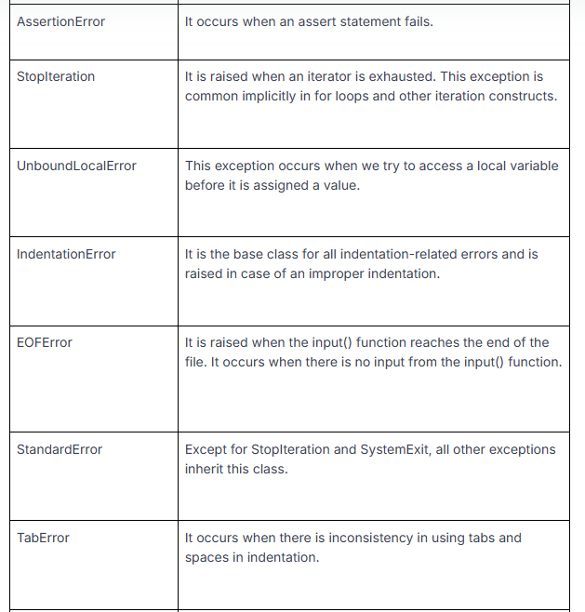

Slide 25
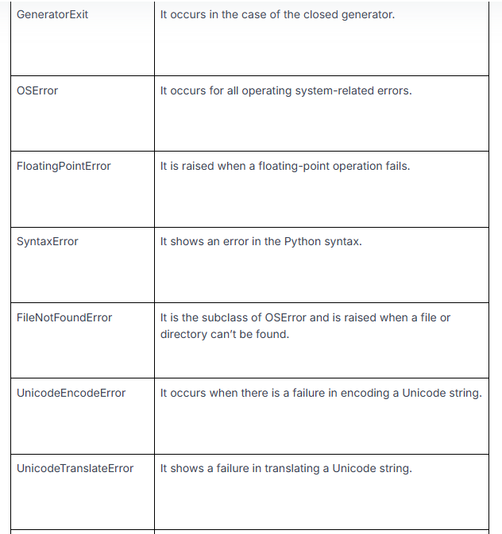

Slide 26
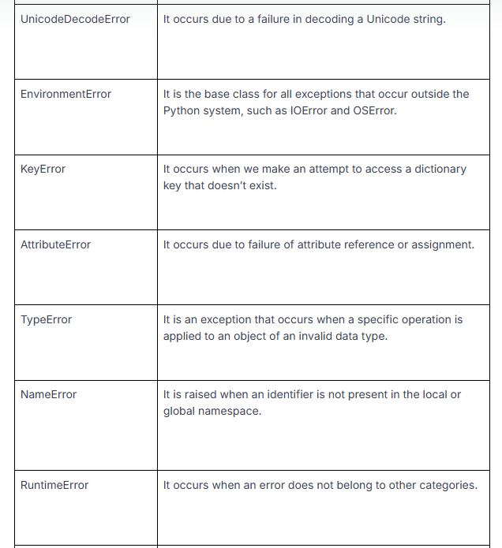

Slide 27
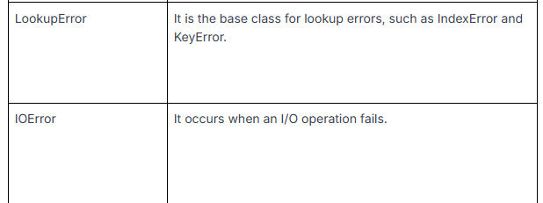

Slide 28
Try Except in Python

Slide 29
Introduction
What Is Try Except in Python?
How does try() work?
Else Clause in Python

Slide 30
Introduction:
There are two types of errors in Python: Syntax Errors and Exceptions. Errors can cause severe issues in a program and result in its immediate termination. On the other hand, exceptions are internal events that change the normal flow of the program. An exception is a warning that something unexpected has occurred. A certain type of object represents a Python exception.
Some common types of exceptions are ValueError (when the built-in function gets a wrong argument)
IOError (when a file fails to open), ImportError (when you can’t find the module) and
KeyboardInterrupt (when a user presses an unrequired key).
We use try and except in Python for exception handling. These statements allow us to address the issue and avoid any emergency effectively.

Slide 31
What Is Try Except in Python?
When any unexpected event occurs in Python, we can raise an exception, and Python will stop the execution of the program and look for an exception handler. Python try except is one such statement used to handle exceptions with the code. It gracefully handles exceptions so that it doesn’t lead to a serious error that can crash the program.
The try-except clause lets your program execute various actions in case of an error. The try block checks the code for errors and executes it if no error is found, whereas the except block executes when the program encounters an error in the preceding try block.
Below, we have explained how to construct a try-except statement:
try:
code block 1
except ExceptionName:
code block 2
Try-except in Python Syntax
try:
# Some Code
except:
# Executed if error in the
# try block

Slide 32
According to the given syntax, Python will try to run the try block. If there is no exception, it will complete the execution of the try statement, and the except block will not be executed. If there is an exception, Python will omit the remainder of the clause. If the mentioned exception type aligns with the exception defined after the exception keyword, the except statement will be executed.
If nothing stops the program, it will continue to run the remaining code after the try-except code blocks. If the exception doesn’t satisfy the defined exception name, it will be forwarded to the outer try in Python, and if there is no exception handler, it will terminate the program.
Here is the principle of try-except in Python:
Try- It contains the catch exception. If there is an exception, it immediately enters the except block.
Except- If an exception is in the try block, the code within the except block will run. It is necessary even if we use try just as a pass statement.
We can combine it with the finally and else keywords:
Else- If no exception is raised in the try block, the code within the else block is executed.
Finally- The code in the finally block is always executed no matter if there is an exception or not.

Slide 33
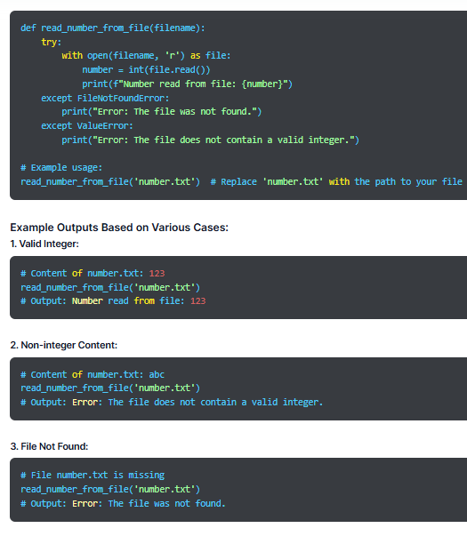

Slide 34
How does try() work?
It starts by executing the try clause, the code between the try block.
In case there is no exception, the try clause is executed, and the except clause is finished.
If there is an exception, the try clause is skipped, and the except clause is executed.
If the except clause within the code doesn’t handle the exception, it is passed on to the outer try statement.
If the exception is not handled, the execution will stop.
A try statement can include more than one except clause.
When there is no exception, the try clause will run.
When there is an exception, the except clause will run.

Slide 35
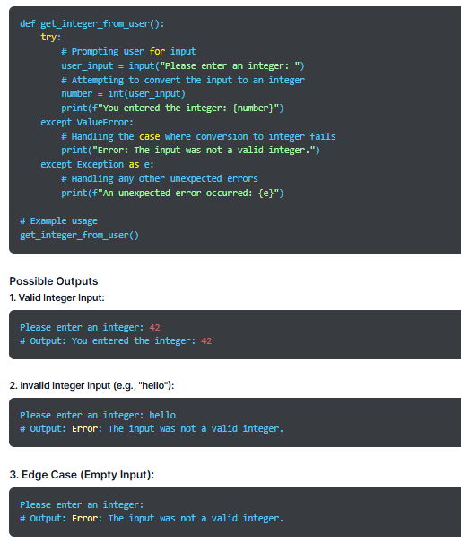

Slide 36
Else Clause in Python
In life, we often encounter situations where we have to make a choice, and based on that decision, we must decide on the next action. In programming, we face similar situations that require us to make choices and run code blocks based on those choices.
In Python, we use decision-making statements (also known as conditional statements) to control the direction of execution of a program. We use the else clause with the try-except block in Python, which is present after all except clauses. The code enters the else block only when the try clause doesn’t encounter an exception.
The else keyword decides the next action when the condition is false. Using the else statement, we can tell the program to run a particular code block if no exception is found in the try clause.
Syntax
try:
# Some Code
except:
# Executed if error in the
# try block
else:
# execute if no exception

