Slide 1
Python –OOPS Concept

Slide 2
Introduction
What Is Object-Oriented Programming in Python?
OOPs Concepts in Python
Applications of OOP Concepts
Advantages and Disadvantages of OOPs in Python

Slide 3
Introduction:
Object-oriented programming is a fundamental concept in Python.
This programming pattern is based on the concept of objects (consisting of data and methods) and allows programmers to build maintainable, scalable, and modular applications.
OOPs concept in Python is a popular programming style, enabling developers to map the virtual world entities (code) to real-world objects.
The core of OOP principles includes classes, objects, inheritance, polymorphism, encapsulation, and abstraction, which are used widely due to their ample benefits.
They enable programmers to leverage Python capabilities to provide efficient solutions to complex problems.

Slide 4
What Is Object-Oriented Programming in Python?
Object-oriented programming (OOP) in Python is a paradigm for designing programs using objects and classes. The primary concept of Python OOPs is to bind data and functions as a single unit so that no other section of the code can access data. Object-oriented programming aims to implement real-world entities, including inheritance, polymorphism, encapsulation, and abstraction.
OOPs are centered around objects and treat every entity as an object. We can create as many objects as we want using a class.
A class is a blueprint used for constructing objects, whereas an object is an instance of that class. Objects can be logical or real-life. Anything with properties and behaviors is known as an object. Moreover, the properties of objects are referred to as the object's variables, and behaviors are the object's functions.
For example, a human can have properties like name, height, gender, age, etc., and his behavior is he can walk, sleep, eat, talk, etc.
Developers can use OOPs as objects with methods to create real-world entities to manipulate data and attributes. This facilitates modularity, encapsulation, and code reuse, simplifying complex programs' management and maintenance. With OOP in Python, we can easily write flexible and scalable code and enhance its productivity and quality by using the concepts of inheritance, encapsulation, and polymorphism.
An example of a logical object is your files in the system as they have properties, such as name, size, and location and behaviors like they can be downloaded and shared and store data.

Slide 5
Key Points to Remember:
Each object in OOP signifies a different section of the code with its own logic and data that it uses to communicate. This avoids any complications in the code.
OOPs reduce code redundancy through inheritance, which ensures we write clear and reusable code.
OOPs can be easily visualized as we can associate them with real-life situations.

Slide 6
OOPs Concepts in Python:
Here are the main Python OOPs concepts that we will discuss in this tutorial:
Python Class
Python Objects
Inheritance
Polymorphism
Encapsulation
Data Abstraction

Slide 7
Python Class:
A class in Python is a collection of objects containing blueprints from which objects are created. It is a logical entity with specific attributes and methods. For example, if the class is a pen, it will have attributes and methods like color, type, etc.
OOPs in Python primarily deals with classes and objects. Classes define functions, known as methods, that describe the actions and behaviors an object can perform. They help us avoid complex codebases by creating a blueprint, which makes the code more manageable. They also define the properties of an object created from the class.
Suppose you need to track employees of your organization. They all have different attributes, such as name, age, gender, department, etc. In a list, the first attribute would be the name of an employee, second would be age, and so on. What if there are over 100 employees and you want to add more properties? That is where we use Python classes.
Please note that a class only defines the structure and doesn’t point to anything specific.
For example, an employee is a class with different properties. It does not refer to a particular employee but explains attributes that any employee must have.

Slide 8
Key points to remember:
We use the keyword class to create classes.
Attributes are variables belonging to a class.
They are public and accessible using the dot (.) operator.
In Python, classes are a fundamental part of Object-Oriented Programming (OOP). A class acts as a blueprint for creating objects (instances) that encapsulate both data (attributes) and behavior (methods). Here’s a detailed explanation of Python classes, including how to create them and work with them.
Defining a Class:
A class in Python is defined using the class keyword followed by the class name. The class can contain methods (functions) and attributes (variables). Methods are functions that belong to the class, and they define the behaviors of objects of that class.

Slide 9
Syntax:
class ClassName:
# Statement-1
.
.
.
# Statement-N
Creating an Empty Class in Python
Example
class Employee:
pass
Structured Syntax:
class ClassName:
# Constructor method (__init__) to initialize attributes
def __init__(self, attribute1, attribute2):
self.attribute1 = attribute1
self.attribute2 = attribute2
# Method inside the class
def some_method(self):
# Do something with the attributes
print(self.attribute1, self.attribute2)
Note: We use ‘pass’ as a placeholder rather than code, as we can skip its implementation for a while. With ‘pass’, we can run the Python code without an error.

Slide 10
Example of Python class:
class Dog:
# Constructor (__init__) method to initialize the object
def __init__(self, name, breed):
self.name = name # Attribute
self.breed = breed # Attribute
# Method inside the class
def bark(self):
print(f"{self.name} says Woof!")
# Creating an object (instance) of the Dog class
dog1 = Dog("Buddy", "Golden Retriever")
dog1.bark() # Output: Buddy says Woof!

Slide 11
Python Objects:
An object is an entity that contains a state and behavior. It is an instance of a class and collection of data and methods. An object is an implementation of a class and can be any real-world object, such as a pen, chair, table, mouse, keyboard, etc.
In Python, everything is an object and has methods and attributes. Arrays, strings, dictionaries, integers, floating-point numbers, etc., are all objects. A single string or integer is also an object. Whether it’s a list, string, or number, all are objects. In fact, we may be using objects often without even realizing it.
An object comprises:
Behavior- It is the method of an object that reflects its response to other objects.
State- It is the attribute of an object that reflects its properties.
Identity- It is the unique name assigned to an object, which allows it to communicate with other objects.

Slide 12
Let’s take the example of an employee class to better understand behavior, state, and identity.
The name of an employee is the identity.
His age, gender, department are attributes or state.
His behavior includes working, speaking, and walking.
Creating an Object in a Class:
Creating a new object from a class is known as instantiating an object. To instantiate an object, we use the class name followed by parentheses. Moreover, we can assign a class object to any variable.
Syntax:
x = ClassName()
When we instantiate an object, memory is allocated to it. This means if we compare the two instances of the same class, it will return false as both of them have different memories.

Slide 13
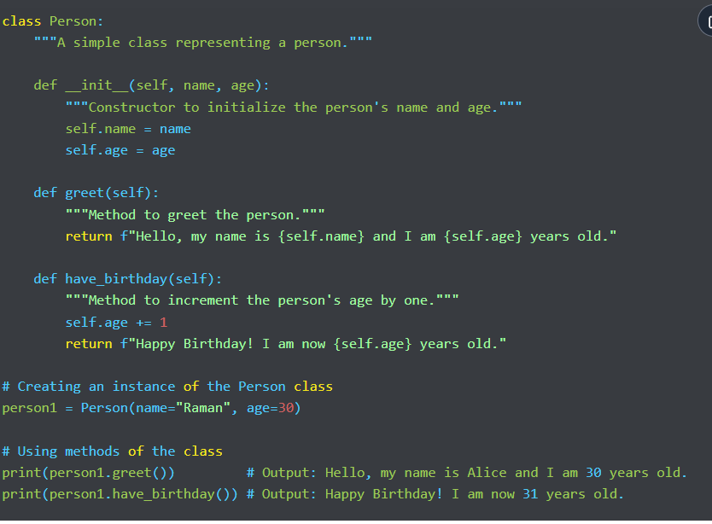
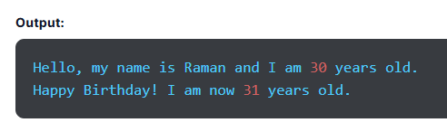
Example of class and Object:

Slide 14
The Python __init__ Method:
The __init__ method in Python is similar to constructors in Java and C++. It is a unique function that runs as soon as an object of a class is instantiated. It initializes the attributes of an object with values assigned upon creating an object.
So, whenever we create a new object, the __init__ sets the initial state of that object by assigning values provided within the properties of the object.
The __init__() method can take any number of parameters, but the first one is always a variable known as ‘self’, which corresponds to the instance being created. This means self points to the address of the current object of a class, which enables you to access the data of the object’s variables.
So, if there are a thousand instances of a class, we can get data of individual objects using self as it points to the address of a particular object and returns the respective value.
Other parameters that populate the attributes of an object are sent after self. To establish the initial state of an object, we use the __init__ method, which ensures it is initialized correctly and ready to use.

Slide 15
The two types of attributes in Python are as follows:
Class Attribute- These variables are the same for all instances of a class and don’t have new values for every new instance created. Class attributes are defined below the class definition.
Example
class Dog:
#class attribute
species = "Animal"
The species attribute has a fixed value for all objects we create.
Instance Attribute- They are the variables defined inside a function in a class. They have different values for each instance of a class, which are dependent on the value passed while creating an object.

Slide 16
Example
class Dog:
#class attribute
species = "Animal"
def __init__(self, breed, name, age):
self.breed = breed
self.name = name
self.age = age
d = Dog("Lebra", "Tuffy", 5)
print(d.name)
print(d.breed)
print(d.age)
Output:
Tuffy
Lebra
5
The variables breed, name, and age are instance attributes, which means they can have different values for every new instance of a class.
So, properties with the same value for every instance of a class use class attributes and properties with different values per instance use instance attributes.

Slide 17
Python Inheritance:
Children often hear that they have features or traits similar to their parents. Even you might have heard somebody pointing out that you have inherited certain habits or facial features from your parents. This is known as inheritance.
The fundamental concept of inheritance in object-oriented programming in Python is based on the same real-life idea of inheritance, which enables a class to inherit or acquire properties of another class. Here, the child class inherits the features or functions of the parent class and the inherited attributes are known as methods or properties.
In other words, inheritance is the capability of one class to acquire or derive the properties of another class. A new class is created by inheriting features from an existing class. The class that acquires properties is called the derived or child class, whereas the class from which the properties are derived is known as the base or parent class.
Inheritance allows code reusability and allows us to develop a hierarchical structure among classes.

Slide 18
The benefits of Python inheritance are as follows:
It allows code reusability, so you don’t have to write the same code repeatedly.
Inheritance is transitive, which means if x class acquires features of class y, then all the subclasses of class x will automatically inherit from class y.
It is based on the real-world concept of inheritance and it enables you to add more features to the class without changing it.
Syntax of Inheritance in Python:
class parent_class:
#body of parent class
pass
class child_class( parent_class):
# inherits the parent class
#body of child class
We define a normal class, then define the child class, and specify the name of the parent class in parentheses.

Slide 19
Types of Inheritance in Python:
Single Inheritance- The derived or child class inherits characteristics from a single base or parent class.
Multiple Inheritance- Multiple Inheritance allows the derived class to inherit features from more than one base class.
Multilevel Inheritance- In multilevel inheritance, the derived class inherits properties from the immediate base class, which inherits characteristics from another parent class. In other words, the derived class inherits from another derived class.
Hierarchical Inheritance- The hierarchical class allows multiple derived classes to inherit properties from a single base class.
Hybrid Inheritance- It combines two or more types of inheritance, usually involving a mix of multilevel, multiple, and hierarchical inheritance.

Slide 20
Super():
In Python, the super() function is an inheritance-related function referring to the base or parent class. We use this function to find the method with a specific name in the superclass of an object.
Syntax
In the syntax of the super() function, we write the super() keyword, which is followed by the method name to refer to the parent class.
super().methodName()

Slide 21
# Derived class (or Child class) inheriting from Animal
class Cat(Animal):
def __init__(self, name, color):
# Call the constructor of the parent class
super().__init__(name)
self.color = color
def speak(self):
return f"{self.name} says Meow!"
# Creating instances of the derived classes
dog = Dog("Buddy", "Golden Retriever")
cat = Cat("Whiskers", "Tabby")
# Accessing the speak method from each instance
print(dog.speak()) # Output: Buddy says Woof!
print(cat.speak()) # Output: Whiskers says Meow!
Example
# Base class (or Parent class)
class Animal:
def __init__(self, name):
self.name = name
def speak(self):
return f"{self.name} makes a sound."
# Derived class (or Child class) inheriting from Animal
class Dog(Animal):
def __init__(self, name, breed):
# Call the constructor of the parent class
super().__init__(name)
self.breed = breed
def speak(self):
return f"{self.name} says Woof!"
Output:
Buddy says Woof!
Whiskers says Meow!

Slide 22
Explanation:
Base Class (Animal): The parent class, which defines a common method speak that can be shared by all animals.
Derived Classes (Dog and Cat): These classes inherit from the Animal class. They override the speak method to provide specific behavior for dogs and cats.
super() Function: Used in the derived classes to call the constructor of the parent class, ensuring that the name attribute is initialized correctly.

Slide 23
Python Polymorphism:
Polymorphism is the combination of two words: ‘poly’, which means multiple or many, and ‘morph’, which means forms. So, polymorphism in Python means something that has multiple forms or can be performed in different ways. It is one of the most crucial Python OOPs concepts, referring to functions with the same name but different functionalities.
We can implement polymorphism in Python through method overloading and method overriding. This allows different classes to offer methods with the same name but with distinct behavior based on the class.
For example, if we want to know whether a specific species of animal can run, we can do so through polymorphism using one single function.
A derived or child class acquires properties from the base or parent class. However, it may want to add its own properties and implementation to the method. We can use polymorphism in Python in different ways:
Example of Inbuilt Polymorphic Functions
One example of an in-built polymorphic function is len(), which we use to calculate the length of different data types, including tuple, list, string, and dictionary. It computes the result and returns the output.

Slide 24
Example
print(len("Hello")) # Output: 5 (length of a string)
print(len([1, 2, 3, 4])) # Output: 4 (length of a list)
print(len((1, 2, 3))) # Output: 3 (length of a tuple)
Output:
5
4
3
Explanation:
len() Function:
Works with various data types like strings, lists, and tuples to return their length.
Demonstrates polymorphism as the function behaves differently based on the type of the object.

Slide 25
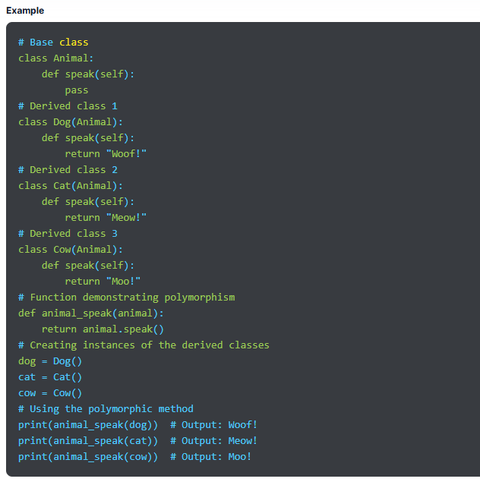
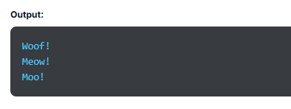

Slide 26
Explanation:
Base Class (Animal):
Defines a method speak that does nothing (pass). This is a placeholder method meant to be overridden by derived classes.
Derived Classes (Dog, Cat, Cow):
Each class inherits from Animal and provides its own implementation of the speak method.
The speak method returns a sound typical to the animal.
Polymorphic Behavior:
The function animal_speak takes an object of type Animal (or any class derived from it) and calls the speak method on it.
Despite the object type, the function works correctly and calls the appropriate method based on the object's class.

Slide 27
Polymorphism with Inheritance;
In Python, we can perform polymorphism with inheritance. We can change a method in the derived class inherited from the base class and add its own implementation to the method.
This process of re-implementing a method in the derived class is called Method Overriding in Python.

Slide 28
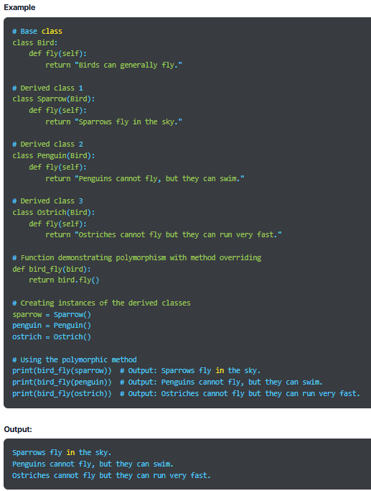

Slide 29
Explanation:
Base Class (Bird):
Contains a method fly that provides a general statement about birds.
Derived Classes (Sparrow, Penguin, Ostrich):
Each derived class inherits from the Bird class and overrides the fly method.
The fly method in each derived class provides a specific behavior or characteristic related to that bird.
Method Overriding:
The derived classes (Sparrow, Penguin, Ostrich) override the fly method inherited from the Bird class.
Even though the method name is the same, the implementation differs depending on the specific bird.
Polymorphic Behavior:
The function bird_fly can take any object of a class derived from Bird and call its fly method.
The appropriate method is executed based on the actual object passed to the function.

Slide 30
Python Encapsulation:
We have all seen medicine capsules, in which medicines are enclosed or wrapped inside a cover to prevent accidental access. It is basically a capsule encapsulating medicine or different combinations of medicines.
Similarly, in Python, encapsulation refers to wrapping data, methods, and variables inside a single unit. It is a core idea of object-oriented programming, which means grouping methods and data into a unit called a class. We have already learned that functions and variables created in OOPs are inside a class.
The process of binding data and methods into one unit prevents any unauthorized or accidental access to parts of components of an object, guarding data from any unintentional interference or misuse. The variable can be changed only by the method of the object, and such variables are called private variables.
Encapsulation presents class members binded together from being accessed by other classes. Controlled access through public methods encourages modularity and helps maintain data integrity of an object. Python encapsulation ensures security by hiding data from unauthorized access. Organizations encapsulate their data to protect their sensitive information from unwanted access by outsiders. One example of encapsulation is a class that wraps data, including functions, variables, etc.

Slide 31
Getters and Setters:
Encapsulation is used for Data Hiding, which is done by defining getter and setter methods for the class. To get data, one has to call the getter method. Moreover, to set a value to the data, one needs to use the setter method. We only know when to use getter and setter methods. However, how they both work is a mystery to people.
Access Modifiers:
When we use access modifiers, it limits access to methods and variables of a class.
The three types of access modifiers are private, public, and protected. Python doesn’t have direct access modifiers, but we can use a single underscore and double underscore instead.
Public- As clear by the name, it is accessible from anywhere outside a class.
Private- It is a private modifier that is accessible only within a class.
Protected- It is accessible within a class and its subclass.
A single underscore signifies a protected class, whereas a double underscore is for a private class.

Slide 32
class Person:
def __init__(self, name, age, salary):
self.name = name # Public attribute
self._age = age # Protected attribute (indicated by a single underscore)
self.__salary = salary # Private attribute (indicated by double underscores)
# Public method to access the private attribute
def get_salary(self):
return self.__salary
# Public method to modify the private attribute
def set_salary(self, new_salary):
if new_salary > 0:
self.__salary = new_salary
else:
print("Salary must be positive!")
# Protected method (indicated by a single underscore)
def _display_age(self):
return f"Age: {self._age}"
# Private method (indicated by double underscores)
def __display_salary(self):
return f"Salary: {self.__salary}"
# Public method to demonstrate access to protected and private methods
def display(self):
age_info = self._display_age()
salary_info = self.__display_salary()
return f"Name: {self.name}, {age_info}, {salary_info}"

Slide 33
# Creating an instance of the Person class
person = Person("Mahesh", 30, 75000)
# Accessing the public attribute
print(person.name) # Output: Mahesh
# Accessing the protected attribute (not recommended, but possible)
print(person._age) # Output: 30
# Trying to access the private attribute directly (will raise an AttributeError)
# print(person.__salary) # Uncommenting this line will cause an error
# Accessing the private attribute through a public method
print(person.get_salary()) # Output: 75000
# Modifying the private attribute using a public method
person.set_salary(80000)
print(person.get_salary()) # Output: 80000
# Accessing the protected method (not recommended, but possible)
print(person._display_age()) # Output: Age: 30
# Trying to access the private method directly (will raise an AttributeError)
# print(person.__display_salary()) # Uncommenting this line will cause an error
# Using a public method to access protected and private methods
print(person.display()) # Output: Name: Mahesh, Age: 30, Salary: 80000
Output:
Mahesh
30
75000
80000
Age: 30
Name: Mahesh, Age: 30, Salary: 80000

Slide 34
Explanation:
Public Members:
Public Attribute: name can be accessed directly from outside the class.
Public Methods: get_salary(), set_salary(), and display() can be accessed from outside the class. These methods interact with private and protected members.
Protected Members:
Protected Attribute: _age is intended to be used within the class and its subclasses. It can be accessed directly, but it’s a convention that it should not be accessed outside the class.
Protected Method: _display_age() is also intended for use within the class and subclasses. It can be accessed directly from outside the class, but doing so breaks the encapsulation principle.
Private Members:
Private Attribute: __salary cannot be accessed directly from outside the class. It can only be accessed through public methods like get_salary() and set_salary().
Private Method: __display_salary() cannot be accessed directly from outside the class. It can only be accessed from within the class, like in the display() method.

Slide 35
Data Abstraction:
Another important OOPs concept in Python is data abstraction. Let’s take a simple example to understand this concept. Suppose you are reading a Python PPT on your computer and making notes. You will also highlight a few points and save important files in your system. Now, as you read, highlight, and save data, you only press some keys and see the screen. You are not concerned about the internal working of the keyboard or buttons on the screen. You can see and know everything important to you, and the rest of the unnecessary information is hidden.
That is how abstraction works in Python. It hides unnecessary and intricate details from users and reveals what’s essential and pertinent to them. It shows everything at an abstract level, including crucial functionalities and what matters, while concealing implementation and inner details.
When we don’t want to give out sensitive details of the code implementation, we use data abstraction. It reduces complexity and enhances efficiency through an uncomplicated and straightforward interface. We can achieve it in Python by creating abstract classes.
Using abstraction, Python programmers can work with simple system representations and manage complex operations. The primary goal of data abstraction is to hide unnecessary information and show only required data to users, so they can handle code complexity better.

Slide 36
Key Points About Abstract Classes:
We can achieve data abstraction in Python through abstract classes.
An abstract class is like a blueprint for another class, which can be used to design large functions. The subclass that inherits them refers to the abstract methods for feature implementation.
We use abstraction to conceal background details or unnecessary implementation data so users can see what matters.
Abstract methods don’t have their own implementation.
In Python, we have the abc module to use data abstraction.
A class containing one or more abstract methods is known as an abstract class.
A subclass can inherit properties from an abstract class. It provides the implementations for the abstract methods.

Slide 37
Syntax of Python Abstract Class
We use the ABC class from the abc module for abstraction in Python.
Syntax:
from abc import ABC
class ClassName(ABC):
Here, ABC is used for Abstract Base Class. The abc module offers the base for defining ABC class.

Slide 38
Example:
from abc import ABC, abstractmethod
# Abstract Base Class
class Shape(ABC):
@abstractmethod
def area(self):
pass
@abstractmethod
def perimeter(self):
pass
# Derived Class 1
class Rectangle(Shape):
def __init__(self, width, height):
self.width = width
self.height = height
def area(self):
return self.width * self.height
def perimeter(self):
return 2 * (self.width + self.height)
# Derived Class 2
class Circle(Shape):
def __init__(self, radius):
self.radius = radius
def area(self):
return 3.14159 * self.radius * self.radius
def perimeter(self):
return 2 * 3.14159 * self.radius
# Creating instances of the derived classes
rectangle = Rectangle(4, 5)
circle = Circle(3)
# Using the abstract methods implemented in derived classes
print(f"Rectangle Area: {rectangle.area()}") # Output: 20
print(f"Rectangle Perimeter: {rectangle.perimeter()}")# Output: 18
print(f"Circle Area: {circle.area()}") # Output: 28.27431
print(f"Circle Perimeter: {circle.perimeter()}") # Output: 18.84954
Output:
Rectangle Area: 20
Rectangle Perimeter: 18
Circle Area: 28.274309999999996
Circle Perimeter: 18.849539999999998

Slide 39
Explanation:
Abstract Base Class (Shape):
The Shape class is an abstract base class that defines abstract methods area() and perimeter().
These methods are declared using the @abstractmethod decorator, which means that any class inheriting from Shape must implement these methods.
Derived Classes (Rectangle, Circle):
The Rectangle and Circle classes inherit from the Shape class and provide concrete implementations for the area() and perimeter() methods.
These classes encapsulate the specific logic for calculating the area and perimeter of a rectangle and a circle, respectively.

Slide 40
Abstraction:
The Shape class provides a blueprint for all shapes, but it does not provide specific details. This abstraction allows the user to work with shapes without needing to understand the underlying implementation details.
The specific details of how the area and perimeter are calculated are hidden in the derived classes, making the code more modular and easier to manage.
Instantiation:
You cannot create an instance of the abstract class Shape directly, as it contains abstract methods. You must create an instance of a derived class like Rectangle or Circle, which provides the specific implementation of the abstract methods.

Slide 41
Applications of OOP Concepts:
Python object-oriented programming offers a wide range of real-life applications, which we have discussed below:
AI Systems
We use OOP features to create AI expert systems that offer solutions for an array of complicated programming problems and technical issues that can be tricky for humans to process and address. These systems are known for their dependability, performance, and responsiveness.
OOP Database
Using an OOP database, we can build a close correlation between the physical components of objects and different databases, which helps retain identity and integrity of an object.
Office Automation Systems
We can use object-oriented programming for office automation systems to create reusable and efficient programming elements. It is useful in developing documentation tasks through work collaboration and management. OOPs also improve automation tasks.
Modeling Systems
Modeling systems demand an in-depth understanding of interactions and precise modeling. As variable specifications are difficult rather than universal, they can be tricky. Hence, we use OOPs to simplify their complex structures through useful approaches.

Slide 42
Client-server Systems:
Client-server systems have a centralized server for communicating and accessing requests to different resources. They process requests and generate appropriate responses. OOPs improve code maintainability, reusability, and modularity to build software components. These systems use OOPs to enable clients to communicate smoothly with each other using a common interface.
CAD Software:
Using OOPs, computer-aided designs, or CAD, software builds classes containing diverse design elements, such as points, solids, surfaces, lines, and more. The designs use several attributes and methods to build relationships between different design components.
Hypertext and Hypermedia:
Hypertext allows people to connect from one text to another. This form of text offers cross-referencing that works in non-linear and multi-sequential ways. Moreover, hypermedia is a broader concept than hypertext. We can develop hypertext and hypermedia using OOPs.

Slide 43
Advantages of Python OOPs
Here are the top benefits of using object-oriented programming in Python:
OOPs store data safely in objects, so you don’t need to write the same code again and again. This eliminates data redundancy, so there is less reiteration of mundane tasks. You can go to the required section of the program without hassle and use it conveniently.
It ensures higher security of data through the use of access modifiers. Therefore, you can decide who can access data by choosing between public, private, and protected access modifiers based on your security requirements.
It makes problem-solving effective as we can write a class for each sub-problem and decide what it does. We can reuse those classes, making solving the next problem quicker and easier.
The code in Python OOPs is reusable and stored in a specific location known to the user. Hence, we can troubleshoot problems in a sorted and seamless way. We can find problematic sections of the code and take corrective actions.
It ensures data privacy and security through encapsulation.

Slide 44
Another benefit of OOP is increased productivity. It contains massive libraries for new programs that are accessible at a larger scale, which speeds up development.
Due to code modularity, debugging is easy. You no longer have to look through hundreds of lines of code to identify one issue.
OOPs break down a big problem into smaller, manageable chunks, which is a recommended and good programming practice. It helps us find the exact point of the problem conveniently. We can also use these small issues to achieve meaningful conclusions.
The concept of inheritance allows code reusability as the child class inherits properties of the parent class. We don’t need to write the same code repeatedly, which makes the work less redundant.
We can have multiple forms of one class through polymorphism which enhances flexibility. This feature is based on extensibility and simplicity and we can use the same code differently in varied situations.
Abstraction reduces code complexity.

Slide 45
Disadvantages of Python OOPs:
OOPs concept in Python provides ample benefits, but it comes with its drawbacks, which we have discussed below:
It is a more complex concept than procedural programming and requires a bit more time for you to understand. Also, it is not an organic concept for many programmers.
Executing code and generating results are slow processes and demand ample time.
According to Python OOPs, everything is an object. So, to work with OOPs, you must get familiar with objects and build brilliant knowledge of the topic. Also, seeing every data as an object may not be easy every time.
The programs we develop using OOPs in Python can be lengthier than the ones created using procedural programming, which can make code huge.
Object-oriented programming is not a universal concept, so we can’t use it everywhere, especially to solve all technical issues. It is useful only in certain programming languages, such as C++, Python, and Java.
OOPs is a tricky concept, and you must possess exceptional skills to tap into the maximum potential of object-oriented programming. You will need a comprehensive plan to use OOP and write codes, which is not the case with procedural programming

Slide 46
Python Classes and Objects

Slide 47
Introduction
What Is a Class in Python?
How to Create a Class in Python?
Python Class Attributes and Methods
What Is an Object in Python?
Declaring Class Objects in Python
Self Parameter
Pass Statement in Python
The __init__ Method
The __str__() Function
Class and Instance Variables
Access Class Attributes Using Objects
Python Class Properties

Slide 48
Introduction:
We already know that Python is an object-oriented programming language, so everything is considered an object and has its properties and methods. A class is a blueprint used to create an object and provides a way to bundle data and functionality.
What Is a Class in Python?
Python programming revolves around two primary aspects- objects and classes. A class is the user-defined blueprint required to create objects. Classes in Python programming are prototypes containing data and methods. They are the means of bundling data and functionality and provide operations and characteristics of objects.
When we create a new class, it creates a new type of object, allowing a new instance of that particular type to be created. For example, a blueprint of a car model is a class. It contains all the details about features, color, engine, design, etc. Based on these details, cars are built. We can create as many objects as we want of the class car.
Objects are instances of a specific class, and each element in Python is an object of some corresponding class, such as a dictionary, string, or number. Objects in Python represent data essential for an app and methods to manipulate data. Encapsulation is the center of the classes, ensuring data is aggregated and protected through a systematic approach to data interaction and portrayal.

Slide 49
A class includes two primary components. First is the attribute attached to a class to maintain its state and store data. For example, car is the Python class with attributes like color and brand. Second is the method used to modify the state of a class. It is the function associated with the class outlining feasible operations on the data. For example, a car can have methods like park, drive, etc.
Creating a class in Python is a simple and efficient process that involves using the keyword class to establish and instantiate a class. Once a class is delineated, it can be instantiated again and again to generate varied objects.
Python is an object-oriented programming language that supports class inheritance. Hence, one class (known as a child class) can acquire or inherit attributes from another class (known as a parent class). Combined with polymorphism, this ensures that a class adjusts and employs methods acquired from the parent class, which promotes code reusability.

Slide 50
Key points about a class in Python program:
A class is defined using the class keyword.
Attributes are variables belonging to a specific class.
Attributes can be public and can be accessed using the dot (.) operator.
How to Create a Class in Python?
Similar to creating a function, creating a class in Python is easy. We start by using the keyword class to indicate class creation. This is followed by the class name and colon (:).
The next indented lines will include memes of the class. The variables within a class are called attributes, which can be accessed later in a Python program using the dot (.) operator.
Syntax for Creating a Python Class
class ClassName:
# Statement 1
# Statement 2
.
.
# Statement n
Note- We use the keyword pass to denote an empty class. It helps us avoid errors while running code.

Slide 51
Python Class Attributes and Methods:
For the best results, we must add some functionality to Python classes with the help of attributes and methods. We set attributes containing functions and data to add functionality to the code. The functions defined within a class are called methods. The additional functionalities are as follows:
Python Class Attributes
Class attributes are variables defined inside a specific class and used by all objects. We can call attributes using the class name, attribute name, and the dot (.) operator. Here’s an example for better understanding:
Example
class Car:
Color = 'Black'
In the example above, we have a class named Car and an attribute is Color with the fixed value Black. The value of an attribute is the same for all objects until changed explicitly in the code.

Slide 52
Example
# Define a class
class Dog:
def __init__(self, name, breed):
self.name = name # Attribute
self.breed = breed # Attribute
def bark(self): # Method
return "Woof!"
# Create an object (instance) of the Dog class
my_dog = Dog("Buddy", "Golden Retriever")
# Access attributes and call a method
print(my_dog.name) # Output: Buddy
print(my_dog.breed) # Output: Golden Retriever
print(my_dog.bark()) # Output: Woof!
Output:
Buddy
Golden Retriever
Woof!

Slide 53
Python Class Methods:
We can also define functions within a specific class that can access the attributes and add more functionality to the code. The functions defined within a class are called methods, and we can define as many methods as we need within a single class.
Syntax:
class ClassName:
def method_name():
#statments
pass
To define a function within a class, we use the def keyword, which is followed by the name of the method. After this, we pass arguments through the method. While defining a method, we must pass at least one parameter named self, referring to the current instance of the class. You can name the parameter anything other than self.
Example
class Dog:
def bark(self): # Method
return "Woof!"
my_dog = Dog()
print(my_dog.bark())
Output:
Woof!

Slide 54
What Is an Object in Python?
An object in Python is an instance of a class that encapsulates data and behavior, i.e., attributes and methods, respectively. If a class is a blueprint, then an instance (object) is the copy of a particular class with actual values. Here are a few points to remember:
Python objects are concrete instances of a class created based on the blueprint or prototype of a class.
Objects have attributes and methods. Attributes are variables used to store data of a specific instance of a class. Methods are functions defined inside a class and operate on the attributes of an object.
Every object created from a class has a unique set of attribute values.
An object in Python contains:
Behavior- It is the method of an object that reflects the response of one object to other objects.
State- It is the attribute of an object, reflecting the properties of a particular object.
Identity- It is a unique name given to an object, allowing it to interact with other objects.

Slide 55
Declaring Class Objects in Python:
Declaring an object, also known as instantiating a class, is based on the blueprint defined by a class. As we instantiate a class, we also create a concrete representation of that class combined with its attributes and methods. All instances share the same behavior and attributes of that class, but the value of the attributes is unique for each object. One class can have any number of instances. Creating an object in Python using classes means:
Defining a Class- We start by defining a class in the code, which is the blueprint specifying the attributes, structure, and methods that objects created from the class will possess.
Instantiating a Class- Creating or declaring an object is also called instantiating a class by calling the class name. We pass the required arguments to the constructor, mainly the __init__ methods.
Creating an Object- When we create an object of a class, we also specify the attribute values. An object is an instance of a particular class with access to its methods and attributes.
Syntax to Create an Object of a Class:
objectName = ClassName()

Slide 56
Self Parameter
The self-parameter in Python is a special parameter used to define methods within a class. It refers to the current instance of a class and accesses class variables. Self parameter is passed automatically as the first argument when methods are called. Although we can name this parameter anything, by convention, it is named self as it enhances the readability and consistency of the code.
Key points about the self parameter
Self Denotes Instance- We use self within instance methods to refer to the instance of the class on which the method is called. You can access and manipulate the attributes and methods of the object within the method.
Automatic Passing- As we call an instance method on an object, we don’t pass the self argument explicitly because Python does it for us.
Naming Convention- We can name the parameter anything we want, but conventionally, we use self as it makes the code more readable and maintainable. Self indicates that the parameter refers to the instance itself.

Slide 57
Pass Statement in Python
In Python, we use the pass statement as a placeholder or no-operation statement, as it doesn’t affect the execution of a program. It is required for the syntactically same code but with no specific instructions for execution. The pass statement allows the program to skip a specific section of the code by working as a valid code block but doesn’t have any actual functionality.
We use it as a temporary placeholder while writing the code. We use it when Python's syntactic restrictions need a valid statement but don’t want to execute useful code. It is a way to meet the requirements of the Python syntax without functional code. We use pass as a placeholder when we want to build the code structure but plan to add functionality later. The common use cases for the pass statement are as follows:

Slide 58
Class Definitions- To define a class that we want to implement later, we use the pass statement inside the class body.
class MyClass:
def method1(self):
pass
def method2(self):
pass
Empty Code Block- We might have a conditional statement that doesn’t need any action in one branch. In such situations, we use pass to show that no action is required.
if condition:
# No action needed for this branch
Pass
else:
Function or Method Definitions- Suppose you define a function without implementing its functionality. In such a case, you can use the pass statement as a placeholder.
def my_function():
pass

Slide 59
Minimal Code Structure-
While creating the code structure, if you want to make sure that it’s syntactically correct, you can use pass until filling in the actual code.
The __init__ Method
We use the __init__ method to initialize the state of an object or to create an instance of a class. We can declare an extra argument in this method to initialize the value of each attribute corresponding to the object. It is similar to the constructors in other programming languages, such as Java and C++. It also includes a collection of statements executed during object creation.
The __init__ method requires only self argument, which refers to the newly generated class instance. It runs as soon as an object is instantiated and is used to initialize what we want to do with it. __init__ begins with a double underscore.

Slide 60
Example
# Define a class
class Car:
def __init__(self, brand, model): # The __init__ method
self.brand = brand # Attribute
self.model = model # Attribute
# Create an object (instance) of the Car class
my_car = Car("Toyota", "Corolla")
# Access attributes
print(my_car.brand) # Output: Toyota
print(my_car.model) # Output: Corolla
Output:
Toyota
Corolla

Slide 61
The __str__() Function
In Python, there is a unique method known as __str__(), which is used to define how a class object must be represented as a string. We use it with the str() and print() functions to make an object human-readable, which helps in debugging, logging, and showing user object information.
It enhances readability and informational value. When we use a class object to create a string with the built-in print() and str() functions, __str__ is used automatically.
Example
class Book:
def __init__(self, title, author, year):
self.title = title
self.author = author
self.year = year
def __str__(self):
return f"'{self.title}' by {self.author} ({self.year})"
# Create an object of the Book class
my_book = Book("1984", "George Orwell", 1949)
# Use print to see the string representation of the object
print(my_book) # Output: '1984' by George Orwell (1949)
# Directly calling str() on the object
print(str(my_book)) # Output: '1984' by George Orwell (1949)
Output:
'1984' by George Orwell (1949)
'1984' by George Orwell (1949)

Slide 62
Explanation:
__init__ Function:
Initializes the Book object with a title, author, and year.
__str__ Function:
Defines what should be returned when the object is converted to a string.
In this case, it returns a nicely formatted string containing the title, author, and year of the book.
Printing the Object:
When you print my_book, Python automatically calls the __str__ method to get the string to display.

Slide 63
Class and Instance Variables
We use class variables for attributes and methods shared by instances of a class. On the other hand, we use instance variables for data, and they are unique to every instance. The value of class variables is assigned in the class and the value of instance variables is assigned within a method.
Defining instance variables using a constructor
Example
class Person:
def __init__(self, name, age):
self.name = name # Instance variable
self.age = age # Instance variable
# Create an object of the Person class
person1 = Person("Alice", 30)
# Access instance variables
print(person1.name) # Output: Alice
print(person1.age) # Output: 30
Output:
Alice
30
Explanation:
Constructor (__init__ Method):
self.name and self.age are instance variables that are initialized when a Person object is created.
Values for name and age are passed during object creation and assigned to the instance variables.

Slide 64
Defining instance variables using the general method
Example
class Person:
def set_details(self, name, age):
self.name = name # Instance variable
self.age = age # Instance variable
# Create an object of the Person class
person2 = Person()
# Set instance variables using a general method
person2.set_details("Bob", 25)
# Access instance variables
print(person2.name) # Output: Bob
print(person2.age) # Output: 25
Output:
Bob
25
Explanation:
General Method (set_details):
self.name and self.age are instance variables that are set by calling the set_details method.
This method can be called after the object is created to assign or update the instance variables.

Slide 65
Access Class Attributes Using Objects
Python allows objects to access class attributes, known as instance variables. We can read and change these class attributes using the dot (.) operator and work with data contained by the object.
We can access class attributes by using the name of the object followed by (.) and the name of the attribute.
Syntax
object_name.attribute_name
Create Multiple Objects of Python Class
To manage multiple instances of a single class, we create multiple objects of that particular class. We use it to maintain different states for instance or model different real-life things. Each item operates independently and has unique properties.
To create numerous objects, call the class multiple times with various arguments. This allocates a different variable to every instance.
object1 = ClassName(attribute1_value, attribute2_value)
object2 = ClassName(attribute1_value, attribute2_value)

Slide 66
Python Class Properties:
In Python, we use the property() function within a class to define additional functionalities. It takes the set, get, and delete methods as arguments and returns an object.

Slide 67
Python - Inheritence

Slide 68
Introduction
What Is Inheritance in Python?
Tyрes of Inheritаnсe
Special Functions in Python Inheritance
Benefits of Inheritance

Slide 69
Introduction:
Python is a high-level and easy-to-learn programming language. It supports procedural and object-oriented approaches along with multiple types of programming, including functional coding and industry-level coding. Inheritance is one of the key pillars of object-oriented programming that supports code reusability. Also, it is quite useful while working with a wide variety of applications in Python.
What Is Inheritance in Python?
One of the key concepts of object-oriented programming is inheritance, which allows new classes to inherit features or attributes from the existing classes. This mechanism creates a hierarchy of classes that share similar properties, methods, and features as new classes are derived from the old classes. In simpler terms, we can say that inheritance is the capability of a class to derive properties of another class. The new class is known as the child class, and the existing class is called the parent class.
The inherited features and properties are defined data structures and functions we can perform with methods. Inheritance promotes code reusability, which is one of the best industrial coding practices that makes the codebase modular. The new class, or derived class, copies all the functions of the older class, or base class, without rewriting the syntax in the new class.

Slide 70
Syntax:
class DerivedClass(BaseClass):
# Class definition
Class BaseClass:
{Body}
Class DerivedClass(BaseClass):
{Body}
Here, DerivedClass is the class that inherits properties from the BaseClass. The BaseClass serves as the parent or superclass.
Example
# Base class
class Animal:
def speak(self):
return "Animal makes a sound"
# Derived class
class Dog(Animal):
def speak(self):
return "Woof!"
# Create an instance of the derived class
my_dog = Dog()
# Call the method from the derived class
print(my_dog.speak()) # Output: Woof!
Output:
Woof!

Slide 71
Tyрes of Inheritаnсe:
Python offers various types of inheritance based on the number of child and parent classes involved in the inheritance.
Single Inheritance in Python
Multiple Inheritances in Python
Multilevel Inheritance in Python
Hierarchical Inheritance in Python
Hybrid Inheritance in Python

Slide 72
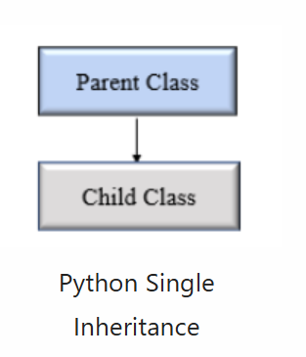
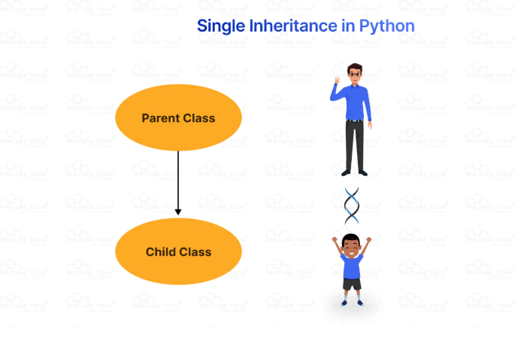
Single Inheritance in Python
Single inheritance is the simplest type of inheritance where a single child class inherits from one parent class. It is also called simple inheritance due to its candid nature. Single inheritance in python

Slide 73
Example
# Base class
class Animal:
def speak(self):
return "Animal makes a sound"
# Derived class
class Dog(Animal):
def speak(self):
return "Woof!"
# Create an instance of the derived class
my_dog = Dog()
# Call the method from the derived class
print(my_dog.speak()) # Output: Woof!
Output:
Woof!

Slide 74
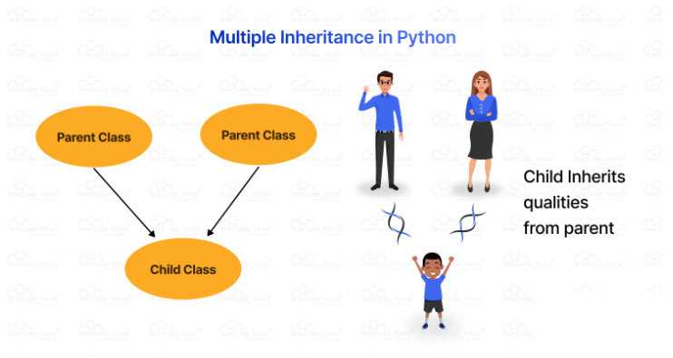
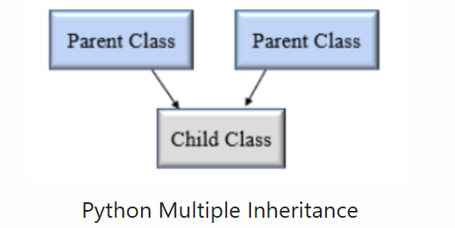
Multiple Inheritance in Python
In multiple inheritance, a single subclass inherits from multiple superclasses. So, the child class can access two or more parent classes it has inherited attributes and methods from. However, if two parent classes share the same ‘named’ methods, the child class performs only the method of the first parent class in order of reference.

Slide 75
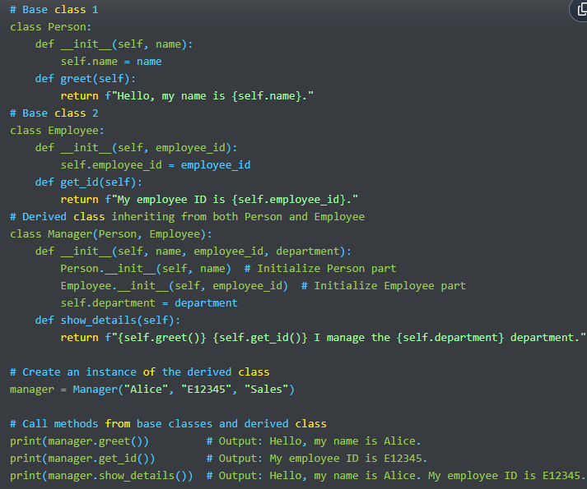
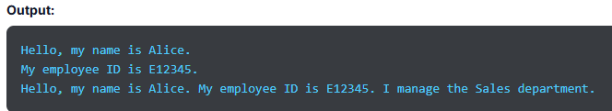

Slide 76
Explanation:
Base Classes (Person, Employee):
Person class has a name attribute and a method greet().
Employee class has an employee_id attribute and a method get_id().
Derived Class (Manager):
Inherits from both Person and Employee.
The __init__ method initializes attributes from both base classes and adds its own attribute department.
The show_details() method combines functionality from both base classes and its own method.
Object Creation and Method Calls:
An instance of Manager is created with name, employee_id, and department.
Calls to greet(), get_id(), and show_details() demonstrate the combined behavior from multiple base classes.

Slide 77
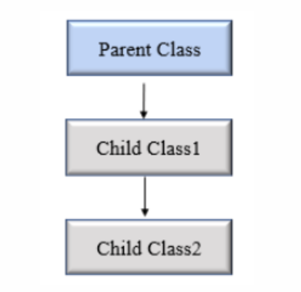
Multilevel Inheritance in Python:
Multilevel inheritance is the one with child and grandchild relationship. It means we go one step beyond the parent-child relationship, introducing the concept of grandchildren, great-grandchildren, grandparents, and other classes. Contrary to two-level inheritance with base and derived classes, this inheritance has multiple levels. So, the child class is derived from the parent class, which is derived from another parent class.

Slide 78
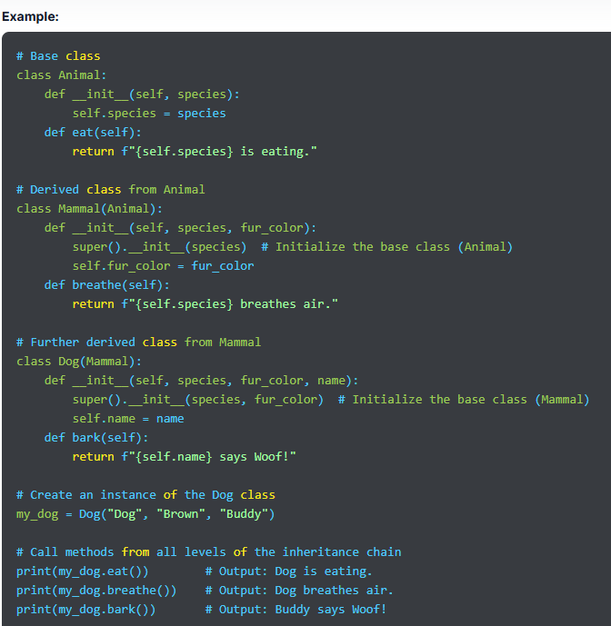
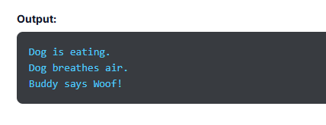

Slide 79
Explanation:
Base Class (Animal):
Defines attributes and methods common to all animals.
__init__ method initializes species, and eat() method represents a general behavior.
Intermediate Class (Mammal):
Inherits from Animal and adds additional functionality specific to mammals.
__init__ method extends the base class initialization to include fur_color, and breathe() method represents a behavior common to mammals.
Derived Class (Dog):
Inherits from Mammal and adds specific features for dogs.
__init__ method extends the Mammal initialization to include name, and bark() method provides a dog-specific behavior.
Object Creation and Method Calls:
An instance of Dog is created with species, fur_color, and name.
Calls to eat(), breathe(), and bark() demonstrate inherited and specific behaviors.

Slide 80
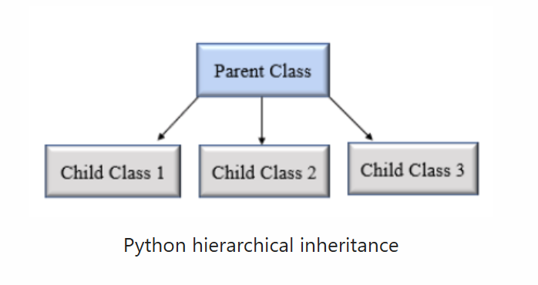
Hierarchical Inheritance in Python:
Hierarchical inheritance is the opposite of multiple inheritance. Therefore, more than one child class can be derived from a single-parent class.

Slide 81
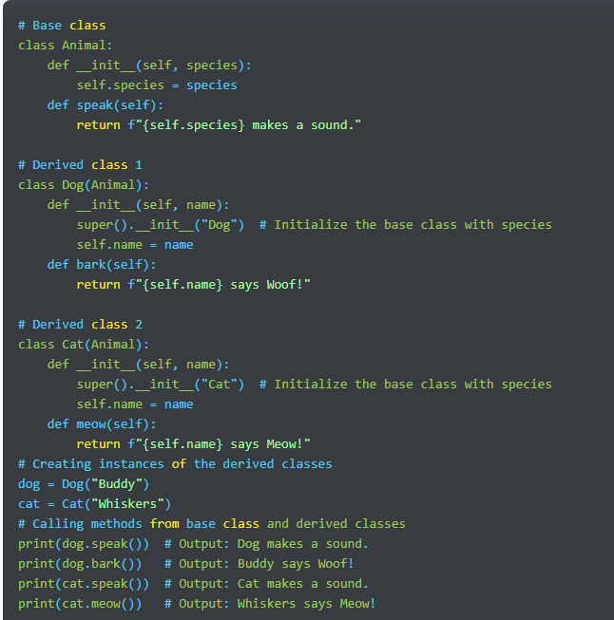
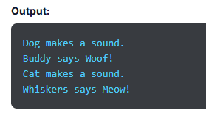

Slide 82
Explanation:
Base Class (Animal):
Contains common attributes and methods for all animals.
__init__ method initializes the species attribute.
speak() method provides a general behavior for all animals.
Derived Class 1 (Dog):
Inherits from Animal.
Initializes with species set to "Dog" and adds a name attribute.
Has an additional method bark() specific to dogs.
Derived Class 2 (Cat):
Inherits from Animal.
Initializes with species set to "Cat" and adds a name attribute.
Has an additional method meow() specific to cats.
Object Creation and Method Calls:
Dog and Cat instances are created, each with their own unique name.
Calls to speak() demonstrate shared functionality from the Animal class.
Calls to bark() and meow() demonstrate functionality specific to each derived class

Slide 83
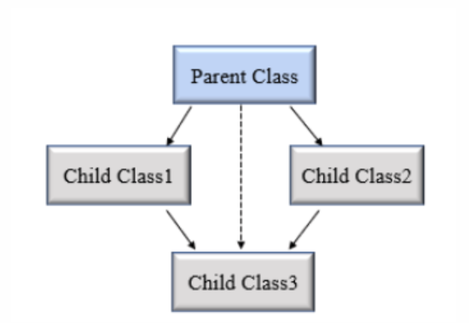
Hybrid Inheritance in Python
Hybrid inheritance combines two or more types of inheritance methods. Hence, we can witness several relationships between the parent class and the child class with multiple levels. We can say that it is a mixture of more than one type of inheritance.

Slide 84
Special Functions in Python Inheritance:
Python is known to be a user-friendly and versatile programming language that offers several built-in functions that come in handy while studying inheritance.
super() Function
The super() function is used to invoke a method from the superclass. It returns the object representing the parent class and allows access to the methods and attributes of a parent class in the child class.
issubclass()
issubclass() is a simple way to check if a class is the subclass of a specific superclass. This function is used to know if the first class is derived from the second class. If the two classes share a parent-child relationship, it returns the boolean value True; else, it returns false.
isinstance()
isinstance() is a built-in Python function used to check if an object is an instance of a specific class or any other class it has inherited. It needs two key parameters- the object and the class we must check it against. This function returns the boolean value ‘True’ if the object is an instance; else, it returns false.

Slide 85
Benefits of Inheritance:
With inheritance, a class can inherit the properties of another existing class, also known as the parent class. Here are a few benefits of Python inheritance:
Inheritance increases modularity by breaking down the codebase into modules. Hence making the code easy to understand. Each defined class becomes a separate module that one or many other classes can inherit.
It allows code reusability, as you don’t need to write the same code repeatedly.
It has a simple model structure.
You just have to make changes in the base class, and the derived class will follow automatically. This saves significant maintenance costs and requires less development.
Inheritance is transitive, so if a class acquires traits of another class, all the subclasses of the derived class would automatically inherit the properties of the base class.
We can add more features to a class without changing it.

