Slide 1
Python –OOPS Concept

Slide 2
Introduction
What Is Object-Oriented Programming in Python?
OOPs Concepts in Python
Applications of OOP Concepts
Advantages and Disadvantages of OOPs in Python

Slide 3
Introduction:
Object-oriented programming is a fundamental concept in Python.
This programming pattern is based on the concept of objects (consisting of data and methods) and allows programmers to build maintainable, scalable, and modular applications.
OOPs concept in Python is a popular programming style, enabling developers to map the virtual world entities (code) to real-world objects.
The core of OOP principles includes classes, objects, inheritance, polymorphism, encapsulation, and abstraction, which are used widely due to their ample benefits.
They enable programmers to leverage Python capabilities to provide efficient solutions to complex problems.

Slide 4
What Is Object-Oriented Programming in Python?
Object-oriented programming (OOP) in Python is a paradigm for designing programs using objects and classes. The primary concept of Python OOPs is to bind data and functions as a single unit so that no other section of the code can access data. Object-oriented programming aims to implement real-world entities, including inheritance, polymorphism, encapsulation, and abstraction.
OOPs are centered around objects and treat every entity as an object. We can create as many objects as we want using a class.
A class is a blueprint used for constructing objects, whereas an object is an instance of that class. Objects can be logical or real-life. Anything with properties and behaviors is known as an object. Moreover, the properties of objects are referred to as the object's variables, and behaviors are the object's functions.
For example, a human can have properties like name, height, gender, age, etc., and his behavior is he can walk, sleep, eat, talk, etc.
Developers can use OOPs as objects with methods to create real-world entities to manipulate data and attributes. This facilitates modularity, encapsulation, and code reuse, simplifying complex programs' management and maintenance. With OOP in Python, we can easily write flexible and scalable code and enhance its productivity and quality by using the concepts of inheritance, encapsulation, and polymorphism.
An example of a logical object is your files in the system as they have properties, such as name, size, and location and behaviors like they can be downloaded and shared and store data.

Slide 5
Key Points to Remember:
Each object in OOP signifies a different section of the code with its own logic and data that it uses to communicate. This avoids any complications in the code.
OOPs reduce code redundancy through inheritance, which ensures we write clear and reusable code.
OOPs can be easily visualized as we can associate them with real-life situations.

Slide 6
OOPs Concepts in Python:
Here are the main Python OOPs concepts that we will discuss in this tutorial:
Python Class
Python Objects
Inheritance
Polymorphism
Encapsulation
Data Abstraction

Slide 7
Python Class:
A class in Python is a collection of objects containing blueprints from which objects are created. It is a logical entity with specific attributes and methods. For example, if the class is a pen, it will have attributes and methods like color, type, etc.
OOPs in Python primarily deals with classes and objects. Classes define functions, known as methods, that describe the actions and behaviors an object can perform. They help us avoid complex codebases by creating a blueprint, which makes the code more manageable. They also define the properties of an object created from the class.
Suppose you need to track employees of your organization. They all have different attributes, such as name, age, gender, department, etc. In a list, the first attribute would be the name of an employee, second would be age, and so on. What if there are over 100 employees and you want to add more properties? That is where we use Python classes.
Please note that a class only defines the structure and doesn’t point to anything specific.
For example, an employee is a class with different properties. It does not refer to a particular employee but explains attributes that any employee must have.

Slide 8
Key points to remember:
We use the keyword class to create classes.
Attributes are variables belonging to a class.
They are public and accessible using the dot (.) operator.
In Python, classes are a fundamental part of Object-Oriented Programming (OOP). A class acts as a blueprint for creating objects (instances) that encapsulate both data (attributes) and behavior (methods). Here’s a detailed explanation of Python classes, including how to create them and work with them.
Defining a Class:
A class in Python is defined using the class keyword followed by the class name. The class can contain methods (functions) and attributes (variables). Methods are functions that belong to the class, and they define the behaviors of objects of that class.

Slide 9
Syntax:
class ClassName:
# Statement-1
.
.
.
# Statement-N
Creating an Empty Class in Python
Example
class Employee:
pass
Structured Syntax:
class ClassName:
# Constructor method (__init__) to initialize attributes
def __init__(self, attribute1, attribute2):
self.attribute1 = attribute1
self.attribute2 = attribute2
# Method inside the class
def some_method(self):
# Do something with the attributes
print(self.attribute1, self.attribute2)
Note: We use ‘pass’ as a placeholder rather than code, as we can skip its implementation for a while. With ‘pass’, we can run the Python code without an error.

Slide 10
Example of Python class:
class Dog:
# Constructor (__init__) method to initialize the object
def __init__(self, name, breed):
self.name = name # Attribute
self.breed = breed # Attribute
# Method inside the class
def bark(self):
print(f"{self.name} says Woof!")
# Creating an object (instance) of the Dog class
dog1 = Dog("Buddy", "Golden Retriever")
dog1.bark() # Output: Buddy says Woof!

Slide 11
Python Objects:
An object is an entity that contains a state and behavior. It is an instance of a class and collection of data and methods. An object is an implementation of a class and can be any real-world object, such as a pen, chair, table, mouse, keyboard, etc.
In Python, everything is an object and has methods and attributes. Arrays, strings, dictionaries, integers, floating-point numbers, etc., are all objects. A single string or integer is also an object. Whether it’s a list, string, or number, all are objects. In fact, we may be using objects often without even realizing it.
An object comprises:
Behavior- It is the method of an object that reflects its response to other objects.
State- It is the attribute of an object that reflects its properties.
Identity- It is the unique name assigned to an object, which allows it to communicate with other objects.

Slide 12
Let’s take the example of an employee class to better understand behavior, state, and identity.
The name of an employee is the identity.
His age, gender, department are attributes or state.
His behavior includes working, speaking, and walking.
Creating an Object in a Class:
Creating a new object from a class is known as instantiating an object. To instantiate an object, we use the class name followed by parentheses. Moreover, we can assign a class object to any variable.
Syntax:
x = ClassName()
When we instantiate an object, memory is allocated to it. This means if we compare the two instances of the same class, it will return false as both of them have different memories.

Slide 13
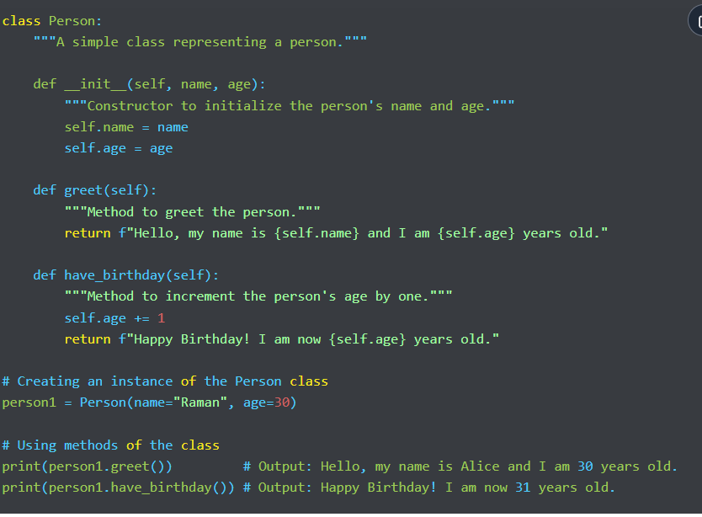
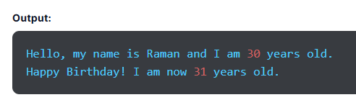
Example of class and Object:

Slide 14
The Python __init__ Method:
The __init__ method in Python is similar to constructors in Java and C++. It is a unique function that runs as soon as an object of a class is instantiated. It initializes the attributes of an object with values assigned upon creating an object.
So, whenever we create a new object, the __init__ sets the initial state of that object by assigning values provided within the properties of the object.
The __init__() method can take any number of parameters, but the first one is always a variable known as ‘self’, which corresponds to the instance being created. This means self points to the address of the current object of a class, which enables you to access the data of the object’s variables.
So, if there are a thousand instances of a class, we can get data of individual objects using self as it points to the address of a particular object and returns the respective value.
Other parameters that populate the attributes of an object are sent after self. To establish the initial state of an object, we use the __init__ method, which ensures it is initialized correctly and ready to use.

Slide 15
The two types of attributes in Python are as follows:
Class Attribute- These variables are the same for all instances of a class and don’t have new values for every new instance created. Class attributes are defined below the class definition.
Example
class Dog:
#class attribute
species = "Animal"
The species attribute has a fixed value for all objects we create.
Instance Attribute- They are the variables defined inside a function in a class. They have different values for each instance of a class, which are dependent on the value passed while creating an object.

Slide 16
Example
class Dog:
#class attribute
species = "Animal"
def __init__(self, breed, name, age):
self.breed = breed
self.name = name
self.age = age
d = Dog("Lebra", "Tuffy", 5)
print(d.name)
print(d.breed)
print(d.age)
Output:
Tuffy
Lebra
5
The variables breed, name, and age are instance attributes, which means they can have different values for every new instance of a class.
So, properties with the same value for every instance of a class use class attributes and properties with different values per instance use instance attributes.

Slide 17
Python Inheritance:
Children often hear that they have features or traits similar to their parents. Even you might have heard somebody pointing out that you have inherited certain habits or facial features from your parents. This is known as inheritance.
The fundamental concept of inheritance in object-oriented programming in Python is based on the same real-life idea of inheritance, which enables a class to inherit or acquire properties of another class. Here, the child class inherits the features or functions of the parent class and the inherited attributes are known as methods or properties.
In other words, inheritance is the capability of one class to acquire or derive the properties of another class. A new class is created by inheriting features from an existing class. The class that acquires properties is called the derived or child class, whereas the class from which the properties are derived is known as the base or parent class.
Inheritance allows code reusability and allows us to develop a hierarchical structure among classes.

Slide 18
The benefits of Python inheritance are as follows:
It allows code reusability, so you don’t have to write the same code repeatedly.
Inheritance is transitive, which means if x class acquires features of class y, then all the subclasses of class x will automatically inherit from class y.
It is based on the real-world concept of inheritance and it enables you to add more features to the class without changing it.
Syntax of Inheritance in Python:
class parent_class:
#body of parent class
pass
class child_class( parent_class):
# inherits the parent class
#body of child class
We define a normal class, then define the child class, and specify the name of the parent class in parentheses.

Slide 19
Types of Inheritance in Python:
Single Inheritance- The derived or child class inherits characteristics from a single base or parent class.
Multiple Inheritance- Multiple Inheritance allows the derived class to inherit features from more than one base class.
Multilevel Inheritance- In multilevel inheritance, the derived class inherits properties from the immediate base class, which inherits characteristics from another parent class. In other words, the derived class inherits from another derived class.
Hierarchical Inheritance- The hierarchical class allows multiple derived classes to inherit properties from a single base class.
Hybrid Inheritance- It combines two or more types of inheritance, usually involving a mix of multilevel, multiple, and hierarchical inheritance.

Slide 20
Super():
In Python, the super() function is an inheritance-related function referring to the base or parent class. We use this function to find the method with a specific name in the superclass of an object.
Syntax
In the syntax of the super() function, we write the super() keyword, which is followed by the method name to refer to the parent class.
super().methodName()

Slide 21
# Derived class (or Child class) inheriting from Animal
class Cat(Animal):
def __init__(self, name, color):
# Call the constructor of the parent class
super().__init__(name)
self.color = color
def speak(self):
return f"{self.name} says Meow!"
# Creating instances of the derived classes
dog = Dog("Buddy", "Golden Retriever")
cat = Cat("Whiskers", "Tabby")
# Accessing the speak method from each instance
print(dog.speak()) # Output: Buddy says Woof!
print(cat.speak()) # Output: Whiskers says Meow!
Example
# Base class (or Parent class)
class Animal:
def __init__(self, name):
self.name = name
def speak(self):
return f"{self.name} makes a sound."
# Derived class (or Child class) inheriting from Animal
class Dog(Animal):
def __init__(self, name, breed):
# Call the constructor of the parent class
super().__init__(name)
self.breed = breed
def speak(self):
return f"{self.name} says Woof!"
Output:
Buddy says Woof!
Whiskers says Meow!

Slide 22
Explanation:
Base Class (Animal): The parent class, which defines a common method speak that can be shared by all animals.
Derived Classes (Dog and Cat): These classes inherit from the Animal class. They override the speak method to provide specific behavior for dogs and cats.
super() Function: Used in the derived classes to call the constructor of the parent class, ensuring that the name attribute is initialized correctly.

Slide 23
Python Polymorphism:
Polymorphism is the combination of two words: ‘poly’, which means multiple or many, and ‘morph’, which means forms. So, polymorphism in Python means something that has multiple forms or can be performed in different ways. It is one of the most crucial Python OOPs concepts, referring to functions with the same name but different functionalities.
We can implement polymorphism in Python through method overloading and method overriding. This allows different classes to offer methods with the same name but with distinct behavior based on the class.
For example, if we want to know whether a specific species of animal can run, we can do so through polymorphism using one single function.
A derived or child class acquires properties from the base or parent class. However, it may want to add its own properties and implementation to the method. We can use polymorphism in Python in different ways:
Example of Inbuilt Polymorphic Functions
One example of an in-built polymorphic function is len(), which we use to calculate the length of different data types, including tuple, list, string, and dictionary. It computes the result and returns the output.

Slide 24
Example
print(len("Hello")) # Output: 5 (length of a string)
print(len([1, 2, 3, 4])) # Output: 4 (length of a list)
print(len((1, 2, 3))) # Output: 3 (length of a tuple)
Output:
5
4
3
Explanation:
len() Function:
Works with various data types like strings, lists, and tuples to return their length.
Demonstrates polymorphism as the function behaves differently based on the type of the object.

Slide 25
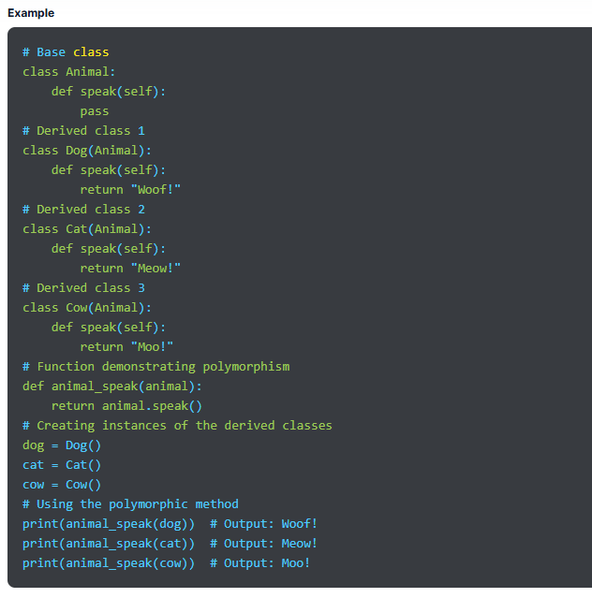
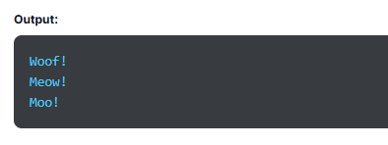

Slide 26
Explanation:
Base Class (Animal):
Defines a method speak that does nothing (pass). This is a placeholder method meant to be overridden by derived classes.
Derived Classes (Dog, Cat, Cow):
Each class inherits from Animal and provides its own implementation of the speak method.
The speak method returns a sound typical to the animal.
Polymorphic Behavior:
The function animal_speak takes an object of type Animal (or any class derived from it) and calls the speak method on it.
Despite the object type, the function works correctly and calls the appropriate method based on the object's class.

Slide 27
Polymorphism with Inheritance;
In Python, we can perform polymorphism with inheritance. We can change a method in the derived class inherited from the base class and add its own implementation to the method.
This process of re-implementing a method in the derived class is called Method Overriding in Python.

Slide 28
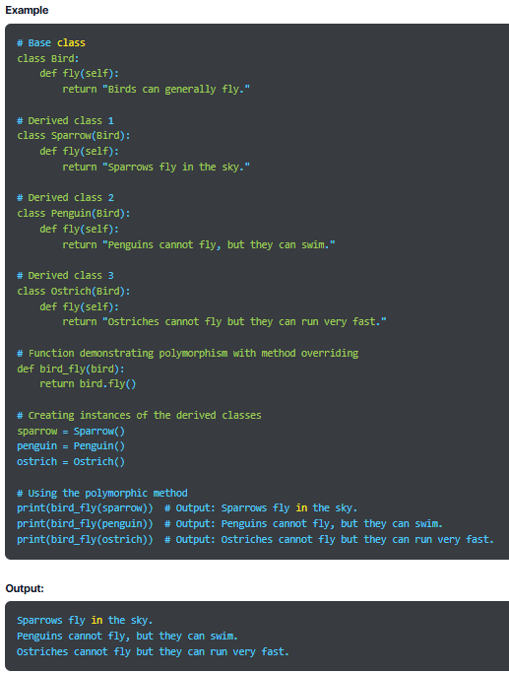

Slide 29
Explanation:
Base Class (Bird):
Contains a method fly that provides a general statement about birds.
Derived Classes (Sparrow, Penguin, Ostrich):
Each derived class inherits from the Bird class and overrides the fly method.
The fly method in each derived class provides a specific behavior or characteristic related to that bird.
Method Overriding:
The derived classes (Sparrow, Penguin, Ostrich) override the fly method inherited from the Bird class.
Even though the method name is the same, the implementation differs depending on the specific bird.
Polymorphic Behavior:
The function bird_fly can take any object of a class derived from Bird and call its fly method.
The appropriate method is executed based on the actual object passed to the function.

Slide 30
Python Encapsulation:
We have all seen medicine capsules, in which medicines are enclosed or wrapped inside a cover to prevent accidental access. It is basically a capsule encapsulating medicine or different combinations of medicines.
Similarly, in Python, encapsulation refers to wrapping data, methods, and variables inside a single unit. It is a core idea of object-oriented programming, which means grouping methods and data into a unit called a class. We have already learned that functions and variables created in OOPs are inside a class.
The process of binding data and methods into one unit prevents any unauthorized or accidental access to parts of components of an object, guarding data from any unintentional interference or misuse. The variable can be changed only by the method of the object, and such variables are called private variables.
Encapsulation presents class members binded together from being accessed by other classes. Controlled access through public methods encourages modularity and helps maintain data integrity of an object. Python encapsulation ensures security by hiding data from unauthorized access. Organizations encapsulate their data to protect their sensitive information from unwanted access by outsiders. One example of encapsulation is a class that wraps data, including functions, variables, etc.

Slide 31
Getters and Setters:
Encapsulation is used for Data Hiding, which is done by defining getter and setter methods for the class. To get data, one has to call the getter method. Moreover, to set a value to the data, one needs to use the setter method. We only know when to use getter and setter methods. However, how they both work is a mystery to people.
Access Modifiers:
When we use access modifiers, it limits access to methods and variables of a class.
The three types of access modifiers are private, public, and protected. Python doesn’t have direct access modifiers, but we can use a single underscore and double underscore instead.
Public- As clear by the name, it is accessible from anywhere outside a class.
Private- It is a private modifier that is accessible only within a class.
Protected- It is accessible within a class and its subclass.
A single underscore signifies a protected class, whereas a double underscore is for a private class.

Slide 32
class Person:
def __init__(self, name, age, salary):
self.name = name # Public attribute
self._age = age # Protected attribute (indicated by a single underscore)
self.__salary = salary # Private attribute (indicated by double underscores)
# Public method to access the private attribute
def get_salary(self):
return self.__salary
# Public method to modify the private attribute
def set_salary(self, new_salary):
if new_salary > 0:
self.__salary = new_salary
else:
print("Salary must be positive!")
# Protected method (indicated by a single underscore)
def _display_age(self):
return f"Age: {self._age}"
# Private method (indicated by double underscores)
def __display_salary(self):
return f"Salary: {self.__salary}"
# Public method to demonstrate access to protected and private methods
def display(self):
age_info = self._display_age()
salary_info = self.__display_salary()
return f"Name: {self.name}, {age_info}, {salary_info}"

Slide 33
# Creating an instance of the Person class
person = Person("Mahesh", 30, 75000)
# Accessing the public attribute
print(person.name) # Output: Mahesh
# Accessing the protected attribute (not recommended, but possible)
print(person._age) # Output: 30
# Trying to access the private attribute directly (will raise an AttributeError)
# print(person.__salary) # Uncommenting this line will cause an error
# Accessing the private attribute through a public method
print(person.get_salary()) # Output: 75000
# Modifying the private attribute using a public method
person.set_salary(80000)
print(person.get_salary()) # Output: 80000
# Accessing the protected method (not recommended, but possible)
print(person._display_age()) # Output: Age: 30
# Trying to access the private method directly (will raise an AttributeError)
# print(person.__display_salary()) # Uncommenting this line will cause an error
# Using a public method to access protected and private methods
print(person.display()) # Output: Name: Mahesh, Age: 30, Salary: 80000
Output:
Mahesh
30
75000
80000
Age: 30
Name: Mahesh, Age: 30, Salary: 80000

Slide 34
Explanation:
Public Members:
Public Attribute: name can be accessed directly from outside the class.
Public Methods: get_salary(), set_salary(), and display() can be accessed from outside the class. These methods interact with private and protected members.
Protected Members:
Protected Attribute: _age is intended to be used within the class and its subclasses. It can be accessed directly, but it’s a convention that it should not be accessed outside the class.
Protected Method: _display_age() is also intended for use within the class and subclasses. It can be accessed directly from outside the class, but doing so breaks the encapsulation principle.
Private Members:
Private Attribute: __salary cannot be accessed directly from outside the class. It can only be accessed through public methods like get_salary() and set_salary().
Private Method: __display_salary() cannot be accessed directly from outside the class. It can only be accessed from within the class, like in the display() method.

Slide 35
Data Abstraction:
Another important OOPs concept in Python is data abstraction. Let’s take a simple example to understand this concept. Suppose you are reading a Python PPT on your computer and making notes. You will also highlight a few points and save important files in your system. Now, as you read, highlight, and save data, you only press some keys and see the screen. You are not concerned about the internal working of the keyboard or buttons on the screen. You can see and know everything important to you, and the rest of the unnecessary information is hidden.
That is how abstraction works in Python. It hides unnecessary and intricate details from users and reveals what’s essential and pertinent to them. It shows everything at an abstract level, including crucial functionalities and what matters, while concealing implementation and inner details.
When we don’t want to give out sensitive details of the code implementation, we use data abstraction. It reduces complexity and enhances efficiency through an uncomplicated and straightforward interface. We can achieve it in Python by creating abstract classes.
Using abstraction, Python programmers can work with simple system representations and manage complex operations. The primary goal of data abstraction is to hide unnecessary information and show only required data to users, so they can handle code complexity better.

Slide 36
Key Points About Abstract Classes:
We can achieve data abstraction in Python through abstract classes.
An abstract class is like a blueprint for another class, which can be used to design large functions. The subclass that inherits them refers to the abstract methods for feature implementation.
We use abstraction to conceal background details or unnecessary implementation data so users can see what matters.
Abstract methods don’t have their own implementation.
In Python, we have the abc module to use data abstraction.
A class containing one or more abstract methods is known as an abstract class.
A subclass can inherit properties from an abstract class. It provides the implementations for the abstract methods.

Slide 37
Syntax of Python Abstract Class
We use the ABC class from the abc module for abstraction in Python.
Syntax:
from abc import ABC
class ClassName(ABC):
Here, ABC is used for Abstract Base Class. The abc module offers the base for defining ABC class.

Slide 38
Example:
from abc import ABC, abstractmethod
# Abstract Base Class
class Shape(ABC):
@abstractmethod
def area(self):
pass
@abstractmethod
def perimeter(self):
pass
# Derived Class 1
class Rectangle(Shape):
def __init__(self, width, height):
self.width = width
self.height = height
def area(self):
return self.width * self.height
def perimeter(self):
return 2 * (self.width + self.height)
# Derived Class 2
class Circle(Shape):
def __init__(self, radius):
self.radius = radius
def area(self):
return 3.14159 * self.radius * self.radius
def perimeter(self):
return 2 * 3.14159 * self.radius
# Creating instances of the derived classes
rectangle = Rectangle(4, 5)
circle = Circle(3)
# Using the abstract methods implemented in derived classes
print(f"Rectangle Area: {rectangle.area()}") # Output: 20
print(f"Rectangle Perimeter: {rectangle.perimeter()}")# Output: 18
print(f"Circle Area: {circle.area()}") # Output: 28.27431
print(f"Circle Perimeter: {circle.perimeter()}") # Output: 18.84954
Output:
Rectangle Area: 20
Rectangle Perimeter: 18
Circle Area: 28.274309999999996
Circle Perimeter: 18.849539999999998

Slide 39
Explanation:
Abstract Base Class (Shape):
The Shape class is an abstract base class that defines abstract methods area() and perimeter().
These methods are declared using the @abstractmethod decorator, which means that any class inheriting from Shape must implement these methods.
Derived Classes (Rectangle, Circle):
The Rectangle and Circle classes inherit from the Shape class and provide concrete implementations for the area() and perimeter() methods.
These classes encapsulate the specific logic for calculating the area and perimeter of a rectangle and a circle, respectively.

Slide 40
Abstraction:
The Shape class provides a blueprint for all shapes, but it does not provide specific details. This abstraction allows the user to work with shapes without needing to understand the underlying implementation details.
The specific details of how the area and perimeter are calculated are hidden in the derived classes, making the code more modular and easier to manage.
Instantiation:
You cannot create an instance of the abstract class Shape directly, as it contains abstract methods. You must create an instance of a derived class like Rectangle or Circle, which provides the specific implementation of the abstract methods.

Slide 41
Applications of OOP Concepts:
Python object-oriented programming offers a wide range of real-life applications, which we have discussed below:
AI Systems
We use OOP features to create AI expert systems that offer solutions for an array of complicated programming problems and technical issues that can be tricky for humans to process and address. These systems are known for their dependability, performance, and responsiveness.
OOP Database
Using an OOP database, we can build a close correlation between the physical components of objects and different databases, which helps retain identity and integrity of an object.
Office Automation Systems
We can use object-oriented programming for office automation systems to create reusable and efficient programming elements. It is useful in developing documentation tasks through work collaboration and management. OOPs also improve automation tasks.
Modeling Systems
Modeling systems demand an in-depth understanding of interactions and precise modeling. As variable specifications are difficult rather than universal, they can be tricky. Hence, we use OOPs to simplify their complex structures through useful approaches.

Slide 42
Client-server Systems:
Client-server systems have a centralized server for communicating and accessing requests to different resources. They process requests and generate appropriate responses. OOPs improve code maintainability, reusability, and modularity to build software components. These systems use OOPs to enable clients to communicate smoothly with each other using a common interface.
CAD Software:
Using OOPs, computer-aided designs, or CAD, software builds classes containing diverse design elements, such as points, solids, surfaces, lines, and more. The designs use several attributes and methods to build relationships between different design components.
Hypertext and Hypermedia:
Hypertext allows people to connect from one text to another. This form of text offers cross-referencing that works in non-linear and multi-sequential ways. Moreover, hypermedia is a broader concept than hypertext. We can develop hypertext and hypermedia using OOPs.

Slide 43
Advantages of Python OOPs
Here are the top benefits of using object-oriented programming in Python:
OOPs store data safely in objects, so you don’t need to write the same code again and again. This eliminates data redundancy, so there is less reiteration of mundane tasks. You can go to the required section of the program without hassle and use it conveniently.
It ensures higher security of data through the use of access modifiers. Therefore, you can decide who can access data by choosing between public, private, and protected access modifiers based on your security requirements.
It makes problem-solving effective as we can write a class for each sub-problem and decide what it does. We can reuse those classes, making solving the next problem quicker and easier.
The code in Python OOPs is reusable and stored in a specific location known to the user. Hence, we can troubleshoot problems in a sorted and seamless way. We can find problematic sections of the code and take corrective actions.
It ensures data privacy and security through encapsulation.

Slide 44
Another benefit of OOP is increased productivity. It contains massive libraries for new programs that are accessible at a larger scale, which speeds up development.
Due to code modularity, debugging is easy. You no longer have to look through hundreds of lines of code to identify one issue.
OOPs break down a big problem into smaller, manageable chunks, which is a recommended and good programming practice. It helps us find the exact point of the problem conveniently. We can also use these small issues to achieve meaningful conclusions.
The concept of inheritance allows code reusability as the child class inherits properties of the parent class. We don’t need to write the same code repeatedly, which makes the work less redundant.
We can have multiple forms of one class through polymorphism which enhances flexibility. This feature is based on extensibility and simplicity and we can use the same code differently in varied situations.
Abstraction reduces code complexity.

Slide 45
Disadvantages of Python OOPs:
OOPs concept in Python provides ample benefits, but it comes with its drawbacks, which we have discussed below:
It is a more complex concept than procedural programming and requires a bit more time for you to understand. Also, it is not an organic concept for many programmers.
Executing code and generating results are slow processes and demand ample time.
According to Python OOPs, everything is an object. So, to work with OOPs, you must get familiar with objects and build brilliant knowledge of the topic. Also, seeing every data as an object may not be easy every time.
The programs we develop using OOPs in Python can be lengthier than the ones created using procedural programming, which can make code huge.
Object-oriented programming is not a universal concept, so we can’t use it everywhere, especially to solve all technical issues. It is useful only in certain programming languages, such as C++, Python, and Java.
OOPs is a tricky concept, and you must possess exceptional skills to tap into the maximum potential of object-oriented programming. You will need a comprehensive plan to use OOP and write codes, which is not the case with procedural programming

Slide 46
Python Classes and Objects

Slide 47
Introduction
What Is a Class in Python?
How to Create a Class in Python?
Python Class Attributes and Methods
What Is an Object in Python?
Declaring Class Objects in Python
Self Parameter
Pass Statement in Python
The __init__ Method
The __str__() Function
Class and Instance Variables
Access Class Attributes Using Objects
Python Class Properties

Slide 48
Introduction:
We already know that Python is an object-oriented programming language, so everything is considered an object and has its properties and methods. A class is a blueprint used to create an object and provides a way to bundle data and functionality.
What Is a Class in Python?
Python programming revolves around two primary aspects- objects and classes. A class is the user-defined blueprint required to create objects. Classes in Python programming are prototypes containing data and methods. They are the means of bundling data and functionality and provide operations and characteristics of objects.
When we create a new class, it creates a new type of object, allowing a new instance of that particular type to be created. For example, a blueprint of a car model is a class. It contains all the details about features, color, engine, design, etc. Based on these details, cars are built. We can create as many objects as we want of the class car.
Objects are instances of a specific class, and each element in Python is an object of some corresponding class, such as a dictionary, string, or number. Objects in Python represent data essential for an app and methods to manipulate data. Encapsulation is the center of the classes, ensuring data is aggregated and protected through a systematic approach to data interaction and portrayal.

Slide 49
A class includes two primary components. First is the attribute attached to a class to maintain its state and store data. For example, car is the Python class with attributes like color and brand. Second is the method used to modify the state of a class. It is the function associated with the class outlining feasible operations on the data. For example, a car can have methods like park, drive, etc.
Creating a class in Python is a simple and efficient process that involves using the keyword class to establish and instantiate a class. Once a class is delineated, it can be instantiated again and again to generate varied objects.
Python is an object-oriented programming language that supports class inheritance. Hence, one class (known as a child class) can acquire or inherit attributes from another class (known as a parent class). Combined with polymorphism, this ensures that a class adjusts and employs methods acquired from the parent class, which promotes code reusability.

Slide 50
Key points about a class in Python program:
A class is defined using the class keyword.
Attributes are variables belonging to a specific class.
Attributes can be public and can be accessed using the dot (.) operator.
How to Create a Class in Python?
Similar to creating a function, creating a class in Python is easy. We start by using the keyword class to indicate class creation. This is followed by the class name and colon (:).
The next indented lines will include memes of the class. The variables within a class are called attributes, which can be accessed later in a Python program using the dot (.) operator.
Syntax for Creating a Python Class
class ClassName:
# Statement 1
# Statement 2
.
.
# Statement n
Note- We use the keyword pass to denote an empty class. It helps us avoid errors while running code.

Slide 51
Python Class Attributes and Methods:
For the best results, we must add some functionality to Python classes with the help of attributes and methods. We set attributes containing functions and data to add functionality to the code. The functions defined within a class are called methods. The additional functionalities are as follows:
Python Class Attributes
Class attributes are variables defined inside a specific class and used by all objects. We can call attributes using the class name, attribute name, and the dot (.) operator. Here’s an example for better understanding:
Example
class Car:
Color = 'Black'
In the example above, we have a class named Car and an attribute is Color with the fixed value Black. The value of an attribute is the same for all objects until changed explicitly in the code.

Slide 52
Example
# Define a class
class Dog:
def __init__(self, name, breed):
self.name = name # Attribute
self.breed = breed # Attribute
def bark(self): # Method
return "Woof!"
# Create an object (instance) of the Dog class
my_dog = Dog("Buddy", "Golden Retriever")
# Access attributes and call a method
print(my_dog.name) # Output: Buddy
print(my_dog.breed) # Output: Golden Retriever
print(my_dog.bark()) # Output: Woof!
Output:
Buddy
Golden Retriever
Woof!

Slide 53
Python Class Methods:
We can also define functions within a specific class that can access the attributes and add more functionality to the code. The functions defined within a class are called methods, and we can define as many methods as we need within a single class.
Syntax:
class ClassName:
def method_name():
#statments
pass
To define a function within a class, we use the def keyword, which is followed by the name of the method. After this, we pass arguments through the method. While defining a method, we must pass at least one parameter named self, referring to the current instance of the class. You can name the parameter anything other than self.
Example
class Dog:
def bark(self): # Method
return "Woof!"
my_dog = Dog()
print(my_dog.bark())
Output:
Woof!

Slide 54
What Is an Object in Python?
An object in Python is an instance of a class that encapsulates data and behavior, i.e., attributes and methods, respectively. If a class is a blueprint, then an instance (object) is the copy of a particular class with actual values. Here are a few points to remember:
Python objects are concrete instances of a class created based on the blueprint or prototype of a class.
Objects have attributes and methods. Attributes are variables used to store data of a specific instance of a class. Methods are functions defined inside a class and operate on the attributes of an object.
Every object created from a class has a unique set of attribute values.
An object in Python contains:
Behavior- It is the method of an object that reflects the response of one object to other objects.
State- It is the attribute of an object, reflecting the properties of a particular object.
Identity- It is a unique name given to an object, allowing it to interact with other objects.

Slide 55
Declaring Class Objects in Python:
Declaring an object, also known as instantiating a class, is based on the blueprint defined by a class. As we instantiate a class, we also create a concrete representation of that class combined with its attributes and methods. All instances share the same behavior and attributes of that class, but the value of the attributes is unique for each object. One class can have any number of instances. Creating an object in Python using classes means:
Defining a Class- We start by defining a class in the code, which is the blueprint specifying the attributes, structure, and methods that objects created from the class will possess.
Instantiating a Class- Creating or declaring an object is also called instantiating a class by calling the class name. We pass the required arguments to the constructor, mainly the __init__ methods.
Creating an Object- When we create an object of a class, we also specify the attribute values. An object is an instance of a particular class with access to its methods and attributes.
Syntax to Create an Object of a Class:
objectName = ClassName()

Slide 56
Self Parameter
The self-parameter in Python is a special parameter used to define methods within a class. It refers to the current instance of a class and accesses class variables. Self parameter is passed automatically as the first argument when methods are called. Although we can name this parameter anything, by convention, it is named self as it enhances the readability and consistency of the code.
Key points about the self parameter
Self Denotes Instance- We use self within instance methods to refer to the instance of the class on which the method is called. You can access and manipulate the attributes and methods of the object within the method.
Automatic Passing- As we call an instance method on an object, we don’t pass the self argument explicitly because Python does it for us.
Naming Convention- We can name the parameter anything we want, but conventionally, we use self as it makes the code more readable and maintainable. Self indicates that the parameter refers to the instance itself.

Slide 57
Pass Statement in Python
In Python, we use the pass statement as a placeholder or no-operation statement, as it doesn’t affect the execution of a program. It is required for the syntactically same code but with no specific instructions for execution. The pass statement allows the program to skip a specific section of the code by working as a valid code block but doesn’t have any actual functionality.
We use it as a temporary placeholder while writing the code. We use it when Python's syntactic restrictions need a valid statement but don’t want to execute useful code. It is a way to meet the requirements of the Python syntax without functional code. We use pass as a placeholder when we want to build the code structure but plan to add functionality later. The common use cases for the pass statement are as follows:

Slide 58
Class Definitions- To define a class that we want to implement later, we use the pass statement inside the class body.
class MyClass:
def method1(self):
pass
def method2(self):
pass
Empty Code Block- We might have a conditional statement that doesn’t need any action in one branch. In such situations, we use pass to show that no action is required.
if condition:
# No action needed for this branch
Pass
else:
Function or Method Definitions- Suppose you define a function without implementing its functionality. In such a case, you can use the pass statement as a placeholder.
def my_function():
pass

Slide 59
Minimal Code Structure-
While creating the code structure, if you want to make sure that it’s syntactically correct, you can use pass until filling in the actual code.
The __init__ Method
We use the __init__ method to initialize the state of an object or to create an instance of a class. We can declare an extra argument in this method to initialize the value of each attribute corresponding to the object. It is similar to the constructors in other programming languages, such as Java and C++. It also includes a collection of statements executed during object creation.
The __init__ method requires only self argument, which refers to the newly generated class instance. It runs as soon as an object is instantiated and is used to initialize what we want to do with it. __init__ begins with a double underscore.

Slide 60
Example
# Define a class
class Car:
def __init__(self, brand, model): # The __init__ method
self.brand = brand # Attribute
self.model = model # Attribute
# Create an object (instance) of the Car class
my_car = Car("Toyota", "Corolla")
# Access attributes
print(my_car.brand) # Output: Toyota
print(my_car.model) # Output: Corolla
Output:
Toyota
Corolla

Slide 61
The __str__() Function
In Python, there is a unique method known as __str__(), which is used to define how a class object must be represented as a string. We use it with the str() and print() functions to make an object human-readable, which helps in debugging, logging, and showing user object information.
It enhances readability and informational value. When we use a class object to create a string with the built-in print() and str() functions, __str__ is used automatically.
Example
class Book:
def __init__(self, title, author, year):
self.title = title
self.author = author
self.year = year
def __str__(self):
return f"'{self.title}' by {self.author} ({self.year})"
# Create an object of the Book class
my_book = Book("1984", "George Orwell", 1949)
# Use print to see the string representation of the object
print(my_book) # Output: '1984' by George Orwell (1949)
# Directly calling str() on the object
print(str(my_book)) # Output: '1984' by George Orwell (1949)
Output:
'1984' by George Orwell (1949)
'1984' by George Orwell (1949)

Slide 62
Explanation:
__init__ Function:
Initializes the Book object with a title, author, and year.
__str__ Function:
Defines what should be returned when the object is converted to a string.
In this case, it returns a nicely formatted string containing the title, author, and year of the book.
Printing the Object:
When you print my_book, Python automatically calls the __str__ method to get the string to display.

Slide 63
Class and Instance Variables
We use class variables for attributes and methods shared by instances of a class. On the other hand, we use instance variables for data, and they are unique to every instance. The value of class variables is assigned in the class and the value of instance variables is assigned within a method.
Defining instance variables using a constructor
Example
class Person:
def __init__(self, name, age):
self.name = name # Instance variable
self.age = age # Instance variable
# Create an object of the Person class
person1 = Person("Alice", 30)
# Access instance variables
print(person1.name) # Output: Alice
print(person1.age) # Output: 30
Output:
Alice
30
Explanation:
Constructor (__init__ Method):
self.name and self.age are instance variables that are initialized when a Person object is created.
Values for name and age are passed during object creation and assigned to the instance variables.

Slide 64
Defining instance variables using the general method
Example
class Person:
def set_details(self, name, age):
self.name = name # Instance variable
self.age = age # Instance variable
# Create an object of the Person class
person2 = Person()
# Set instance variables using a general method
person2.set_details("Bob", 25)
# Access instance variables
print(person2.name) # Output: Bob
print(person2.age) # Output: 25
Output:
Bob
25
Explanation:
General Method (set_details):
self.name and self.age are instance variables that are set by calling the set_details method.
This method can be called after the object is created to assign or update the instance variables.

Slide 65
Access Class Attributes Using Objects
Python allows objects to access class attributes, known as instance variables. We can read and change these class attributes using the dot (.) operator and work with data contained by the object.
We can access class attributes by using the name of the object followed by (.) and the name of the attribute.
Syntax
object_name.attribute_name
Create Multiple Objects of Python Class
To manage multiple instances of a single class, we create multiple objects of that particular class. We use it to maintain different states for instance or model different real-life things. Each item operates independently and has unique properties.
To create numerous objects, call the class multiple times with various arguments. This allocates a different variable to every instance.
object1 = ClassName(attribute1_value, attribute2_value)
object2 = ClassName(attribute1_value, attribute2_value)

Slide 66
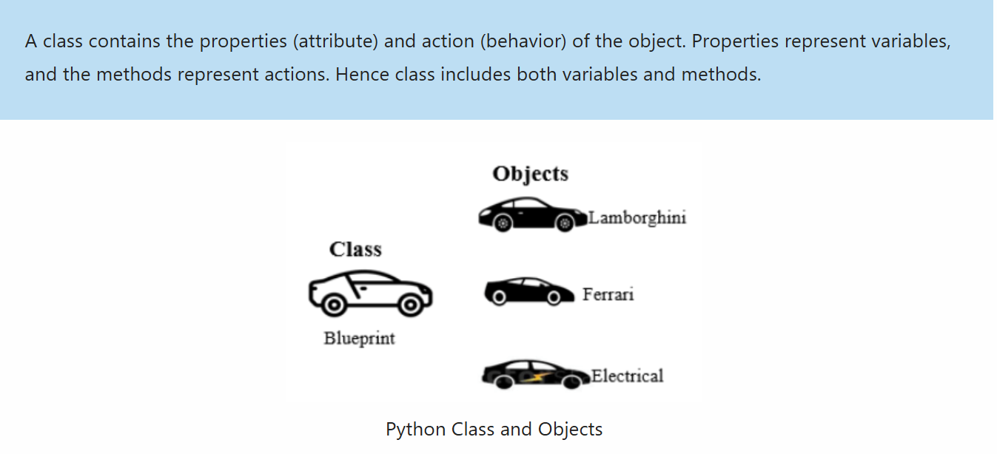
Python Class Properties:
In Python, we use the property() function within a class to define additional functionalities. It takes the set, get, and delete methods as arguments and returns an object.

Slide 67
Python - Inheritence

Slide 68
Introduction
What Is Inheritance in Python?
Tyрes of Inheritаnсe
Special Functions in Python Inheritance
Benefits of Inheritance

Slide 69
Introduction:
Python is a high-level and easy-to-learn programming language. It supports procedural and object-oriented approaches along with multiple types of programming, including functional coding and industry-level coding. Inheritance is one of the key pillars of object-oriented programming that supports code reusability. Also, it is quite useful while working with a wide variety of applications in Python.
What Is Inheritance in Python?
One of the key concepts of object-oriented programming is inheritance, which allows new classes to inherit features or attributes from the existing classes. This mechanism creates a hierarchy of classes that share similar properties, methods, and features as new classes are derived from the old classes. In simpler terms, we can say that inheritance is the capability of a class to derive properties of another class. The new class is known as the child class, and the existing class is called the parent class.
The inherited features and properties are defined data structures and functions we can perform with methods. Inheritance promotes code reusability, which is one of the best industrial coding practices that makes the codebase modular. The new class, or derived class, copies all the functions of the older class, or base class, without rewriting the syntax in the new class.

Slide 70
Syntax:
class DerivedClass(BaseClass):
# Class definition
Class BaseClass:
{Body}
Class DerivedClass(BaseClass):
{Body}
Here, DerivedClass is the class that inherits properties from the BaseClass. The BaseClass serves as the parent or superclass.
Example
# Base class
class Animal:
def speak(self):
return "Animal makes a sound"
# Derived class
class Dog(Animal):
def speak(self):
return "Woof!"
# Create an instance of the derived class
my_dog = Dog()
# Call the method from the derived class
print(my_dog.speak()) # Output: Woof!
Output:
Woof!

Slide 71
Tyрes of Inheritаnсe:
Python offers various types of inheritance based on the number of child and parent classes involved in the inheritance.
Single Inheritance in Python
Multiple Inheritances in Python
Multilevel Inheritance in Python
Hierarchical Inheritance in Python
Hybrid Inheritance in Python

Slide 72
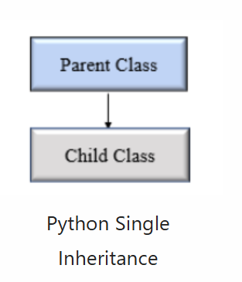
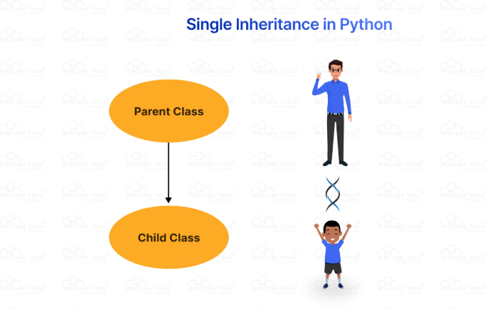
Single Inheritance in Python
Single inheritance is the simplest type of inheritance where a single child class inherits from one parent class. It is also called simple inheritance due to its candid nature. Single inheritance in python

Slide 73
Example
# Base class
class Animal:
def speak(self):
return "Animal makes a sound"
# Derived class
class Dog(Animal):
def speak(self):
return "Woof!"
# Create an instance of the derived class
my_dog = Dog()
# Call the method from the derived class
print(my_dog.speak()) # Output: Woof!
Output:
Woof!

Slide 74
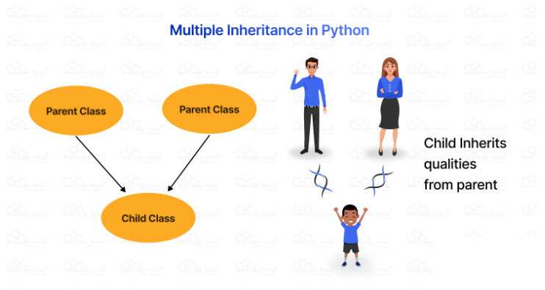
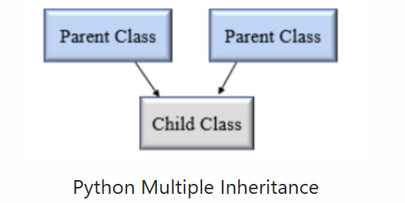
Multiple Inheritance in Python
In multiple inheritance, a single subclass inherits from multiple superclasses. So, the child class can access two or more parent classes it has inherited attributes and methods from. However, if two parent classes share the same ‘named’ methods, the child class performs only the method of the first parent class in order of reference.

Slide 75
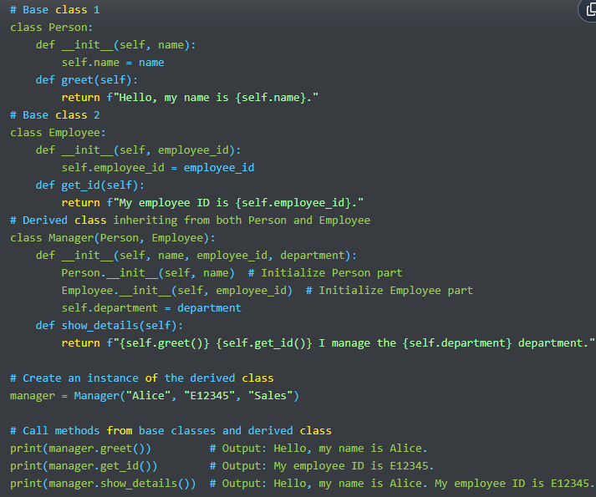
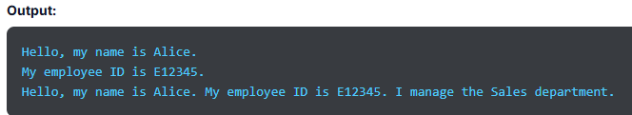

Slide 76
Explanation:
Base Classes (Person, Employee):
Person class has a name attribute and a method greet().
Employee class has an employee_id attribute and a method get_id().
Derived Class (Manager):
Inherits from both Person and Employee.
The __init__ method initializes attributes from both base classes and adds its own attribute department.
The show_details() method combines functionality from both base classes and its own method.
Object Creation and Method Calls:
An instance of Manager is created with name, employee_id, and department.
Calls to greet(), get_id(), and show_details() demonstrate the combined behavior from multiple base classes.

Slide 77
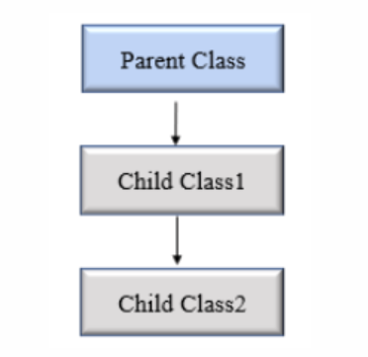
Multilevel Inheritance in Python:
Multilevel inheritance is the one with child and grandchild relationship. It means we go one step beyond the parent-child relationship, introducing the concept of grandchildren, great-grandchildren, grandparents, and other classes. Contrary to two-level inheritance with base and derived classes, this inheritance has multiple levels. So, the child class is derived from the parent class, which is derived from another parent class.

Slide 78
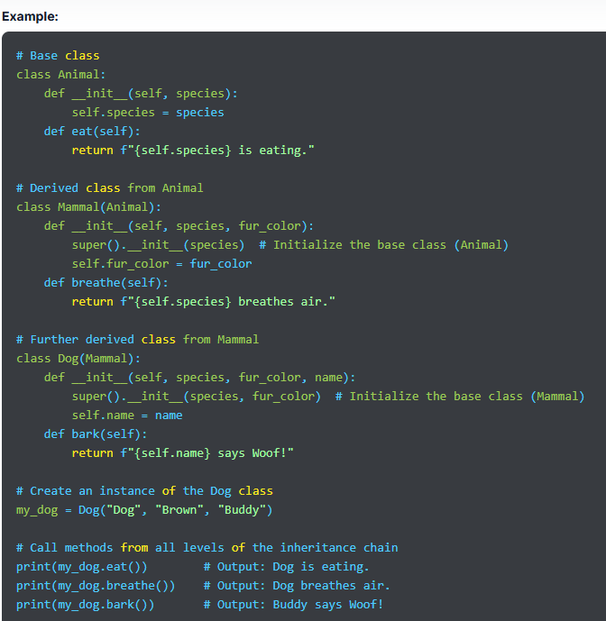
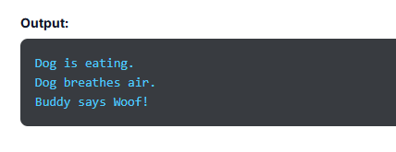

Slide 79
Explanation:
Base Class (Animal):
Defines attributes and methods common to all animals.
__init__ method initializes species, and eat() method represents a general behavior.
Intermediate Class (Mammal):
Inherits from Animal and adds additional functionality specific to mammals.
__init__ method extends the base class initialization to include fur_color, and breathe() method represents a behavior common to mammals.
Derived Class (Dog):
Inherits from Mammal and adds specific features for dogs.
__init__ method extends the Mammal initialization to include name, and bark() method provides a dog-specific behavior.
Object Creation and Method Calls:
An instance of Dog is created with species, fur_color, and name.
Calls to eat(), breathe(), and bark() demonstrate inherited and specific behaviors.

Slide 80
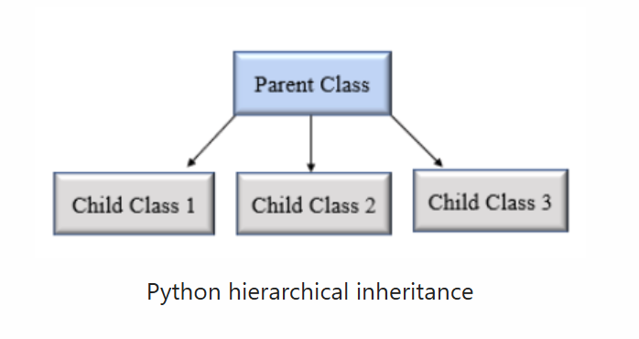
Hierarchical Inheritance in Python:
Hierarchical inheritance is the opposite of multiple inheritance. Therefore, more than one child class can be derived from a single-parent class.

Slide 81
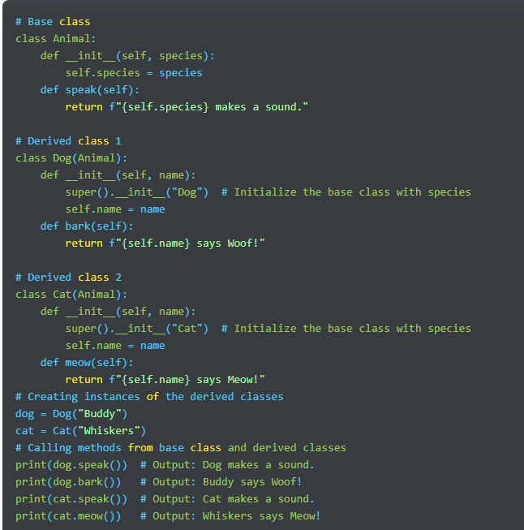
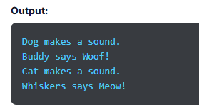

Slide 82
Explanation:
Base Class (Animal):
Contains common attributes and methods for all animals.
__init__ method initializes the species attribute.
speak() method provides a general behavior for all animals.
Derived Class 1 (Dog):
Inherits from Animal.
Initializes with species set to "Dog" and adds a name attribute.
Has an additional method bark() specific to dogs.
Derived Class 2 (Cat):
Inherits from Animal.
Initializes with species set to "Cat" and adds a name attribute.
Has an additional method meow() specific to cats.
Object Creation and Method Calls:
Dog and Cat instances are created, each with their own unique name.
Calls to speak() demonstrate shared functionality from the Animal class.
Calls to bark() and meow() demonstrate functionality specific to each derived class

Slide 83
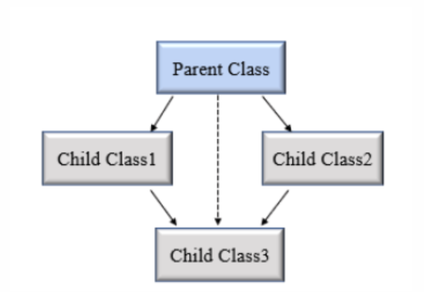
Hybrid Inheritance in Python
Hybrid inheritance combines two or more types of inheritance methods. Hence, we can witness several relationships between the parent class and the child class with multiple levels. We can say that it is a mixture of more than one type of inheritance.

Slide 84
Special Functions in Python Inheritance:
Python is known to be a user-friendly and versatile programming language that offers several built-in functions that come in handy while studying inheritance.
super() Function
The super() function is used to invoke a method from the superclass. It returns the object representing the parent class and allows access to the methods and attributes of a parent class in the child class.
issubclass()
issubclass() is a simple way to check if a class is the subclass of a specific superclass. This function is used to know if the first class is derived from the second class. If the two classes share a parent-child relationship, it returns the boolean value True; else, it returns false.
isinstance()
isinstance() is a built-in Python function used to check if an object is an instance of a specific class or any other class it has inherited. It needs two key parameters- the object and the class we must check it against. This function returns the boolean value ‘True’ if the object is an instance; else, it returns false.

Slide 85
Benefits of Inheritance:
With inheritance, a class can inherit the properties of another existing class, also known as the parent class. Here are a few benefits of Python inheritance:
Inheritance increases modularity by breaking down the codebase into modules. Hence making the code easy to understand. Each defined class becomes a separate module that one or many other classes can inherit.
It allows code reusability, as you don’t need to write the same code repeatedly.
It has a simple model structure.
You just have to make changes in the base class, and the derived class will follow automatically. This saves significant maintenance costs and requires less development.
Inheritance is transitive, so if a class acquires traits of another class, all the subclasses of the derived class would automatically inherit the properties of the base class.
We can add more features to a class without changing it.

Slide 86
Python Encapsulation

Slide 87
Introduction
What Is Encapsulation in Python?
Why do we need Encapsulation in Python?
Access Modifiers in Python Encapsulation

Slide 88
Introduction:
Encapsulation is a key concept of object-oriented programming. It is the process of bundling data members and functions within a single class. This also helps in data hiding while ensuring that objects are self-sufficient functioning pieces that can work independently.

Slide 89
What Is Encapsulation in Python?
Encapsulation is a crucial OOP concept that refers to the idea of wrapping up data and its related methods into a single unit. It limits direct access to variables and methods and prevents any unintentional or accidental modifications of data. To avoid these unintended changes, a variable of an object can be changed only by the method of an object. These variables are called private variables.
In simple terms, encapsulation is a mechanism to bundle data and its associated methods and restrict outside classes to access the data. We can control access to class variables in two ways- private variables and public variables.
How data and methods are organized doesn’t matter to users. They are concerned only about the right method to provide input and get the right output based on the input they provide.
A common example of Python encapsulation is a class, which encapsulates all the data, including variables, member functions, and more. Encapsulation ensures that objects are self-sufficient functioning pieces and are able to work independently. Also, hiding information guarantees that the state of an object is always valid, as it restricts access to attributes that are hidden from the outside class.
Moreover, encapsulation promotes code organization and reusability while helping to build robust software systems.

Slide 90
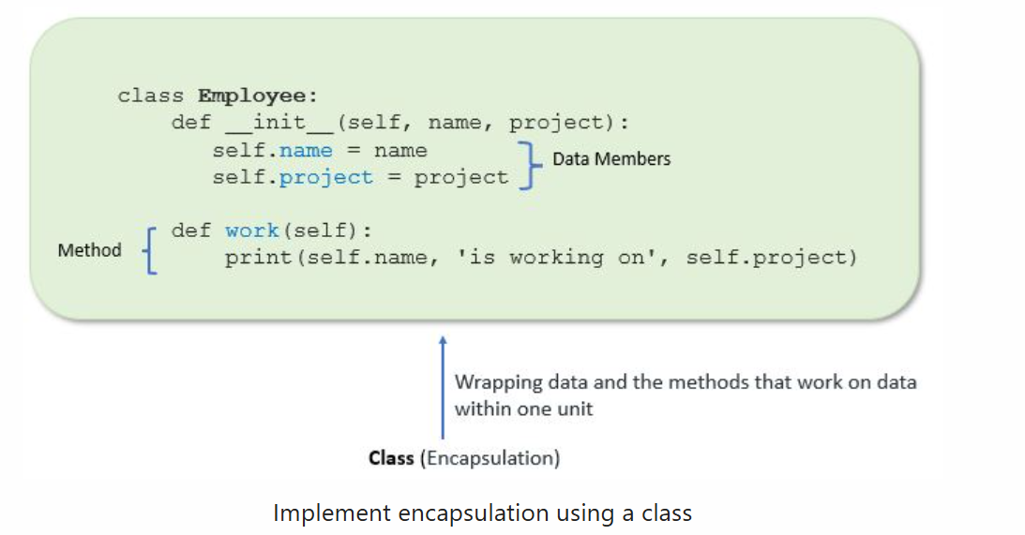
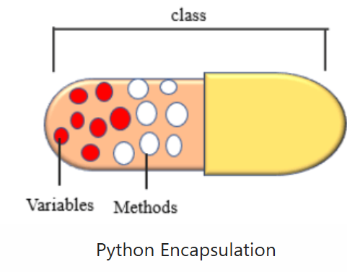

Slide 91
Why do we need Encapsulation in Python?
Encapsulation is a fundamental concept of object-oriented programming, as it limits access to a few components of an object. Using encapsulation in Python, we can restrict users from accessing the state values for the variables of each object. Moreover, it can hide data functions and data members associated with the instance of a class. With encapsulation, we have more flexibility to set variables to either read or write. It also supports code reusability and enables writing cleaner code. Hence, we can conclude that encapsulation facilitates data facilitation, at least in a way.

Slide 92
Access Modifiers in Python Encapsulation
At times, we might need to restrict access to certain variables or methods while programming. In such situations, we use access modifiers in Python encapsulation that limit the access of the class data members from outside the class. They protect the internal data of a class and instances associated with it. There are 3 types of access modifiers supported by encapsulation in Python. They are as follows:
Public Members- Member variables of a class are public by default, which means the data members and methods can be accessed outside or inside of a class.
Private Members- The private data members are accessible only within a class and are denoted with a double underscore prefix before their name.
Protected Members- These data members are accessible within a class and their subclasses and are denoted by a single underscore prefix before the name.

Slide 93
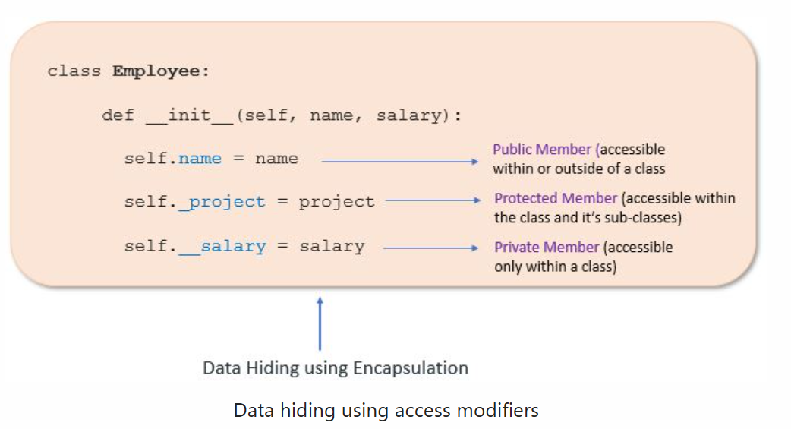
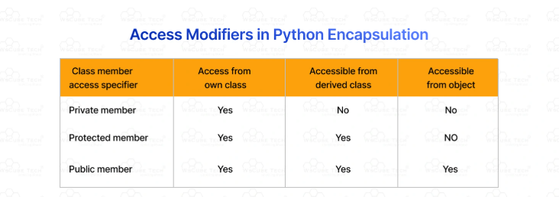

Slide 94
Public Access Modifier:
Public members are the variables and methods that can be accessed from anywhere within a class, i.e., both outside and inside the class and from any part of a program. They are the default members and are specified without any explicit keyword.
Example:
class MyClass:
def __init__(self, value):
self.value = value # Public attribute
def show_value(self): # Public method
print(self.value)
# Usage
obj = MyClass(10)
obj.show_value() # Accessing public method
print(obj.value) # Accessing public attribute
Output:
10
10

Slide 95
Private Access Modifier:
Private members in encapsulation are the variables that can be accessed only within the class. They are similar to the protected members, but what sets private members apart is they can’t be accessed outside the class or by any base class. In Python, you won’t find Private instance variables that can’t be accessed except within a class.
We can define a private access modifier by prefixing a private member with the double underscore ‘__’.
Also, private and protected members can be accessed outside a class through name mangling in Python.

Slide 96
Example
class MyClass:
def __init__(self, value):
self.__value = value # Private attribute
def __show_value(self): # Private method
print(self.__value)
def public_method(self): # Public method
self.__show_value() # Accessing private method within the class
# Usage
obj = MyClass(10)
# obj.__show_value() # This would raise an AttributeError
# print(obj.__value) # This would raise an AttributeError
obj.public_method() # Accesses private method through a public method
Output:
10

Slide 97
Protected Access Modifier:
The members or variables of a class that can be accessed only within the class and its subclass and not outside the class are known as protected members. These members are denoted by prefixing their name with a single underscore ‘_’.
The difference between protected members and private members is that the former can be accessed within the class and involve subclasses, unlike the private variables. With a private access modifier, members can be referenced within the class and the subsequent subclasses. As soon as an object of a class is instantiated, it runs the _init_ method.

Slide 98
Example
class BaseClass:
def __init__(self, value):
self._value = value # Protected attribute
def _show_value(self): # Protected method
print(self._value)
class SubClass(BaseClass):
def display(self):
self._show_value() # Accessing protected method from the subclass
# Usage
obj = SubClass(10)
obj.display() # Accessing protected method via public method in subclass
print(obj._value) # Accessing protected attribute directly (not recommended)
Output:
10
10

Slide 99
Advantages of Encapsulation:
Security:
The main advantage of using encapsulation is the security of the data. Encapsulation protects an object from unauthorized access. It allows private and protected access levels to prevent accidental data modification.
Data Hiding:
The user would not be knowing what is going on behind the scene. They would only be knowing that to modify a data member, call the setter method. To read a data member, call the getter method. What these setter and getter methods are doing is hidden from them.
Simplicity:
It simplifies the maintenance of the application by keeping classes separated and preventing them from tightly coupling with each other.
Aesthetics: Bundling data and methods within a class makes code more readable and maintainable

Slide 100
Python Polymorphism

Slide 101
Introduction
What Is Polymorphism in Python?
Function Polymorphism in Python
Polymorphism with Class Methods
Polymorphism with Inheritance
Polymorphism with Function and Objects

Slide 102
Introduction:
Python is an object-oriented programming (OOP) language. OOP refers to the method that involves designing programs using classes and objects. Polymorphism is one of the fundamental concepts of OOPs that allows one object to take multiple forms. We can implement polymorphism in different ways, such as classes, inheritance, methods, etc. In operator overloading, we use the same operator in different ways, such as string concatenation and addition.

Slide 103
What Is Polymorphism in Python?
The word polymorphism is the combination of two Greek words, ‘poly’, which means ‘many’, and ‘morphism’, which means ‘forms’. Therefore, the meaning of the term polymorphism is ‘having many forms’. We can also say that polymorphism refers to the occurrence of something in different forms.
When it comes to programming, polymorphism means the same function with the same name but different signatures and used in different ways and scenarios. The difference is primarily in the data types and number of arguments used in a function.
Polymorphism in Python makes code more flexible and reusable while making programming hassle-free and intuitive. It enables a function to display different functionalities together. Basically, it creates a structure that is capable of using many forms of objects. No wonder that polymorphism is considered a cornerstone of object-oriented programming.
In Python, polymorphism involves a child class that inherits methods with the same name from the parent class. It can be implemented in different ways. The concept has become an essential part of programming and allows a single entity to represent itself in multiple forms in different contexts, such as operators, methods, and objects.
We can use polymorphism in various ways in Python and define it using numerous class methods, functions, and objects. Basic example. A man can be a husband, employee, father, brother, friend, and partner.

Slide 104
Polymorphism in Python Example
class Shape:
def area(self):
raise NotImplementedError("Subclasses should implement this!")
class Rectangle(Shape):
def __init__(self, width, height):
self.width = width
self.height = height
def area(self):
return self.width * self.height
class Circle(Shape):
def __init__(self, radius):
self.radius = radius
def area(self):
import math
return math.pi * self.radius ** 2
def print_area(shape):
print(f"The area is: {shape.area()}")
# Usage
rectangle = Rectangle(5, 10)
circle = Circle(3)
print_area(rectangle) # The area is: 50
print_area(circle) # The area is: 28.274333882308138
Output:
The area is: 50
The area is: 28.274333882308138

Slide 105
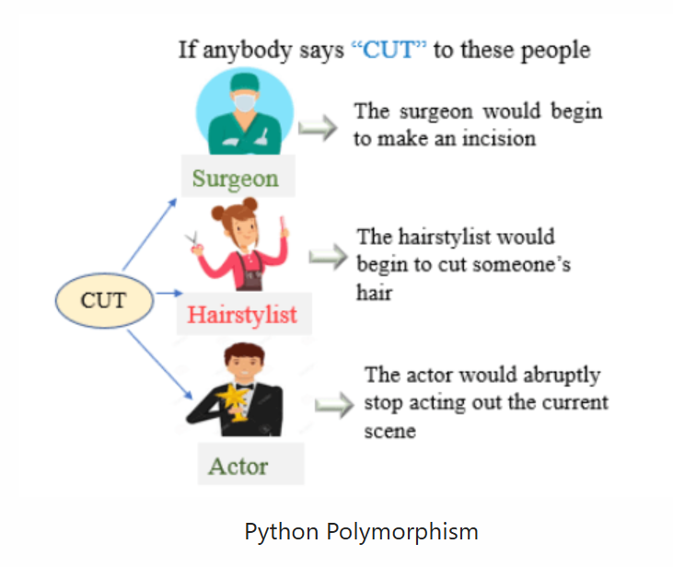

Slide 106
Function Polymorphism in Python:
We can achieve polymorphism in Python using the polymorphic function. There are two functions- an in-built function and a user-defined function. We will have a look at each of them in the following section:
In-built Function- Here’s an example showing how we can achieve polymorphism using the in-built function.
User-defined Function- Here’s an example demonstrating how to achieve polymorphism using the user-defined function.

Slide 107
Polymorphism with Class Methods:
We can achieve polymorphism using class methods. Python uses two different class types in the same way. When a method is called on an object, the Python compiler decides and chooses the appropriate method. It selects the method based on the type of the object and the argument passed.
We design a for-loop that iterates through a tuple of objects and executes all the methods for the first object in the tuple, then the second one in the tuple, and so on. It calls the methods without knowing about the type of class each object is. We just assume that the methods exist in each class.

Slide 108
Example
class Dog:
def speak(self):
print("Woof!")
class Cat:
def speak(self):
print("Meow!")
class Bird:
def speak(self):
print("Chirp!")
# Tuple of objects
animals = (Dog(), Cat(), Bird())
# Call speak method on each object
for animal in animals:
animal.speak()
Output:
Woof!
Meow!
Chirp!

Slide 109
Polymorphism with Inheritance:
Python polymorphism with inheritance allows a child class method to share the same name as the parent class method. Inheritance is the mechanism where the child class inherits the methods of the parent class.
We can modify some of the methods that a child class inherits from the parent class.
This is used when the method inherited from the parent class doesn’t fit the child class well.
So, we re-implement the method in the child class, and this process is known as Method Overriding. Also, making changes ensures that the child class works seamlessly.

Slide 110
Example
class Animal:
def make_sound(self):
print("Some generic sound")
class Dog(Animal):
def make_sound(self):
print("Woof!")
class Cat(Animal):
def make_sound(self):
print("Meow!")
# Create instances
animals = [Dog(), Cat()]
# Call make_sound method on each object
for animal in animals:
animal.make_sound()
Output:
Woof!
Meow!

Slide 111
Polymorphism with Function and Objects:
It’s not necessary to use polymorphism with just classes. We can use it with functions and objects, too.
Polymorphism with functions and objects is an interesting use case.
We can create a function that can take any object to induce polymorphism.
The functions are first-class objects passed as arguments and returned as values, adding more flexibility and modularity to programming.

Slide 112
Example :
def process_object(obj):
obj.action()
class Printer:
def action(self):
print("Printing...")
class Scanner:
def action(self):
print("Scanning...")
# Create instances
printer = Printer()
scanner = Scanner()
# Use the same function with different objects
process_object(printer) # Printing...
process_object(scanner) # Scanning...
Output:
Printing...
Scanning...

Slide 113
Python Constructors

Slide 114
Introduction
What Is a Constructor in Python?
Creating a Constructor in Python
Rules of Python Constructor
Types of Constructors in Python
Default Constructor in Python
Multiple Constructor in a Single Python Class
Advantages of Using Constructors in Python
Disadvantages of using constructors in Python

Slide 115
Introduction:
Constructors in Python are the backbone of Python programming. They ensure that all objects have the attributes required to function smoothly. When an object of a class is created, a constructor is also invoked automatically, which sets up the initial state of an object.
Whether you are an experienced programmer or kickstarting your programming journey, understanding the intricacies of Python constructors is crucial to mastering the language.

Slide 116
What Is a Constructor in Python?
A constructor in Python is a unique function used to initialize the instance of a class. It is called automatically when an object is created. In Java and C++ programming languages, a constructor has the same name as its class, but Python treats constructors differently. Here, they are used to create objects.
The use of constructors in Python is crucial as it is the foundation of object-oriented programming. Its primary purpose is to set initial values to data members and establish core functionalities once an object is created. In Python, __init__() is a constructor that is automatically called when an object is instantiated from a class.

Slide 117
Example:
class Student:
# constructor
# initialize instance variable
def __init__(self, name):
print('Inside Constructor')
self.name = name
print('All variables initialized')
# instance Method
def show(self):
print('Hello, my name is', self.name)
# create object using constructor
s1 = Student('Emma')
s1.show()
Output:
Inside Constructor
All variables initialized
Hello, my name is Emma
An object s1 is created using the constructor
While creating a Student object name is passed as an argument to the __init__() method to initialize the object.
Similarly, various objects of the Student class can be created by passing different names as arguments.

Slide 118
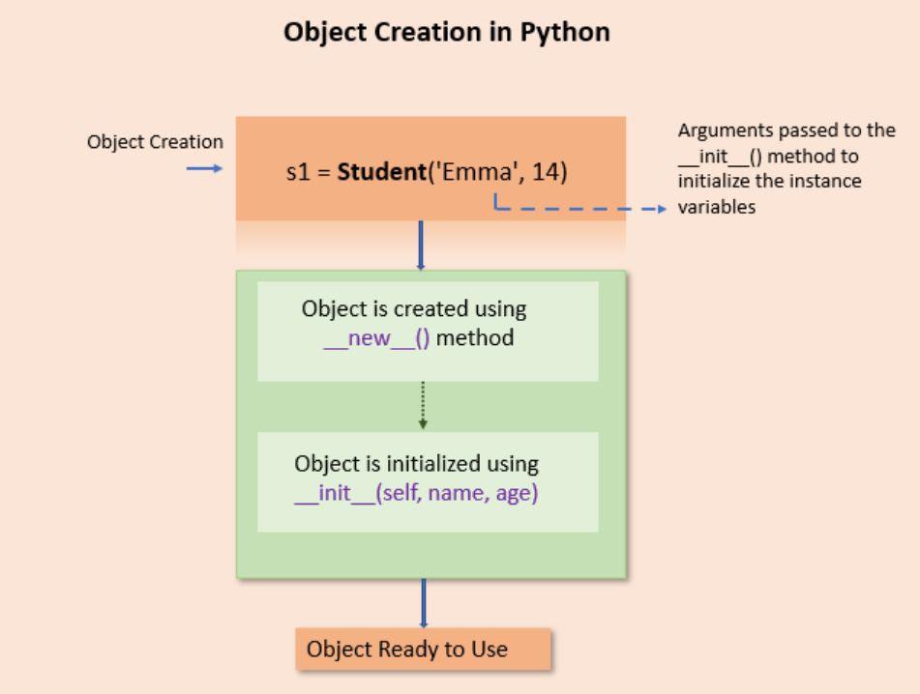
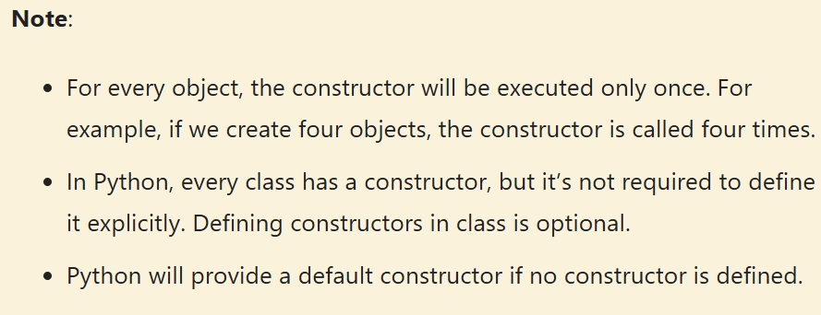

Slide 119
Creating a Constructor in Python
let’s understand how to create constructor in Python. As we said, constructors are special methods that initialize objects of a class. The __init__ method is the most common constructor in Python used to initialize class attributes.
Every class in Python has a constructor even if it relies on the default constructor. The __init__ method takes the self keyword as the first argument, allowing access to methods of the class.
Syntax to Declare a Constructor in Python
We use the following constructor syntax in Python for constructor declaration:
Syntax
class ClassName:
def __init__(self, parameter1, parameter2, ...):
# Constructor code here
Here, class ClassName is used to define a class using the name of the class.
def __init__(self, parameter1, parameter2, ...) defines the constructor method using __init__. The self is a mandatory parameter, referring to the instance of the class created. If you need, you can pass more parameters to the constructor.
Constructor code here is used to add code within the constructor. It initializes attributes or is used to perform other setup tasks.

Slide 120
Example:
class Car:
def __init__(self, make, model, year):
self.make = make
self.model = model
self.year = year
def display_info(self):
print(f"{self.year} {self.make} {self.model}")
# Create an instance of the Car class
my_car = Car("Toyota", "Corolla", 2020)
# Display the car's information
my_car.display_info()
Output:
2020 Toyota Corolla

Slide 121
Rules of Python Constructor
Like other Python functions, a Python constructor starts with the def keyword.
This is followed by init, which is prefixed and suffixed with double underscores and parentheses. It looks like this __init__().
__init__ is a special name in Python that is used to name the constructor method.
The first argument must be self, which is a reference to the object. It is used to access its methods and attributes and assign values to data members (variables).
When a constructor is called, an object is created and passed automatically to the __init__ () method.
A constructor is defined inside the class definition and not outside it.
When we define default and parameterized constructors in a class, the default constructor is used when we don’t pass any arguments, and the parameterized constructor is used when we pass arguments to the object.

Slide 122
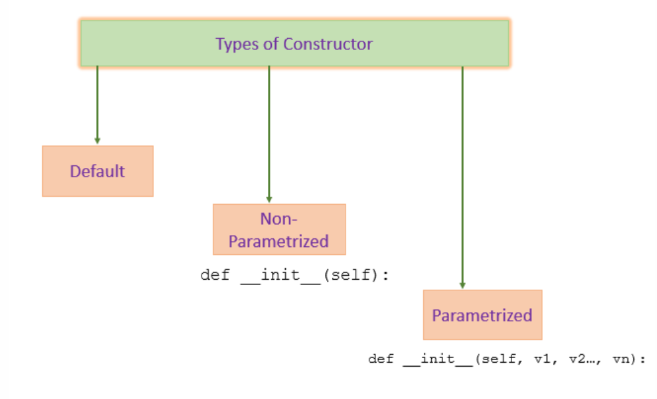
Types of Constructors in Python:
Python constructors are among the most fundamental and crucial concepts of the object-oriented paradigm. They ensure that objects are created with attributes required to function smoothly. This section will discuss two main types of constructors in Python.
Default Constructor
Parameterized Constructor
Non-parameterized Constructor

Slide 123
Default Constructor:
Python will provide a default constructor if no constructor is defined. Python adds a default constructor when we do not include the constructor in the class or forget to declare it. It does not perform any task but initializes the objects. It is an empty constructor without a body.
If you do not implement any constructor in your class or forget to declare it, the Python inserts a default constructor into your code on your behalf. This constructor is known as the default constructor.
It does not perform any task but initializes the objects. It is an empty constructor without a body.
Note:
The default constructor is not present in the source py file. It is inserted into the code during compilation if not exists.
If you implement your constructor, then the default constructor will not be added.
It is a basic non-parameterized constructor with no specific task or initialization apart from basic object creation.

Slide 124
Parameterized Constructor:
A parameterized constructor in Python takes additional arguments along with the standard self parameter. It takes the first argument as a reference to the instance, and the programmer provides the rest of the arguments. This constructor allows classes in Python to start their attributes with particular values.
Parameterized constructors can accept arguments, which are used to initialize attributes of an object or perform operations when an object is created.

Slide 125
Parameterized Constructor in Python Example :
class Person:
def __init__(self, name, age, city):
self.name = name
self.age = age
self.city = city
def introduce(self):
print(f"Hello, my name is {self.name}. I'm {self.age} years old and I live in {self.city}.")
# Creating instances of the Person class with Indian names and cities
person1 = Person("Amit", 28, "Mumbai")
person2 = Person("Priya", 24, "Bengaluru")
# Introducing the persons
person1.introduce() # Output: Hello, my name is Amit. I'm 28 years old and I live in Mumbai.
person2.introduce() # Output: Hello, my name is Priya. I'm 24 years old and I live in Bengaluru.
Output:
Hello, my name is Amit. I'm 28 years old and I live in Mumbai.
Hello, my name is Priya. I'm 24 years old and I live in Bengaluru.

Slide 126
Non-parameterized Constructor:
A non-parameterized constructor in Python takes no arguments or parameters except the mandatory self parameter. We use it to initialize class members with default values or perform initialization tasks that don’t need external inputs. This type of constructor ensures that the object has a standard structure by assigning default values.
The best of a non-parameterized constructor is its simplicity. When an object is created, it gets predefined values, bringing consistency and uniformity. We don’t necessarily need this constructor; programmers can decide whether to use it in class. However, they are useful in the following situations:
To perform operations when an object is created, such as establishing a connection to a database or opening a file.
To initialize the default values for instance variables of an object.
To create a skeleton object used as a template to create other objects.

Slide 127
Example:
class Person:
def __init__(self):
self.name = "John Doe"
self.age = 30
def display_info(self):
print(f"Name: {self.name}, Age: {self.age}")
# Create an instance of the Person class using the non-parameterized constructor
person = Person()
# Display the person's information
person.display_info()
Output:
Name: John Doe, Age: 30

Slide 128
Multiple Constructor in a Single Python Class:
Unlike other programming languages, Python doesn’t support multiple constructors with different parameters. However, we can emulate more than one constructor by using default arguments and conditional logic with __init__.
The ability of Python to define multiple constructors in a class with a different number or parameter for each is known as Python constructor overloading or method overloading. This allows a class to manage several initialization situations, bringing object creation flexibility.

Slide 129
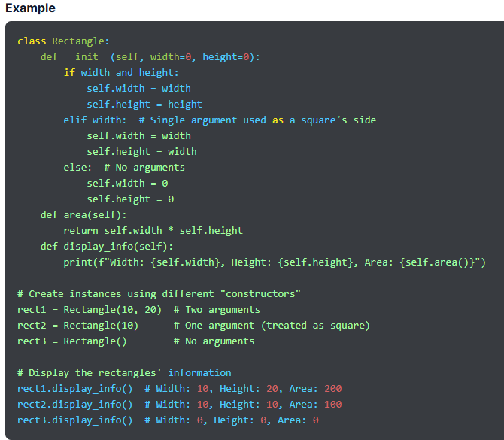
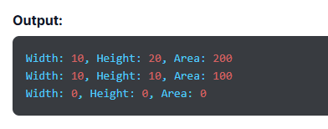

Slide 130
Advantages of Using Constructors in Python
Constructors in Python are strategic assets that make programming more efficient by enhancing code readability, efficiency, and functionality. Here are a few benefits of Python constructors that make them crucial to Python.
1. Improved Readability- Python constructors give structure to the code, clearly stating what values are initialized and how. This makes the code more readable for programmers and enables them to understand it better.
2. Automatic Invocation- Automatic invocation is among the best features of Python constructors, which ensures every object is initialized properly, promotes consistency, and reduces human errors.
3. Easy Initialization- Constructors offer an efficient way to assign an initial value to all objects of a class. We can set default values for attributes and initialize objects with custom data. Also, they streamline object creation, so each object has the right start.
4. Flexible Object Creation- Parameterized constructors in Python ensure that each object has distinct attributes. This creates a dynamic programming environment where all objects are customized based on specific requirements.
5. Easy Implementation- In Python, constructors are easy to implement. We can define them using the __init__ method.
6. Efficient Memory- When it comes to memory optimization, constructors stand out. They initialize objects at the outset, which prevents resource redundancy and keeps the memory footprints to minimal.

Slide 131
Disadvantages of using constructors in Python:
Similar to any tool, constructors also have drawbacks and challenges. Along with their benefits, programmers must be familiar with their loopholes and limitations to employ constructors judiciously and tap into their full potential.
1. Overloading Complexity- In Python, native constructor overloading is not as intuitive as other programming languages, which can confuse programmers when they transition from other languages.
2. Limited Functionality- Compared to other languages, Python constructors have restricted functionality. For example, they don’t have access modifiers.
3. Overhead Complications- If not implemented judiciously, constructors can lead to overhead and slow down the program execution.
4. Error Propagation- Constructors affect every object of a class. Therefore, any error in a constructor doesn’t stay confined. It can hamper the entire program and create widespread problems.
5. Issues with Multiple Constructors- Python doesn’t support method overloading, so you can’t have multiple constructors with distinct parameters in a single class.
6. Dependency Issues- Relying completely on constructors can reduce modularity. Objects intertwined deeply with constructors can be difficult to handle, specifically for complex projects.
7. Initialization Challenges- In the case of diverse methods of object initialization, constructors can be restrictive and rigid.

Slide 132
Method Overriding in Python

Slide 133
Introduction
What Is Method Overriding in Python?
Features of Method Overriding in Python
Prerequisites for Method Overriding
Method Resolution Order in Python
Method Overriding with Multiple and Multilevel Inheritance
Super()
Difference Between Method Overloading and Method Overriding in Python

Slide 134
Introduction:
Object-oriented programming languages allow a child class to provide a custom implementation method already supplied by its parent class. This is called method overriding, where override means a subclass method replacing a superclass method when both methods have the same parameters, name, signature, and return type.
What Is Method Overriding in Python?
Method overriding is a special feature of object-oriented programming closely related to inheritance, enabling the concept of inheritance to tap into its full potential. This concept allows a subclass or child class to provide its own implementation of a method already defined in its superclass or parent class.
When the subclass method has the same name, parameter, and return type as the superclass method, it overrides the superclass method. This is known as a Python overriding method, where subclass is the overriding method and superclass is the overridden method.
Its execution is based on the data used to invoke the method and not the reference data provided in the parent class. If the superclass object invokes the implementation method specific to a program, the version of the method in the parent class is executed. However, if the object of the subclass invokes the method, the execution depends on the features of the subclass. So, the type of the object being referred to determines the version of the overridden method to be executed and not the type of reference variable.

Slide 135
Method overriding uses numerous methods with the same number of arguments. The methods have the same signatures and names but are located in different classes. Method overriding is different from method overloading as the latter occurs when two functions have the same name but different parameters. Also, Python doesn’t directly support method overloading.
To override a method in Python, there are certain conditions to meet, which are as follows:
Python override method is not allowed in the same class. You can do it only in a subclass or child class through the concept of inheritance.
To override the superclass, create a function in the subclass that has the same name and same number of parameters. This is known as function overriding.

Slide 136
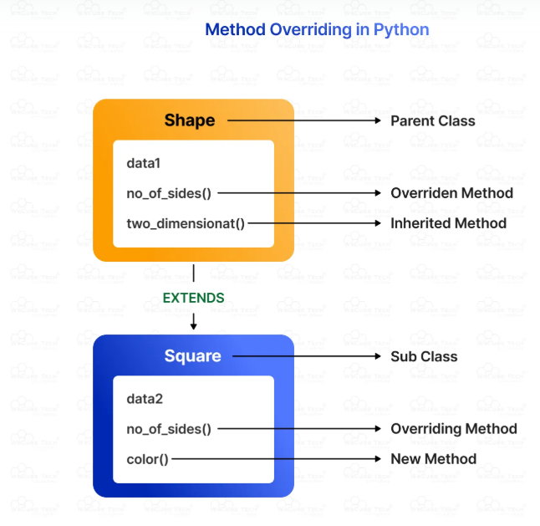
In this example,
data1 and data2 are two distinct properties of the classes.
In the Vehicle class, drive() is the overridden method because drive() in the Car class method overrides it.
color() is inherited by the subclass, and park() is the new method added to the Car class.
Please replace Shape with Vehicle, no of sides with drive(), two dimensional with color(), square with Car, and color with park().

Slide 137
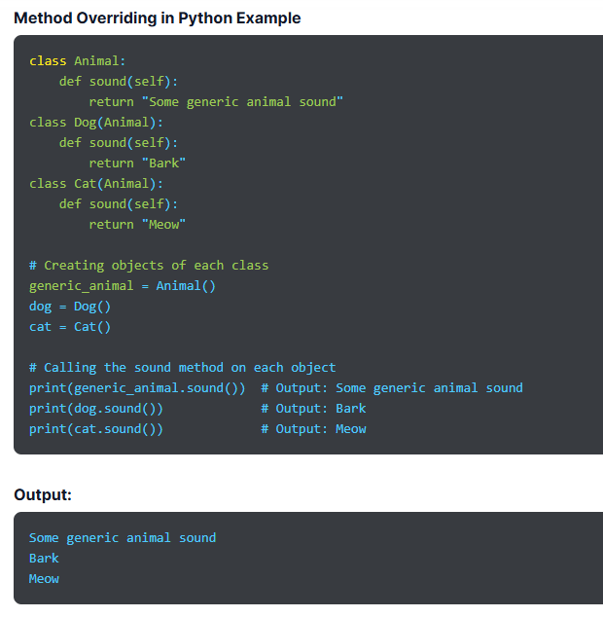

Slide 138
Features of Method Overriding in Python:
Let’s take a look at the key features of method overriding in Python to help you understand the concept better:
Method overriding always uses the feature of inheritance.
It is derived from object-oriented programming.
The child class can adapt to the execution of any method provided by one of the parent classes.
It allows the main class to declare methods shared by all, and the subclass can define the implementation of any or all methods.
It helps avoid code duplication.
It occurs between the superclass and the subclass.
It allows us to change or override the implementation of a function in the child class defined in the parent class.

Slide 139
The subclass and superclass must have the same signature and parameters.
It changes the behavior of existing methods.
It improves code by adding more properties.
It requires at least two classes to carry out method overriding.
Prerequisites for Method Overriding
Method overriding has a few prerequisites that we have listed in this section:
The method must share the same name as the parent class.
It can’t occur in the class and requires a child class derived from the parent class. Therefore, it is considered a part of the concept of inheritance.
The method must have the same number of parameters as the superclass.

Slide 140
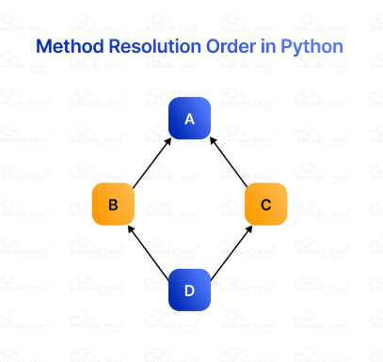
Method Resolution Order in Python
In method resolution order, a Python program searches for a class in multiple inheritance. Here are a few points to consider:
Multi-inheritance refers to a class derived from more than one parent class.
It follows the depth-first search approach.
It is crucial in programs using multi-inheritance.
First, the attributes are searched for in the base class. If not found, the search moves to the immediate superclass, and the search continues following the same approach.
Here is an example of diamond inheritance, which refers to ambiguity when two classes (B and C) inherit from one parent class (A) and another class (D) inherits from B and C. If a method is overridden in either class B or C or both, the ambiguity arises as to which of the two classes D should inherit. To solve the issue, we adopt the depth-first approach

Slide 141
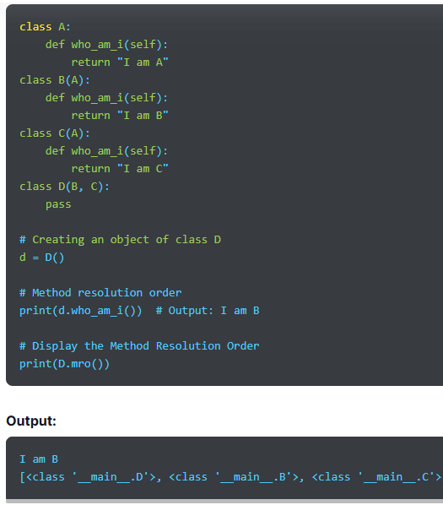
Explanation:
1. Class Hierarchy:
A is the base class.
B and C both inherit from A.
D inherits from both B and C.
2. Diamond Inheritance:
B and C both override the who_am_i() method defined in A.
D has two potential paths to A: through B or through C.
This creates a "diamond" shape in the inheritance structure.

Slide 142
3. Method Resolution:
When d.who_am_i() is called, Python searches for the who_am_i() method in the class D.
If not found, it follows the MRO, checking B first, then C, and finally A if necessary.
Since B defines who_am_i(), that method is called, resulting in "I am B.“
4. MRO Display:
The D.mro() method displays the order in which classes are checked: [D, B, C, A, object].
This shows that Python follows a depth-first, left-to-right search order while respecting the MRO rules.

Slide 143
Method Overriding with Multiple and Multilevel Inheritance:
Inheritance refers to the capability of one class to inherit the properties from another class. It is crucial in method overriding because it connects subclass and superclass methods. Also, it promotes code reusability.
Inheritance is transitive, so if one child class inherits from a parent class, all the subclasses of the child class will automatically inherit from that parent class. As we call the overridden method in Python, the method of the derived class is invoked. This means the method in the parent class is now hidden.
To help you understand method overriding implementation, let’s take an example. Son inherits traits from father. So, the object of the child class (son) can access the parent class (father) method and its own methods. However, due to the same method names in both classes, the child class method will override the parent class method.
Now, let’s understand the use of method overriding in Python in multiple and multilevel inheritances, two fundamental concepts in most object-oriented programming languages.

Slide 144
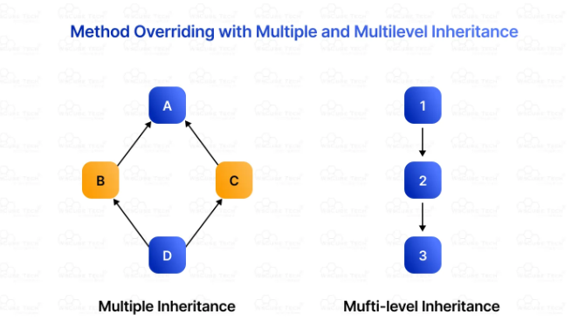

Slide 145
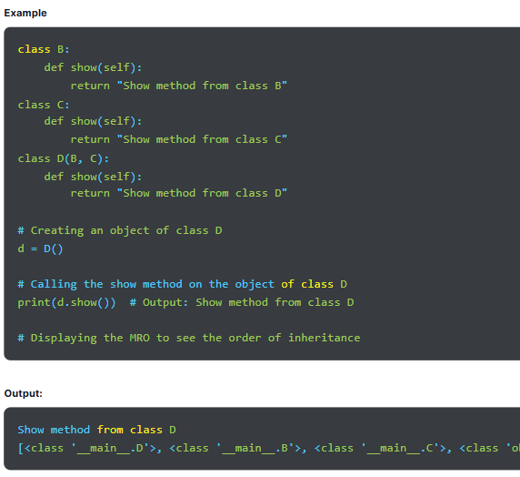
Multiple Inheritance:
In multiple inheritance, a subclass inherits properties and features from more than one superclass. For example, in the image above, class D is the child class that inherits from parent classes B and C. So, D will have the features of both B and C.
Overriding in Multiple Inheritance
Overriding in multiple inheritance refers to a child class providing its implementation to the attributes that it inherits from the parent class.

Slide 146
Multilevel Inheritance:
In multilevel inheritance, there are different levels of inheritance involving child and grandchild classes. Here, a subclass inherits from a base class, which acquires attributes from another parent class. The subclass has unique features inherited from its parent class. For example, class 3 inherits from class 2, which in turn inherits from class 1. Therefore, class 3 and class 1 share a grandparent and grandchild relationship.
Overriding in Multilevel Inheritance
When we override one attribute of one parent class, it is known as overriding in multilevel inheritance. In other words, we override the methods of the parent or grandparent class through the child class.
Calling the Base Class Methods within Overridden Methods
Parent class methods can be invoked within overridden methods using the following ways:
Classname
The parent class methods can be invoked by using the Parent classname.method within the overridden method.

Slide 147
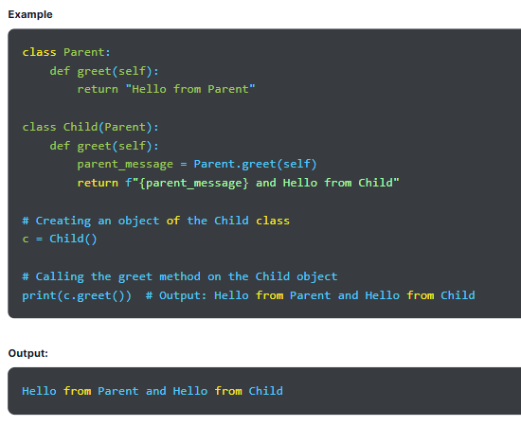

Slide 148
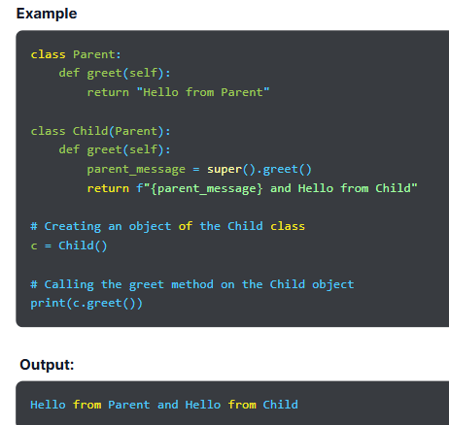
Super():
We can also use the super() function that allows us to explicitly refer to the parent class. It is used when we need to call superclass functions and the method returns the proxy object to refer to the parent class by super.

Slide 149
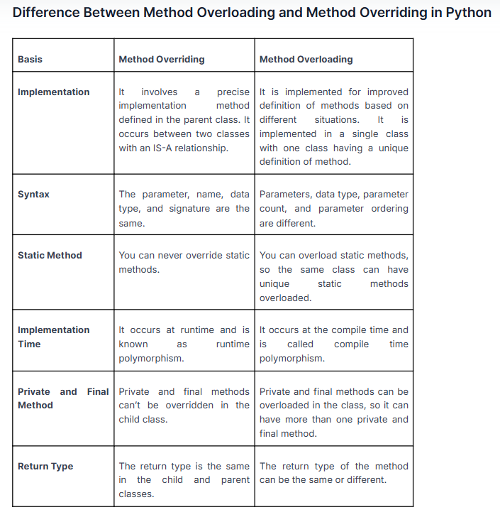

Slide 150
Data Abstraction in Python

Slide 151
Introduction
Data Abstraction in OOP
What Is Data Abstraction in Python?
Abstraction Classes in Python
Using the abc module to import the ABC class.
Why use an abstract base class?
Working of Abstract Class
Concrete Method in the Abstract Base Class
How to create an abstract base class and abstract method?
Importance of Python Data Abstraction
Introduction
Abstraction hides unnecessary and internal functionality from users and provides access to helpful information. Therefore, users interact with basic implementation details without knowing their inner workings. This means users are aware of “what a function does” without knowing “how it does it.”
For example, we may use a smartphone, knowing its different functions, such as voice recorder, messaging, camera, and calls. However, we don’t know how the smartphone performs these operations or what’s happening in the background.

Slide 152
Data Abstraction in OOP:
Data abstraction is a powerful and essential concept in object-oriented programming. It simplifies complex codes and tasks for users by hiding irrelevant details and showing only the useful parts.
In programming, there are times when we don’t want to expose or share sensitive details of code implementation. Hence, we use data abstraction in such cases. For example, when you go through a tutorial online, you only know that a subject expert prepared it and, at times, the name of the writer. However, you are not aware of the entire process that goes behind preparing, editing, and publishing that tutorial because those details are not useful to you.
For a coder or programmer, data abstraction goes beyond simply hiding a section of information. For example, if they want to build a program to add or multiply two specific numbers, they won’t make an effort to develop an app that can add or multiply specifically those two numbers. The ideal scenario would be to create a program that can add or multiply any two numbers.
Therefore, we can say that abstraction separates specific uses of a function from its generalized purpose. Hence, we can reduce task complexities and build more scalable and flexible programs.

Slide 153
What Is Data Abstraction in Python?
Data abstraction is the process of hiding unnecessary and complex implementation details from users while showing only essential details and functionalities. This is a core concept in object-oriented programming that allows users to implement complex logic based on the information provided without bothering with backend complexities.
We can achieve Python abstraction by using abstract classes created through the abstract base class (abc) module and its @abstractmethod.
Another example of Python data abstraction is driving a car. We know how to use breaks, clutch, and gear but we are not familiar with what’s happening behind the scenes.

Slide 154
Abstraction Classes in Python
An abstract class is one in which one or more abstract methods are defined. When we declare a method inside a class without its implementation, it is called an abstract method. An abstract class is a blueprint or template for other classes as it defines a list of methods a class must implement. A subclass can inherit an abstract class, and the object of the derived class can be used to access base class features.
An abstract class provides the standard interface for implementations of components, enabling a class to derive data and functions from the base class. In Python, we use the abc module for abstraction, and here is the syntax for it.
Syntax
from abc import ABC
class ClassName(ABC):
Abstract classes lay down the blueprint and create a structure to build other classes. Hence, it ensures a standard set of methods to implement in the derived classes. Basically, an abstract class dictates a type of contract and inheriting classes adhere to it by implementing the methods. The following are the key components of an abstract class:
One of the primary features of abstract classes is they can’t be created or instantiated directly. They are the base for other classes and are not instantiated themselves.
They lay down the template or structure to build other classes. They provide a blueprint for other classes by defining methods without implementing them

Slide 155
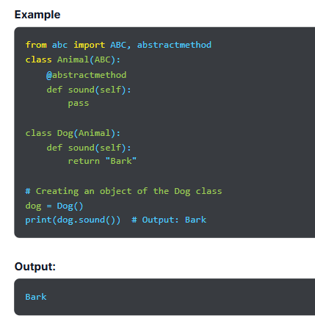

Slide 156
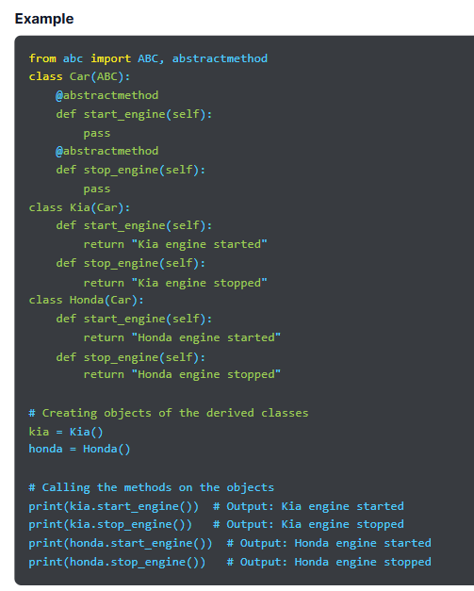
Using the abc module to import the ABC class.
For example, we create an abstract class named Car and derive two subclasses, Kia and Honda, from it. The two classes implement the methods defined in the abstract class. The Car class is the parent abstract class, whereas Kia and Honda are subclasses. We can’t access methods of the parent class by creating an object but have to create objects of two derived classes for it.

Slide 157
Why use an abstract base class?
When we define an abstract base class, it allows us to create a common API for multiple subclasses. This comes in handy while working in large teams and codebases, as we don’t need to remember all the classes.
Working of Abstract Class
Most high-level programming languages provide the abstract class, but the abstract method is not a default feature in Python. Therefore, we achieve this using the abc module that provides the base class and necessary tools to define Abstract Base Class (ABC).
The abc module’s @abstractmethod decorator indicates abstract methods in the base class. Also, it has a virtual subclasses feature. These are the classes that don’t inherit from a class but are recognized by
isinstance()
and
issubclass()

Slide 158
The abc module provides the metaclass ABCMeta to define ABCs, whereas the helper class defines ABCs through inheritance. While defining ABC, we can create the abstract methods in the base class by decorating using the @abstractmethod keyword and register concrete methods as implementations of the base class.
We can create our ABCs as shown:
from abc import ABC
class MyABC(ABC):
pass
The abstract method of the base class tells the child class to write an implementation of all defined abstract methods. If it’s not done, the code will throw an error.

Slide 159
Concrete Method in the Abstract Base Class:
In abstract methods, an implementation may vary for any subclass, and there must be an implementation while defining the subclass. However, some methods have the same implementation for all subclasses. Some of the features exhibit the properties of an abstract class and must be implemented in the abstract class; else all inherited classes will have repetitive code. Such methods are known as concrete methods.
In Python, concrete methods are defined in the abstract class with complete implementation and must avoid code repetition in the subclass. So, if an abstract class has a method with the same implementation as its subclasses, we just need to write the implementation of that particular method in the abstract base class rather than repeatedly writing the implementation of the concrete method for every subclass.
An abstract class can have abstract and concrete methods. To access the concrete method of an abstract class, we instantiate an object of a child class, which also lets us access its abstract methods. However, we must provide an implementation of the abstract method in the child class even when it is in the abstract class. Also, a subclass implements all abstract methods defined in the parent class; else it can throw an error.

Slide 160
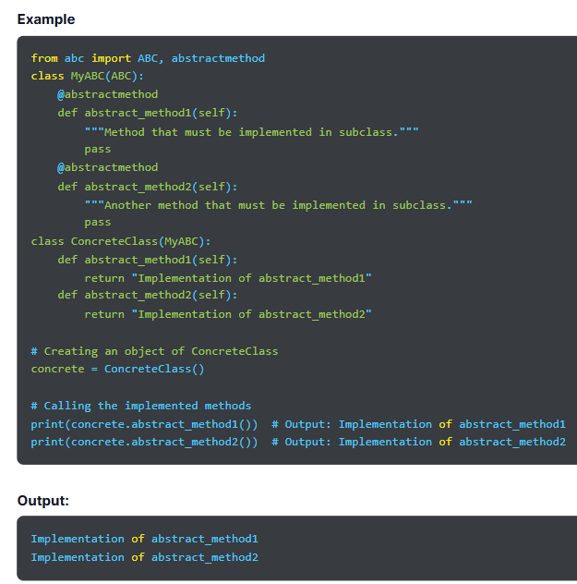
Explanation:
Abstract Base Class (MyABC):
Inherits from ABC and defines two abstract methods, abstract_method1 and abstract_method2, using the @abstractmethod decorator. These methods have no implementation and must be overridden in any concrete subclass.
Concrete Class (ConcreteClass):
Inherits from MyABC and provides concrete implementations for both abstract_method1 and abstract_method2.
Creating Instances:
You can create an instance of ConcreteClass and call the implemented methods.

Slide 161
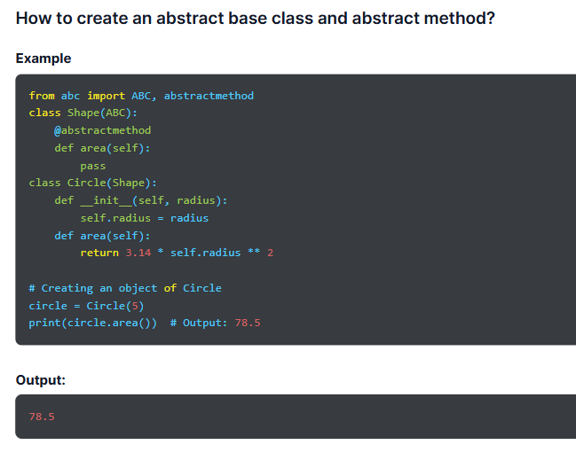

Slide 162
Importance of Python Data Abstraction
Data abstraction shows only the most crucial and useful data to users while hiding complex implementation details. This enables them to design modular and organized code, promotes code reusability, makes it easier to understand and maintain code, and ensures seamless collaboration.
1. Improved Modularity- Data abstraction helps us create a modular, reusable, and understandable program. This makes software expandable and adaptable.
2. Better Security- It protects sensitive and complex data from unauthorized access, which enhances the security of data and systems.
3. Simplified Complexity- Data abstraction streamlines the code and makes it user-friendly. This simplification allows users to interact with complex systems intuitively without bothering about useless and unnecessary details.
4. Reduced Errors- As abstraction hides implementation details about data structures from users, it ensures data integrity. It mitigates the chances of errors and safeguards crucial data.
5. Improved Maintainability- By showing only useful and necessary details and exposing a consistent interface, abstraction enables developers to modify the underlying code without hampering the user experience.
6. Enhanced Flexibility- Abstraction makes software flexible, so developers can modify internal code, optimize performance, and add new functionalities without disrupting the user interface or affecting user interaction.

Slide 163
Iterators in Python

Slide 164
Introduction
What is an Iterator?
What Is an Iterator in Python?
Iterator vs Iterable
Creating an iterator using iter() and next()
StopIteration
Python Infinite Iterators
Introduction:
The more we learn about the Python programming language, the more we realize how powerful it is. Ample Python tools add to its popularity, and iterators are one of them.
Python iterators is a crucial concept used for controlled traversal of collections. In Python, everything, including variables, lists, sets, functions, tuples, etc., is considered an object. Similarly, iterators are also objects.

Slide 165
What is an Iterator?
An iterator is a term derived from iterating, a technical term for looping elements. It is a fundamental concept in programming languages like C, Java, and Python that allows sequential access to elements or items in a list, array or set. It means iterating or looping through a collection of elements without exposing their underlying structure.
An iterator is like a cursor that points at the current position in the collection, offers a way to retrieve the next element, and checks if there are more elements to process. This makes the traversal of larger datasets more efficient as it doesn’t load the entire collection into memory at once.
What Is an Iterator in Python?
A Python iterator is an object used to iterate over objects, such as tuples, lists, sets, and dictionaries. In simple terms, iterators in Python means looping through iterable objects.
We use the iter() method to initialize a Python iterator object and the next() method for iteration.
The two primary methods of Python iterators are:
iter()
next()

Slide 166
__iter__()- This method initializes an iterator and returns an iterator object. It allows the instance of an object to be used for iterating.
Syntax
myiterator = iter()
__next__()- This method returns the next element in the collection and raises a StopIteration to indicate the end of the iteration. The for loop relies on iterators, so when we use it to traverse through iterable objects, it uses iter() in Python to get an iterator object, which uses the next() method to iterate over. It makes looping through various data structures cleaner and more concise.
Syntax
item = next(myiterator)
Python iter() Example
Example
# A list of numbers
numbers = [1, 2, 3, 4, 5]
# Create an iterator object
iterator = iter(numbers)
# Iterate through the iterator using a loop
for number in iterator:
print(number)
Output:
1
2
3
4
5

Slide 167
Iterator vs Iterable:
Thanks to programming jargon, it is easy for anyone to get confused between an iterator (that facilitates looping) and an iterable (that can be looped over), the two fundamental concepts in Python. A programmer must understand the difference between an iterator and an iterable to manipulate data in Python efficiently.
An iterator is an object containing __iter__() and __next__() methods. It maintains the state of the current iteration and allows sequential access. On the other hand, an iterable can return one element at a time and can’t save the state of the iteration.
Iterators are created using iterables, so every iterator is an iterable. Also, they are used to loop through collections effectively. However, every iterable is not an iterator.

Slide 168
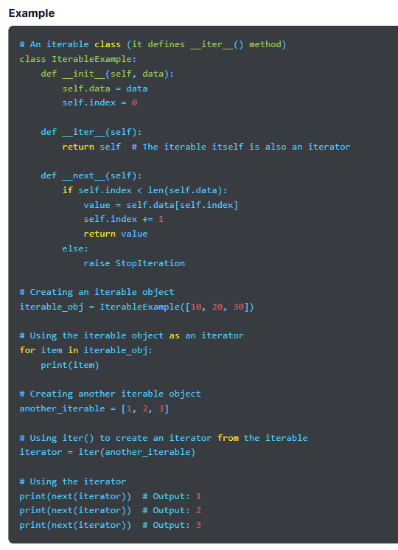
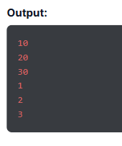

Slide 169
Creating an iterator using iter() and next()
In Python, we can create an iterator object or class and loop over an iterator using the iter() and next() methods. We use the __iter__() function, which takes an iterable object and returns an iterator.
The __iter__() method is similar to the __init__() that is used to initialize an object. The difference is that the former returns the iterator object. The __next__() method allows operations and returns the next element in the sequence. It raises StopIteration upon reaching the end. Similar to other things in Python, creating a custom iterator from scratch is easy.
Syntax
Class className:
def __iter__(self):
-- Operation --
return self
def __next__(self):
-- Operation --
return x

Slide 170
Iterating over built-in iterable using the iter() method
We use the __iter__() method to convert a built-in iterable into an iterator. This process enables efficient data handling.
Example
# A built-in iterable (list)
numbers = [1, 2, 3, 4, 5]
# Convert the list into an iterator
iterator = iter(numbers)
# Iterate over the iterator
print(next(iterator)) # Output: 1
print(next(iterator)) # Output: 2
print(next(iterator)) # Output: 3
print(next(iterator)) # Output: 4
print(next(iterator)) # Output: 5
Output:
1
2
3
4
5

Slide 171
StopIteration
StopIteration in Python is a built-in exception that is raised when an iterator can’t return any more items. Python allows an iterable to be iterated over multiple times. However, iterators raise a StopIteration error when all the items are already iterated over.
This error indicates that the iteration process has reached its end and helps to stop the iteration at state so that the iteration doesn’t go over and over. The error occurs when the next() function is called on an iterator that has already been iterated through all the elements. It is used to stop the iteration after a particular condition or termination statement. If you don’t use StopIteration, the iteration will continue forever in a for loop.
The StopIteration is also used in the next() method to stop the iteration after a specific condition or termination statement. Also, the program can crash if you don’t handle this exception. Hence, use a try and except block to handle StopIteration, and it would ensure effective use of iterators with seamless and controlled data processing.
Syntax
class MyNumbers:
def __iter__(self):
-- Operation --
return self
def __next__(self):
Terminating Condition
-- Operation –
return x
else:
raise StopIteration

Slide 172
Python Infinite Iterators:
Typically, iterators iterate over an iterable with a finite or fixed length. However, they can be never-ending, too. So, the iterators that never end are known as infinite iterators. They can run forever and must be taken care of meticulously while handling iterators.
Example
import itertools
# Create an infinite iterator using itertools.count
infinite_counter = itertools.count(start=1, step=1)
# Take a few elements from the infinite iterator
for _ in range(5):
print(next(infinite_counter))
Output:
1
2
3
4
5

Slide 173
Python Generators
Introduction
What Are Generators in Python?
Create a Generator in Python
Generator Object
Python Generator Expression
Yield vs Return
A Generator Function vs a Normal Function
Python Generators With a Loop
Benefits of Python Generators

Slide 174
Introduction
Generators in Python are functions that return an iterator using the yield keyword. They create iterators and return a traversal object, helping traverse all elements one at a time.
What Are Generators in Python?
Python generators are capabilities that create iterators and return a traversal object. They traverse all the items in the iterator one at a time and help produce a large sequence of values. However, we don’t store them all in memory at once. A generator can also be an expression with a syntax similar to that of the list comprehension in Python.
Creating an iteration in Python is a lengthy and complex process that requires us to implement __iter__() and __next__() methods to track the internal state. Hence, we use generators, one of the most crucial concepts in Python, to simplify the process.
A Python generator function is defined like a normal function. However, in the normal function, we use the return keyword, whereas in generators, we use the yield keyword to generate a value. If yield is present in the body of the def, that function will automatically become a generator function.

Slide 175
Create a Generator in Python
In Python, we create a generator function the same way we create a normal function by using the def keyword. We use the yield keyword instead of the return keyword. The syntax for creating a generator function is:
Syntax
def function_name():
yield statement
Here, we use the yield keyword to produce a value from the generator. As the generator function is called, instead of executing the function immediately, it returns a generator object that is iterated over to generate values.
Python Generator Example
def simple_generator():
yield 1
yield 2
yield 3
# Create a generator object
gen = simple_generator()
# Iterate through the generator
for value in gen:
print(value)
Output:
1
2
3

Slide 176
Generator Object
A generator function in Python returns a generator as an iterable object (an object that can be used as an iterator). We can use these objects by calling the next method of a generator object or using the object in the for-in loop.
Example
def count_up_to(max):
count = 1
while count <= max:
yield count
count += 1
# Create a generator object
counter = count_up_to(3)
# Use the generator with the next() method
print(next(counter)) # Output: 1
print(next(counter)) # Output: 2
print(next(counter)) # Output: 3
# Uncommenting the following line will raise StopIteration because the generator is exhausted
# print(next(counter)) # Raises StopIteration
# Alternatively, use the generator in a for loop
for number in count_up_to(3):
print(number)
Output:
1
2
3
1
2
3

Slide 177
Python Generator Expression
A generator expression in Python is a concise way of creating a generator object. It is a way of writing a generator function and uses the list comprehension method in Python. However, it doesn’t store elements in a list in memory but creates generator objects that can be iterated over to produce a value.
Python Generator Expression Syntax
(expression for item in iterable)
Here, expression refers to a value returned for every item in an iterable. The Python generator expression creates a generator object that produces a value for every item in an iterable.
Example
# Generator expression to produce squares of numbers from 1 to 5
squares = (x**2 for x in range(1, 6))
# Iterate through the generator expression
for square in squares:
print(square)
Output:
1
4
9
16
25

Slide 178
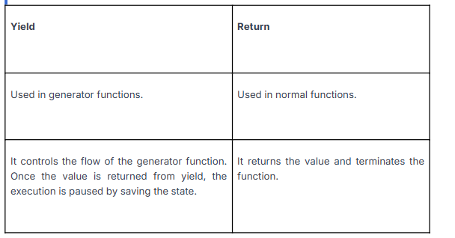
Yield vs Return:
Yield controls the flow of the generator function in Python. It saves the states and yields, which stops the execution of the function. It resumes execution once the progressive capability is called. We can use multiple yield statements in the generator function.
The return statement returns a worth and is used in a normal function. It stops the function and returns the value.

Slide 179
A Generator Function vs a Normal Function:
A generator function has one or more yield functions, whereas a normal function has only one function.
The states of local variables are retained between calls.
Once the generator function stops, the StopIteration is called automatically.
When a generator function is called, the normal function halts the execution and the call is transferred to the generator function.

Slide 180
Python Generators With a Loop
We can use generators in Python with a loop, as shown in the example.
Example
def simple_gen():
yield 10
yield 20
yield 30
# Create a generator object
gen = simple_gen()
# Use the generator in a for loop
for value in gen:
print(value)
Output:
10
20
30

Slide 181
Benefits of Python Generators
The use of generators in Python offers various benefits that we have explained below:
Memory Efficient
A normal function creates an entire sequence in memory to return a sequence from the list. If the number of items in the sequence is large, it can consume ample memory. However, a generator function is memory-friendly as it calculates the value and produces one item at a time.
Pipelining Generators
We can use multiple generators to pipeline a series of operations. There is a huge dataset or streams of information to handle, but that doesn’t require additional PC memory. For example, suppose we want to evaluate a log file of a business. So, a section of the log document will monitor the quantity of products sold. We can find the total sales or total number of products sold in the last 5 years. For this, we will use generators to create a pipeline using a series of operations.
Easy to Implement
Generators offer a clearer and more concise way for implementation than their iterator class counterparts.
Represent Infinite Stream
We know that storing infinite sequences in memory is not possible. Therefore, we use generators that are considered brilliant mediums to present an infinite stream of data as they produce one item at a time.

Slide 182
Python Closure

Slide 183
Introduction
Nested Functions in Python
What Is a Closure in Python?
When and Why to Use Closures?
Introduction:
Closure in Python is a nested function that we use to access variables of the outer function even when the outer function is closed.
Here is a Python code for you:
def outer_func():
message = 'Hello'
def inner_func():
print(message)
return inner_func
Here, there are two functions. In the outer_func(), a variable is initialized using the string ‘Hello’; in the inner_func(), we print the message.
Before we start studying Python closures, let’s revise nested functions, a crucial concept to understanding closures.

Slide 184
Nested Functions in Python
A function defined within another function is called a nested function. It can access variables of the enclosing scope. When we look at the inner_func, it means we are looking at the free variable message that has the value ‘Hello’ and the inner_func function.
The combination of the inner_func function and variable message is known as the closure. Now that you are familiar with the nested function let’s learn about non-local variables.
Non-Local Variables in Nested Functions
Each variable has a scope, which refers to the part of the code where we can find and access a variable whenever required. We can access non-local variables only within their scope and not outside it.

Slide 185
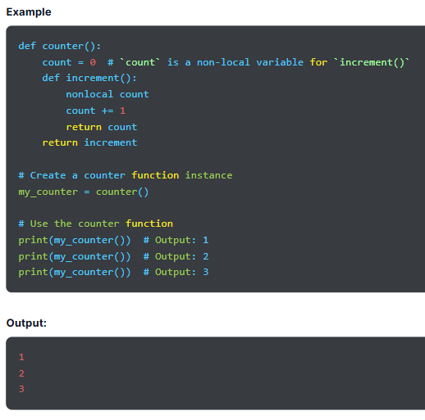
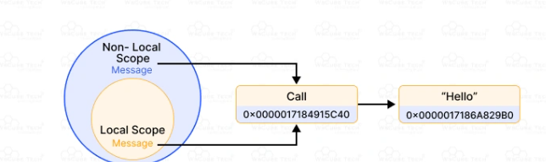

Slide 186
What Is a Closure in Python?
A Python closure is an inner function object, which refers to a function that behaves like an object that remembers values in an enclosing scope even if they are not available in memory. It can access variables in the local scope it was created in even when the outer function finishes execution.
A closure is also a way to bind data to a function without passing it as a parameter. If a value in enclosing scope is not present in memory, a closure remembers it. A closure is not like a normal function. It lets the function access captured variables through the copies of the closure of values or references, even if it is invoked outside their scope.
Please Note- Objects are data with attached methods, whereas closures are functions with data attached.
Here are the key points to remember about Python closures:
A closure is a nested function.
It is a record to store a function with an environment. It is a mapping that associates every free variable of a function, i.e., variables used locally but defined within an enclosing scope with the reference or value.
It can access a free variable present in the outer scope.
Closure can also be called a function object that can remember values in an enclosing scopes even if they are not in memory.

Slide 187
Example :
def create_greeting(template):
def greet(name):
return template.format(name=name)
return greet
# Create specific greeting functions
formal_greeting = create_greeting("Hello, {name}. How do you do?")
casual_greeting = create_greeting("Hey {name}! What's up?")
# Use the greeting functions
print(formal_greeting("Raman"))
print(casual_greeting("Suman"))
Output:
Hello, Raman. How do you do?
Hey Suman! What's up?

Slide 188
When and Why to Use Closures?
There are times when variables in the global scope are not used by more than one function. So, we can use a closure rather than defining variables in the global scope. We can define them in the outer function and use them in the inner function.
We can access the inner function only by calling the outer function. Closures in Python are like callback functions that offer a type of data hiding. This reduces the use of global variables.
In Python programming, a class has the __init__ method. When you have one extra method, the best solution is to use a closure instead of a class. This is because it improves code readability while reducing workload of a programmer. Hence, we can use closures to avoid unnecessary use of a class.
In the case of a few functions in the code, closures are the best way. However, in case of many functions, opting for a class (OOP) is an ideal solution.

Slide 189
Python @property Decorator

Slide 190
Introduction
What Is property() in Python?
What is returned by the @property?
Python property() Function Methods
Why Use @property Decorator?
Python Attribute vs Property
Property Setter
Property Deleter
Class Without Getters and Setters
Using Getters and Setters

Slide 191
Introduction:
Python property() is a built-in function used to create a property of a class. It returns the property class’ object and defines the properties of the Python class. To use a function like an attribute or property, we use the built-in @property decorator in Python that comes under the property() function. It makes using getter and setter methods simpler in object-oriented programming.
A decorator is a powerful function in Python that takes another function as an argument and returns another function with extended or modified behavior. Let’s study about Python @property decorator in detail.

Slide 192
What Is property() in Python?
@property is a decorator and is used for functions like an attribute or property. Python @property is a built-in decorator that comes under the property() function used to define or create a special attribute type known as the property of a class.
Properties encapsulate access to an object attribute and add logic to the process, including access control, computation, or validation. @property simplifies the tasks as we don’t have to manually call the property() function to get class properties. We can use it on any method of a class and use that method as a property. Through @property decorator, using getters and setters is also easier.
Python property() Syntax
We use the Python property() function to declare a function as a property or create a class property. The property function returns the object of the property class.
Syntax
property(fget, fset, fdel, doc)

Slide 193
Parameters
fget() is an optional argument used to get the value of an attribute. Its default value is None.
fset() is another optional argument used to set the value of an attribute.
fdel() is an optional argument used to delete an attribute's value.
doc(), or docstring, contains the documentation for the attribute of the class.
Return is used to return the property attribute from getter, setter, and deleter.
In case of no arguments, the property() method returns the base property attribute that doesn’t include any getter, setter, or deleter.
In case there is no doc, the property() method takes the docstring of the getter.

Slide 194
What is returned by the @property?
There are three methods related to Python property:
Getter allows access to the value of the attribute.
Setter is used to set the attribute value.
Deleter is used to delete the instance attribute.
The property() method uses getter, setter, and deleter to return the function as a property class.

Slide 195
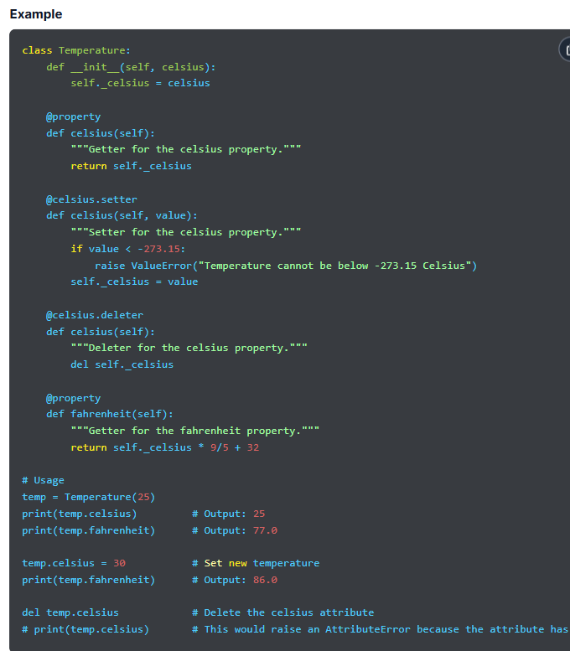
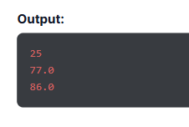

Slide 196
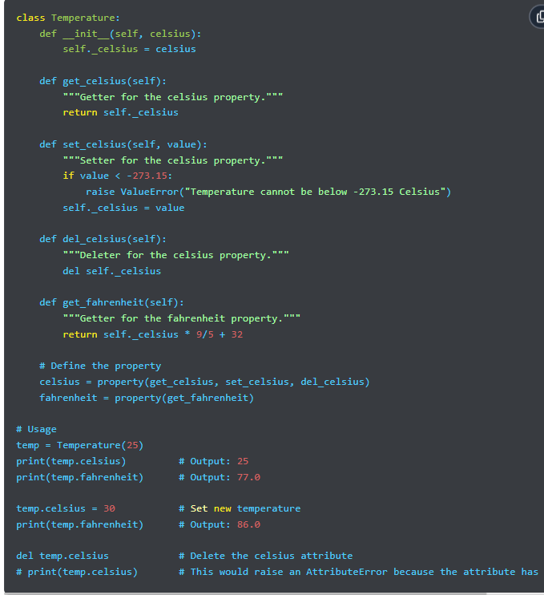

Python property() Function Methods
There are two ways to create a property for a class
in Python. They are as follows:
Using property() method
Using @property decorator
1. Using property() Method

Slide 197


Using @property Decorator:
After learning about the @property method, it’s time to learn about @property decorator.
It is a more frequently used and practical technique than the @property method. We use decorators in Python to add functionality to the existing code.
It is also known as metaprogramming as one part of a program modifies another part at the compile time.
Using the @property decorator, we can declare the function as a property in Python.

Slide 198

Why Use @property Decorator?
The @property decorator gives access to data and allows modification in a more Pythonic manner. We don’t have to invoke a getter method to get the value of the property; we can use it like other attributes.
This method also enables us to encapsulate data by presenting it like a public attribute of a class. Using the getter and setter methods, we can access and modify it. Hence, we can manage how we access and edit data and apply logic for validation and other reasons.
We can isolate the logic to access data, which enhances code readability and maintainability through the @property method. This makes the code easier to understand, and we know how it operates. Also, we can change the code without disrupting anything else.
Python Attribute vs Property
Class Attribute
It is unique to each class, and every instance of a class has its own attributes. Here is an example to explain it better.

Slide 199

Python property()
It returns the object of the property class. The following example shows the use property() function.

Slide 200

Property Setter:
Till now, we have learned to use the @property decorator and its syntax. However, one of the main issues with this method is that we can’t use property to modify values or attributes of a class.
We can use the @property decorator to access the return value of the function but can’t modify the value with it. Therefore, Python offers a special method known as the setter method that allows us to modify the value of the function.
Here is the syntax of the setter method:
@property-name.setter

Slide 201

Property Deleter
Similar to the setter method, we can also use the deleter method in Python to delete the property of a class. Once a property is deleted, we can’t access it using the same instance.
We can invoke the deleter method by using the del keyword with the class name, which deletes the property of a class.
Syntax of the deleter method is
@property-name.deleter

Slide 202

Class Without Getters and Setters
Many don’t recommend using objects to set and get values, as it can raise concerns regarding data security. Hence, we use getter and setter to set and get values of a class. We have discussed this method later in the tutorial.
Using Getters and Setters
After learning about getting and setting values of a class using objects, let’s understand about the two common methods, which are getter and setter methods. They ensure that the class data is secured. In the absence of getters and setters, any object can access and change the values. These methods encapsulate the data in a single unit so it can’t be modified by using only the object of a class.

Slide 203
Python Decorators

Slide 204
Introduction
Prerequisites for Learning Decorators
What Are Decorators in Python?
Decorator Functions with Parameters
Syntactic Decorator
Keeping the Original Name and Docstring of the Decorated Function
Reusing Decorator
Returning Values from Decorated Functions
Chaining Decorators
Decorators with Arguments
Fancy Decorators
Classes as Decorators in Python
What if a function returns something or an argument is passed to the function?

Slide 205
Introduction:
Python decorators are functions that take another function as an argument and extend its behavior without modifying it explicitly. They enclose target functions and let you include pre- and post-processing logic.
It is among the most powerful features of Python used to enhance code modularity by isolating concerns and promoting code reusability. We can identify decorators by the @ symbol, followed by the name of the decorator function above the target function. A decorator offers various real-life applications, including authentication, debugging, logging, caching, etc.

Slide 206
Prerequisites for Learning Decorators
Before we dive deeper into decorators in Python, it’s important to understand some basic concepts that will be used while learning about decorators. These prerequisites are:
Functions in Python and how they work
First Class Objects
Inner Functions
Higher-order Functions
Functions in Python:
In Python, everything is treated as an object, including classes and variables. Functions are first-class objects used or passed as arguments. They return values based on the arguments.
A few properties of a function are:
We can return a function from another function.
A function is an instance of an object type.
We can store a function as a variable.
We can store it in data structures, such as lists and hash tables.
We can pass a Python function as a parameter or argument to another function.

Slide 207
Example: Treating a function as an object
def square(x):
return x * x
# Assigning the function to another variable
operation = square
result = operation(5) # Treating the function as an object
print(result) # Output: 25
Output:
25
First Class Objects
A Python function is treated as a first-class object, so it gets all the rights as other variables in Python programming. Therefore, we can assign a function to a variable, return it from another function, or pass it to a function.
Example: Assigning a function to a variable:
def greet(name):
return f"Hello, {name}!"
# Assign the function to a variable
greet_func = greet
# Call the function using the variable
print(greet_func("Raghav"))
Output
Hello, Raghav!

Slide 208
Example: Passing a function as an argument:
def shout(text):
return text.upper()
def whisper(text):
return text.lower()
def greet(func):
greeting = func("Hello, World!")
print(greeting)
# Pass the 'shout' and 'whisper' functions as arguments
greet(shout) # Output: HELLO, WORLD!
greet(whisper) # Output: hello, world!
Output:
HELLO, WORLD!
hello, world!
Example: Returning a function from another function
def create_multiplier(x):
def multiplier(y):
return x * y
return multiplier
# Create a multiplier function
times_two = create_multiplier(2)
times_three = create_multiplier(3)
# Use the returned functions
print(times_two(5)) # Output: 10
print(times_three(5)) # Output: 15
Output
10
15

Slide 209
One technique that decorators use in Python is to return a function from a function:
Example: Passing a function to another function
def shout(text):
return text.upper()
def whisper(text):
return text.lower()
def greet(func, name):
return func(f"Hello, {name}!")
# Passing 'shout' and 'whisper' as arguments
print(greet(shout, "Alice")) # Output: HELLO, ALICE!
print(greet(whisper, "Bob")) # Output: hello, bob
Output:
HELLO, ALICE!
hello, bob!
In Python, decorators use the technique of passing functions as an argument to another function.

Slide 210
Inner Functions
Python allows us to define one function within another. These functions are known as inner functions or nested functions. They can access variables in the outer space of the enclosing function, and this pattern is called a Closure
Example
def outer_function(text):
def inner_function():
# Accessing the variable from the outer function's scope
print(text)
# Returning the inner function
return inner_function
# Calling outer_function and storing the returned inner_function
my_function = outer_function("Hello, World!")
# Calling the inner function
my_function() # Output: Hello, World!
Output:
Hello, World!

Slide 211
Higher-order Functions :
These are the functions that take a function as an argument or return a function.
Example
def add(x, y):
return x + y
def subtract(x, y):
return x - y
def apply_operation(x, y, operation):
return operation(x, y)
# Using the higher-order function with different operations
result1 = apply_operation(10, 5, add)
result2 = apply_operation(10, 5, subtract)
print(result1) # Output: 15
print(result2) # Output: 5
Output
15
5

Slide 212
What Are Decorators in Python?:
In Python, decorators are dynamic and adaptable programming constructs that take a function and return it by enhancing its functionality or behavior. They take functions as an argument within another function and call them within the wrapper function. Moreover, they enclose added functionality around the main logic, encouraging concern separation and improving code modularity.
Decorators in Python ensure the maintenance of a legible, modular, and efficient codebase by encapsulating auxiliary capabilities and improving reusability. They handle and address cross-platform issues, such as caching, logging, performance optimization, and access control. So, a logging decorator allows the implementation of consistent logging capability across different methods without duplicating code.
They also enhance reusability by enabling developers to isolate frequently used capabilities into independent decorators across multiple functions. This reduces redundancy and enhances code maintainability and readability.
The flexibility of decorators enables the implementation of complex customizations and retains clean functions. This comes in handy when modifications in basic logic may lead to complex code. Python programmers can wrap the target function with a decorator, which lets them implement sophisticated features without compromising on the clarity of a function

Slide 213
Decorator Functions with Parameters:
After getting familiar with the meaning of Python decorators, it’s time to expand our knowledge of decorators. The key purpose of decorators in Python is to enhance the behavior of a function without changing it.
Syntax
func = decorator(func)
Here, func refers to the function that is decorated, whereas decorator signifies the function used to decorate it.
Syntactic Decorator
Although the mentioned syntax earned popularity in the Python community, it was not so elegant. The syntax contains the function name thrice and the decoration is a little bit hidden below the function definition. Hence, Python came up with an improved way to use decorators. This syntactic sugar contains the @ symbol and makes code easier to read and express.
Syntax
@decorator
def func(arg1, arg2, ...):
pass

Slide 214


Slide 215

Keeping the Original Name and Docstring of the Decorated Function:
Functions in Python have the name attribute and a docstring that is used in debugging and documentation. However, decorating a function changes its identity to a wrapper function.

Slide 216

Reusing Decorator
A decorator in Python is like a regular Python function, so we can reuse it by recalling that specific decorator function. Here is an example of a decorator being used in different functions.

Slide 217

Returning Values from Decorated Functions:
We can control the return type from a decorated function. Here is an example showing what happens to the returned value from decorated functions.

Slide 218

Chaining Decorators:
Chaining decorators in Python means applying multiple decorators to a single function. The process involved placing several decorators one after the other, where the innermost decorator is applied first.

Slide 219

Decorators with Arguments:
We can pass arguments to decorators by defining the decorator within another function that takes the arguments. After this, we use those arguments within the decorator. Also, we return it from the enclosing function

Slide 220




Slide 221

2. Decorating a Complete Class:
In Python, we can decorate the complete class. Writing a function decorator and writing a class decorator are quite similar, except for one difference. The decorator will only get a class and not function as an argument. Please note that decorating a class doesn’t mean it will decorate its methods.
className = decorator(className)
This will add functionality to the class instantiation process.

Slide 222

Classes as Decorators in Python
Classes are known to be the best way to maintain the state of data, and we can use them as decorators.
To do this, we use the __init__ function, which takes the function as an argument.
As the class is used as a decorator, which must be a callable object, the class must implement the __call__ method.
When we use a class as a decorator, we use functools.update_wrapper rather than functools.wraps.

Slide 223
What if a function returns something or an argument is passed to the function?
When a function doesn’t return anything, there is no issue. However, you may want a return value or encounter a scenario where a decorated function returns something or takes an argument. Here are examples showing how decorators handle such situations.
Decorated Function Returns Something
When a function returns a value, the decorator must capture and return that value. For this, we use *args and **kwargs syntax within the wrapper function to take any argument or keyword argument that the function returns.
Arguments Passed to the Function
When the function takes an argument, the decorator must accept that argument and pass it to the decorated function.

Slide 224
Python Operator Overloading

Slide 225
Introduction
What is Operator Overloading in Python?
How to Overload the Operators in Python?
Overloading Binary + Operator in Python
How Does Operator Overloading Work?
Overloading Comparison Operators in Python
Overloading Equality and Less than Operators
Magic Methods or Special Functions for Python Operator Overloading
Advantages of Operator Overloading in Python

Slide 226
Introduction:
Have you ever wondered why one built-in operator behaves differently for different class objects? This is because of operator overloading in Python, one of the most powerful features that enables us to redefine how an operator works with objects of a class. Operator overloading is the capability of an operator to perform varied operations based on the class of the operand.
For example, operators like +, -, *, and custom operators can be used with user-defined objects due to overloading. It is a key concept of object-oriented programming that offers expressiveness and customization.
What is Operator Overloading in Python?
Operator overloading refers to providing extended meaning to operators beyond the intended or predefined operational meaning. For example, we use the + operator to add two integers, join two strings, and merge two lists.
We can achieve this using the + operator because it is overloaded by the int class and str class. The same in-built operator or function displays different behavior for objects of different classes. This is known as Python operator overloading, which we will discuss in detail in this tutorial.

Slide 227

How to Overload the Operators in Python?
Let’s say a user has two objects representing a user-defined data type class. When the user adds the two objects using the binary + operator, it will throw an error because the compiler doesn’t know how to add two objects.
Hence, the user must define the method or function for the operator. Therefore, the process of declaring the function before using an operator is called operator overloading.
A user can overload existing operators but can’t create a new one. In Python, there is a special function, also known as the magic function, used for operator overloading. It is automatically invoked when associated with a particular operator. For example, if a person uses the + operator, it will invoke the magic function __add__ automatically in the command line where the + operator is defined.

Slide 228

Overloading Binary + Operator in Python:
As we explained, when somebody uses a Python operator on user-defined data types, a special function associated with that operator is invoked automatically. Altering or changing the behavior of an operator is simple, similar to changing the behavior of a function or method defined.
Define methods in the class, and the operator works based on that behavior defined in the function. Using the + operator will automatically invoke the __add__ method where the + operator is defined. It will change the code of the magic function and add extra meaning to the operator.

Slide 229

How Does Operator Overloading Work?
When we change the behavior of any existing operator using the process of operator overloading in Python, it redefines the special function automatically invoked when we use that operator with the objects.
As we use operator overloading with a user-defined object, Python calls the relevant magic method to perform the operation.

Slide 230


Slide 231

Overloading Comparison Operators in Python:
Comparison operator overloading goes beyond binary operators and extends to other Python operators, such as <, >, <=, >=, ==, and !=.
This lets us prescribe how objects within one class must be evaluated.

Slide 232

Overloading Equality and Less than Operators:
Using Python operator overload for equality and less than operators enables us to define how objects of a custom class are compared for equality and less than operations.
We use customizations to compare objects based on specific conditions or attributes.
Python offers magic methods, also called dunder methods (short for double underscore), which are special methods used for operator overloading.
Using these methods, we can define custom behaviors for different operators when we work with objects of custom classes.

Slide 233


Magic Methods or Special Functions for Python Operator Overloading

Slide 234



Slide 235



Slide 236
Advantages of Operator Overloading in Python
Operator overloading in Python offers several benefits, which we have mentioned below.
Improved Readability
As you overload boolean operators, you can create natural syntax and semantics for your class and make your code and intent of operations easier.
Abstraction
You can abstract complex logic in your class and offer a cleaner interface to users.
Concise Code
Overloading boolean operators makes your code concise and expressive, so you can use operators to perform custom operations on your objects.
Expressive Code
You can write code similar to mathematical and real-world operations to make your code more intuitive, making it easier for you to understand and maintain it.
Integration with Built-in Functions
With operator overloading, you can smoothly integrate built-in functions in Python, such as overloading the operator to use = and sum() with custom objects.

Slide 237
Improved Functionality
Overloading boolean operators enables you to add new functionality to a class. For example, performing 'or' operation or logical operation on the class instance.
Enhanced Code Reusability
Operator overloading improved code reusability. This means you can use the same symbols or operators with different classes to perform the same operations, which saves your effort and time in writing the same code repeatedly.

