Slide 1
Dictionary

Slide 2
Dictionary:
Dictionaries are used to store data values in key:value pairs.
A dictionary is a collection which is ordered*, changeable and do not allow duplicates.
As of Python version 3.7, dictionaries are ordered. In Python 3.6 and earlier, dictionaries are unordered.
Dictionaries are written with curly brackets, and have keys and values:
Get your own Python Server
Create and print a dictionary:
thisdict = {
"brand": "Ford",
"model": "Mustang",
"year": 1964
}
print(thisdict)

Slide 3
Dictionary Items:
Dictionary items are ordered, changeable, and do not allow duplicates.
Dictionary items are presented in key:value pairs, and can be referred to by using the key name.
Example
Print the "brand" value of the dictionary:
thisdict = {
"brand": "Ford",
"model": "Mustang",
"year": 1964
}
print(thisdict["brand"])
Ordered or Unordered?
As of Python version 3.7, dictionaries are ordered. In Python 3.6 and earlier, dictionaries are unordered.

Slide 4
When we say that dictionaries are ordered, it means that the items have a defined order, and that order will not change.
Unordered means that the items do not have a defined order, you cannot refer to an item by using an index.
Changeable
Dictionaries are changeable, meaning that we can change, add or remove items after the dictionary has been created.
Duplicates Not Allowed
Dictionaries cannot have two items with the same key:
Example
Duplicate values will overwrite existing values:
thisdict = {
"brand": "Ford",
"model": "Mustang",
"year": 1964,
"year": 2020
}
print(thisdict)

Slide 5
Dictionary Length:
To determine how many items a dictionary has, use the len() function:
Example
Print the number of items in the dictionary:
print(len(thisdict))
Dictionary Items - Data Types
The values in dictionary items can be of any data type:
Example
String, int, boolean, and list data types:
thisdict = {
"brand": "Ford",
"electric": False,
"year": 1964,
"colors": ["red", "white", "blue"]
}

Slide 6
type():
From Python's perspective, dictionaries are defined as objects with the data type 'dict':
<class 'dict'>
Example
Print the data type of a dictionary:
thisdict = {
"brand": "Ford",
"model": "Mustang",
"year": 1964
}
print(type(thisdict))
The dict() Constructor
It is also possible to use the dict() constructor to make a dictionary.
Example
Using the dict() method to make a dictionary:
thisdict = dict(name = "John", age = 36, country = "Norway")

Slide 7
Accessing Items:
You can access the items of a dictionary by referring to its key name, inside square brackets:
Example:
Get the value of the "model" key:
thisdict = {
"brand": "Ford",
"model": "Mustang",
"year": 1964
}
x = thisdict["model"]
There is also a method called get() that will give you the same result:
Example
Get the value of the "model" key:
x = thisdict.get("model")

Slide 8
The list of the keys is a view of the dictionary, meaning that any changes done to the dictionary will be reflected in the keys list.
Example
Add a new item to the original dictionary, and see that the keys list gets updated as well:
car = {
"brand": "Ford",
"model": "Mustang",
"year": 1964
}
x = car.keys()
print(x) #before the change
car["color"] = "white"
print(x) #after the change

Slide 9
Get Values
The values() method will return a list of all the values in the dictionary.
Example:
Get a list of the values:
x = thisdict.values()
The list of the values is a view of the dictionary, meaning that any changes done to the dictionary will be reflected in the values list.

Slide 10
Example:
Make a change in the original dictionary, and see that the values list gets updated as well:
car = {
"brand": "Ford",
"model": "Mustang",
"year": 1964
}
x = car.values()
print(x) #before the change
car["year"] = 2020
print(x) #after the change

Slide 11
Example
Add a new item to the original dictionary, and see that the values list gets updated as well:
car = {
"brand": "Ford",
"model": "Mustang",
"year": 1964
}
x = car.values()
print(x) #before the change
car["color"] = "red"
print(x) #after the change

Slide 12
Get Items
The items() method will return each item in a dictionary, as tuples in a list.
Example :Get a list of the key:value pairs
x = thisdict.items()
The returned list is a view of the items of the dictionary, meaning that any changes done to the dictionary will be reflected in the items list.
Example :Make a change in the original dictionary, and see that the items list gets updated as well:
car = {
"brand": "Ford",
"model": "Mustang",
"year": 1964
}
x = car.items()
print(x) #before the change
car["year"] = 2020
print(x) #after the change

Slide 13
Example:
Add a new item to the original dictionary, and see that the items list gets updated as well:
car = {
"brand": "Ford",
"model": "Mustang",
"year": 1964
}
x = car.items()
print(x) #before the change
car["color"] = "red"
print(x) #after the change

Slide 14
Check if Key Exists:
To determine if a specified key is present in a dictionary use the in keyword:
Example:
Check if "model" is present in the dictionary:
thisdict = {
"brand": "Ford",
"model": "Mustang",
"year": 1964
}
if "model" in thisdict:
print("Yes, 'model' is one of the keys in the thisdict dictionary")

Slide 15
Change Values:
You can change the value of a specific item by referring to its key name:
Example:
Change the "year" to 2018:
thisdict = {
"brand": "Ford",
"model": "Mustang",
"year": 1964
}
thisdict["year"] = 2018

Slide 16
Update Dictionary:
The update() method will update the dictionary with the items from the given argument.
The argument must be a dictionary, or an iterable object with key:value pairs.
Example
Update the "year" of the car by using the update() method:
thisdict = {
"brand": "Ford",
"model": "Mustang",
"year": 1964
}
thisdict.update({"year": 2020})

Slide 17
Adding Items:
Adding an item to the dictionary is done by using a new index key and assigning a value to it:
Example:
thisdict = {
"brand": "Ford",
"model": "Mustang",
"year": 1964
}
thisdict["color"] = "red"
print(thisdict)

Slide 18
Update Dictionary:
The update() method will update the dictionary with the items from a given argument. If the item does not exist, the item will be added.
The argument must be a dictionary, or an iterable object with key:value pairs.
Example:
Add a color item to the dictionary by using the update() method:
thisdict = {
"brand": "Ford",
"model": "Mustang",
"year": 1964
}
thisdict.update({"color": "red"})

Slide 19
Removing Items
There are several methods to remove items from a dictionary:
Example
The pop() method removes the item with the specified key name:
thisdict = {
"brand": "Ford",
"model": "Mustang",
"year": 1964
}
thisdict.pop("model")
print(thisdict)

Slide 20
Example:
The popitem() method removes the last inserted item (in versions before 3.7, a random item is removed instead):
thisdict = {
"brand": "Ford",
"model": "Mustang",
"year": 1964
}
thisdict.popitem()
print(thisdict)

Slide 21
Example:
The del keyword removes the item with the specified key name:
thisdict = {
"brand": "Ford",
"model": "Mustang",
"year": 1964
}
del thisdict["model"]
print(thisdict)
Example
The del keyword can also delete the dictionary completely:
thisdict = {
"brand": "Ford",
"model": "Mustang",
"year": 1964
}

Slide 22
del thisdict
print(thisdict) #this will cause an error because "thisdict" no longer exists.
Example
The clear() method empties the dictionary:
thisdict = {
"brand": "Ford",
"model": "Mustang",
"year": 1964
}
thisdict.clear()
print(thisdict)

Slide 23
Loop Through a Dictionary
You can loop through a dictionary by using a for loop.
When looping through a dictionary, the return value are the keys of the dictionary, but there are methods to return the values as well.
Example:
Print all key names in the dictionary, one by one:
for x in thisdict:
print(x)
Example:
Print all values in the dictionary, one by one:
for x in thisdict:
print(thisdict[x])

Slide 24
Example:
You can also use the values() method to return values of a dictionary:
for x in thisdict.values():
print(x)
Example:
You can use the keys() method to return the keys of a dictionary:
for x in thisdict.keys():
print(x)
Example:
Loop through both keys and values, by using the items() method:
for x, y in thisdict.items():
print(x, y)

Slide 25
Copy a Dictionary:
You cannot copy a dictionary simply by typing dict2 = dict1, because: dict2 will only be a reference to dict1, and changes made in dict1 will automatically also be made in dict2.
There are ways to make a copy, one way is to use the built-in Dictionary method copy().
Example
Make a copy of a dictionary with the copy() method:
thisdict = {
"brand": "Ford",
"model": "Mustang",
"year": 1964
}
mydict = thisdict.copy()
print(mydict)

Slide 26
Another way to make a copy is to use the built-in function dict().
Example:
Make a copy of a dictionary with the dict() function:
thisdict = {
"brand": "Ford",
"model": "Mustang",
"year": 1964
}
mydict = dict(thisdict)
print(mydict)

Slide 27
Nested Dictionaries
A dictionary can contain dictionaries, this is called nested dictionaries.
Example
Create a dictionary that contain three dictionaries:
myfamily = {
"child1" : {
"name" : "Emil",
"year" : 2004
},
"child2" : {
"name" : "Tobias",
"year" : 2007
},
"child3" : {
"name" : "Linus",
"year" : 2011
}
}
Or, if you want to add three dictionaries into a new dictionary:

Slide 28
Example
Create three dictionaries, then create one dictionary that will contain the other three dictionaries:
child1 = {
"name" : "Emil",
"year" : 2004
}
child2 = {
"name" : "Tobias",
"year" : 2007
}
child3 = {
"name" : "Linus",
"year" : 2011
}
myfamily = {
"child1" : child1,
"child2" : child2,
"child3" : child3
}

Slide 29
Access Items in Nested Dictionaries
To access items from a nested dictionary, you use the name of the dictionaries, starting with the outer dictionary:
Example
Print the name of child 2:
print(myfamily["child2"]["name"])
Loop Through Nested Dictionaries
You can loop through a dictionary by using the items() method like this:
Example
Loop through the keys and values of all nested dictionaries:
for x, obj in myfamily.items():
print(x)
for y in obj:
print(y + ':', obj[y])

Slide 30
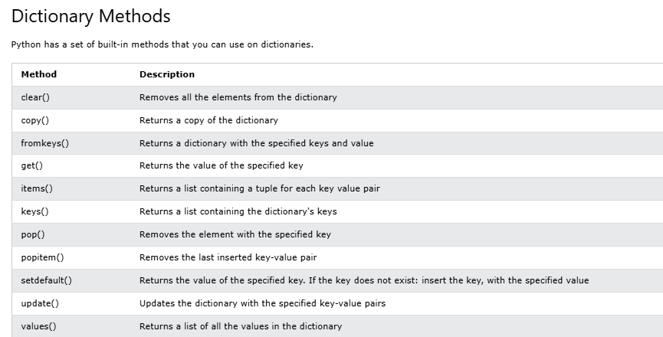

Slide 31
Python If ... Else

Slide 32
Python Conditions and If statements
Python supports the usual logical conditions from mathematics:
Equals: a == b
Not Equals: a != b
Less than: a < b
Less than or equal to: a <= b
Greater than: a > b
Greater than or equal to: a >= b
These conditions can be used in several ways, most commonly in "if statements" and loops.
An "if statement" is written by using the if keyword.
Example :If statement:
a = 33
b = 200
if b > a:
print("b is greater than a")
In this example we use two variables, a and b, which are used as part of the if statement to test whether b is greater than a. As a is 33, and b is 200, we know that 200 is greater than 33, and so we print to screen that "b is greater than a".

Slide 33
Indentation:
Python relies on indentation (whitespace at the beginning of a line) to define scope in the code. Other programming languages often use curly-brackets for this purpose.
Example
If statement, without indentation (will raise an error):
a = 33
b = 200
if b > a:
print("b is greater than a") # you will get an error

Slide 34
Types of Conditional Statements in Python
We can use different combinations of conditional statements in Python to implement our code during decision-making scenarios. Below, we have explained types of conditional statements in Python with example, flowchart, and syntax.
Python if Conditional Statement
Python if-else Conditional Statement
Python Nested if Conditional Statement
Python if-elif-else Conditional Statement
Python Ternary Expression

Slide 35
Python if Conditional Statement:
The if statement in Python is the simplest decision-making statement to execute a block of code. It tests the given condition, and if the condition is true, it executes the if block of code. The specified condition can be a valid logic expression needed to be evaluated as True or False.
Python considers all non-zero values True, whereas None and 0 are False. We can also write a single if statement without adding an else block. However, we can’t write an else statement without an if statement in Python.
Syntax of the if Statement
if condition:
# Statements to execute if
# condition is true
Here, the code evaluates the expression. If the given condition is fulfilled, the code will be executed; otherwise, it will not. If the evaluated condition is False, it will not execute the block of code. We use the condition through parentheses ().

Slide 36
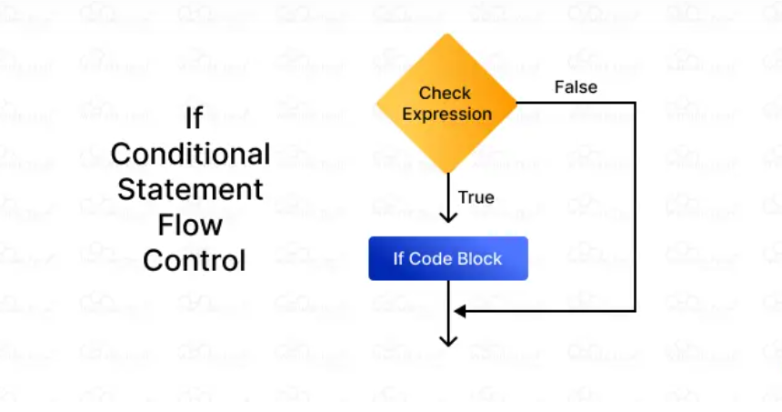

Slide 37
Python if-else Conditional Statement:
The Python if statement executes a block of code only when the given condition is true; if it is false, it doesn’t execute anything. So, the if-else statement addresses this issue by merging the else statement, which is executed when the condition is false.
So, if the condition is true, the program executes the if block of code; if the condition is false, it executes the if-else code block.
Syntax of the if-else Statement
if (condition):
# Executes the statement 1 if
# condition is true
Else:
# Executes the statement 2 if
# condition is false
Here, the code evaluates the condition to determine whether it is True or False. If the condition is True, it executes statement 1 and skips the else statement. However, if the condition is false, it executes statement 2. We separate the blocks using indentation.

Slide 38
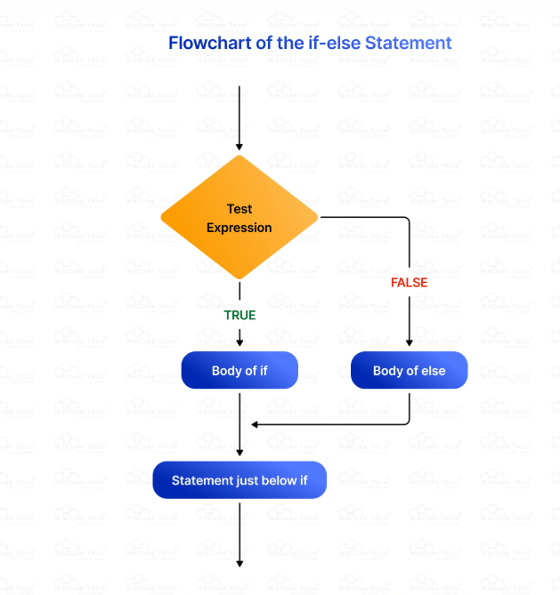

Slide 39
The program checks the test expression. If it is true, the statement in the if block will be executed based on indentation. If the test expression is false, the statement in the else block will be executed.
Example:
x = 3
if x > 5:
print("x is greater than 5")
else:
print("x is not greater than 5")
Output:
x is not greater than 5

Slide 40
Python Nested if Conditional Statement:
The nested if conditional statement in Python places an if statement inside another if statement. We use it to test and evaluate multiple possibilities and filter a variable several times. The nested if statement requires us to focus on correct indentation to define the scope of each statement, especially when there are multiple blocks of nested if statements.
We can include as many nested if statements as we want, but it can make the code less optimized, hampering its readability. Therefore, minimize the use of Python nested if statements.
Syntax of the Nested if Statement
if (condition1):
# Executes if condition 1 is true
if (condition2):
# Executes if condition 2 is true
# if Block (condition 1) ends here
# if Block (condition 2) ends here.
The program uses the if statement to execute the code only if the condition is true. It includes nested if statements, assessing condition within the first if statement. We use indentation to separate different code blocks.

Slide 41
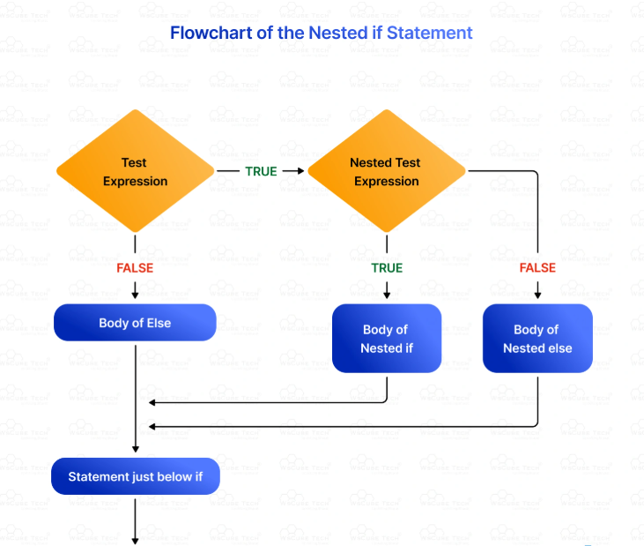

Slide 42
Example:
a = 7
b = 10
c = 7
if a + b > c and a + c > b and b + c > a:
print("The sides form a valid triangle.")
if a == b == c:
print("The triangle is Equilateral.")
elif a == b or b == c or a == c:
print("The triangle is Isosceles.")
else:
print("The triangle is Scalene.")
else:
print("The sides do not form a valid triangle.")
Output:
The sides form a valid triangle.
The triangle is Isosceles.

Slide 43
Python if-elif-else Conditional Statement :
Python executes the if statement from top to bottom. So, if one condition is fulfilled and is evaluated to be true, the program executes the statement associated with it and skips the remaining statements. If no condition is true, it executes the else statement. Basically, the if-else statement executes a block of code between two alternatives. However, what if we have to choose between more than two alternatives? That is where we use the if-elif-else statement in Python.
The elif statement follows the if-else-if ladder statement and allows us to check multiple conditions in Python, executing a code block based on the true condition among them. We can add several elif statements in the code. It tests all the statements in order, and if all of them are false, it checks the elif statements. If the condition is true, it executes the block after the if statement and skips the rest of the statements. If no condition is true, it executes the else statement.

Slide 44
Syntax of the if-elif-else Statement :
if expression1:
print(statement_if)
elif (expression2):
print(statement_elif)
else:
print(statement_else)
if condition1:
# code block 1
elif condition2:
# code block 2
else:
# code block 3
If expression 1 is true, it executes the code block statement_if. If it is not true, the program evaluates the expression 2. If it is true, statement_elif is executed. However, if both expression 1 and expression 2 are not true, it executes statement_else by default.

Slide 45
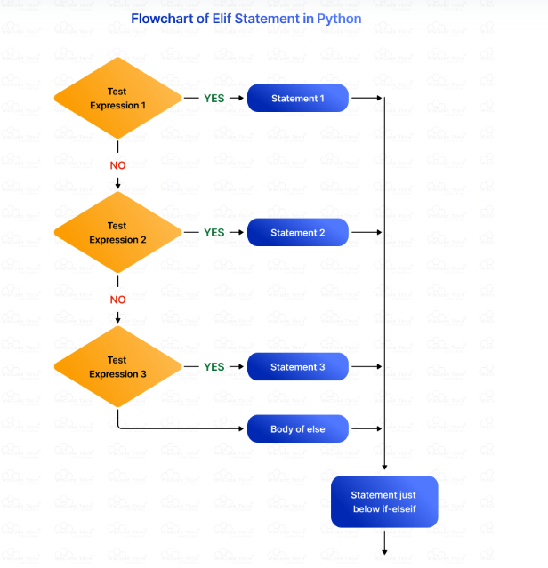

Slide 46
Example:
score = 78
if score >= 90:
grade = "A"
elif score >= 80:
grade = "B"
elif score >= 70:
grade = "C"
elif score >= 60:
grade = "D"
else:
grade = "F"
print(f"The grade for a score of {score} is {grade}.")
Output:
The grade for a score of 78 is C.

Slide 47
Elif
The elif keyword is Python's way of saying "if the previous conditions were not true, then try this condition".
Example
a = 33
b = 33
if b > a:
print("b is greater than a")
elif a == b:
print("a and b are equal")
In this example a is equal to b, so the first condition is not true, but the elif condition is true, so we print to screen that "a and b are equal".
Else
The else keyword catches anything which isn't caught by the preceding conditions.

Slide 48
Example:
a = 200
b = 33
if b > a:
print("b is greater than a")
elif a == b:
print("a and b are equal")
else:
print("a is greater than b")
In this example a is greater than b, so the first condition is not true, also the elif condition is not true, so we go to the else condition and print to screen that "a is greater than b".

Slide 49
You can also have an else without the elif:
Example
a = 200
b = 33
if b > a:
print("b is greater than a")
else:
print("b is not greater than a")
Short Hand If
If you have only one statement to execute, you can put it on the same line as the if statement.
Example
One line if statement:
if a > b: print("a is greater than b")

Slide 50
Short Hand If ... Else:
If you have only one statement to execute, one for if, and one for else, you can put it all on the same line:
Example
One line if else statement:
a = 2
b = 330
print("A") if a > b else print("B")
This technique is known as Ternary Operators, or Conditional Expressions.
You can also have multiple else statements on the same line:
Example
One line if else statement, with 3 conditions:
a = 330
b = 330
print("A") if a > b else print("=") if a == b else print("B")
And
The and keyword is a logical operator, and is used to combine conditional statements:

Slide 51
Example:
Test if a is greater than b, AND if c is greater than a:
a = 200
b = 33
c = 500
if a > b and c > a:
print("Both conditions are True")
Or
The or keyword is a logical operator, and is used to combine conditional statements:
Example :Test if a is greater than b, OR if a is greater than c:
a = 200
b = 33
c = 500
if a > b or a > c:
print("At least one of the conditions is True")
Not
The not keyword is a logical operator, and is used to reverse the result of the conditional statement:

Slide 52
Python Ternary Expression or ShortHand if Statement:
The ternary expression in Python tests the condition and returns the appropriate value accordingly. It is also known as the ShortHand if statement, which constructs a concise statement with a single line of code. We use it to assign a value to a variable according to a simple condition. Python supports different shorthand statements, so we can write code more concisely and space-efficiently.
Indentation is not important when we write a Python conditional statement in one line for ternary expressions. We write it in the same line as the if conditional statement. ShortHand if is easier to write, and developers can focus more on code instead of alignment.
Syntax of the ShortHand if
if expression: statement
Here, while evaluating the shorthand if statement, we implement it by writing the statement to be executed once the condition is True. We must place the statement on the same line.

Slide 53
Example
score = 78
if score >= 33:print("Pass")
Output:
Pass

Slide 54
Indentation in Python:
Python doesn’t use parentheses to delimit the code blocks as it wants to keep the program easy and simple. Therefore, it uses indentation to define the code structure and scope. Python indentation is the whitespace at the beginning of a line that groups statements and indicates nesting level.
Indentation is crucial while working with the -if-else conditional statements in Python. Statements at the same indentation level mean they are part of the same code block. We must take proper care of indentation for if-elif-else statements, else, we can encounter IndentationError.
Key points to consider while using indentation in Python:
We indent code blocks using a consistent number of spaces or tabs. Generally, we use four spaces for each level of indentation.
Make sure that you are consistent when it comes to choosing indentation throughout the code. Don’t mix tabs and spaces, as it can cause syntax errors and confusion.
We use a colon (:) after condition statements to mark the beginning of the indented code block.
The level of indentation shows the scope of statements. Statements at the same level of indentation are considered a part of the same code block.

Slide 55
Best Practices for Using Python Conditional Statements
While using conditional statements in Python, we must adhere to a few best practices, which are as follows:
Avoid using extensively nested code blocks and divide complex code into smaller and more manageable functions.
Use the ternary conditional operator in Python for single conditional statements.
Conditions must be simple and expressive to enhance readability.
Use any() and all() for conditions applied to iterables.
Add comments for complex conditions to state their purpose clearly.
Mention conditional expressions within generator expressions and list comprehensions.

Slide 56
Loops

Slide 57
Python Loops:
Python has two primitive loop commands:
while loops
for loops
The while Loop
With the while loop we can execute a set of statements as long as a condition is true.
Example
Print i as long as i is less than 6:
i = 1
while i < 6:
print(i)
i += 1
Note: remember to increment i, or else the loop will continue forever.

Slide 58
while Loop Syntax:
while condition:
# body of while loop
Here,
The while loop evaluates condition, which is a boolean expression.
If the condition is True, body of while loop is executed. The condition is evaluated again.
This process continues until the condition is False.
Once the condition evaluates to False, the loop terminates.
Note:We should update the variables used in condition inside the loop so that it eventually evaluates to False. Otherwise, the loop keeps running, creating an infinite loop.

Slide 59
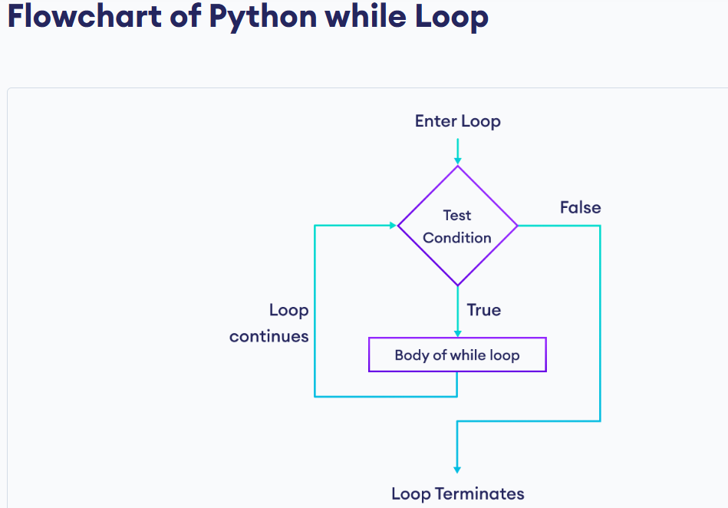

Slide 60
Example: Python while Loop
# Print numbers until the user enters 0
number = int(input('Enter a number: '))
# iterate until the user enters 0
while number != 0:
print(f'You entered {number}.')
number = int(input('Enter a number: '))
print('The end.')
Run Code
Output:
Enter a number: 3
You entered 3.
Enter a number: 1
You entered 1.
Enter a number: -4
You entered -4.
Enter a number: 0
The end.
Here is how the above program works:
It asks the user to enter a number.
If the user enters a number other than 0, it is printed.
If the user enters 0, the loop terminates.

Slide 61
Infinite while Loop:
If the condition of a while loop always evaluates to True, the loop runs continuously, forming an infinite while loop. For example,
age = 32
# The test condition is always True
while age > 18:
print('You can vote’)
Output
You can vote
You can vote
You can vote
.
.
.
The above program is equivalent to:
age = 32
# the test condition is always True
while True:
print('You can vote')

Slide 62
The while loop requires relevant variables to be ready, in this example we need to define an indexing variable, i, which we set to 1.
The break Statement
With the break statement we can stop the loop even if the while condition is true:
Example
Exit the loop when i is 3:
i = 1
while i < 6:
print(i)
if i == 3:
break
i += 1

Slide 63
Python while loop with break statement:
We can use a break statement inside a while loop to terminate the loop immediately without checking the test condition. For example,
while True:
user_input = input('Enter your name: ')
# terminate the loop when user enters end
if user_input == 'end':
print(f'The loop is ended')
break
print(f'Hi {user_input}’)
Output
Enter your name: Kevin
Hi Kevin
Enter your name: end
The loop is ended
Here, the condition of the while loop is always True. However, if the user enters end, the loop termiantes because of the break statement.

Slide 64
Python while loop with else clause:
In Python, a while loop can have an optional else clause - that is executed once the loop condition is False. For example,
counter = 0
while counter < 2:
print('This is inside loop')
counter = counter + 1
else:
print('This is inside else block’)
Output:
This is inside loop
This is inside loop
This is inside else block
Here, on the third iteration, the counter becomes 2 which terminates the loop. It then executes the else block and prints This is inside else block.
Note: The else block will not execute if the while loop is terminated by a break statement.

Slide 65
The continue Statement
With the continue statement we can stop the current iteration, and continue with the next:
Example:Continue to the next iteration if i is 3:
i = 0
while i < 6:
i += 1
if i == 3:
continue
print(i)
The else Statement
With the else statement we can run a block of code once when the condition no longer is true:
Example :Print a message once the condition is false:
i = 1
while i < 6:
print(i)
i += 1
else:
print("i is no longer less than 6")

Slide 66
Python For Loops:
A for loop is used for iterating over a sequence (that is either a list, a tuple, a dictionary, a set, or a string).
This is less like the for keyword in other programming languages, and works more like an iterator method as found in other object-orientated programming languages.
With the for loop we can execute a set of statements, once for each item in a list, tuple, set etc.
Example:
Print each fruit in a fruit list:
fruits = ["apple", "banana", "cherry"]
for x in fruits:
print(x)
The for loop does not require an indexing variable to set beforehand.

Slide 67
for loop Syntax
for val in sequence:
# run this code
The for loop iterates over the elements of sequence in order, and in each iteration, the body of the loop is executed.
The loop ends after the body of the loop is executed for the last item.
Indentation in Loop:
In Python, we use indentation (spaces at the beginning of a line) to define a block of code, such as the body of a loop. For example,
languages = ['Swift', 'Python', 'Go']
# start of the loop
for lang in languages:
print(lang)
print('-----')
# end of the for loop
print('Last statement')
Output
Swift
-----
Python
-----
Go
-----
Last statement
Here, print('Last statement') is outside the body of the loop. Therefore, this statement is executed only once at the end.

Slide 68
Looping Through a String
Even strings are iterable objects, they contain a sequence of characters:
Example:Loop through the letters in the word "banana":
for x in "banana":
print(x)
The break Statement
With the break statement we can stop the loop before it has looped through all the items:
Example :Exit the loop when x is "banana":
fruits = ["apple", "banana", "cherry"]
for x in fruits:
print(x)
if x == "banana":
break
Example:Exit the loop when x is "banana", but this time the break comes before the print:
fruits = ["apple", "banana", "cherry"]
for x in fruits:
if x == "banana":
break
print(x)

Slide 69
Using for loop without accessing sequence items:
If we don't intend to use items of sequence inside the body of a loop, it is clearer to use the _ (underscore) as the loop variable. For example,
# iterate from i = 0 to 3
for _ in range(0, 4:
print('Hi’)
Output
0
1
2
3
Here, the loop runs four times. In each iteration, we have displayed Hi. Since we are not using the items of the sequence(0, 1, 2 and 4) in the loop body, it is better to use _ as the loop variable.

Slide 70
The continue Statement:
With the continue statement we can stop the current iteration of the loop, and continue with the next:
Example:Do not print banana:
fruits = ["apple", "banana", "cherry"]
for x in fruits:
if x == "banana":
continue
print(x)
The range() Function
To loop through a set of code a specified number of times, we can use the range() function,
The range() function returns a sequence of numbers, starting from 0 by default, and increments by 1 (by default), and ends at a specified number.
Example:Using the range() function:
for x in range(6):
print(x)
Note that range(6) is not the values of 0 to 6, but the values 0 to 5.
The range() function defaults to 0 as a starting value, however it is possible to specify the starting value by adding a parameter: range(2, 6), which means values from 2 to 6 (but not including 6):

Slide 71
Example:Using the start parameter:
for x in range(2, 6):
print(x)
The range() function defaults to increment the sequence by 1, however it is possible to specify the increment value by adding a third parameter: range(2, 30, 3):
Example:Increment the sequence with 3 (default is 1):
for x in range(2, 30, 3):
print(x)
Else in For Loop
The else keyword in a for loop specifies a block of code to be executed when the loop is finished:
Example:Print all numbers from 0 to 5, and print a message when the loop has ended:
for x in range(6):
print(x)
else:
print("Finally finished!")
Note: The else block will NOT be executed if the loop is stopped by a break statement.

Slide 72
Example :Break the loop when x is 3, and see what happens with the else block:
for x in range(6):
if x == 3: break
print(x)
else:
print("Finally finished!")
Nested Loops:
A nested loop is a loop inside a loop.
The "inner loop" will be executed one time for each iteration of the "outer loop":
Example
Print each adjective for every fruit:
adj = ["red", "big", "tasty"]
fruits = ["apple", "banana", "cherry"]
for x in adj:
for y in fruits:
print(x, y)

Slide 73
The pass Statement:
for loops cannot be empty, but if you for some reason have a for loop with no content, put in the pass statement to avoid getting an error.
Example:
for x in [0, 1, 2]:
pass

Slide 74
Python break and continue:
In programming, the break and continue statements are used to alter the flow of loops:
break exits the loop entirely
continue skips the current iteration and proceeds to the next one
Python break Statement
The break statement terminates the loop immediately when it's encountered.
Syntax
Break
Note: The break statement is usually used inside decision-making statements such as if...else.

Slide 75
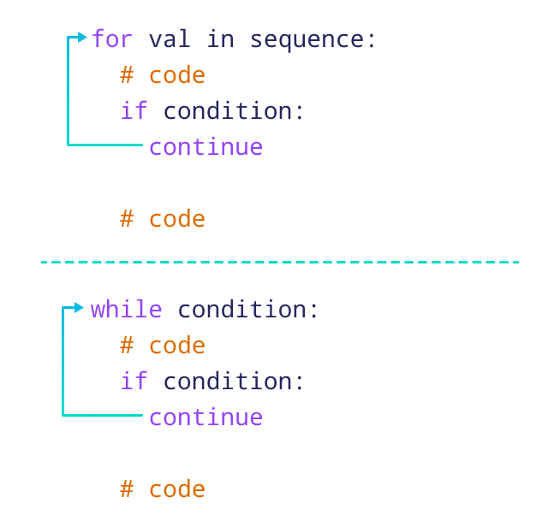

Slide 76
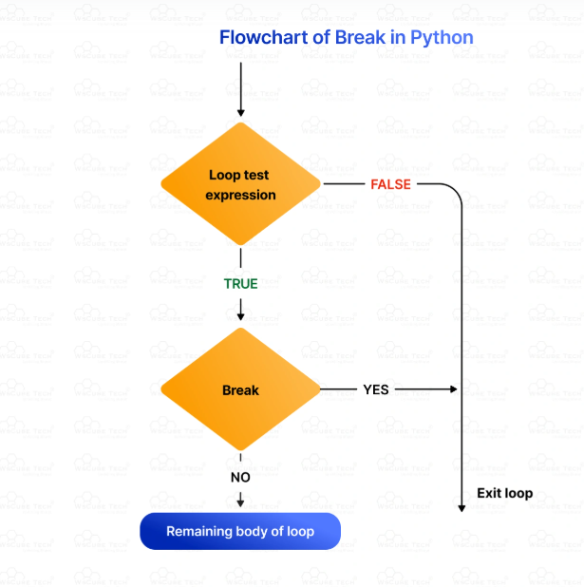

Slide 77
Example: break Statement with for Loop:
We can use the break statement with the for loop to terminate the loop when a certain condition is met.
For example,
for i in range(5):
if i == 3:
break
print(i)
Output:
0
1
2
In the above example,
if i == 3:
break
terminates the loop when i is equal to 3. Hence, the output doesn't include values after 2.
Note: We can also terminate the while loop using a break statement.

Slide 78
Best Practices for Using Break
To use the break statement in Python effectively, make sure to adhere to the following best practices:
As you use the break statement in your code, it must enhance code readability and maintainability instead of making it complex.
Examine and test the code meticulously to find errors and ensure that break works as expected under different circumstances.
Nested loops are powerful and crucial in Python programming, but using them excessively can make the code complex and hard to read. So, use break to make nested loops easier to understand.
Mention clear conditions for using the break statement to terminate a loop.
If your reason for terminating a loop or using break is not obvious, add comments to define your purpose of using the break statement.

Slide 79
Python continue Statement
The continue statement skips the current iteration of the loop and the control flow of the program goes to the next iteration.
Syntax:
Continue
Working of continue Statement in Python
Working of continue statement in Python
Example: continue Statement with for Loop
We can use the continue statement with the for loop to skip the current iteration of the loop and jump to the next iteration. For example,
for i in range(5):
if i == 3:
continue
print(i)
In this example,
if i == 3:
continue
skips the current iteration when i is equal to 3, and continues the next iteration. Hence, the output has all the values except 3.
Note: We can also use the continue statement with a while loop.
Output
0
1
2
4

Slide 80
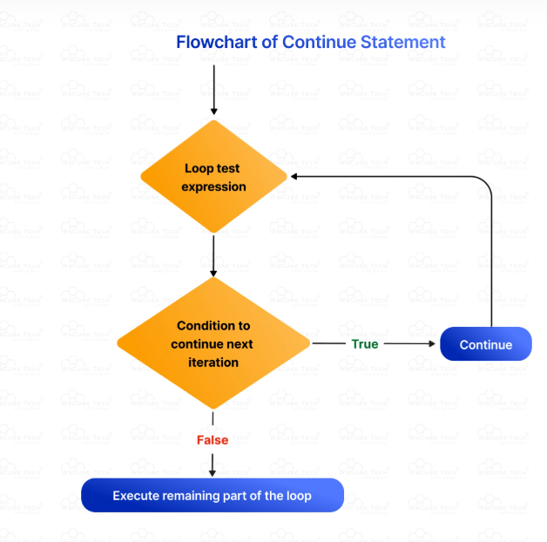
The program begins with loop execution.
It executes the code within the loop. If it encounters the continue statement, it will begin the next iteration.
If the condition is true, it will execute the loop.
If the condition is false, it will exit and end the loop.

Slide 81
Features and Benefits of Python Continue Statement
Here are the primary features of the continue statement in Python:
The main use of continue in Python is to skip unnecessary iterations, which makes the loop execution more efficient. This is specifically useful in situations that require the exclusion of certain conditions from processing.
The continue statement ensures code maintainability by clearly specifying the intention to skip iterations based on certain conditions. Therefore, it makes the code easy to update and understand.
We can selectively skip loop iterations depending on certain conditions and get control over which code to execute and which one to skip.
It makes the code cleaner and more readable than complex boolean conditions and nested if statements.

Slide 82
Python pass Statement
In Python programming, the pass statement is a null statement which can be used as a placeholder for future code.
Suppose we have a loop or a function that is not implemented yet, but we want to implement it in the future. In such cases, we can use the pass statement.
The syntax of the pass statement is:
pass
Using pass With Conditional Statement
n = 10
# use pass inside if statement
if n > 10:
pass
print('Hello’)
Here, notice that we have used the pass statement inside the if statement .
However, nothing happens when the pass is executed. It results in no operation (NOP).

Slide 83
Suppose we didn't use pass or just put a comment as:
n = 10
if n > 10:
# write code later
print('Hello’)
Here, we will get an error message: IndentationError: expected an indented block
Note: The difference between a comment and a pass statement in Python is that while the interpreter ignores a comment entirely, pass is not ignored.
Use of pass Statement inside Function or Class
We can do the same thing in an empty function or class as well. For example,
def function(args):
pass
class Example:
pass

Slide 84
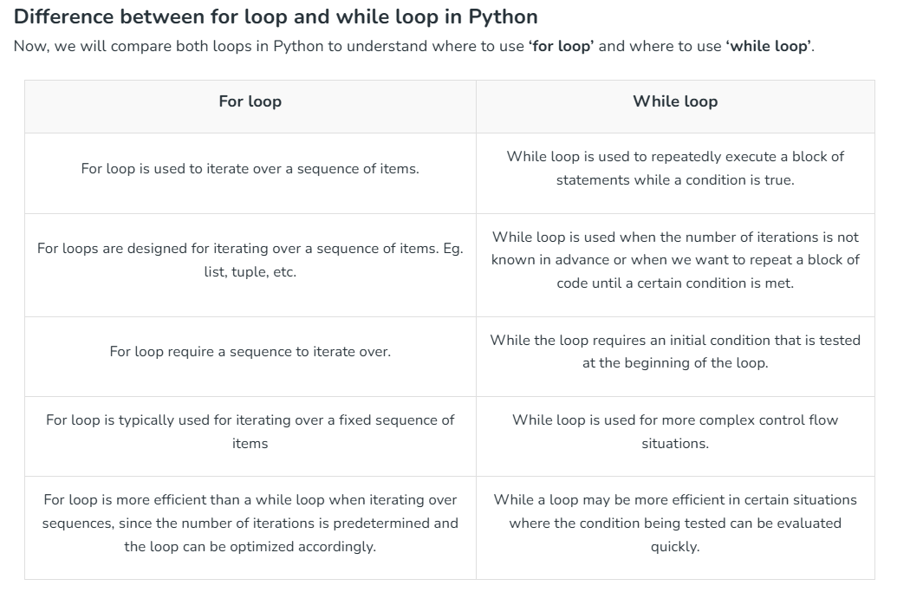

Slide 85
Which loop is faster in Python?
Why is Python slow in loops?
How many loops are used in Python?
How to improve Python loops?
Is for loop bad in Python?

Slide 86
Which loop is faster in Python?
In general, for loops tend to be faster than while loops in Python due to the way they are implemented. However, the difference in performance between for and while loops is often negligible for most practical purposes. The choice between them should be based on clarity and suitability for the specific task rather than performance concerns.
Why is Python slow in loops?
Python can be perceived as slow in loops when compared to lower-level languages like C or C++. This is primarily because Python is an interpreted language, meaning that each line of code is executed one by one at runtime. Additionally, Python’s dynamic typing and memory management can introduce overhead compared to statically-typed compiled languages.

Slide 87
How many loops are used in Python?
Python supports several types of loops:
for loop: Iterates over a sequence (e.g., list, tuple, string, dictionary).
while loop: Executes a block of code as long as a specified condition is true.
Nested loops: One loop inside another loop.
Comprehensions (e.g., list comprehensions, dictionary comprehensions): Concise ways to create lists, dictionaries, etc., using loops.
How to improve Python loops?
To optimize loops in Python, consider the following tips:
Use list comprehensions: They are often faster than traditional for loops for creating lists.
Minimize function calls: Move function calls outside loops if possible.
Use built-in functions: Python’s built-in functions (e.g., map(), filter(), sum()) are optimized and can be faster than manually written loops.
Profile our code: Use tools like cProfile to identify bottlenecks and optimize accordingly.
Consider using libraries: Libraries like NumPy and pandas offer optimized functions for common tasks involving loops over arrays or data frames.

Slide 88
Is for loop bad in Python?
No, for loops are not inherently bad in Python. They are a fundamental construct for iteration and are widely used in Python programming. However, for certain tasks involving large datasets or performance-critical code, optimizing loop operations using techniques like list comprehensions, vectorized operations (in libraries like NumPy), or reducing function calls can improve efficiency.

Slide 89
Python Nested Loops:
Use, Work, Syntax, Example

Slide 90
Contents:
Introduction
What Is a Nested Loop in Python?
How Does a Nested Loop Work in Python?
When to Use a Nested Loop in Python?
Nested while Loop in Python
Nested for Loop in Python
Using the Break Statement in Python Nested Loops
Using the Continue Statement in Nested Loops
Single Line Nested Loops Using List Comprehension
How to Turn a Nested for Loop into a List Comprehension?
When to Use a Nested Loop in Python?

Slide 91
How Does a Nested Loop Work in Python?
A nested loop contains one loop inside another, where the outer loop determines the total number of times the inner loop will run or execute. Every iteration of the outer loop triggers a complete cycle of the inner loop.
As the loop executes, the outer loop advances and the inner loop begins again for every iteration of the outer loop. Nested loops in Python are used for complex iteration patterns, especially for multi-dimensional data structures and repetitive operations with multiple factors.
Nested loops facilitate several tasks, including pairwise comparisons, nested repetitive operations, and more, making them a powerful programming tool. However, as they can increase the complexity level of computation, you must take care of a few aspects, such as considering alternative methods and optimizations for enhanced efficiency.
So, now, after understanding the nested loop definition, let’s get familiar with a few alternative approaches:
List Comprehensions- It is a shorter way to manage and create a list. So, if you want to create a list with multiple elements using two separate lists, you can use the list comprehension method instead of a nested loop.
multiples = [i*j for i in range(1, 4) for j in range(1, 4)]
The itertools.product- It is a direct approach to executing a nested loop over different lists.
from itertools import product
for i, j in product(range(1, 4), repeat=2):
print(i * j)

Slide 92
When to Use a Nested Loop in Python?
We use nested loops in Python to work with multi-dimensional data structures, such as dictionaries, tuples, sets, lists, etc., because they allow us to manipulate and traverse elements effectively.
As they provide a flexible option for executing complex logic within an iteration, nested loops help in performing repetitive tasks with multiple dimensions. They are also helpful in generating combinations, pairwise comparisons, performing nested repetitive operations, and implementing algorithms. Basically, nested loops are used for computations as they ensure efficient data processing and accurate control.
Example
# 2D grid representing a matrix
matrix = [
[1, 2, 3],
[4, 5, 6],
[7, 8, 9]
]
# Sum of all elements in the matrix
total_sum = 0
# Outer loop for each row
for row in matrix:
# Inner loop for each element in the row
for element in row:
total_sum += element
print(f"Total sum of elements: {total_sum}")

Slide 93
Nested while Loop in Python:
Here is the syntax for the Python nested while loop:
Example
# Outer loop countdown from 3 to 1
outer_counter = 3
while outer_counter > 0:
print(f"Outer loop: {outer_counter}")
# Inner loop countdown from 2 to 1
inner_counter = 2
while inner_counter > 0:
print(f" Inner loop: {inner_counter}")
inner_counter -= 1
outer_counter -= 1
print() # Add a blank line for better readability
print("Countdown finished!")
Syntax:
while (expression_1): #Outer loop
[code to execute] #Optional
while (expression_2): #Inner loop
[code to execute]

Slide 94
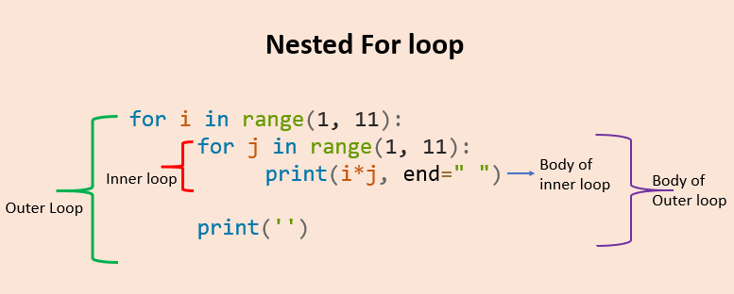

Slide 95
Nested for Loop in Python:
The syntax for Python nested for loop is as follows:
Syntax
for element in sequence1:
for element in sequence2:
# inner loop body here
# outer loop body here

Slide 96
Using the Break Statement in Python Nested Loops
The break statement is a type of control statement used to exit or escape the loop. When we use it inside the nested loop, it skips the remaining iteration and terminates the innermost loop.
The break statement is needed when the code doesn’t have to continue a loop. For example, if the loop is required to find a target value, it will be terminated once it discovers the target. It ends the inner loop but continues to run the outer loop.
Example
for i in range(4):
for j in range(4):
if j == i:
break
print(i, j)
Output:
1 0
2 0
2 1
3 0
3 1
3 2

Slide 97
Using the Continue Statement in Nested Loops
The continue statement is also a loop control statement and is the opposite of the break statement. In Python, when we use the continue statement within a loop, it skips all the statements below it and jumps to the next iteration of the loop.
Example :
first = [2, 4, 6]
second = [2, 4, 6]
for i in first:
for j in second:
if i == j:
continue
print(i, '*', j, '= ', i * j)
Output
2 * 4 = 8
2 * 6 = 12
4 * 2 = 8
4 * 6 = 24
6 * 2 = 12
6 * 4 = 24

Slide 98
Single Line Nested Loops Using List Comprehension:
List comprehension allows us to convert a for loop into a concise loop, so we don’t have to write multiple lines of code. It provides a clean, single-line statement and created the same way as a nested for loop.
List comprehension consists of brackets of expressions that we execute for every element. The for loop iterates over every element in the list. Python programmers decide whether to compress for loops or not using comprehensions based on the requirement. Some may find it useful as it makes the code compact and simple, but many believe it adds more complexity.
Illegible and long expressions can often hamper code quality, so prefer using list comprehension only when it improves the quality of code.
Syntax of List Comprehension
newList = [ expression(element) for element in oldList if condition ]

Slide 99
Example:
# Original list of numbers
numbers = [1, 2, 3, 4, 5]
# List comprehension to create a list of squares
squares = [number ** 2 for number in numbers]
print(squares)
Output:
[1, 4, 9, 16, 25]
Time Complexity: O(n2), faster than nested loops
Auxiliary Space: O(n)

Slide 100
How to Turn a Nested for Loop into a List Comprehension?
In Python, list comprehensions can be confusing for programmers as the outer loop occurs in the inner part of the code, whereas the inner loop occurs in the outer part. Apart from this, there is no significant difference between a normal loop and list comprehension.
Here is the formula for generating nested list comprehension from a nested for loop:
[expression for outer_loop for inner_loop]
Example:
# Size of the multiplication table
n = 5
# Create a multiplication table using nested list comprehension
multiplication_table = [[i * j for j in range(1, n + 1)] for i in range(1, n + 1)]
# Print the multiplication table
for row in multiplication_table:
print(row)
Output:
[1, 2, 3, 4, 5]
[2, 4, 6, 8, 10]
[3, 6, 9, 12, 15]
[4, 8, 12, 16, 20]
[5, 10, 15, 20, 25]

Slide 101
When to Use a Nested Loop in Python?
As nested loops increase computation complexity, programmers use it carefully and in special circumstances. There are several use cases for nested loops in Python, which we have mentioned below:
We use them to handle multi-dimensional data structures as they enable easy traversal and manipulation, with each loop iterating over a different dimension.
To compare elements across multiple dimensions in sorting or searching algorithms.
To execute repetitive tasks in a nested way or sequentially.
Nested loops allow iterating through rows and columns for matrix operations, such as addition, multiplication, and transposition.
To generate possible pairings between multiple lists or sets.
They are also useful in the cases of nested array or lists that need to be looped through the same function.

Slide 102
Nested while Loop in Python:
Here is the syntax for the Python nested while loop:
Example
# Outer loop countdown from 3 to 1
outer_counter = 3
while outer_counter > 0:
print(f"Outer loop: {outer_counter}")
# Inner loop countdown from 2 to 1
inner_counter = 2
while inner_counter > 0:
print(f" Inner loop: {inner_counter}")
inner_counter -= 1
outer_counter -= 1
print() # Add a blank line for better readability
print("Countdown finished!")
Syntax
while (expression_1): #Outer loop
[code to execute] #Optional
while (expression_2): #Inner loop
[code to execute]
Output:
Outer loop: 3
Inner loop: 2
Inner loop: 1
Outer loop: 2
Inner loop: 2
Inner loop: 1
Outer loop: 1
Inner loop: 2
Inner loop: 1
Countdown finished!

Slide 103
Nested for Loop in Python
The syntax for Python nested for loop is as follows:
Syntax:
for element in sequence1:
for element in sequence2:
# inner loop body here
# outer loop body here

Slide 104
Using the Break Statement in Python Nested Loops:
The break statement is a type of control statement used to exit or escape the loop. When we use it inside the nested loop, it skips the remaining iteration and terminates the innermost loop.
The break statement is needed when the code doesn’t have to continue a loop. For example, if the loop is required to find a target value, it will be terminated once it discovers the target. It ends the inner loop but continues to run the outer loop.
Example
for i in range(4):
for j in range(4):
if j == i:
break
print(i, j)
Output:
1 0
2 0
2 1
3 0
3 1
3 2

Slide 105
Using the Continue Statement in Nested Loops
The continue statement is also a loop control statement and is the opposite of the break statement. In Python, when we use the continue statement within a loop, it skips all the statements below it and jumps to the next iteration of the loop.
Example
first = [2, 4, 6]
second = [2, 4, 6]
for i in first:
for j in second:
if i == j:
continue
print(i, '*', j, '= ', i * j)
Output:
2 * 4 = 8
2 * 6 = 12
4 * 2 = 8
4 * 6 = 24
6 * 2 = 12
6 * 4 = 24

Slide 106
Single Line Nested Loops Using List Comprehension:
List comprehension allows us to convert a for loop into a concise loop, so we don’t have to write multiple lines of code. It provides a clean, single-line statement and created the same way as a nested for loop.
List comprehension consists of brackets of expressions that we execute for every element. The for loop iterates over every element in the list. Python programmers decide whether to compress for loops or not using comprehensions based on the requirement. Some may find it useful as it makes the code compact and simple, but many believe it adds more complexity.
Illegible and long expressions can often hamper code quality, so prefer using list comprehension only when it improves the quality of code.
Syntax of List Comprehension:
newList = [ expression(element) for element in oldList if condition ]
Example
# Original list of numbers
numbers = [1, 2, 3, 4, 5]
# List comprehension to create a list of squares
squares = [number ** 2 for number in numbers]
print(squares)
Output:
[1, 4, 9, 16, 25]

Slide 107
How to Turn a Nested for Loop into a List Comprehension?
In Python, list comprehensions can be confusing for programmers as the outer loop occurs in the inner part of the code, whereas the inner loop occurs in the outer part. Apart from this, there is no significant difference between a normal loop and list comprehension.
Here is the formula for generating nested list comprehension from a nested for loop:
[expression for outer_loop for inner_loop]
Example
# Size of the multiplication table
n = 5
# Create a multiplication table using nested list comprehension
multiplication_table = [[i * j for j in range(1, n + 1)] for i in range(1, n + 1)]
# Print the multiplication table
for row in multiplication_table:
print(row)
Output:
[1, 2, 3, 4, 5]
[2, 4, 6, 8, 10]
[3, 6, 9, 12, 15]
[4, 8, 12, 16, 20]
[5, 10, 15, 20, 25]

Slide 108
When to Use a Nested Loop in Python?
As nested loops increase computation complexity, programmers use it carefully and in special circumstances. There are several use cases for nested loops in Python, which we have mentioned below:
We use them to handle multi-dimensional data structures as they enable easy traversal and manipulation, with each loop iterating over a different dimension.
To compare elements across multiple dimensions in sorting or searching algorithms.
To execute repetitive tasks in a nested way or sequentially.
Nested loops allow iterating through rows and columns for matrix operations, such as addition, multiplication, and transposition.
To generate possible pairings between multiple lists or sets.
They are also useful in the cases of nested array or lists that need to be looped through the same function.

Slide 109
What is a Nested Loop structure?
How many nested loops can a programmer use in Python code?
How can we control the flow of a nested loop in Python?
How to use nested loops to generate a Matrix (List of Lists) in Python?

Slide 110
What is a Nested Loop structure?
A nested loop structure means a loop within another loop. It allows us to handle complex data and implement algorithms by iterating through multiple iteration levels.
How many nested loops can a programmer use in Python code?
In Python, we can use any number of nested loops. The number of loops is limited only by the available system resources and program requirements.
How can we control the flow of a nested loop in Python?
Python nested loops are powerful tools for handling complex iterations, and we can control their flow using control statements. Using the break statement within an inner loop terminates the inner loop immediately, and the program continues with the successive iteration of the outer loop. We use this method to exit the inner loop prematurely in certain situations.
How to use nested loops to generate a Matrix (List of Lists) in Python?
We can generate a matrix by stating rows and columns and generating a matrix through a loop.

