Slide 1
Keywords in Python
Keywords in Python

Slide 2
Introduction
A language is made of a set of words and rules that come together to make a sentence. Similarly, Python programming language consists of various predefined words known as keywords, which create meaningful code and programs.

Slide 3
What Are Keywords in Python?
Keywords in Python are predefined and reserved words with special meanings. They are a part of Python syntax. Python language keywords can’t be used as a variable, function, or identifier name.
You must understand the rules of using keywords to write correct Python code. So, here are the basic rules and guidelines for Python keywords:
Keywords in Python are case-sensitive.
All the keywords must be in lowercase except True and False.
They may vary with Python versions.
Keywords have specific meanings and predefined uses, which can’t be altered.
They are a part of Python syntax and can’t be changed.
They must be according to the syntax rules in Python.
Keywords can’t be used as identifiers.
Some words can be used as keywords in specific contexts and as identifiers in other cases.

Slide 4
List of Python Keywords

Slide 5
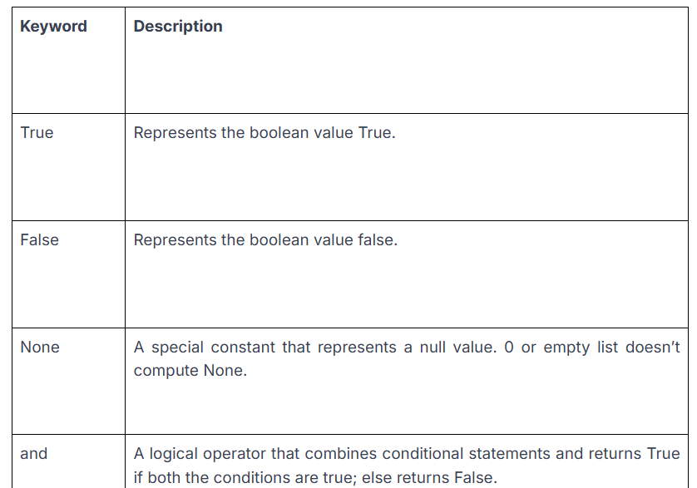

Slide 6
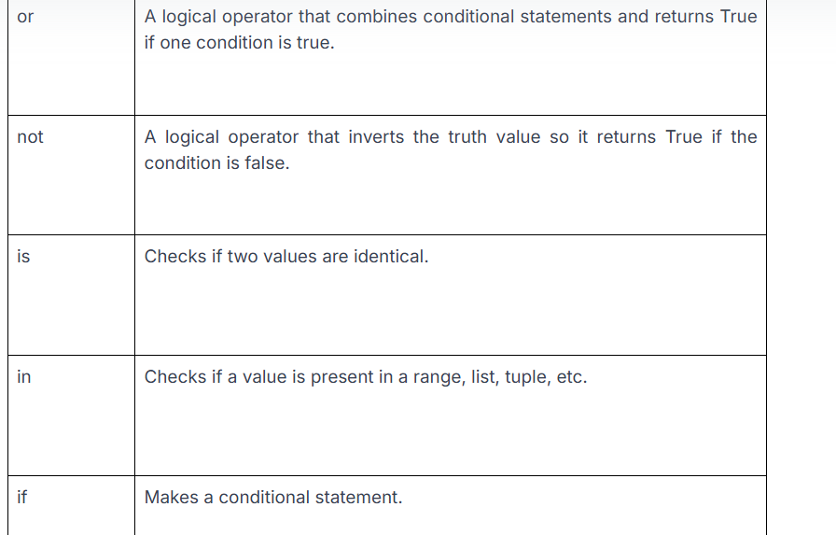

Slide 7
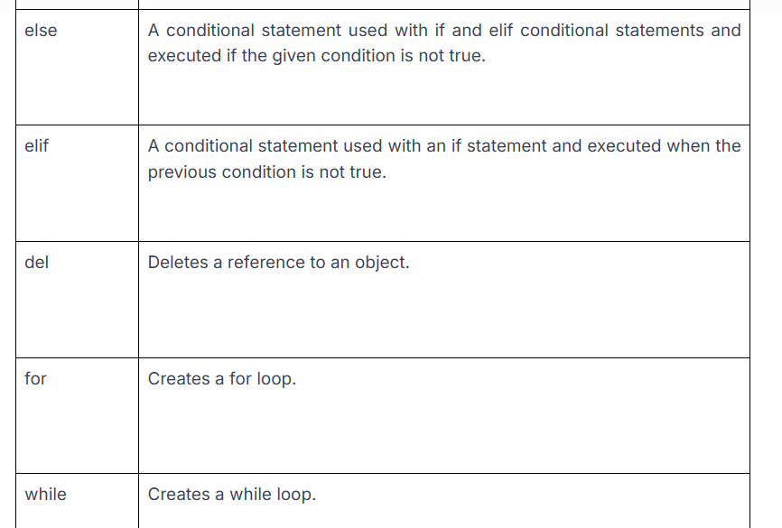

Slide 8
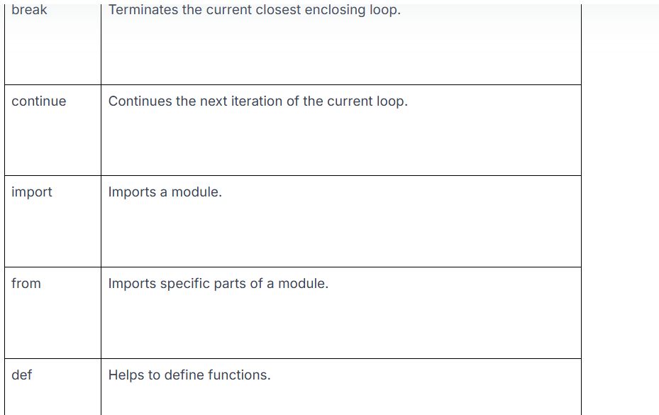

Slide 9
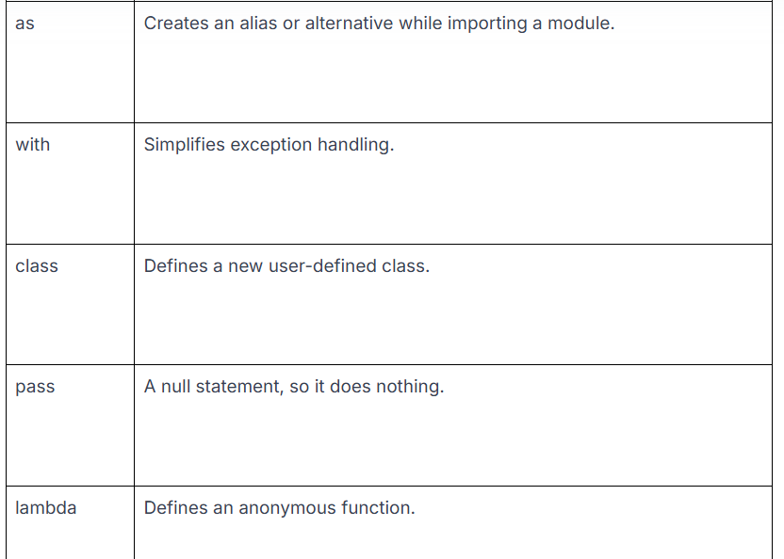

Slide 10
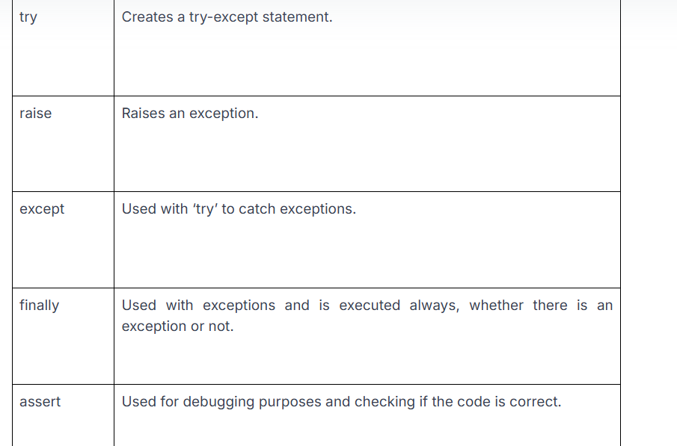

Slide 11
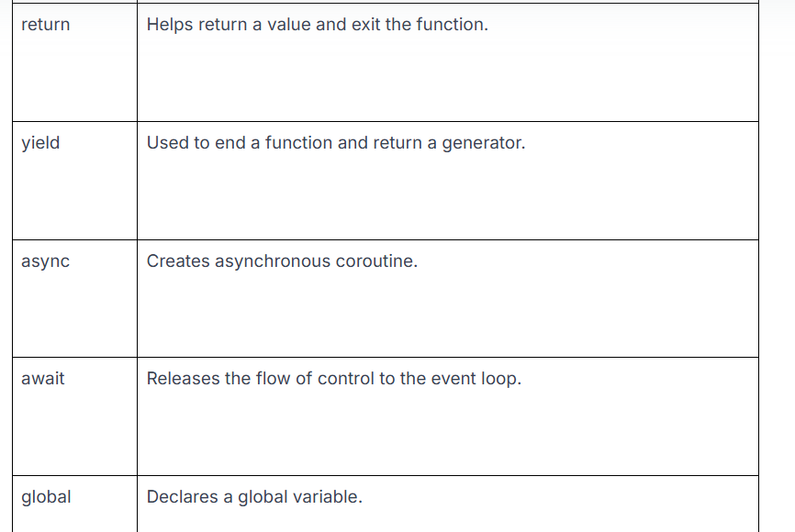
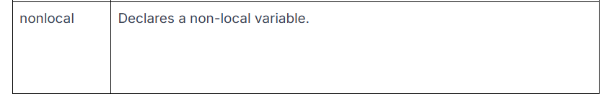

Slide 12
These keywords may vary based on Python versions. Some versions may have a few new ones, while others may have fewer. To get a complete list of keywords in your current version, use the given prompt:
Example
import keyword
print(keyword.kwlist)
Output
['False', 'True', 'None', 'and', 'while', 'with', 'assert', 'async', 'await', 'break', 'class'] etc....

Slide 13
Description of Python Keywords:
Below, we have discussed all the Python programming keywords in detail with examples:
True, False Keywords
True and False keywords are truth values in Python and the result of comparison operations.
True represents a boolean value True. If a statement is true, ‘True’ is returned.
False represents a boolean value False. If a statement is false, False is returned.

Slide 14
None:
None is a special constant that represents a null or void value. Remember that None doesn’t denote 0, False, string, or empty list. None is the object of its datatype- NoneType. You can’t create multiple None objects but can assign them to variables that are equal to one another.
False = 0 and True = 1.
True + True + True is 3.
True + False + False is 1.
None isn’t equal to 0 or an empty list ([])

Slide 15
Example :
print(False == 0)
print(True == 1)
print(True + True + True)
print(True + False + False)
print(None == 0)
print(None == [])
Output
True
True
3
1
False
False

Slide 16
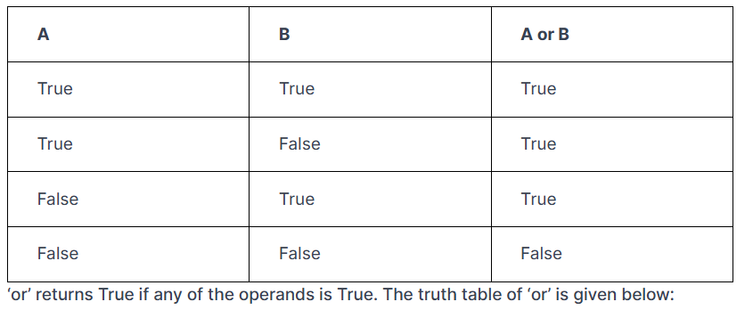
And, or, and not are logical operators in Python and among the most important keywords of Python. The ‘and’ operator returns True if both operands are True. Here is the truth table for ‘and’:

Slide 17
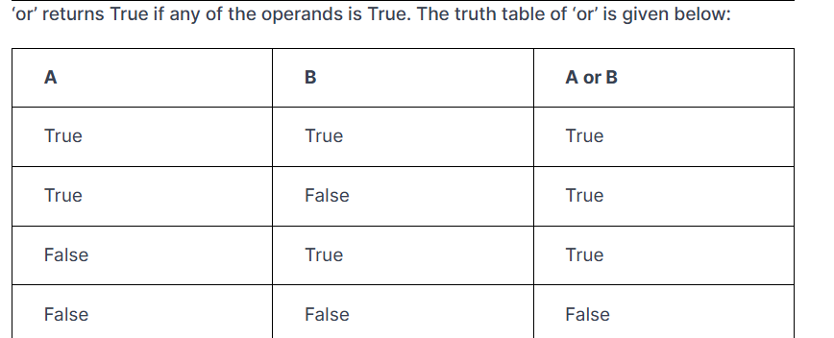

Slide 18
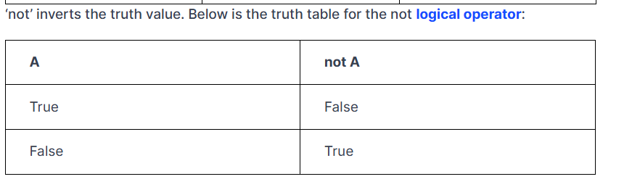

Slide 19
is and in Keywords
The ‘is’ keyword in Python tests object identity, which means it checks if both objects have the same memory location. We use the == operator to check if two variables are equal or not, but we use ‘is’ to check if both of them refer to the same object. If the two objects are the same, it returns True; otherwise it returns False.
Next on our Python keywords list is ‘in’, which tests if a sequence contains a value. It returns True if a value is present; else, it returns False. The ‘in’ keyword also loops through the sequence.
Example
a = [1, 2, 3]
b = a
c = [1, 2, 3]
print(a is b) # True, because a and b are the same object
print(a is c) # False, because a and c are different objects

Slide 20
if, else, elif- Conditional keywords in Python:
if, else, and elif keywords are used for decision-making or conditional branching.
if is a control statement, and if a condition is true, the if block is executed.
else is also a control statement, and the else block is executed when the given condition is false.
elif is a short for ‘else if’ and is used to check a condition and execute the block if the statement is true.
Example
# Define a variable to store the temperature
temperature = 75
# Check the temperature and print an appropriate message
if temperature > 85:
print("It's really hot outside!")
elif temperature > 65:
print("It's a nice day.")
else:
print("It's a bit chilly today.")

Slide 21
del Keyword
The Python del keyword deletes a reference to an object. We can delete any variable or list value using this keyword. You must know that everything is an object in Python.
Example
x = 5
print(x) # will print 5
del x
print(x) #will give error because x object(variable) is deleted

Slide 22
for, while, break, continue- Iteration Keywords in Python:
for- In Python, ‘for’ is used for looping. It controls flow and is used for looping and with any type of sequence, like string or list. We use it mostly when we already know the exact number of times we want to loop.
Example :
for i in range(10):
print(i, end = "")
Output:
0123456789

Slide 23
while-
wile serves the same purpose as for and is used for looping and to control flow. The statement within the while loop is executed until the condition for the while loop proves to be false or there is a break statement.
break-
This keyword is used inside for and while loops and alters their normal behavior. The break keyword controls the flow of the loop. Using break will end the loop and pass the control to the statement immediately after the loop.
continue-
This keyword also controls the flow of code and is used to end the current iteration of the loop and not the entire loop.

Slide 24
Example :
count = 0
while count < 5:
count += 1
if count == 3:
continue # Skip the rest of the loop when count is 3
if count == 5:
break # Exit the loop when count is 5
print(count)
print("While loop ended")
Output:
1
2
4
While loop ended

Slide 25
import, from Keywords
import- The import keyword imports a particular module or a specific function into the current program and makes it accessible in the code.
from- This keyword is used with import to import a specific function or class from a module.
def, as, with, class, pass, lambda- Structure Keywords in Python
def- This keyword is used to declare a user-defined function. Function refers to a block of related statements that come together to perform a specific task. It is used to organize code into manageable chunks and do repetitive tasks.
def say_hello():
print("hello there! have a good day")
say_hello()
Output:
hello there! have a good day

Slide 26
as:
The as keyword is used to create an alias for the imported module. It gives a new name to the module while importing it.
Example
import time as t #aliasing/renaming time module as t for shorter access
print("1")
t.sleep(5)
print("2")
Output:
1
2
#note : 2 will be visible after 5 seconds due to delay

Slide 27
With:
The with keyword wraps the execution of a block of code within methods defined by the context manager. A context manager is a class implementing __enter__ and __exit__ methods. When we use the with keyword, it ensures to call the __exit__ method at the end of the nested block. However, this is one of the Python keywords that is rarely used as we don’t include it in day-to-day programming.
Example
# Using the with keyword to open a file
with open('example.txt', 'w') as file:
file.write('Hello, world!')
# The file is automatically closed after the with block

Slide 28
class:
The class keyword declares user-defined classes in Python. Classes are a collection of related methods and attributes representing a real-world situation. Although they can be defined anywhere in a program, it is recommended to define a single class in a module. The idea of bringing functions and data together in a class is the core of object-oriented programming (OOP).
Example:
# Define a simple class
class MyClass:
pass
# Create an instance of the class
my_instance = MyClass()

Slide 29
pass:
In Python, the pass keyword is a null statement. When you execute the pass keyword, it results in nothing. Pass is used as a placeholder and prevents indentation errors.
Example
# Define a simple class
class MyClass:
pass
# Create an instance of the class
my_instance = MyClass()

Slide 30
lambda
lambda creates an anonymous function, which means a function with no name. It is used to make an inline returning function with no return statement allowed internally. This keyword consists of expressions that are evaluated and returned.
Example
# Define a lambda function that adds two numbers
add = lambda x, y: x + y
# Use the lambda function
result = add(2, 3)
print(result)
Output:
5

Slide 31
try, raise, except, finally, and assert- Exception Handling Keywords in Python:
Exceptions are errors suggesting there is something wrong while executing the program. A few common examples of exceptions in Python are ImportError, IOError, NameError, ValueError, TypeError, and ZeroDivisionError. We use try—except blocks to catch exceptions. You can understand all keywords in Python better through the given examples.
try- This keyword is used to catch errors in code. Once the code in the try block is checked and an error is found, the except block is executed.
raise- Using the raise keyword, we can raise an explicit exception.
except- This keyword is used with ‘try’ to catch exceptions.
finally- We use finally with the try…except block to close file streams or resources. Irrespective of the result of the try block, we always execute the finally block. So, even if there is an unhandled exception, it will execute the code within the finally block.

Slide 32
assert-
We use the assert keyword for debugging. As a programmer, you may sometimes need to check the internal state or see if an assumption is true. Hence, assert is used to find bugs easily. It is used to check the correctness of code. If a statement is true, nothing happens. However, if the statement is false, it raises the AssertionError. You can print a message with the error and separate it using a comma.

Slide 33
Example
def divide(a, b):
try:
# Assert to check if the inputs are integers or floats
assert isinstance(a, (int, float)) and isinstance(b, (int, float)), "Inputs must be numbers"
# Raise an exception if dividing by zero
if b == 0:
raise ZeroDivisionError("Division by zero is not allowed")
result = a / b
return result
except AssertionError as e:
print(f"AssertionError: {e}")
except ZeroDivisionError as e:
print(f"ZeroDivisionError: {e}")
except Exception as e:
# Catch any other exceptions
print(f"An unexpected error occurred: {e}")
finally:
# This block will always execute
print("Execution of divide function complete.")

Slide 34
# Test cases:
print(divide(10, 2)) # Should print 5.0 and "Execution of divide function complete."
print(divide(10, 0)) # Should print "ZeroDivisionError: Division by zero is not allowed" and "Execution of divide function complete."
print(divide(10, 'a')) # Should print "AssertionError: Inputs must be numbers" and "Execution of divide function complete."
Output:
Execution of divide function complete.
5.0
ZeroDivisionError: Division by zero is not allowed
Execution of divide function complete.
None
AssertionError: Inputs must be numbers
Execution of divide function complete.
None

Slide 35
return, yield- Return Keywords in Python:
return- We use the return keyword to return a final result from a function. It is used within a function and exits it immediately while returning a value. If a value is not returned explicitly, it returns None automatically.
Example:
def add(a, b):
return a + b
result = add(3, 5)
print(result)
Output:
8

Slide 36
yield:
yield is used like a return statement inside a function. It returns a generator, which is an iterator that generates one item at a time. As a long list of values can consume a lot of memory, we use generators to generate one value at a time rather than storing all the values together.
The return keyword returns a single value and ends the function, whereas the yield keyword returns multiple values but one at a time.
Example:
def generate_numbers(n):
for i in range(n):
yield i
# Using the generator
for number in generate_numbers(5):
print(number)
Output:
0
1
2
3
4

Slide 37
async, await Keywords:
In Python, the asyncio library provides async and await keywords. They both are used to write concurrent code in Python.
Example
import asyncio
# Define an asynchronous function
async def fetch_data():
print("Start fetching data...")
await asyncio.sleep(2) # Simulate a network request with a 2-second delay
print("Data fetched.")
return {"data": "sample data"}
# Define another asynchronous function that uses await to call fetch_data
async def main():
print("Calling fetch_data")
data = await fetch_data() # Wait for fetch_data to complete
print(f"Received data: {data}")
# Run the main function using asyncio
asyncio.run(main())
# Output:
Calling fetch_data
Start fetching data...
Data fetched.
Received data: {'data': 'sample data'}

Slide 38
global, nonlocal Keywords:
global- When we need to change the value of a global variable inside a function, we must declare it using the global keyword. If we don’t use this keyword, it will create a local variable with that name. However, if we have to read the value of a global variable, we don’t have to define it as global.
Example
x = 10 # Global variable
def modify_global():
global x # Declare x as global
x = 20 # Modify the global variable
print(f"Inside modify_global: x = {x}")
modify_global()
print(f"Outside modify_global: x = {x}")
Output:
Inside modify_global: x = 20
Outside modify_global: x = 20

Slide 39
The nonlocal keyword is used similarly to the global keyword. However, it declares a variable inside a nested function to indicate that the variable is outside of the enclosing function. To change the value of a nonlocal variable inside a nested function, we must declare it using nonlocal; otherwise, it will create a local variable with that name.
Example
def outer_function():
y = 5 # Enclosing variable
def inner_function():
nonlocal y # Declare y as nonlocal
y = 15 # Modify the enclosing variable
print(f"Inside inner_function: y = {y}")
inner_function()
print(f"Inside outer_function: y = {y}")
outer_function()
Output:
Inside inner_function: y = 15
Inside outer_function: y = 15

Slide 40
Rules for Keywords in Python:
Reserved Words
Keywords in Python are reserved and cannot be used as identifiers such as variable names, function names, or any other custom identifiers.
def for():
Invalid Function Name!
This will throw a SyntaxError.
2. Case Sensitivity
Python keywords are case-sensitive. For example, if is a keyword, but IF or If is not.
if = 10 # Invalid, raises SyntaxError
If = 10 # Valid, as "If" is not a keyword
3. Cannot Be Re-Defined
Keywords cannot be redefined or assigned values.
True = False # Invalid, raises SyntaxError

Slide 41
Only Lowercase and Camel Case:
Except for True, False, and None, all Python keywords are in lowercase.
global = "variable" # Invalid
TRUE = "value" # Valid, as TRUE is not a keyword
5. No Additions or Deletions
The set of Python keywords is predefined and cannot be altered by the user. They are determined by the Python interpreter and vary with Python versions.
Contextual Use: Keywords are context-sensitive and are meant for specific tasks such as defining conditions (if, else), loops (for, while), and more.
for i in range(5): # 'for' is used in loop statements
print(i)
6. Avoid Confusion with Identifiers:
Keywords should not be used in a way that might confuse the interpreter, even indirectly.
def class_():
pass # Valid, but confusing and discouraged

Slide 42
How to Identify Python Keywords:
it's important to check whether the keywords you're using are correct or not. There are a few methods with the help of which you can identify if a word you have used is a keyword or not. These methods are as follows:
Use an IDE With Syntax Highlighting
Several IDEs provide features like syntax highlighting. When you write code in Python using these IDEs, the keywords are highlighted. Keywords appear in different colors or styles, which helps programmers easily identify them while writing the code or reviewing it.
Use Code in a REPL to Check Keywords
You can also use a REPL (Read-Eval-Print Loop) environment like we have Python's interactive interpreter or Jupyter Notebook. They have features that help developers test small snippets of code with potential keywords. This will help them verify if the keywords they are using are recognized as a keywords by Python or not so they can make required changes then and there.
Look for a SyntaxError
Another method is looking for SyntaxError in your Python code. If you notice that a SyntaxError has occurred, you will know that you have used a keyword incorrectly because keywords can not be used as identifiers in Python like a variable name or a function name.

Slide 43
Classification of Python keywords:

Slide 44
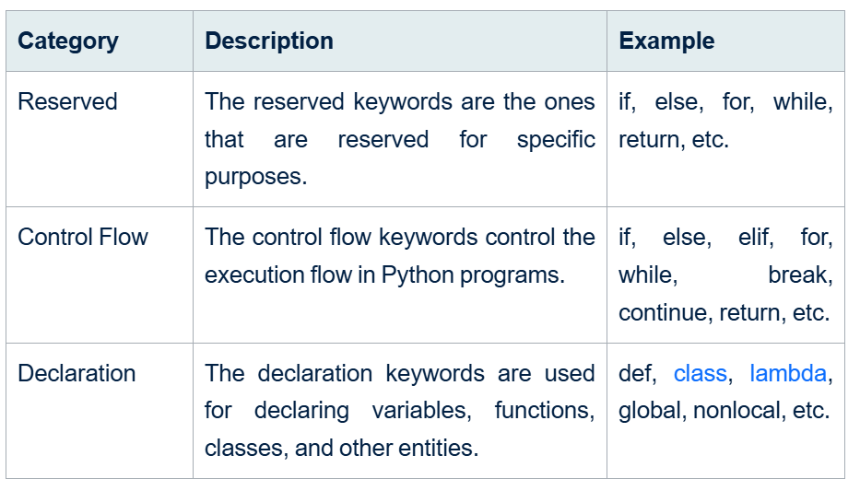

Slide 45
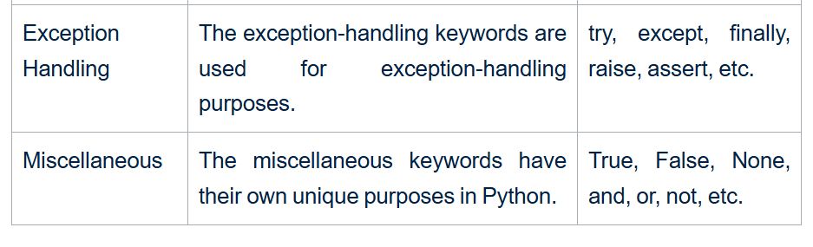

Slide 46
Value Keywords:
Value keywords are used to represent specific values in Python.
True, False- They both are used in logical expressions and represent the boolean values 'True' and ' False'.
None- It is used to represent that there is no value or it is null.
Example of Value keywords
print(True)
print(False)
print(None)

Slide 47
Operator Keywords:
The operator keywords are used to perform logical and comparison operations in a Python program.
and-It will return 'True' when both the operands are 'True'.
or-It will return 'True' when at least one of the operand is 'True'.
not-It will return the opposite of the operand.
in-It checks that whether a specified value is present in the given sequence.
is-It compares the identity of objects.
Example of Operator keywords
a = True
b = False
print(a and b)
print(a or b)
print(not a)
print(5 in [1, 2, 3, 4, 5])
print(5 is 5)
Try it Yourself >>
Output
False
True
False
True
True

Slide 48
Control Flow Keywords:
The control flow keywords are used to execute code blocks with conditional statements.
if-It will execute a code block if the condition is 'True'.
elif-It is the short form of 'else if'. It will put another alternative condition for checking if the 'if' condition is 'False'.
else-It will execute a code block if none of the conditions are 'True’.
Example of Control Flow keywords
x = 10
if x > 5:
print("x is greater than 5")
elif x == 5:
print("x is equal to 5")
else:
print("x is less than 5")
Try it Yourself >>
Output
x is greater than 5

Slide 49
Iteration Keywords:
The iteration keywords are used to control loop execution.
for-It iterates over the elements of a specified sequence.
while-It will execute a code block as long as the condition is 'True'.
break-It is used for terminating the loop before completion.
continue-It is used for skipping the current iteration and continue with the next one.
else-It will execute a code block when the has completed without a 'break' statement.
Example of Iteration keywords
for i in range(5):
if i == 3:
break
print(i)
else:
print("Loop completed successfully")
Output
0
1
2

Slide 50
Structure Keywords:
The structure keywords are used for defining structure of a program.
def-It defines a function.
class-It defines a class.
with-It uses context managers to simplify resource management.
as-It renames or aliases imported modules or objects.
pass-It indicates that no action needs to be taken.
lambda- It creates an anonymous function.
Example of Structure keywords
def example_function():
pass
class ExampleClass:
pass
with open('example.txt', 'r') as file:
data = file.read()
lambda_func = lambda x: x * x
print(lambda_func(5))
Try it Yourself >>
Output
25

Slide 51
Returning Keywords:
The returning keywords are used for returning values from functions and generators.
return-It will exit a function and may also return a value.
yield-It will stop the execution of a function and will return a value to the caller while the state of the function remains constant.
Read More: Functions in Python
Example of Returning keywords
def example_function():
return 42
def generator_function():
yield 1
yield 2
yield 3
print(example_function())
print(list(generator_function()))
Output
42
[1, 2, 3]

Slide 52
Import Keywords:
The import keywords are used for importing symbols and modules in Python.
import-It will import a whole module.
from-It will import specific symbols from a module.
as-It will alias the imported symbols or modules.
Example of Import keywords
import math
from datetime import datetime as dt
print(math.pi)
print(dt.now())
Output
3.141592653589793
<current date and time>

Slide 53
Exception-Handling Keywords
The exception handling keywords in Python are used for handling exceptions in a python program.
try-It will start and check a code block that may have an exception but not execute it.
except-It is used for checking and handling exceptions.
raise- It will raise an exception.
finally-It will execute a code no matter if any exceptions occur or not.
else-It will execute the code if there is no exception occurring in the 'try' block.
assert-When the condition is 'False', an 'AssertionError' is raised to assert a condition.
Example of Exception-Handling keywords
try:
x = 1 / 0
except ZeroDivisionError:
print("Error: Division by zero")
else:
print("No error occurred")
finally:
print("Cleanup code")
assert 2 + 2 == 4, "Math is broken"
Output
Error: Division by zero
Cleanup code

Slide 54
Asynchronous Programming Keywords:
The asynchronous programming keywords are used for asynchronous programming in Python.
async-It is used for defining a coroutine function.
await-It will pause the execution of a coroutine function until its own coroutine function completes.
Example of Asynchronous Programming keywords
import asyncio
async def example_coroutine():
await asyncio.sleep(1)
print("Async function executed")
async def main():
await example_coroutine()
asyncio.run(main())
Output
Async function executed

Slide 55
Variable Handling Keywords
The variable handling keywords are used for manipulating and scoping variables in Python.
del-It will delete a variable from a collection.
global-It is used for declaring a variable with a global scope.
nonlocal-It is used for declaring a variable with a scope of the nearest function just outside the current one.
Example of Variable Handling keywords:
x = 10
print(x)
del x
print(x) # Raises NameError because x is deleted
Output
10
NameError: name 'x' is not defined
Summ

Slide 56
None:
A null object or variable can be denoted using the none keyword. In the Python programming language, the none keyword itself is an object. Simply put, it is a data type of the NoneType class. Hence, it is not possible to create another NoneType class. A programmer can assign the null object to any variable. All objects that are assigned the None point will refer to the same object. A new instance of None will not be created every time we assign it to a new variable.

Slide 57
Points to Note:
Both the == operator and the is operator is supported by the none keyword
None doesn’t mean 0. It means NULL. Both aren’t the same.
The False keyword and the none keyword aren’t the same things.
If you compare none with anything else, the statement will always return a False. It returns a True only if none is being compared with another none.
None doesn’t denote an empty string

Slide 58
A programmer can get a list of the keywords by following the below steps –
Syntax: Type in help followed by keywords in parenthesis as shown below.
>>> help(“keywords”)
Output: Below will be the output that you will be able to see on your screen

Slide 59
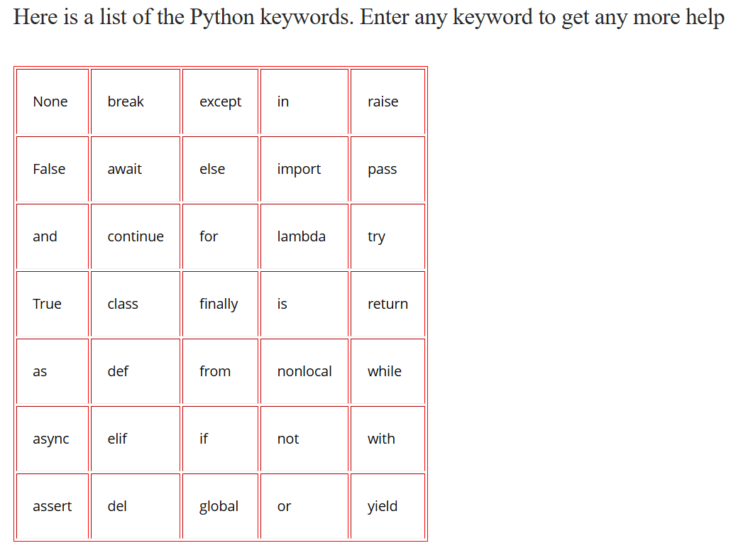

Slide 60
How do you use any keyword in Python?
A: You can’t use a Python keyword to name a variable or any other identifier. The syntax for each keyword depends on the purpose of the keyword. Hence, the syntax will be different for different keywords.
What are keywords in Python along with an example?
A: Python reserves a certain set of keywords for various internal operations. These words are also known as Python Keywords. These words cannot be used for naming variables, functions, or classes. There are certain restrictions on the usage of these keywords. A few common keywords are break, global, yield, else, and raise.
How many keywords are there in Python 3?
A: There were 33 keywords in Python 3.7. However, the number increased to 35 in Python 3.8. Hence, we can see that the number of keywords in Python is not constant. It might vary from version to version. Refer to the table above to understand the various keywords that you can use while programming in Python.

