Slide 1
Python Directory and
Files Management

Slide 2
Introduction
What Is a Directory in Python?
Python Directory Management
Introduction:
When software is required to manage a massive number of files, we prefer organizing them by sorting code into different folders. This makes handling numerous files hassle-free. A directory in Python is a folder that groups files and subdirectories. We use the os module in Python, which offers multiple useful methods for working with directories and files.

Slide 3
What Is a Directory in Python?
A Python directory is a collection of files and subdirectories (a directory within a directory). It allows us to store, organize, and separate files on a computer. A directory without a parent is known as a root directory.
A path is a way to reach the file, containing a combination of directory and folder names separated by slashes and colons, giving a route to the file in the system. In Python, the OS module provides useful methods for working with directories and files.
Python Directory Management
Several modules in Python contain built-in functions used to manipulate and process data. Moreover, some modules enable us to interact with operating systems and files. These modules are also used for directory management. Here are the modules that offer functionalities:
os and os.path
shutil
tempfile
filecmp

Slide 4
os and os.path Module:
The os modules offer different ways to handle files and directories. It allows us to create, rename, and delete directories so we can know the current working directory (CWD) and how to change it to another. We can also copy files from one directory to another. Let’s have a look at the main methods used for directory management.
Get the Current Working Directory (CWD)
Every computer system process has a directory associated with it known as the Current Working Directory (CWD). We use os.getcwd() to get the current working directory, and it returns a string representing the path of CWD. We can also use the os.getcwdb() method, which returns a byte string representing the CWD. These methods don’t need parameters to be passed.
Example :
import os
print("your current working directory= ",os.getcwd())
Output:
your current working directory= your_path\to\current\directory

Slide 5
Create a New Directory:
We can create a new directory using the os.mkdir() method. We pass the desired name of the newly created directory. It takes the path of the new directory. To create a new directory somewhere else, we must specify the path, which must contain forward slashes and not backward ones. This method creates a new directory within the CWD by default if no path is mentioned.
Example
import os
os.mkdir("python tutorial")
Note : New folder will be created into your current directory with name python tutorial

Slide 6
Change Current Working Directory (CWD):
We use the chdir() method to change the Current Working Directory(CWD). The path of the desired directory we want to change into is passed as a parameter, and we can use either backward slash or forward slash to separate the elements of the path.
Example
import os
os.chdir(r"C:path\to\your\directory")
Rename a directory
We can rename a directory or a file using the os.rename() method. There are two basic arguments passed- the old_name as the first argument followed by the new_name. In case an existing directory already has the new_name passed, it raises OSError in Unix and Windows.
Example
import os
with open("old_name.txt", 'w') as file:
file.write('This is a file to be renamed.')
os.rename("old_name.txt", "new_name.txt")
Note : old_name.txt will be changed to new_name.txt

Slide 7
List the files in a directory:
A directory in Python can have subdirectories and various files. We can list them using the os.listdir() method, which takes no or only one parameter. If the path is specified, it returns a list of subdirectories and files contained in that path. However, if no path is specified, it returns the list of files and subdirectories from the CWD.
Example
import os
print(os.listdir())
Output
All files and folder of your current working directory will be shown
Remove a directory
We can remove or delete a directory using the os.rmdir() method, which takes the path to that directory as a parameter. If the directory is empty, it only deletes it; otherwise, it raises an OSError.
Example
import os
os.rmdir(r"path\to\your\directory_to_remove")
Note : use if you want to remove a folder

Slide 8
Check whether it is a directory
We use os.path.isdir(path) to know if the path is a valid directory or not. This method returns the boolean value, returning true if the path is a valid directory; else, returning false.
Example
import os
print(os.path.isdir(r"paht\to\your\directory"))
Output:
True if that directory exist as per your path
False if directory not exist of it is a file not a folder
Get the size of the directory
Using os.path.getsize(path_name), we can know the size of the directory in bytes. If the path is invalid, it raises an OSError.
Example
import os
print(os.path.getsize(r"path\to\your\directory or file"))
Output:
Your File Size in Bytes

Slide 9
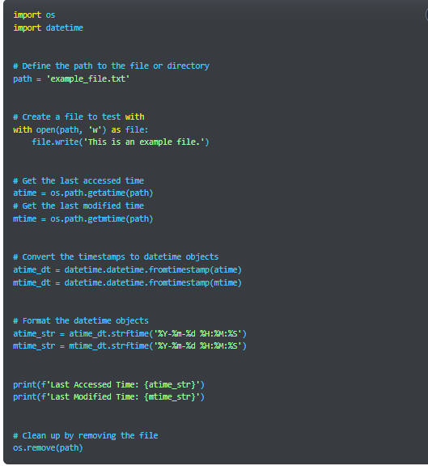

Get access and modification times:
We use os.path.getatime(path) to get the last accessed time of a directory and use os.path.getmtime(path) to find the last modified time of a directory.
These two methods return the number of seconds since the epoch. If you want to format it, use the datetime module’s strftime().

Slide 10
shutil module:
The shutil module focuses on high-level operations on directories and files and allows us to copy or move a directory from one source to another.
shutil.copytree(s, d, symlinks=False, ignore=None, copy_function=copy2, ignore_dangling_symlinks=False)
This will recursively copy the source directory, signified as s, to the destination directory, signified as d, but d should not exist already.
symlinks, or symbolic links, signify virtual files, reference folders, or folders located somewhere else. They take true, false, or omitted values. The true value means the symlinks in the source are marked the same in the destination, too, but it will not copy associated metadata. The false or omitted value means the content and metadata of the linked file are copied to the destination.
We use this parameter to indicate which files should be ignored while copying.
copy2 is the default copy_function that allows to copy metadata. We can also use copystat() and copy().

Slide 11
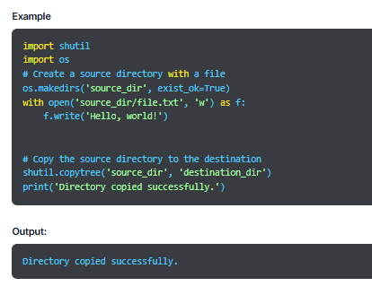

Slide 12
shutil.rmtree(path, ignore_errors=False, onerror=None)
This method will delete a directory completely, so we can use it instead of os.rmdir, which deletes the directory only when it’s empty.
path is a valid directory, and the method won’t accept symlinks to a directory.
In case ignore_errors is false or omitted, the errors are handled by the one specified in the onerror parameter. However, if the value is true, the error is ignored when the directory is removed.
oneerror is a callable that takes three parameters- function (raises an exception), path (to be passed to the function), and excinfo (exception information returned by sys.exc_info()).
Example:
import shutil
shutil.rmtree('source_dir')
shutil.rmtree('destination_dir')
It will remove previously created source_dir and destination_dir folder.

Slide 13
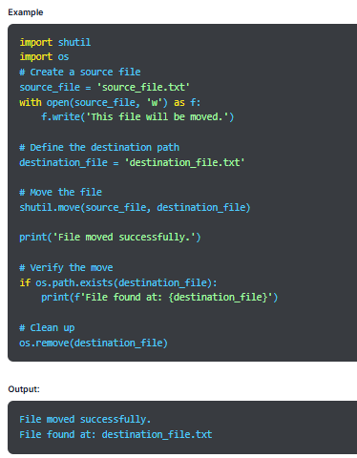
shutil.move(s,d)
It will remove the source directory to the mentioned destination.
The destination must not exist already. If it does, it will be overwritten based on the os.rename() semantics.

Slide 14
tempfile module
We use this module to create temporary directories or files in the temp directory that the operating system creates.
profile/AppData/Local/temp
mkdtemp()
It passes suffix, prefix, and dir parameters to create a temporary directory.
The suffix and prefix align with the naming conventions for the temp directory. The suffix parameter decides the end of the file name, whereas the prefix decides its beginning and is commonly set to ‘tmp’.
dir is used to specify the path where the temporary directory is to be created. By default, it is set to the temp directory that the operating system creates.
Users who create the temp dir must delete the temporary directory once the work is complete.
Temporary directories are writable, readable, and searchable by the creator using the unique ID.
The method runs the path of the new directory.

Slide 15
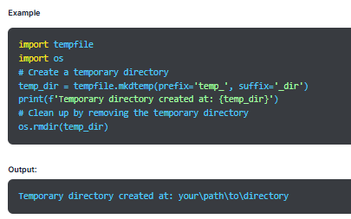

Slide 16
TemporaryDirectory()
It uses mkdtemp() to create a temporary directory, and we must pass the same parameters for this method.
The basic difference is the object created works like a context manager.
We use object-name to get the name of the new temporary directory.
The file system automatically deletes the temporary file, so users do not need to do it manually.
We use the cleanup() function to explicitly delete the temporary dir.

Slide 17
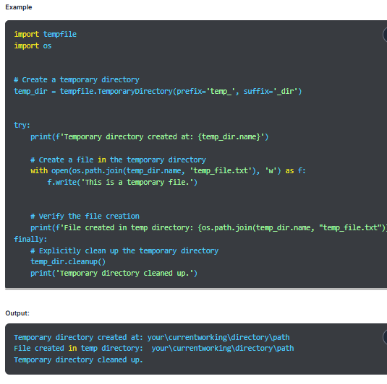

Slide 18
filecmp module
This module provides functions to compare files and directories. For this, we create an object for the class file.dircmp to describe the file to ignore and the file to hide from functions of that class. We also invoke the constructor before calling any function of the class. Here’s the method to invoke the constructor:
Syntax
d = filecmp . dircmp( dir_1, dir_2, ignore=[a,b,c]/None, hide=[d,e,f]/None )
Functions for Comparing Directories
d.report()- It is used to compare two directories while invoking a constructor. This method presents a summary of a list of files in the two directories. If the files are the same, they are listed and common subdirectories are also printed as an output.

Slide 19
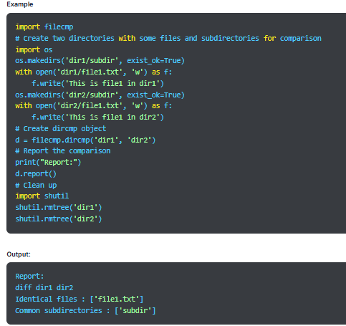

Slide 20
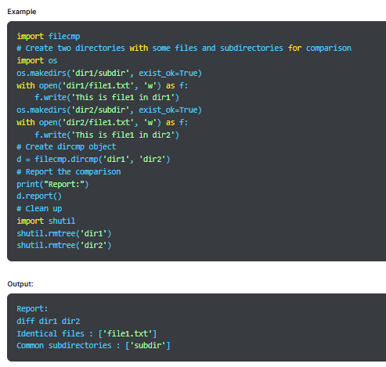
d.report_partial_closure()- It will print the comparison done between two directories and comparisons between immediate common subdirectories.

Slide 21
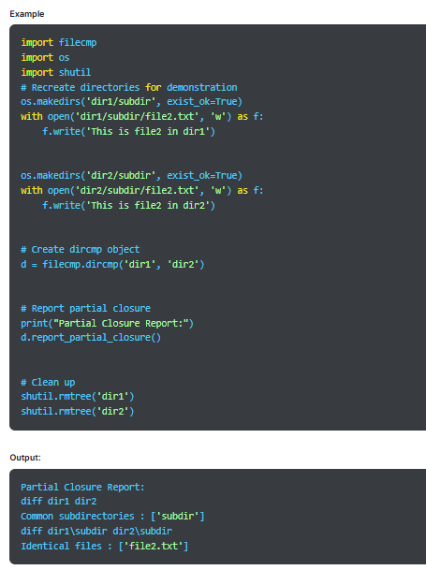
d.report_partial_closure()- It will print the comparison done between two directories and comparisons between immediate common subdirectories.
d.report_full_closure()- Although this is the same method as the last one, it performs comparison recursively. It also compares identical files, common subdirectories, and things that don’t match

Slide 22
Python CSV File:
Read and Write CSV File

Slide 23
Introduction
Working With CSV Files in Python
Reading from a CSV File in Python
Writing to a CSV File in Python
Using Python Pandas to Handle CSV Files

Slide 24
Introduction:
The CSV (Comma Separated Values) format is an import and export format to store tabular data. In a CSV file, each data field is separated using a delimiter. This commonly used method is used to exchange data between applications. A wide range of applications support the CSV format, and it is also used in data science. To represent a CSV file, save it with the .csv file extension.

Slide 25
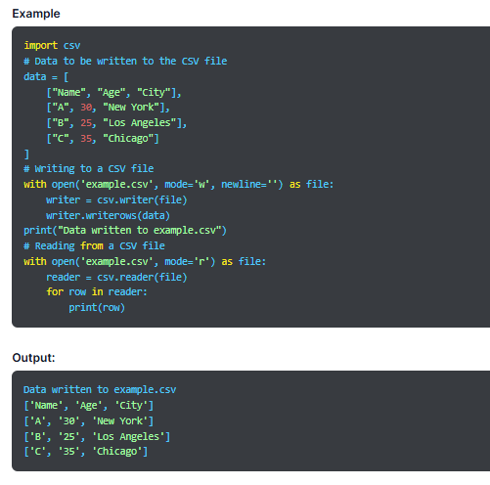

Slide 26
Working With CSV Files in Pythone
In Python, there is a dedicated CSV module used to work with CSV files. It includes different methods that enable us to perform various operations. We start by importing the module using the following method:
import csv
Reading from a CSV File in Python
The csv module in Python is used for handling the CSV files. We use the reader class from the module to read data from a CSV file. Open the file using the open() method in ‘r’ mode. It will return the file object. To read the file, we use the csv.reader() method of the csv module, which returns the reader object that iterates through lines in the given CSV document.
Syntax
csv.reader(csvfile, dialect='excel', **fmtparams)

Slide 27
Example
import csv
with open('example.csv', mode='r') as csvfile:
reader = csv.reader(csvfile, dialect='excel')
for row in reader:
print(row)
Output:
['Name', 'Age', 'City']
['A', '30', 'New York']
['B', '25', 'Los Angeles']
['C', '35', 'Chicago']

Slide 28
Writing to a CSV File in Python
We use the csv.writer() function of the CSV module to write to a CSV file or insert data to it. This class returns a write object that converts data into a delimited string. We open the CSV file object with newline=”; else newline characters within quotes fields will be interpreted incorrectly.
Syntax:
csv.writer(csvfile, dialect='excel', **fmtparams)
There are two methods in the csv.writer class to write to a CSV file, which are as follows:
writerow()
It is used to write a single row at a time, and we use it to write a field row.
Syntax:
writerow(fields

Slide 29
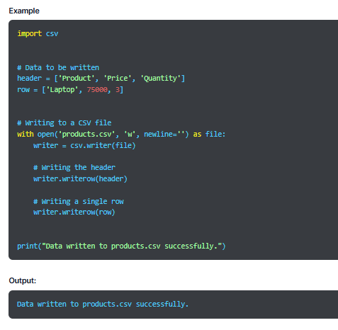

Slide 30
DictWriter
In Python, we can write a dictionary to the CSV file using the csv.DictWriter class provided by the CSV module. It will return a writer object that maps dictionaries on the output rows.
Syntax
csv.DictWriter(csvfile, fieldnames, restval=”, extrasaction=’raise’, dialect=’excel’, *args, **kwds)
We can write to CSV using the following two methods provided by csv.DictWriter:
writeheader()
The writerheader() method is used to write the first row of the CSV file using the mentioned fieldnames.
Syntax
writeheader()

Slide 31
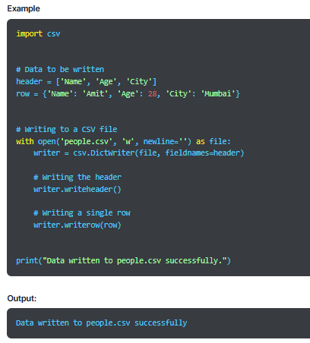

Slide 32
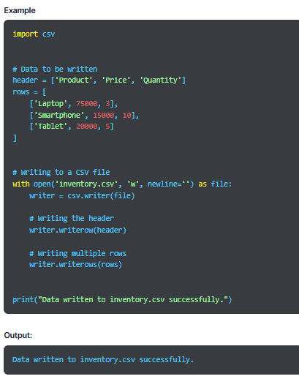
writerows()
This method will write all rows but only the values in each row and not the keys.
Syntax
writerows(mydict)

Slide 33
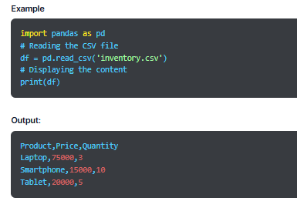
Using Python Pandas to Handle CSV Files
Pandas is a data science library in Python used for data manipulation and analysis. When you have to work with massive data, prefer using pandas for CSV file management as it ensures better efficiency. To use pandas, first, install and import it using the following syntax:
Syntax
import pandas as pd
Read CSV Files
Pandas allows us to read the CSV file using the read_csv() function. We can use the read_csv() function to read the CSV file using pandas. We will use the previously created inventory.csv file in this example.

Slide 34
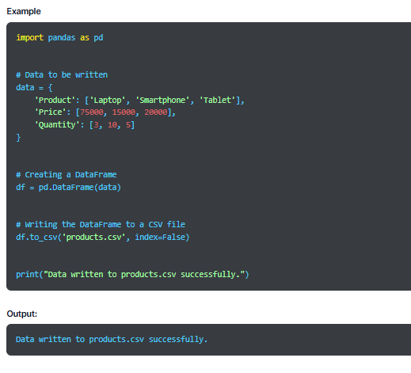
Write to a CSV File:
The DataFrame supports the to_csv() method used to write a CSV file. In the pandas library, we can write a file by creating a DataFrame using the pd.DataFrame() method. This will call the to_csv() function to write people_records.csv file.

Slide 35
Reading CSV Files in Python

Slide 36
Introduction
Reading a CSV File in Python
Python CSV Module Functions
Introduction:
A Comma-Separated Values File (CSV) is a plain text document that uses a specific format to organize tabular information. The CSV file format uses commas to separate values and treats every row as a data log, each containing one or more fields divided by commas. CSV is the most common file format used to import and export spreadsheets and databases.

Slide 37
Reading a CSV File in Python:
We can use two ways for reading a CSV file in Python, either the CSV module or the Pandas library.
CSV Module-
Using the CSV module in Python, we get the classes for reading and writing tabular format in the CSV file format.
Pandas Library:
This is an open-source library in Python known for providing high-performance data structures and data analysis tools that make Python programming efficient.
Using csv.reader()
We start by opening the CSV file using the open() method in the ‘r’ mode, which shows the read mode while opening a file. This will return the file object, which is read using the csv.reader() method, which returns the reader object that iterates through lines in the given CSV document.

Slide 38
Example
import csv
# Opening the CSV file in read mode
with open('employees.csv', 'r') as csvFile:
reader = csv.reader(csvFile)
# Iterating over each row in the CSV file
for row in reader:
print(row)
Output:
ID,Name,Department,Salary
1,Rajesh,IT,70000
2,Sneha,HR,60000
3,Vikram,Finance,80000
4,Anjali,Marketing,75000

Slide 39
Example
import csv
# Opening the CSV file in read mode
with open('employees.csv', 'r') as csvFile:
reader = csv.DictReader(csvFile)
# Iterating over each row in the CSV file
for row in reader:
print(dict(row))
Output:
{'ID': '1', 'Name': 'Rajesh', 'Department': 'IT', 'Salary': '70000'}
{'ID': '2', 'Name': 'Sneha', 'Department': 'HR', 'Salary': '60000'}
{'ID': '3', 'Name': 'Vikram', 'Department': 'Finance', 'Salary': '80000'}
{'ID': '4', 'Name': 'Anjali', 'Department': 'Marketing', 'Salary': '75000'}
Using csv.DictReader() class:
This method is the same as the csv.reader() method, where we open the file using the open() method but read it using the DictReader class of the CSV module.
It is similar to the regular CSV file reader in Python but it maps the information in the file onto a dictionary. The first line of the file contains the dictionary keys.

Slide 40
CSV files with Custom Delimiters
By default, we use a comma as a delimiter in the CSV file but for some files, we can use delimiters, such as \t and |.
Example
import csv
# Opening the CSV file with a custom delimiter (e.g., pipe '|')
with open('custom_delimited.csv', 'r') as csvFile:
reader = csv.reader(csvFile, delimiter='|')
# Iterating over each row in the CSV file
for row in reader:
print(row)
Output:
['ID', 'Name', 'Department', 'Salary']
['1', 'Rajesh', 'IT', '70000']
['2', 'Sneha', 'HR', '60000']
['3', 'Vikram', 'Finance', '80000']
['4', 'Anjali', 'Marketing', '75000']

Slide 41
Using Pandas.read_csv()
Method The pandas library makes reading a CSV file hassle-free. We use the read_csv() method provided by the pandas library to read data from the CSV file.
Example
import pandas as pd
# Reading the CSV file into a DataFrame
df = pd.read_csv('employees.csv')
# Displaying the DataFrame
print(df)
Output:
ID Name Department Salary
0 1 Rajesh IT 70000
1 2 Sneha HR 60000
2 3 Vikram Finance 80000
3 4 Anjali Marketing 75000

Slide 42
CSV Files with Initial Spaces:
In some CSV files, you can find a special character after a delimiter. So, if you use csv.reader() to read a CSV file, it will show spaces in the output. Therefore, remove these spaces by passing an additional parameter skipinitialspace.
Example
import csv
# Opening the CSV file with initial spaces in fields
with open('initial_spaces.csv', 'r') as csvFile:
reader = csv.reader(csvFile, skipinitialspace=True)
# Iterating over each row in the CSV file
for row in reader:
print(row)
Output:
['ID', 'Name', 'Department', 'Salary']
['1', 'Rajesh', 'IT', '70000']
['2', 'Sneha', 'HR', '60000']
['3', 'Vikram', 'Finance', '80000']
['4', 'Anjali', 'Marketing', '75000']

Slide 43
CSV Files with Quotes
There are a few CSV files with quotes around each or some of the entries.
Example
import csv
# Opening the CSV file with quoted fields
with open('quoted_fields.csv', 'r') as csvFile:
reader = csv.reader(csvFile)
# Iterating over each row in the CSV file
for row in reader:
print(row)
Output:
"ID","Name","Department","Salary"
"1","Rajesh","IT","70000"
"2","Sneha","HR","60000"
"3","Vikram","Finance","80000"
"4","Anjali","Marketing","75000"

Slide 44
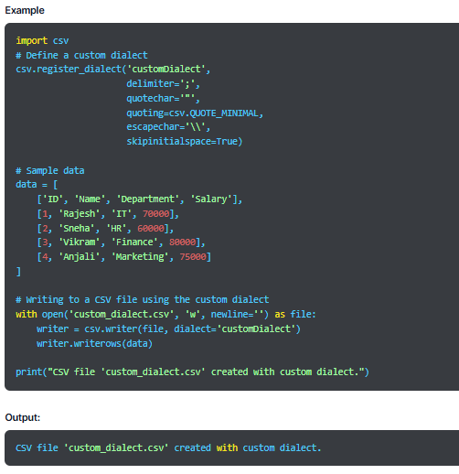
Dialects in the CSV Module:
Passing multiple parameters to the csv.reader() function works while dealing with one or two files. However, when you work with multiple CSV files with similar formats, this method can make the code cluttered and redundant.
Hence, we use dialect, which is an optional parameter provided by the CSV module. It groups multiple formatting patterns, such as quoting, delimiter, escapechar, and skipinitialspace, into a single dialect name. We can pass it as a parameter to various reader or writer instances.

Slide 45
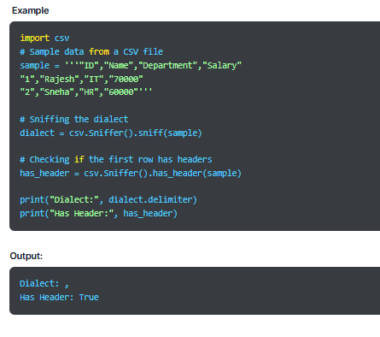
Using the csv.
Sniffer Class We use the sniffer class to deduce the CSV file format. It provides two methods:
sniff(sample, delimiters=None)- It analyzes the CSV text sample, returning a dialect subclass containing the deduced parameters.
We can also pass an optional delimiter parameter as a string with valid delimiter characters.
has_header(sample)- It will return a True or False value after analysing if the CSV file sample has the first row as column headers.

Slide 46
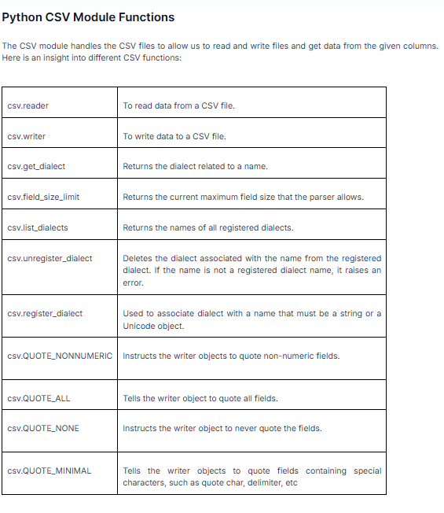

Slide 47
Writing CSV Files in Python

Slide 48
Introduction
Ways to Write CSV Files in Python
Advanced CSV Writing
Introduction
Comma Separated Values (CSV) is a simple file format in Python for storing tabular data like a database or spreadsheet. Every line of this file shows recorded data with fields separated by commas. It is a simple and commonly used format, which makes it popular among programmers.

Slide 49
Ways to Write CSV Files in Python
There are various methods for writing CSV files in Python, which we have discussed below:
Writing CSV Files using csv.writer()
Using csv.writer, we can write data directly to the CSV file. This method returns the writer object, which handles data conversion to a delimited string format. The CSV file object must be opened with newline=”; else, newline characters within quotes will be interpreted incorrectly.
Syntax
csv.writer(csvfile, dialect=’excel’, **fmtparams)
Parameters
csvfile- It is the file object with the write() method.
dialect (optional)- It represents the dialect name to be used.
fmtparams (optional)- It is the formatting parameter to override the ones specified in the dialect.

Slide 50
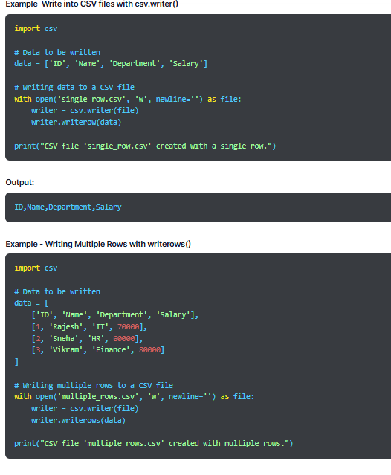
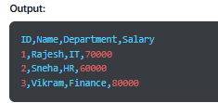

Slide 51
Write CSV files with csv.DictWriter()
We use csv.DictWriter() class that maps dictionaries onto output rows and enables you to write data where every row is represented by a dictionary.
Syntax
csv.DictWriter(csvfile, fieldnames, restval=”, extrasaction=’raise’, dialect=’excel’, *args, **kwds)
Parameters
csvfile- It is the file object with the write() method.
fieldnames- It shows a sequence of keys that identifies the order in which values must be written in the CSV file.
restval (optional)- It is the default value we write if a dictionary is missing a key in fieldnames.
extrasaction (optional)- It is the action to be taken if the key not found in fieldnames is encountered. If we set it to ‘raise’, it will raise a ValueError.
dialect (optional)- It is the name of the dialect to be used.

Slide 52
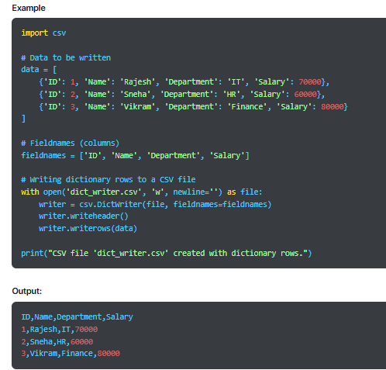

Slide 53
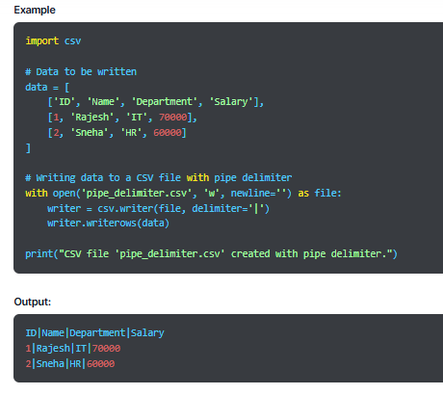
Advanced CSV Writing
Here are a few examples to demonstrate the methods of advanced CSV writing in Python.
Creating CSV Files with Pipe Delimiters
Mention the delimiter while creating the writer object to use a delimiter other than a comma.

Slide 54
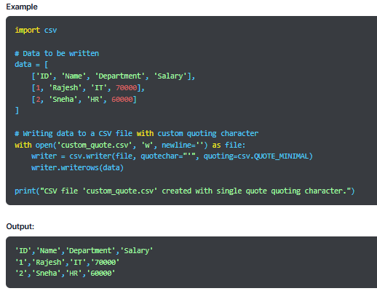
Writing CSV Files with Custom Quoting Characters:
We can also customize quoting characters in the CSV file by using an optional parameter called quotechar

Slide 55
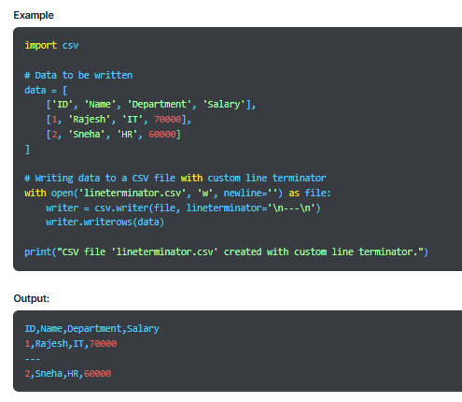
CSV Files with lineterminator
A string used to terminate lines created by the writer object is known as lineterminator.
Its default value is \r\n. To change the default value, we pass any string as a lineterminator parameter.
As the reader object recognizes \r or \n as lineterminator values, we must avoid using other characters.

Slide 56
Using escapechar and doublequotes CSV Writer:
By specifying an escape character, we can handle special characters in the data. To separate delimiter characters in the entries, the CSV module uses quotation marks to quote those entries.
For example, an entry: She is an efficient, skilled employee. is written as “She is an efficient, skilled employee.”
By default, the CSV module uses double quotes to escape the quote character in the entries. For example, Read “WsCube Python Tutorial” would be written as “Read “”WsCube Python Tutorial”””. Here, each double quote (“) is followed by a (”) to escape the last one.
escapechar
It is a string used to escape the delimiter when quoting is set to csv.QUOTE_NONE and quotechar in case doublequote value is False. By default, its value is set to None.

Slide 57
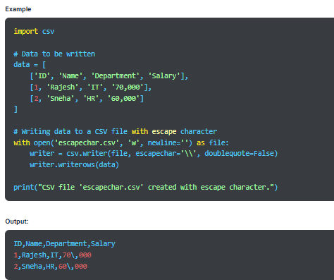

Slide 58
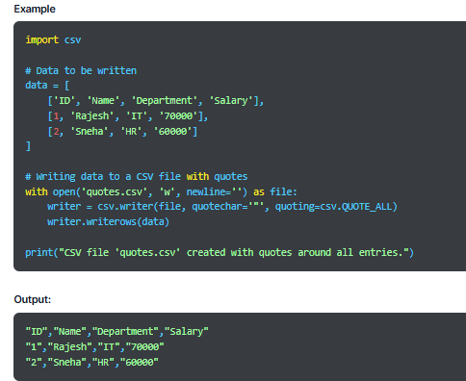
Doublequotes:
It is responsible for how quotechar in the entry is quoted. If True, the quoting character is double. The False value results in using the escapechar as a prefix to the quotechar. Its default value is True.
Write CSV Files with Quotes
Some entries in the CSV files can also have quotes around them.

Slide 59
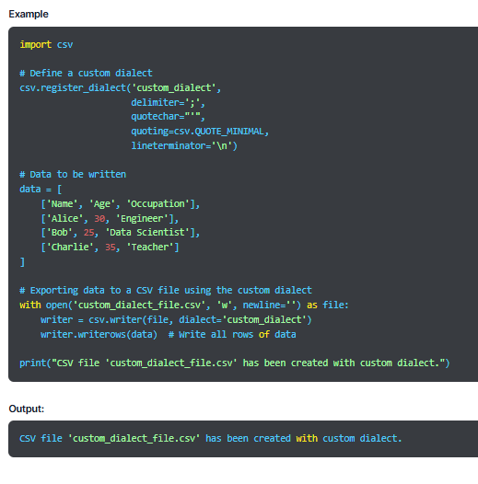
Dialects in CSV Module:
We use the dialect provided by the CSV module as an optional parameter while working with multiple CSV files with the same formats. It groups multiple formatting patterns into a single dialect name and can be passed as a parameter to read and write various instances.

Slide 60
Thank you

