Slide 1
Operators

Slide 2
Python Operators:
Operators are used to perform operations on variables and values.
Python divides the operators in the following groups:
Arithmetic operators
Assignment operators
Comparison operators
Logical operators
Identity operators
Membership operators
Bitwise operators

Slide 3
Python Arithmetic Operators:
Arithmetic operators are used with numeric values to perform common mathematical operations:
Operator Name Example
+ Addition x + y
- Subtraction x - y
* Multiplication x * y
/ Division x / y
% Modulus x % y
** Exponentiation x ** y
// Floor division x // y

Slide 4
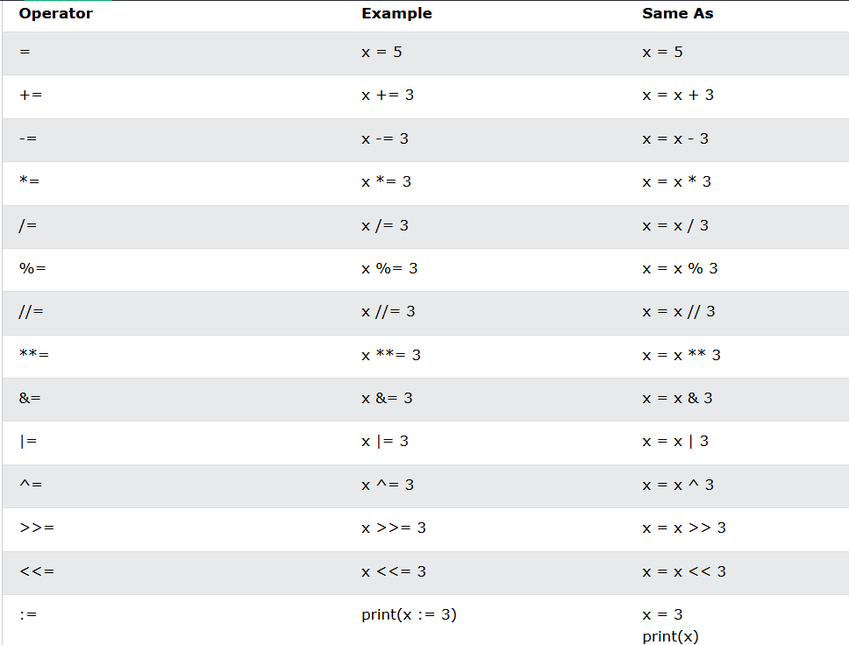
Python Assignment Operators
Assignment operators are used to assign values to variables:

Slide 5
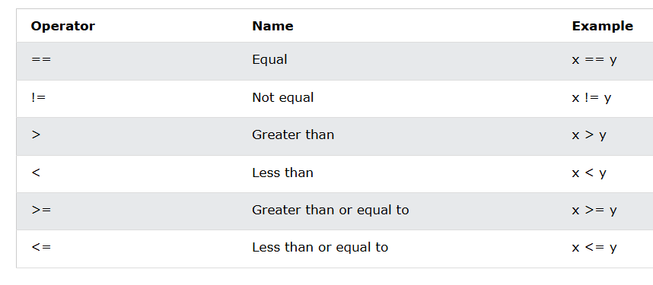
Python Comparison Operators
Comparison operators are used to compare two values:

Slide 6
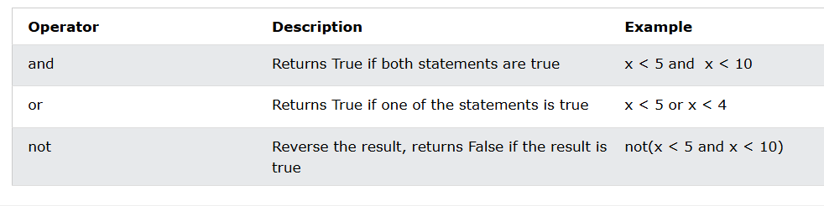
Python Logical Operators
Logical operators are used to combine conditional statements:

Slide 7
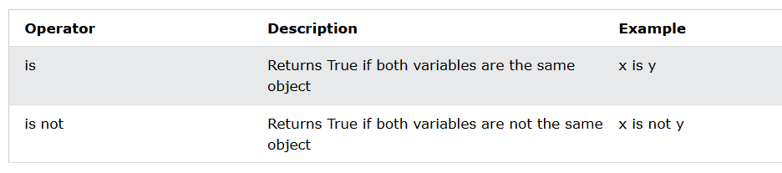
Python Identity Operators:
Identity operators are used to compare the objects, not if they are equal, but if they are actually the same object, with the same memory location:

Slide 8
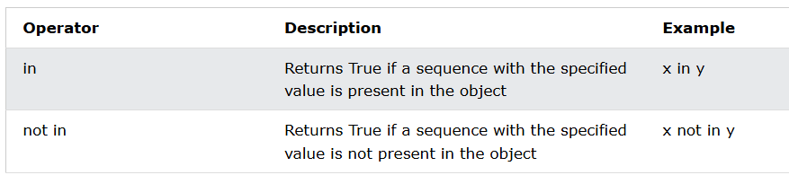
Python Membership Operators:
Membership operators are used to test if a sequence is presented in an object:

Slide 9
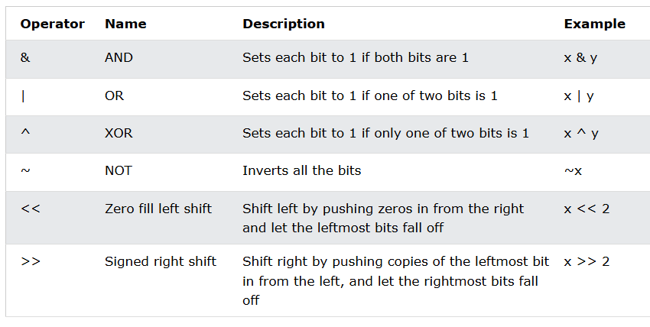
Python Bitwise Operators:
Bitwise operators are used to compare (binary) numbers:

Slide 10
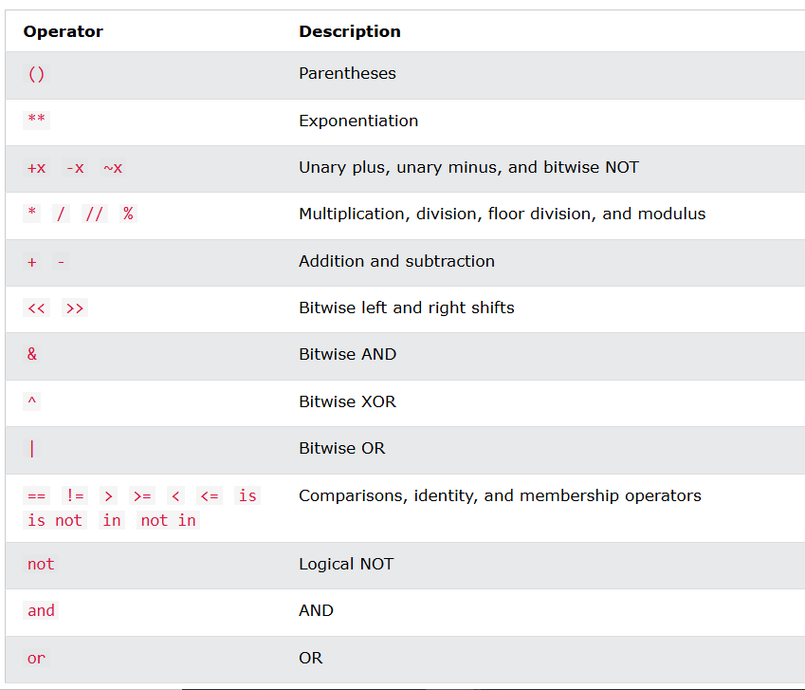
Operator precedence:

Slide 11
Guidelines for using operators:
You must use parentheses to write more readable and clearer expressions.
Python allows for chaining operators, but using them in excess will only make the code more complex and difficult to read, so avoid them as much as possible.
Use names for variables that clearly describe the purpose of the operands.
Pay extra attention while using Membership and Identity operators.
Use Bitwise operators only when necessary as they can be a little complicated to use.
Test your code thoroughly to check if all the operators are working correctly or not.

Slide 12
Parentheses has the highest precedence, meaning that expressions inside parentheses must be evaluated first:
print((6 + 3) - (6 + 3))
Multiplication * has higher precedence than addition +, and therefor multiplications are evaluated before additions:
Addition + and subtraction - has the same precedence, and therefor we evaluate the expression from left to right:
print(5 + 4 - 7 + 3)
10 + 20 * 30 is calculated as 10 + (20 * 30)
and not as (10 + 20) * 30
# Precedence of '+' & '*'
expr = 10 + 20 * 30
print(expr)

Slide 13
‘if‘ block is executed even if the age is 0. Because the precedence of logical ‘and‘ is greater than the logical ‘or‘.
# Precedence of 'or' & 'and'
name = "Alex"
age = 0
if name == "Alex" or name == "John" and age >= 2:
print("Hello! Welcome.")
else:
print("Good Bye!!")
To run the ‘else‘ block we can use parenthesis( ) as their precedence is highest among all the operators.
# Precedence of 'or' & 'and'
name = "Alex"
age = 0
if (name == "Alex" or name == "John") and age >= 2:
print("Hello! Welcome.")
else:
print("Good Bye!!")

Slide 14
# Left-right associativity
# 100 / 10 * 10 is calculated as
# (100 / 10) * 10 and not
# as 100 / (10 * 10)
print(100 / 10 * 10)
# Left-right associativity
# 5 - 2 + 3 is calculated as
# (5 - 2) + 3 and not
# as 5 - (2 + 3)
print(5 - 2 + 3)
# left-right associativity
print(5 - (2 + 3))
# right-left associativity
# 2 ** 3 ** 2 is calculated as
# 2 ** (3 ** 2) and not
# as (2 ** 3) ** 2
print(2 ** 3 ** 2)

Slide 15
100 + 200 / 10 - 3 * 10 is calculated as 100 + (200 / 10) - (3 * 10)
and not as (100 + 200) / (10 - 3) * 10
expression = 100 + 200 / 10 - 3 * 10
print(expression)
Non-associative Operators
In Python, most operators have associativity, which means they are evaluated from left to right or right to left when they have the same precedence. However, there are a few operators that are non-associative, meaning they cannot be chained together.
Example
a = 5
b = 10
c = 15
a = b = (a < b) += (b < c) # Sysntax Error

Slide 16
Ternary Operator in Python
In Python, Ternary operators also known as conditional expressions are operators that evaluate something based on a condition being true or false. It was added to Python in version 2.5.
It simply allows testing a condition in a single line replacing the multiline if-else making the code compact.
Syntax : [on_true] if [expression] else [on_false]
Examples of Ternary Operator in Python:
a, b = 10, 20
min = a if a < b else b
print(min)
# o/p 10

Slide 17
Objects In Python

Slide 18
Types of objects in python:
Immutable object : Data value cannot be changes
Mutable objects : Data value can be changed.
Immutable objects:
int
float
string
bool
tuple
Mutable objects:
list
set
Dictionary

Slide 19
List:
Lists are used to store multiple items in a single variable.
Lists are one of 4 built-in data types in Python used to store collections of data, the other 3 are Tuple, Set, and Dictionary, all with different qualities and usage.
Lists are created using square brackets:
Example:
FruitList = ["apple", "banana", "cherry"]
print(FruitListk)

Slide 20
List Items
List items are ordered, changeable, and allow duplicate values.
List items are indexed, the first item has index [0], the second item has index [1] etc.
Ordered
When we say that lists are ordered, it means that the items have a defined order, and that order will not change. If you add new items to a list, the new items will be placed at the end of the list.
Changeable
The list is changeable, meaning that we can change, add, and remove items in a list after it has been created.
Allow Duplicates
Since lists are indexed, lists can have items with the same value:
Example
Lists allow duplicate values:
mylist = ["apple", "banana", "cherry", "apple", "cherry"]
print(mylist)

Slide 21
List Length:
To determine how many items a list has, use the len() function:
Example:
Print the number of items in the list:
thislist = ["apple", "banana", "cherry"]
print(len(thislist))
List Items - Data Types:
List items can be of any data type:
Example:
String, int and boolean data types:
list1 = ["apple", "banana", "cherry"]
list2 = [1, 5, 7, 9, 3]
list3 = [True, False, False]

Slide 22
A list can contain different data types:
Example
A list with strings, integers and boolean values:
list1 = ["abc", 34, True, 40, "male"]
type()
From Python's perspective, lists are defined as objects with the data type 'list':
<class 'list'>
Example
What is the data type of a list?
mylist = ["apple", "banana", "cherry"]
print(type(mylist))

Slide 23
The list() Constructor:
It is also possible to use the list() constructor when creating a new list.
Example:
Using the list() constructor to make a List:
mylist = list(("apple", "banana", "cherry")) # note the double round-brackets
print(mylist)

Slide 24
Python - Access List Items
List items are indexed and you can access them by referring to the index number:
Example:
Print the second item of the list:
thislist = ["apple", "banana", "cherry"]
print(thislist[1])
Note: The first item has index 0.
Negative Indexing
Negative indexing means start from the end
-1 refers to the last item, -2 refers to the second last item etc.
Example: Print the last item of the list:
thislist = ["apple", "banana", "cherry"]
print(thislist[-1])

Slide 25
Range of Indexes:
You can specify a range of indexes by specifying where to start and where to end the range.
When specifying a range, the return value will be a new list with the specified items.
Example
Return the third, fourth, and fifth item:
thislist = ["apple", "banana", "cherry", "orange", "kiwi", "melon", "mango"]
print(thislist[2:5])
Note: The search will start at index 2 (included) and end at index 5 (not included).
Remember that the first item has index 0.
By leaving out the start value, the range will start at the first item:
Example
This example returns the items from the beginning to, but NOT including, "kiwi":
thislist = ["apple", "banana", "cherry", "orange", "kiwi", "melon", "mango"]
print(thislist[:4])

Slide 26
By leaving out the end value, the range will go on to the end of the list:
Example
This example returns the items from "cherry" to the end:
thislist = ["apple", "banana", "cherry", "orange", "kiwi", "melon", "mango"]
print(thislist[2:])
Python - Change List Items
To change the value of a specific item, refer to the index number:
Example:
Change the second item:
thislist = ["apple", "banana", "cherry"]
thislist[1] = "blackcurrant"
print(thislist)

Slide 27
Change a Range of Item Values:
To change the value of items within a specific range, define a list with the new values, and refer to the range of index numbers where you want to insert the new values:
Example
Change the values "banana" and "cherry" with the values "blackcurrant" and "watermelon":
thislist = ["apple", "banana", "cherry", "orange", "kiwi", "mango"]
thislist[1:3] = ["blackcurrant", "watermelon"]
print(thislist)
o/p: ['apple', 'blackcurrant', 'watermelon', 'orange', 'kiwi', 'mango’]

Slide 28
The length of the list will change when the number of items inserted does not match the number of items replaced.
If you insert less items than you replace, the new items will be inserted where you specified, and the remaining items will move accordingly:
Example
Change the second and third value by replacing it with one value:
thislist = ["apple", "banana", "cherry"]
thislist[1:3] = ["watermelon"]
print(thislist)
o/p: ['apple', 'watermelon']

Slide 29
Insert Items:
To insert a new list item, without replacing any of the existing values, we can use the insert() method.
The insert() method inserts an item at the specified index:
Example
Insert "watermelon" as the third item:
thislist = ["apple", "banana", "cherry"]
thislist.insert(2, "watermelon")
print(thislist)
o/p: ['apple', 'banana', 'watermelon', 'cherry']
As a result of the example above, the list will now contain 4 items.

Slide 30
Append Items:
Python - Add List Items
To add an item to the end of the list, use the append() method:
Example:
Using the append() method to append an item:
thislist = ["apple", "banana", "cherry"]
thislist.append("orange")
print(thislist)
But for inserting at specified index use insert()
Example:
thislist = ["apple", "banana", "cherry"]
thislist.insert(1, "orange")
print(thislist)

Slide 31
Extend List
To append elements from another list to the current list, use the extend() method.
Example
thislist = ["apple", "banana", "cherry"]
tropical = ["mango", "pineapple", "papaya"]
thislist.extend(tropical)
print(thislist)
The elements will be added to the end of the list.
Add Any Iterable
The extend() method does not have to append lists, you can add any iterable object (tuples, sets, dictionaries etc.).
Example
Add elements of a tuple to a list:
thislist = ["apple", "banana", "cherry"]
thistuple = ("kiwi", "orange")
thislist.extend(thistuple)
print(thislist)

Slide 32
Python - Remove List Items:
Remove Specified Item
The remove() method removes the specified item.
Example
Remove "banana":
thislist = ["apple", "banana", "cherry"]
thislist.remove("banana")
print(thislist)
If there are more than one item with the specified value, the remove() method removes the first occurrence:
Example:
Remove the first occurrence of "banana":
thislist = ["apple", "banana", "cherry", "banana", "kiwi"]
thislist.remove(“banana”);

Slide 33
Remove Specified Index:
The pop() method removes the specified index.
Example
Remove the second item:
thislist = ["apple", "banana", "cherry"]
thislist.pop(1)
print(thislist)
If you do not specify the index, the pop() method removes the last item.
Example:
Remove the last item:
thislist = ["apple", "banana", "cherry"]
thislist.pop()
print(thislist)

Slide 34
The del keyword also removes the specified index:
Example
Remove the first item:
thislist = ["apple", "banana", "cherry"]
del thislist[0]
print(thislist)
The del keyword can also delete the list completely.
Example
Delete the entire list:
thislist = ["apple", "banana", "cherry"]
del thislist

Slide 35
Clear the List:
The clear() method empties the list.
The list still remains, but it has no content.
Example:
Clear the list content:
thislist = ["apple", "banana", "cherry"]
thislist.clear()
print(thislist)

Slide 36
Loop Through a List
You can loop through the list items by using a for loop:
Example: Print all items in the list, one by one:
thislist = ["apple", "banana", "cherry"]
for item in thislist:
print(item)
Loop Through the Index Numbers
You can also loop through the list items by referring to their index number.
Use the range() and len() functions to create a suitable iterable.
Example :Print all items by referring to their index number:
thislist = ["apple", "banana", "cherry"]
for i in range(len(thislist)):
print(thislist[i])
The iterable created in the example above is [0, 1, 2].

Slide 37
Sort List Alphanumerically:
List objects have a sort() method that will sort the list alphanumerically, ascending, by default:
Example :Sort the list alphabetically:
thislist = ["orange", "mango", "kiwi", "pineapple", "banana"]
thislist.sort()
print(thislist)
Example :Sort the list numerically:
thislist = [100, 50, 65, 82, 23]
thislist.sort()
print(thislist)

Slide 38
Sort Descending:
To sort descending, use the keyword argument reverse = True:
Example :Sort the list descending:
thislist = ["orange", "mango", "kiwi", "pineapple", "banana"]
thislist.sort(reverse = True)
print(thislist)
Example
Sort the list descending:
thislist = [100, 50, 65, 82, 23]
thislist.sort(reverse = True)
print(thislist)

Slide 39
Customize Sort Function:
You can also customize your own function by using the keyword argument key = function.
The function will return a number that will be used to sort the list (the lowest number first):
Example :Sort the list based on how close the number is to 50:
def myfunc(n):
return abs(n - 50)
thislist = [100, 50, 65, 82, 23]
thislist.sort(key = myfunc)
print(thislist)

Slide 40
Case sensitive sorting can give an unexpected result:
thislist = ["banana", "Orange", "Kiwi", "cherry"]
thislist.sort()
print(thislist)
Luckily we can use built-in functions as key functions when sorting a list.
So if you want a case-insensitive sort function, use str.lower as a key function:
Example
Perform a case-insensitive sort of the list:
thislist = ["banana", "Orange", "Kiwi", "cherry"]
thislist.sort(key = str.lower)
print(thislist)

Slide 41
Reverse Order:
What if you want to reverse the order of a list, regardless of the alphabet?
The reverse() method reverses the current sorting order of the elements.
Example
Reverse the order of the list items:
thislist = ["banana", "Orange", "Kiwi", "cherry"]
thislist.reverse()
print(thislist)

Slide 42
Copy a List
You cannot copy a list simply by typing list2 = list1, because: list2 will only be a reference to list1, and changes made in list1 will automatically also be made in list2.
Use the copy() method
You can use the built-in List method copy() to copy a list.
Example :Make a copy of a list with the copy() method:
thislist = ["apple", "banana", "cherry"]
mylist = thislist.copy()
print(mylist)
Use the list() method
Another way to make a copy is to use the built-in method list().
Example :Make a copy of a list with the list() method:
thislist = ["apple", "banana", "cherry"]
mylist = list(thislist)
print(mylist)

Slide 43
Use the slice Operator:
You can also make a copy of a list by using the : (slice) operator.
Example
Make a copy of a list with the : operator:
thislist = ["apple", "banana", "cherry"]
mylist = thislist[:]
print(mylist)

Slide 44
Join Two Lists
There are several ways to join, or concatenate, two or more lists in Python.
One of the easiest ways are by using the + operator.
Example :Join two list:
list1 = ["a", "b", "c"]
list2 = [1, 2, 3]
list3 = list1 + list2
print(list3)
Another way to join two lists is by appending all the items from list2 into list1, one by one:
Example :Append list2 into list1:
list1 = ["a", "b" , "c"]
list2 = [1, 2, 3]
for x in list2:
list1.append(x)
print(list1)

Slide 45
Use the extend() method, where the purpose is to add elements from one list to another list:
Example
Use the extend() method to add list2 at the end of list1:
list1 = ["a", "b" , "c"]
list2 = [1, 2, 3]
list1.extend(list2)
print(list1)

Slide 46
