Slide 1
STUDENT MANAGEMENT SYSTEM FODs Project
GROUP MEMBERS:-
-Lokesh Bhatta
-Drabya Hamal
-Reshav Karna

Slide 2

INTRO DUCTION
The system addresses the shift from traditional to digital record-keeping.
Aims to manage student data efficiently including grades and activities.
Built using Python with file handling and OOP principles.

Slide 3
Project Structure
Object-Oriented Python project
Modules: User, Student, Admin
Menus for Admin and Student users
Main menu for login and system initialization

Slide 4

OOP Concepts Used
Encapsulation of data using classes
Inheritance: Student & Admin inherit from User
Constructor (__init__) to initialize object attributes
Method Overriding for specific role functionalities

Slide 5
Student Functionalities
View
View profile: Personal info, grades, and ECA
Update
Update profile: Change name or email
View
View grade chart using matplotlib

Slide 6
Admin Functionalities
Add new users (students/admins)
Modify student records: info, grades, ECA
Delete student: Removes all related data
Generate insights: averages, distributions, activity levels

Slide 7
File Handling
users.txt – stores user data
passwords.txt – stores login credentials
grades.txt – subject-wise grades
eca.txt – extracurricular activities
Robust read/write/modify/delete file operations

Slide 8
Insights and Visualization
Average grade computation by subject
Top students in extracurriculars
Box plots and bar charts using matplotlib

Slide 9
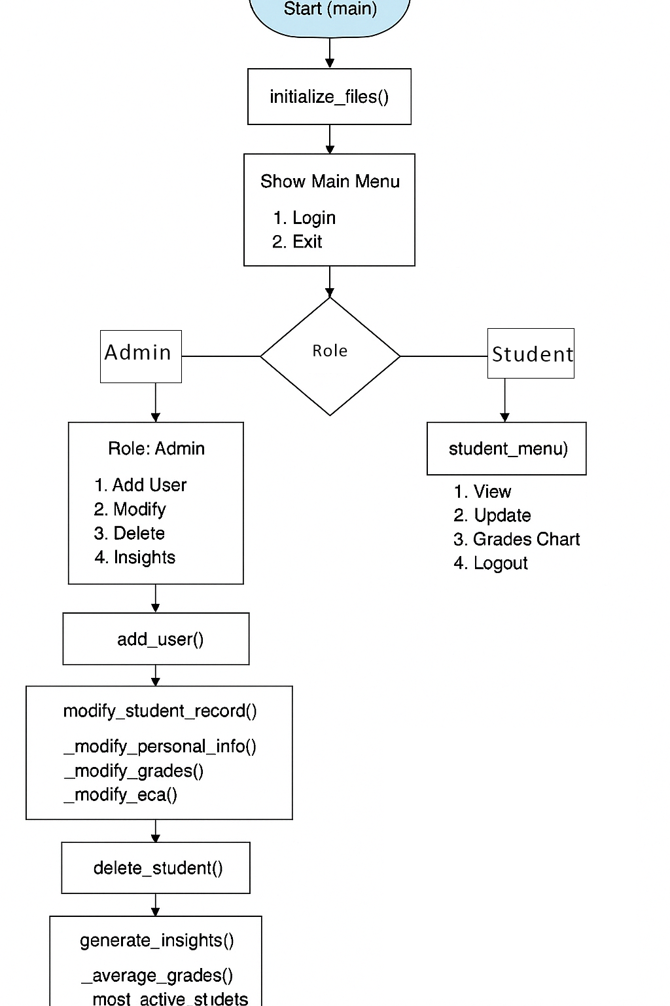
System Flowchart

Slide 10
How to Use the System
Launch the system and login
Students can view/update profiles, view grades
Admins can manage users, grades, and ECAs

Slide 11
Security Measures
Password-based login with encrypted storage.
User verification before allowing access.
Admin access restricted with role checks.

Slide 12
Testing & Results
Functional testing for login, registration, data entry
Test scenarios simulate real use cases
Successful validation for most test cases

Slide 13
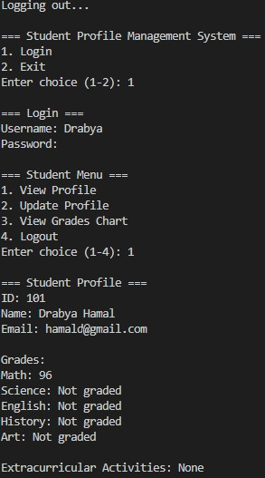
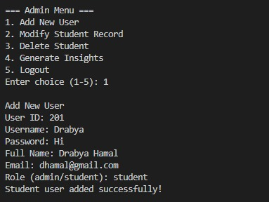
Output

Slide 14
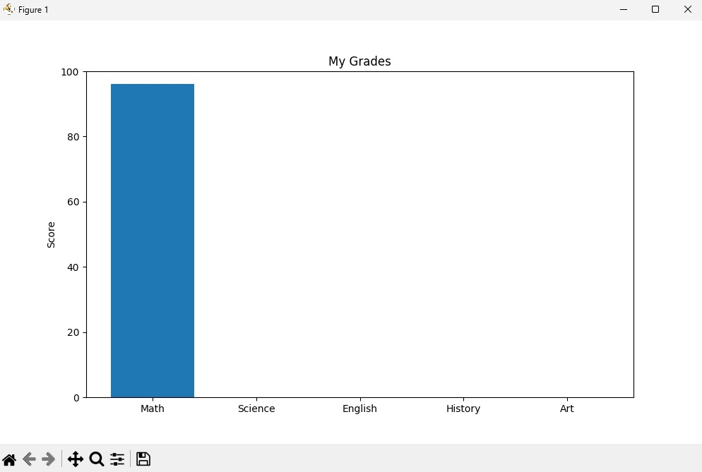
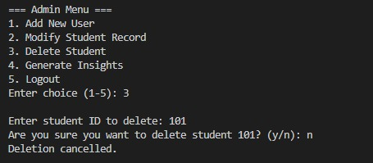
Output

Slide 15
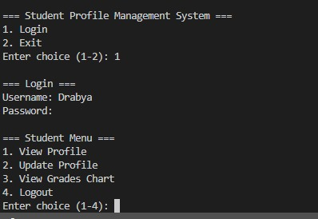
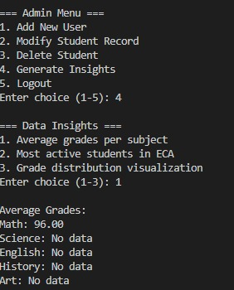
Output

Slide 16
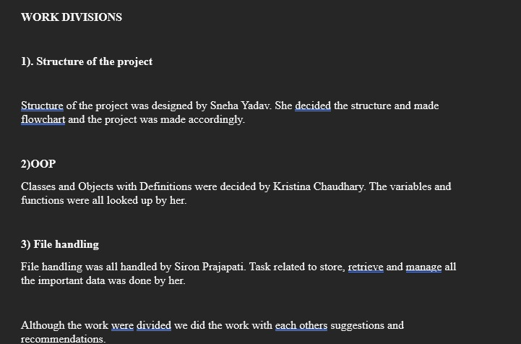
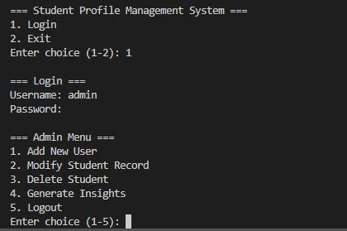
Output

Slide 17
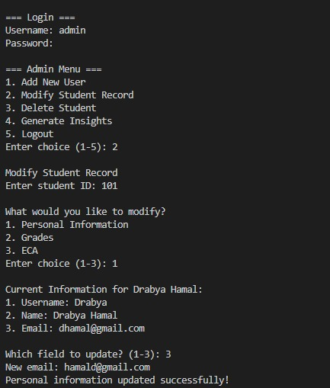
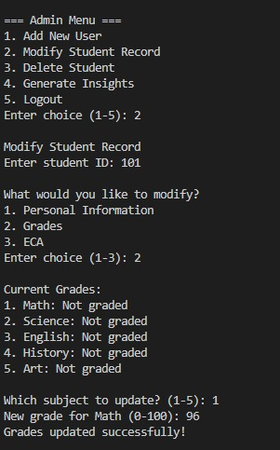
Output

Slide 18
Thank You!
Project built in Python using OOP and File Handling
Includes visual insights for better analytics

