Slide 1
Introduction
19CSE311 Computer Security

Slide 2
Definitions
Computer Security - generic name for the collection of tools designed to protect data and to thwart hackers
Network Security - measures to protect data during their transmission
Internet Security - measures to protect data during their transmission over a collection of interconnected networks

Slide 3
Levels of Impact
can define 3 levels of impact from a security breach
Low
Moderate
High
Notes:
We can define three levels of impact on organizations or individuals should there be a breach of security (i.e., a loss of confidentiality, integrity, or availability). These levels are defined in FIPS PUB 199:
• Low: The loss could be expected to have a limited adverse effect on organizational operations, organizational assets, or individuals. A limited adverse effect means that, for example, the loss of confidentiality, integrity, or availability might (i) cause a degradation in mission capability to an extent and duration that the organization is able to perform its primary functions, but the effectiveness of the functions is noticeably reduced; (ii) result in minor damage to organizational assets; (iii) result in minor financial loss; or (iv) result in minor harm to individuals.
• Moderate: The loss could be expected to have a serious adverse effect on organizational operations, organizational assets, or individuals. A serious adverse effect means that, for example, the loss might (i) cause a significant degradation in mission capability to an extent and duration that the organization is able to perform its primary functions, but the effectiveness of the functions is significantly reduced; (ii) result in significant damage to organizational assets; (iii) result in significant financial loss; or (iv) result in significant harm to individuals that does not involve loss of life or serious, life-threatening injuries.
• High: The loss could be expected to have a severe or catastrophic adverse effect on organizational operations, organizational assets, or individuals. A severe or catastrophic adverse effect means that, for example, the loss might (i) cause a severe degradation in or loss of mission capability to an extent and duration that the organization is not able to perform one or more of its primary functions; (ii) result in major damage to organizational assets; (iii) result in major financial loss; or (iv) result in severe or catastrophic harm to individuals involving loss of life or serious life threatening injuries.
3

Slide 4
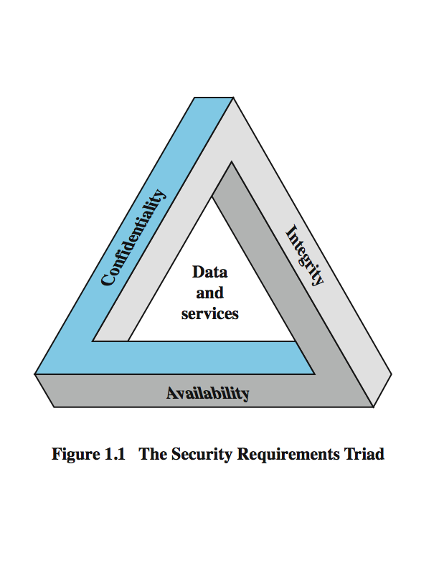
Key Security Concepts – Security Goals
These three concepts form what is often referred to as the CIA triad.
Notes:
These three concepts form what is often referred to as the CIA triad (Figure 1.1). The three concepts embody the fundamental security objectives for both data and for information and computing services. FIPS PUB 199 provides a useful characterization of these three objectives in terms of requirements and the definition of a loss of security in each category:
• Confidentiality (covers both data confidentiality and privacy): preserving authorized restrictions on information access and disclosure, including means for protecting personal privacy and proprietary information. A loss of confidentiality is the unauthorized disclosure of information.
• Integrity (covers both data and system integrity): Guarding against improper information modification or destruction, and includes ensuring information non-repudiation and authenticity. A loss of integrity is the unauthorized modification or destruction of information.
• Availability: Ensuring timely and reliable access to and use of information. A loss of availability is the disruption of access to or use of information or an information system.
Although the use of the CIA triad to define security objectives is well established, some in the security field feel that additional concepts are needed to present a complete picture. Two of the most commonly mentioned are:
• Authenticity: The property of being genuine and being able to be verified and trusted; confidence in the validity of a transmission, a message, or message originator.
• Accountability: The security goal that generates the requirement for actions of an entity to be traced uniquely to that entity.
4

Slide 5
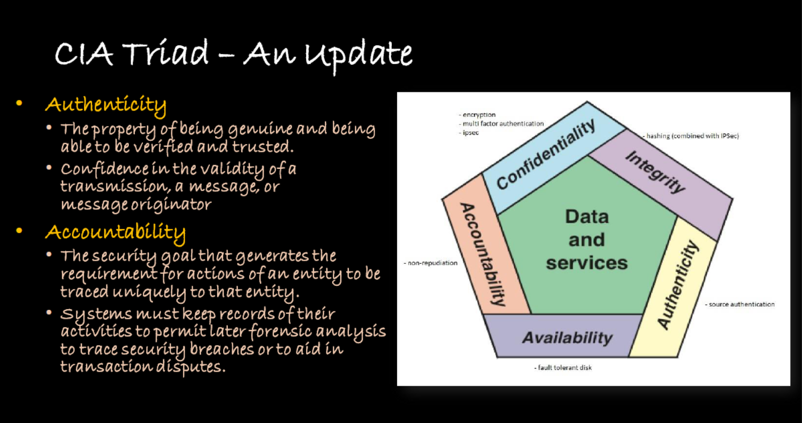
Notes:
We can define three levels of impact on organizations or individuals should there be a breach of security (i.e., a loss of confidentiality, integrity, or availability). These levels are defined in FIPS PUB 199:
• Low: The loss could be expected to have a limited adverse effect on organizational operations, organizational assets, or individuals. A limited adverse effect means that, for example, the loss of confidentiality, integrity, or availability might (i) cause a degradation in mission capability to an extent and duration that the organization is able to perform its primary functions, but the effectiveness of the functions is noticeably reduced; (ii) result in minor damage to organizational assets; (iii) result in minor financial loss; or (iv) result in minor harm to individuals.
• Moderate: The loss could be expected to have a serious adverse effect on organizational operations, organizational assets, or individuals. A serious adverse effect means that, for example, the loss might (i) cause a significant degradation in mission capability to an extent and duration that the organization is able to perform its primary functions, but the effectiveness of the functions is significantly reduced; (ii) result in significant damage to organizational assets; (iii) result in significant financial loss; or (iv) result in significant harm to individuals that does not involve loss of life or serious, life-threatening injuries.
• High: The loss could be expected to have a severe or catastrophic adverse effect on organizational operations, organizational assets, or individuals. A severe or catastrophic adverse effect means that, for example, the loss might (i) cause a severe degradation in or loss of mission capability to an extent and duration that the organization is not able to perform one or more of its primary functions; (ii) result in major damage to organizational assets; (iii) result in major financial loss; or (iv) result in severe or catastrophic harm to individuals involving loss of life or serious life threatening injuries.
5

Slide 6
Definitions
» Cryptography (Apply mathematical principles for security)
» Cryptography, a word with Greek origins, means “secret writing.”
» Refer to the science and art of transforming messages to make them secure and immune to attacks.
» Cryptography referred only to the encryption and decryption of messages using secret keys,
» Categories :
» symmetric-key encipherment,
» asymmetric-key encipherment and
» hashing.

Slide 7
Definitions
» Steganography
» Origin in Greek, means “covered writing,” in contrast with cryptography, which means “secret writing.”
» Cryptography means concealing the contents of a message by enciphering;
» Steganography means concealing the message itself by covering it with something else
Hiding a secret message inside of (or top of) something that is not secret

Slide 8
Definitions
» Cryptanalysis (The process of finding weakness in cryptographic schemes)
» Study of methods for obtaining the meaning of encrypted information, without access to the secret information that is typically required to do so.
» Involves knowing how the system works and finding a secret key.
» Cryptanalysis is also referred to as codebreaking or cracking the code

Slide 9
Services, Mechanisms, Attacks
need systematic way to define requirements
consider three aspects of information security:
security attack
security mechanism
security service
consider in reverse order

Slide 10
Security Service
is something that enhances the security of the data processing systems and the information transfers of an organization
intended to counter security attacks
make use of one or more security mechanisms to provide the service
replicate functions normally associated with physical documents
eg. have signatures, dates; need protection from disclosure, tampering, or destruction; be notarized or witnessed; be recorded or licensed

Slide 11
Security Mechanism
a mechanism that is designed to detect, prevent, or recover from a security attack
no single mechanism that will support all functions required
however one particular element underlies many of the security mechanisms in use: cryptographic techniques
hence our focus on this area

Slide 12
Security Attack
any action that compromises the security of information owned by an organization
information security is about how to prevent attacks, or failing that, to detect attacks on information-based systems
have a wide range of attacks
can focus of generic types of attacks
note: often threat & attack mean same

Slide 13
OSI Security Architecture
ITU-T X.800 Security Architecture for OSI
defines a systematic way of defining and providing security requirements
for us it provides a useful, if abstract, overview of concepts we will study

Slide 14
Security Services
X.800 defines it as: a service provided by a protocol layer of communicating open systems, which ensures adequate security of the systems or of data transfers
RFC 2828 defines it as: a processing or communication service provided by a system to give a specific kind of protection to system resources
X.800 defines it in 5 major categories

Slide 15
Security Services (X.800)
Authentication - assurance that the communicating entity is the one claimed
Access Control - prevention of the unauthorized use of a resource
Data Confidentiality –protection of data from unauthorized disclosure
Data Integrity - assurance that data received is as sent by an authorized entity
Non-Repudiation - protection against denial by one of the parties in a communication

Slide 16
Examples of Security Services/Requirements
confidentiality – student grades
integrity – patient information
availability – authentication service
authenticity – admission ticket
non-repudiation – stock sell order
Notes:
We now provide some examples of applications that illustrate the requirements just enumerated.
• Confidentiality - Student grade information is an asset whose confidentiality is considered to be highly important by students. Grade information should only be available to students, their parents, and employees that require the information to do their job. Student enrollment information may have a moderate confidentiality rating. While still coveredby FERPA, this information is seen by more people on a daily basis, is less likely to be targeted than grade information, and results in less damage if disclosed. Directory information, such as lists of students or faculty or departmental lists, may be assigned a low confidentiality rating or indeed no rating. This information is typically freely available to the public and published on a school's Web site.
• Integrity – Consider a hospital patient's allergy information stored in a database. The doctor should be able to trust that the information is correct and current. Now suppose that an employee (e.g., a nurse) who is authorized to view and update this information deliberately falsifies the data to cause harm to the hospital. The database needs to be restored to a trusted basis quickly, and it should be possible to trace the error back to the person responsible. Patient allergy information is an example of an asset with a high requirement for integrity. Inaccurate information could result in serious harm or death to a patient and expose the hospital to massive liability.
• Availability - The more critical a component or service, the higher is the level of availability required. Consider a system that provides authentication services for critical systems, applications, and devices. An interruption of service results in the inability for customers to access computing resources and staff to access the resources they need to perform critical tasks. The loss of the service translates into a large financial loss in lost employee productivity and potential customer loss.
16

Slide 17
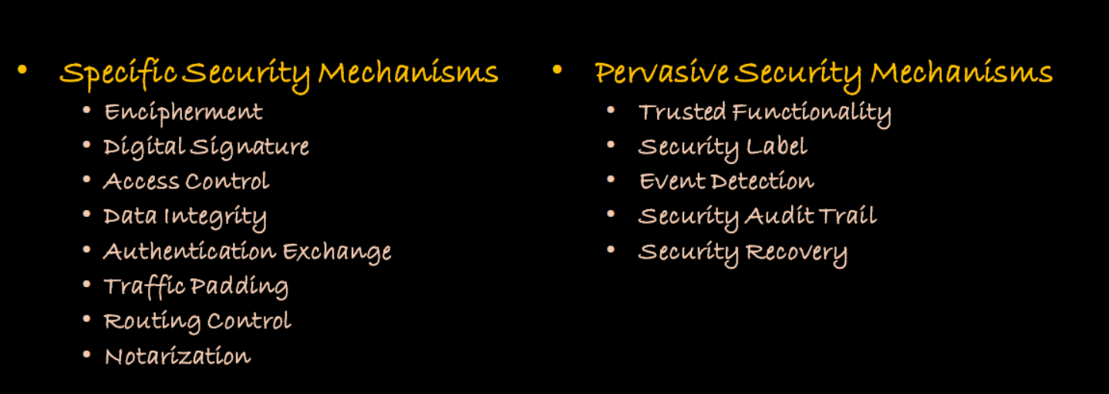
Security Mechanisms (X.800)

Slide 18
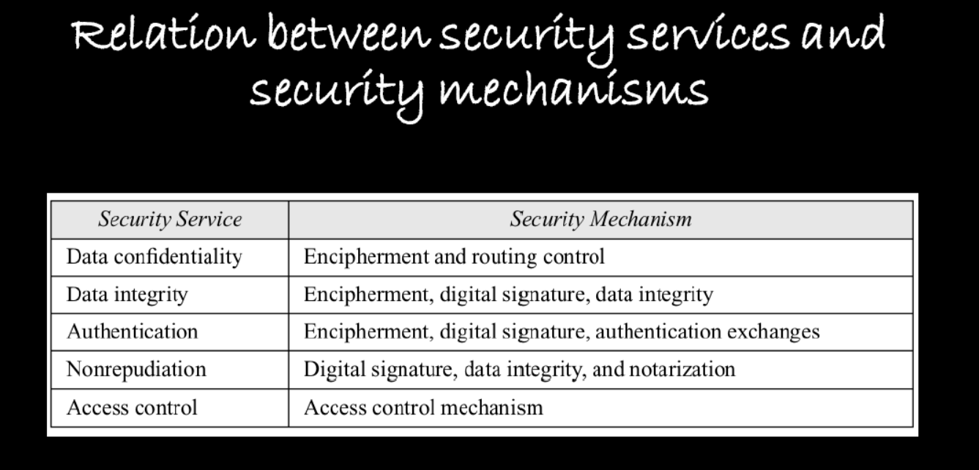

Slide 19
Classify Security Attacks as
passive attacks - eavesdropping on, or monitoring of, transmissions to:
obtain message contents, or
monitor traffic flows
active attacks – modification of data stream to:
masquerade of one entity as some other
replay previous messages
modify messages in transit
denial of service

Slide 20
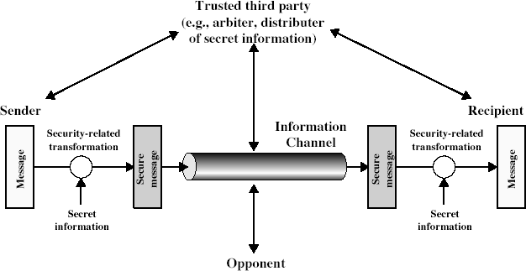
Model for Network Security

Slide 21
Model for Network Security
using this model requires us to:
design a suitable algorithm for the security transformation
generate the secret information (keys) used by the algorithm
develop methods to distribute and share the secret information
specify a protocol enabling the principals to use the transformation and secret information for a security service

Slide 22
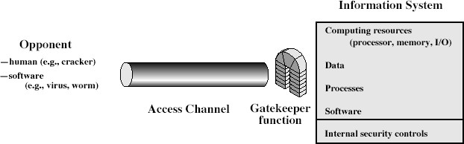
Model for Network Access Security

Slide 23
Model for Network Access Security
using this model requires us to:
select appropriate gatekeeper functions to identify users
implement security controls to ensure only authorised users access designated information or resources
trusted computer systems can be used to implement this model

Slide 24
Summary
have considered:
computer, network, internet security def’s
security services, mechanisms, attacks
X.800 standard
models for network (access) security

