Slide 1
Number Theory Basics
19CSE311 Computer Security Department of CSE

Slide 2
Basic Terminology
plaintext - the original message
ciphertext - the coded message or encrypted message
cipher - algorithm for transforming plaintext to ciphertext
key - info used in cipher known only to sender/receiver
encipher (encrypt) - converting plaintext to ciphertext
decipher (decrypt) - recovering ciphertext from plaintext
cryptography - study of encryption principles/methods
cryptanalysis (codebreaking) - the study of principles/ methods of deciphering ciphertext without knowing key
cryptology - the field of both cryptography and cryptanalysis

Slide 3
Basic Terminology
algorithm - Series of steps / mathematical formula / function which takes plain text as input and returns encrypted text / vice-versa.
cryptosystem - Implementation of cryptographic techniques and accompanying infrastructure
Components of crypto system
Plaintext
Encryption algorithm
Decryption algorithm
Cipher text
Keys - single (symmetric) or multiple (asymmetric)

Slide 4
Basic Terminology
Cryptography process
Sender selects the algorithm, message and key
Key is shared with the receiver
Key and message are fed to the encryption algorithm
Ciphertext is sent over the public network to the receiver
Receiver uses the key and cipher text as input to the decryption algorithm and receives the plain text
Attacker - Since the cipher text is shared in public, the attackers will try to get the key

Slide 5
Math behind cryptography
Number Theory
Linear Algebra
Algebraic structures

Slide 6

Integer Arithmetic
» In integer arithmetic, we use a set and a few operations.
» Set of Integers - The set of integers, denoted by Z, contains all integral numbers (with no fraction) from negative infinity to positive infinity

Slide 7
Binary Operations
» In cryptography, we are interested in three binary operations applied to the set of integers.
» A binary operation takes two inputs and creates one output.
» Three common binary operations defined for integers are addition, subtraction, and multiplication.
» Each of these operations takes two inputs (a and b) and creates one output (c)

Slide 8
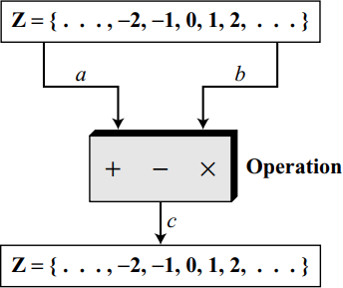
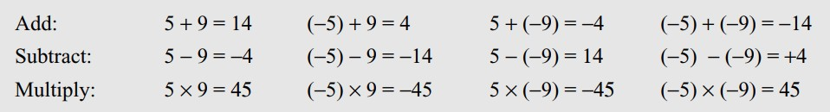
Binary Operations

Slide 9
Integer Division
» In integer arithmetic, if we divide a by n, we can get q and r.
» The relationship between these four integers can be shown as
» a =q ×n +r
» In this relation,
» a is called the dividend;
» q, the quotient;
» n, the divisor; and
» r, the
» remainder.
» Note that this is not an operation, because the result of dividing a by n is two integers, q and r.
» We call it division relation

Slide 10
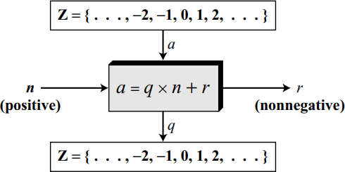
Two Restrictions
» First, we require that the divisor be a positive integer (n > 0).
» Second, we require that the remainder be a nonnegative integer (r ≥ 0)

Slide 11
Divisors
say a non-zero number b divides a if for some m have a=mb (a,b,m all integers)
that is b divides into a with no remainder
denote this b|a
and say that b is a divisor of a
eg. all of 1,2,3,4,6,8,12,24 divide 24

Slide 12
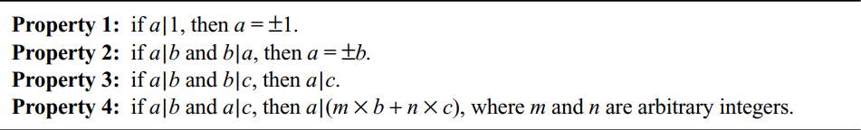
Properties of Divisibility

Slide 13
Greatest Common Divisor (GCD)
a common problem in number theory
GCD (a,b) of a and b is the largest number that divides evenly into both a and b
– eg GCD(60,24) = 12
often want no common factors (except 1) and hence numbers are relatively prime
– eg GCD(8,15) = 1
– hence 8 & 15 are relatively prime

Slide 14
Euclid's GCD Algorithm
an efficient way to find the GCD(a,b)
uses theorem that:
– GCD(a,b) = GCD(b, a mod b)
Euclid's Algorithm to compute GCD(a,b):
A=a, B=b
while B>0
R = A mod B
A = B, B = R
return A

Slide 15
GCD(80808, 31863)
Q | R_{n-1} | R_{n} | R_{n+1}
2 | 80808 | 31863 | 17082
1 | 31863 | 17082 | 14781
1 | 17082 | 14781 | 2301
6 | 14781 | 2301 | 975
2 | 2301 | 975 | 351
2 | 975 | 351 | 273
1 | 351 | 273 | 78
3 | 273 | 78 | 39
2 | 78 | 39 | 0

Slide 16
GCD(42823, 6409)
Q | R_{n-1} | R_{n} | R_{n+1}
6 | 42823 | 6409 | 4369
1 | 6409 | 4369 | 2040
2 | 4369 | 2040 | 289
7 | 2040 | 289 | 17
17 | 289 | 17 | 0
 | GCD = 17

Slide 17
GCD(1160718174, 316258250)
Q | N1 | N2 | R
3 | 1160718174 | 316258250 | 211943424
1 | 316258250 | 211943424 | 104314826
2 | 211943424 | 104314826 | 3313772
31 | 104314826 | 3313772 | 1587894
2 | 3313772 | 1587894 | 137984
11 | 1587894 | 137984 | 70070
1 | 137984 | 70070 | 67914
1 | 70070 | 67914 | 2156
31 | 67914 | 2156 | 1078
2 | 2156 | 1078 | 0
 | GCD = 1078

Slide 18
Thank you

