Slide 1

Basics of Number Theory

Slide 2
Numbers
ℤ → set of integers { . . . . -3, -2, -1, 0, 1, 2, 3, . . . }
Let a, b, c, d - integers & belong to set ℤ and (+,-,x,/) be 4 basic operations on members of this set
We find that algebraic operations –: “+”, “-”, and “×” – valid with set
e.g. a + b, a – b, a + b + c + d, a × b, b × d
→ all integers &belong to set ℤ
Members of ℤ satisfy
  Associative laws:
    (a + b) + c = a + (b + c)
    (a × b) × c = a × (b × c)
  Commutative laws:
    a + b = b + a
    a × b = b × a
  Distributive law:
    (a + b) × c = a × c + b × c

Slide 3
Numbers contd..
ring → set members satisfy
addition, subtraction, multiplication &
associative, distributive laws
commutative ring → satisfies commutative property additionally
* Remember More elements in set and more number of operations considered enhances security

Slide 4
GCD
80808 & 31863 ← 3, 13 – common factors
greatest common denominator – gcd (80808, 31863) → related & important concept
Approach 1:
school book approach
To get gcd → Factorize 80808 & 31863 as product of prime numbers
80808 = 2 × 2 ×2 × 3 × 7 ×13 × 37
{2, 2, 2, 3, 7, 13, 37} ← factor set of 80808
31863 = 3 × 13× 19 × 43
{3, 13, 19, 43} ← factor set of 31863
{3, 13 } ← common factors set of 80808 & 31863
3 × 13 = 39 ← desired gcd.
⇒ gcd(80808, 31863) = 39

Slide 5
Approach 2: Euclidean Algorithm (EA)
31863(b) | 80808(a) |  | a= q*b + r
 | 2(quot) | 17082(rem) | 80808 = 2×31863 + 17082
17082 | 31863
 | 1 | 14781 | 31863 = 1 × 17082 + 14781
14781 | 17082
 | 1 | 2301 | 17082 = 1 × 14781 + 2301
2301 | 14781
 | 6 | 975 | 14781 = 6 × 2301 + 975
975 | 2301
 | 2 | 351 | 2301 = 2 × 975 + 351

Slide 6
Division for Euclidean algorithm – cont’d
351 | 975
 | 2 | 273 | 975 = 2 × 351 + 273
273 | 351
 | 1 | 78 | 351 = 1 × 273 + 78
78 | 273
 | 3 | 39 | 273 = 3 × 78 + 39
39(Ans) | 78
 | 2 | 0 | 78 = 2 × 39 + 0
Note : When remainder = 0 ? → stop
previous remainder – 39 → desired gcd

Slide 7
r₀=a r₁=b |  | r₂
n | q | ^{r}n-1 | r_{n} | ^{r}n+1
1 | 2 | 80808 | 31863 | 17082
2 | 1 | 31863 | 17082 | 14781
3 | 1 | 17082 | 14781 | 2301
4 | 6 | 14781 | 2301 | 975
5 | 2 | 2301 | 975 | 351
6 | 2 | 975 | 351 | 273
7 | 1 | 351 | 273 | 78
8 | 3 | 273 | 78 | 39
9 | 2 | 78 | 39
gcd (80808, 31863) = 39
r₁
r₂
r₃
rn-1 rn |  | rn+1
Euclidean algorithm - Computational process flow & Results (let n=1)
r_{n}
rn+1
gcd(a, b) = r_{n}

Slide 8
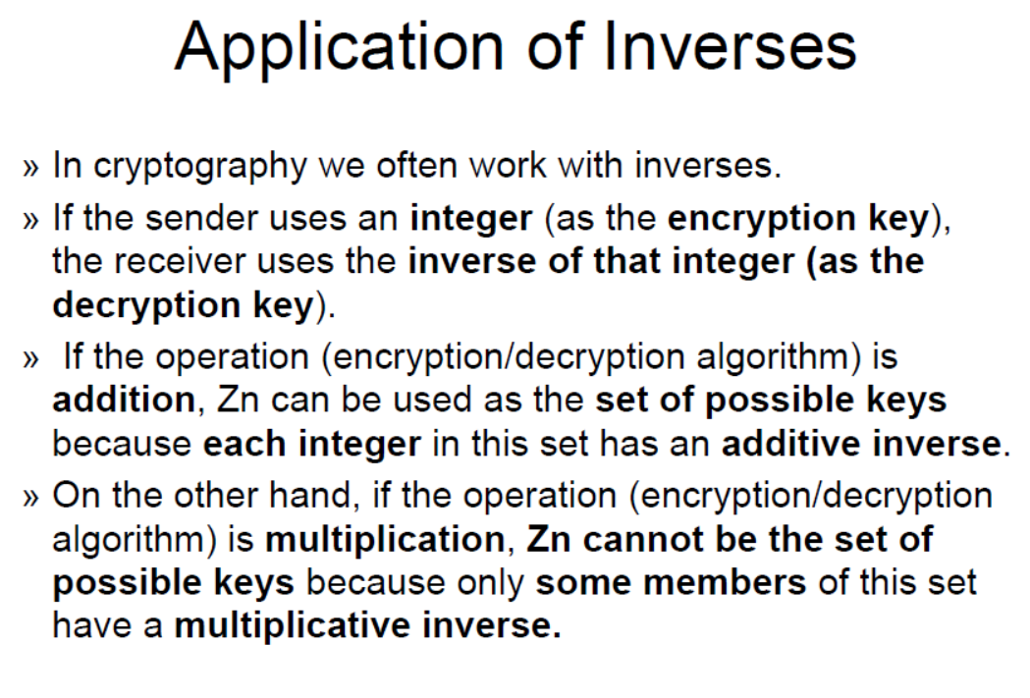

Slide 9
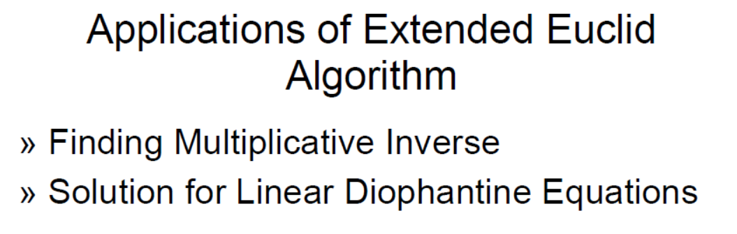
Extended Euclidean Algorithm(EEA)

Slide 10
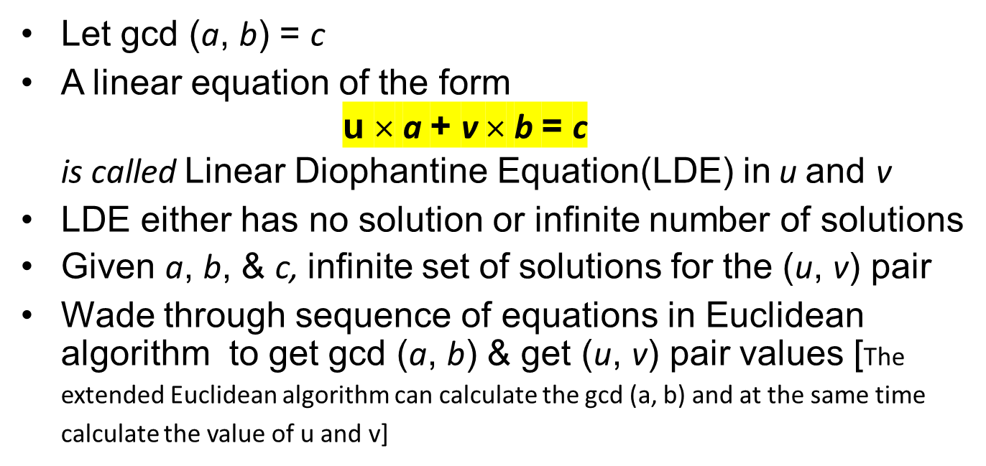
Extended Euclidean Algorithm(EEA)

Slide 11
(u₀ + kb) × a + (v₀ – ka ) x b = c ← generalized version
set (u₀, v₀) is your initial solution
Let k = any element of ℤ
a
(u + kb)
→
u
0
1
c
(v − ka) ^{b}
→
v
0
c
1
Diophantine equation → infinite number of solutions Substituting different values for k, other solutions can be obtained using the obtained (u₀, v₀)

Slide 12
r set
u set
v set
r₀ = a
r₁=b
r₂
u₀=1
u₁=0
u₂
v₀=0
v₁=1
v₂
r₁
r₂
r₃
u₁
u₂
u₃
v₁
v₂
v₃
rn-1
r_{n}
rn+1
un-1
u_{n}
un+1
vn-1
v_{n}
vn+1
r_{n}
rn+1
u_{n}
un+1
v_{n}
vn+1
gcd(a, b) = r_{n} u = u_{n}
Computational process flow for extended Euclidean algorithm
v = v_{n}

Slide 13
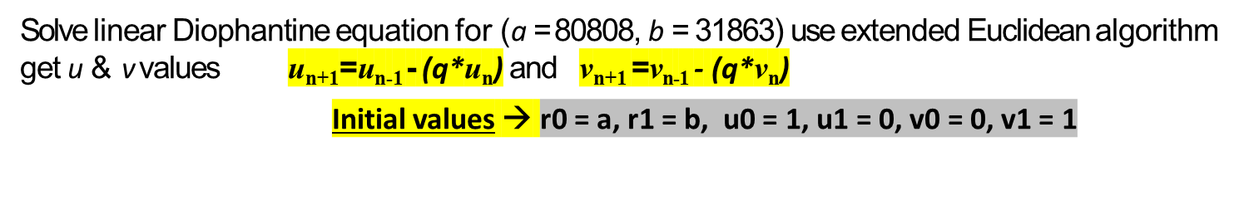
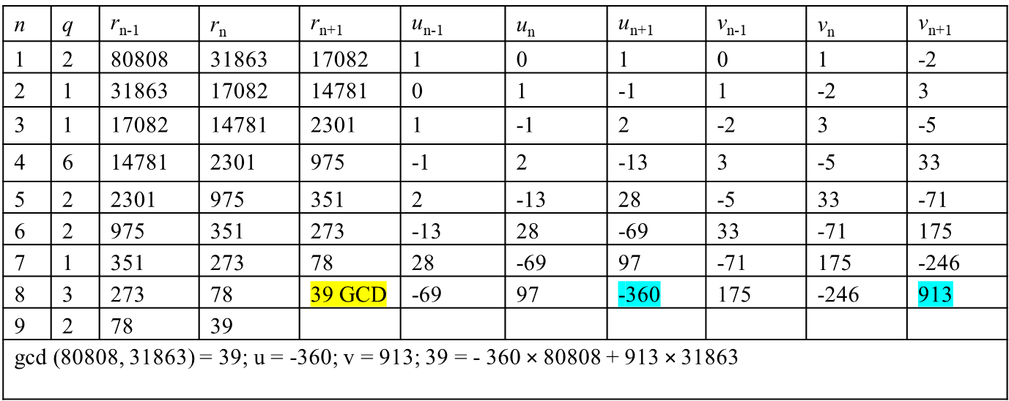


Slide 14
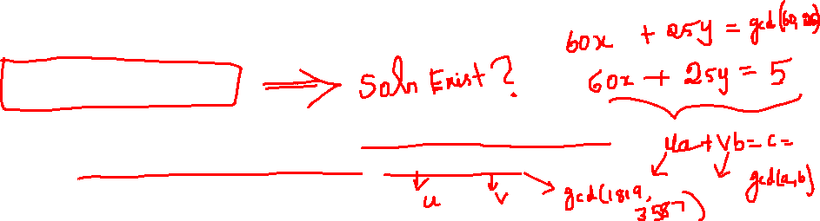

Review Questions
1. Find the gcd of 42823 and 6409 = 17
2. GCD(24140,16762) = ?. 34
3. GCD(4655, 12075) = ? 35
4. GCD(1970, 1066)=? 2
5. Find integers x and y to satisfy 42823x + 6409y = 17.
6. Solve 60x+25y = 55
7. Find the greatest common divisor g of the numbers 1819 and 3587,
and then find integers x and y to satisfy 1819x + 3587y = g (Try it !)

Slide 15
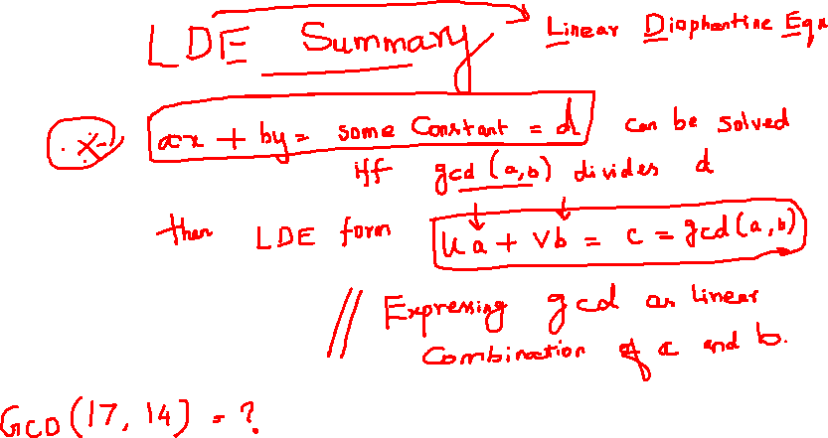
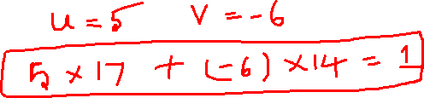

Slide 16
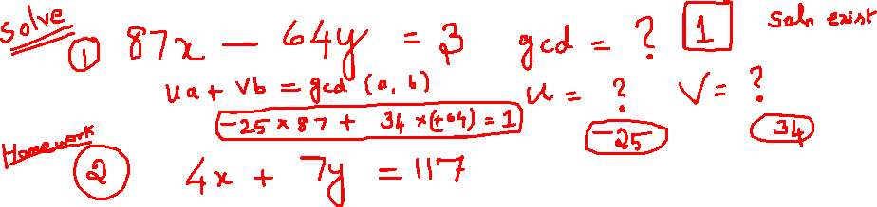
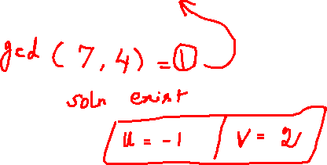
Solution = ?

Slide 17
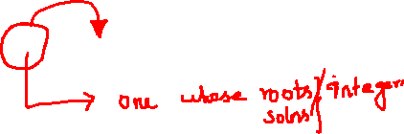
To explore…
What is the significance of LDE in cryptography?

Slide 18


