Slide 1
SMART PUBLIC RESTROOM USING IOT(phase-V)
NAME : LOKESH D
REG.NO : 212921106044
DEPT : ECE
YEAR : III
COLLEGE: ST.JOSEPH COLLEGE OF ENGINEERING-2129
DOMAIN : INTERNET OF THINGS
SUBMITTED BY
LOKESH.D

Slide 2
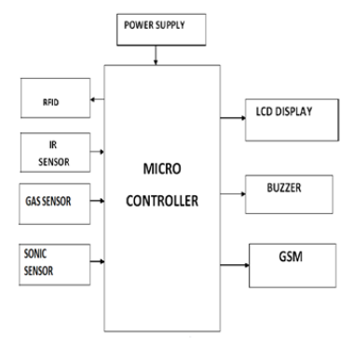
BLOCK DIAGRAM

Slide 3
IGSM
GSM stands for Global System for Mobile communication. It establishes the mobile communication from one place to another place. Figure 10: GSM Module It transfers the information from main circuit to operator. It uses Time Division Multiple Access (TDMA). GSM is mainly used for communicating and transferring message from one person to concerned organization. GSM module is used to establish communication between a computer and a GSM and GPRS system.
Here we are using GSM LT-2 communication module makes it possible to use GSM paths to provide monitoring and messaging functions in alarm systems. It facilitates cooperation with SATEL and third party control panel diallers or correctly configured outputs

Slide 4
He GSM LT-2 module makes it possible to implement monitoring as well as text and voice messaging functions. The caller ID retransmission function creates it likely to present the incoming callers number on telecommunication station sarmed with this functionality.
GSM alarm system built-in GSM communication module inside, work as a mobile handset. After purchased the GSM alarm system, people need to acquisition the SIM card, and select the mobile service package. GSM alarm system can program several phone numbers for alarm receiving. When any abnormal event happens, the system will response, then inform the owner via voice call and short message (SMS).
GSM will check the messaging activities for sweepers and also need to check with their cleanliness duty for their work. The sweepers need to check with particular activity of its work by their sensors

Slide 5
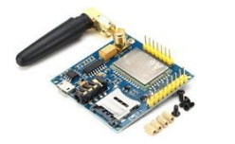
GSM MODULE

Slide 6
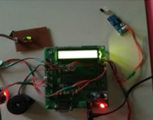
WORKING MODEL
This is the module of the proposed system. Here the sensors are connected with the microcontroller.

Slide 7
advantages
It can creates an awareness among the people about the proper toilet management
It can prevents the many contagious diseases like malaria, typhoid, cholera, streptococcus, asthma, etc..
It can promotes the “Swachhbharat” scheme

Slide 8
CONCLUSION
Our proposed project will create awareness among the people about the proper sanitation. It makes use of Internet of things, which is a rapidly growing technology. Our proposed system will make everyone to strictly follow the cleanliness and proper sanitation in the toilets. It prevents the many new contagious diseases that spread due to improper sanitation of the toilets. Thus by using technologies in the smarter way, we can maintain the cleanliness which is next to the godliness. Keep Clean, Be Safe.

Slide 9
THANK YOU

