Slide 1
SMART PUBLIC RESTROOM USING IOT(phase-iV)
NAME : LOKESH D
REG.NO : 212921106044
DEPT : ECE
YEAR : III
COLLEGE: ST.JOSEPH COLLEGE OF ENGINEERING-2129
DOMAIN : INTERNET OF THINGS
SUBMITTED BY
LOKESH.D

Slide 2
WORKING PRINCIPLE
In the first phase, IR sensor is used to discover the dirt present in the toilet.
Here the set of sample images are given as input.
After using the toilet, the sensor senses the basin of the toilet.
Then it relates the sensed image with the input image.
If the dirt present, it increases the alarm.
Then the user wants to be clean the waste.
Through this activity, people can get the awareness about the toilet management.
In the second phase, Figaro sensor is used to perceive the unwanted gases present in the toilet.

Slide 3
In the first phase, IR sensor is used to discover the dirt present in the toilet.
Here the set of sample images are given as input.
After using the toilet, the sensor senses the basin of the toilet.
Then it relates the sensed image with the input image.
If the dirt present, it increases the alarm.
Then the user wants to be clean the waste. Through this activity, people can get the awareness about the toilet management.

Slide 4
In the second phase, Figaro sensor is used to perceive the unwanted gases present in the toilet.
In the final phase, the sonic sensor is used to detect the depth of the septic tank.
Here, the range of septic tank is fixed prior manner.
If the sewage reached with the range, then it directs message to an organization.
All the message transfer can be done by the GSM (Global System for Communication).

Slide 5
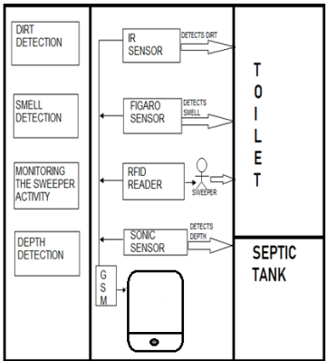
ARCHITECTURE OF THE PROPOSED SYSTEM

Slide 6
HARDWARE REQUIREMENTS
Microcontroller
Power supply
LCD display
Buzzer
Infrared sensor
Sonic sensor
Gas sensor
RFID
GSM modem

Slide 7
SOFTWARE REQUIREMENTS
Embedded C

Slide 8
MICROCONTROLLER
A microcontroller is a small computer on a single combined circuit holding a processor core, memory and programmable input/output peripherals. Program memory in the form of Ferroelectric RAM, NOR flash or OTP ROM is also often included on chip, as well as a typically small amount of RAM. Microcontrollers are designed for embedded applications, in contrast to the microprocessors used in personal computers or other general-purpose applications. PIC 16F877 is one of the most advanced microcontroller from Microchip. This controller is commonly used for experimental and modern applications because of its low price, wide range of requests, high quality, and ease of obtainability. It is ideal for applications such as machine control applications, measurement devices, study purpose, and so on. The PIC 16F877 features all the mechanisms which present microcontrollers usually have.

Slide 9
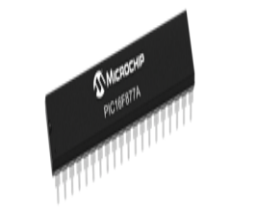
MICROCONTROLLER

Slide 10
LCD
LCD stands for Liquid Crystal Display. By using the LCD, all the outputs are displayed. LCD doesn’t know about the content (data or commands) supplied to its data bus. It is the user who has to specify whether the content at its data pins are data or commands. LCD Display For this, if a command is inputted then a certain arrangement of 0s and 1s has to be applied to the Control lines so as to specify it is a command on the other hand if a data is inputted at the data lines thenan another combination of 0s and 1s has to be applied to the control lines to require it is Data.

Slide 11
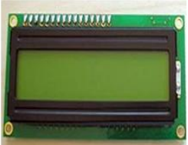
LCD

Slide 12
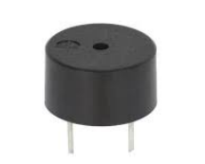
BUZZER
Buzzer is also called as Beeper. It is a sound signaling mechanical device.

Slide 13
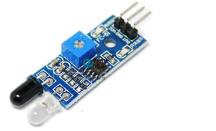
INFRARED SENSOR
The IR sensor is used to detect the dirt present in the toilet. Here we nourish the image models into the sensor. It can perceive the dirt by comparing the images we feed into it, after using the toilet. If it can detect the dirt, it raises the alarm, and the users may get embraced and they clean it. This system can create the responsiveness among the people.

Slide 14
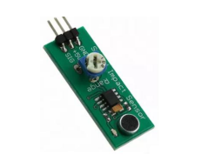
SMELL SENSOR
The Smell Sensor is used to detect the unwanted smell and gases in the toilet. For this purpose, we are going to use the sensor called Figaro sensor. Smell Sensor It cansintellect the dry gases present in the toilets such as NH3, CO2, CH4, H2S, etc. By taking those gases leads to Nausea, Drowsiness, instant loss of awareness, etc. After sensing the unwanted gases, it can blink the red light. Then the sweeper can clean it by using particular Cleaning Agents.

Slide 15
RFID READER
The RFID stands for Radio Frequency Identification. It can be used for monitoring the Sweeper. The Organization wishes to provide the identity tag for the Sweeper. The Sweeper desires to show the tag before the cleaning process is going to start and after it is finished. Then the CR4 sensor can spot the presence of dirt. If it is present, it can blink the red light. If it is clean, it can blink the blue light. It assistances to understand the responsibilities of sweeper by his/her own. If Sweeper is not clean the toilets for period of time, his/her absence in cleaning the toilet also reported to the dependable organization. These all the details are stored in the database.

Slide 16
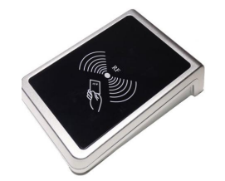
RFID READER

Slide 17
THANK YOU

