Slide 1

TheGameRoom
Submitted By
Submitted To
Shivanand Kumar Jha (201500656)
Aditya Gupta (201500035)
Lokesh Goswami (201500372)
Mr. Farmanul Haque
(Technical Trainer)

Slide 2

Introduction
TheGameRoom is platform where two friends can play tic-tac-toe. You can play the game by using simple signup/login to the game and other join the game using friends username. When both join
the game successfully then the game begin and they will play according to his/her innings. During game they can chat and react with different emojis.

Slide 3
Objective of the project:
The main objective of this Web Application is to play game with your friend from anywhere on the globe.
User can sign up if he/she does not have an account.
User can Log-In after with his/her username. So that they can be logged in even after refreshing the page.
User can play tic-tac-toe with his friend.
User can also chat and react with each other.

Slide 4
Working
Sign Up.
Allow user to login .
Join the Game with friend username.
Allow user to Chat .
Allow user to react on chat.

Slide 5

PROJECT DESCRIPTION
This multiplayer tic tac toe game made using React on the front-end and a NodeJS server on the backend with SocketIO for realtime gameplay communication and Stream.io for realtime chat communication.
Creating & Joining an existing room
Setting a web socket between the two players
Chat and react with friend using stream.io
Calculating the winner of the game

Slide 6
Use case
description
Name | Description
User | To provide the functionality to sign up or sign in
Write Chat | Allow user to Chat
React | Allow user to react on chat
Wait | Wait if another not enter
Refresh | Login in game after refreshing page

Slide 7
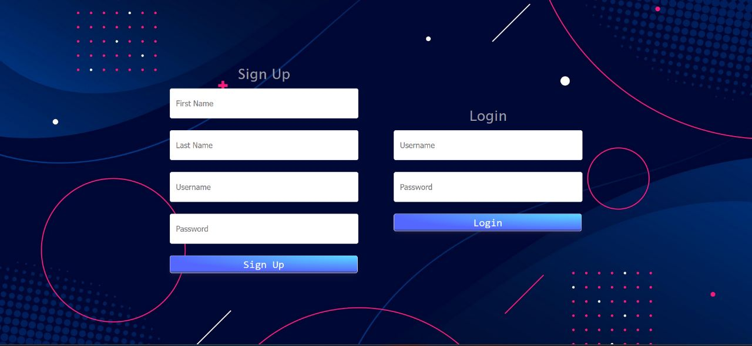
SIGN UP and Log-In Page

Slide 8
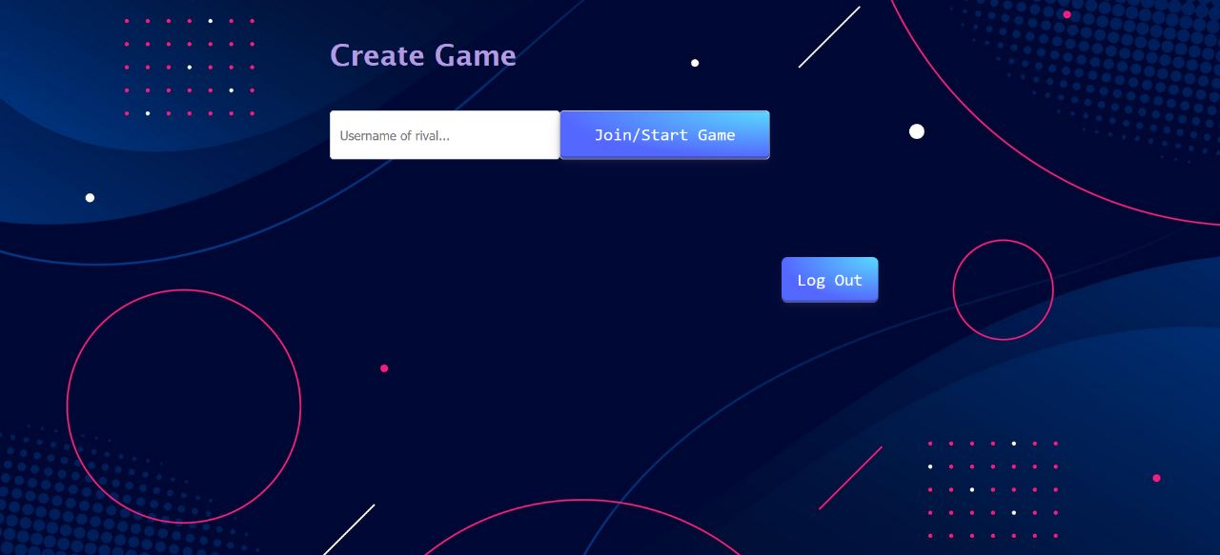
Join with friend’s username

Slide 9
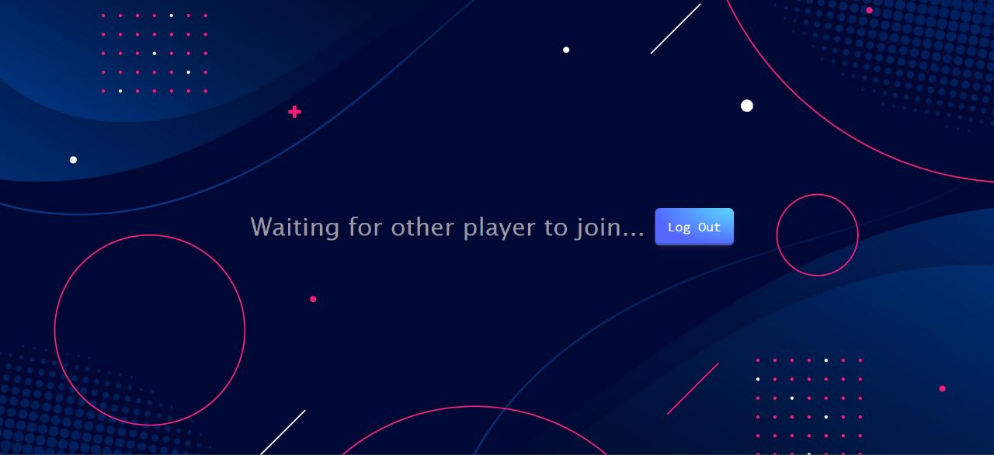
Waiting for Friend to join the Game

Slide 10
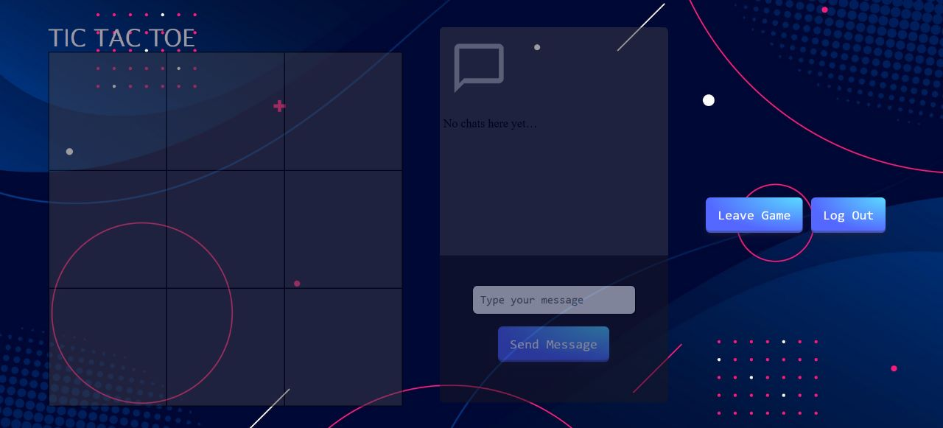
After joining the game the interface look’s like

Slide 11
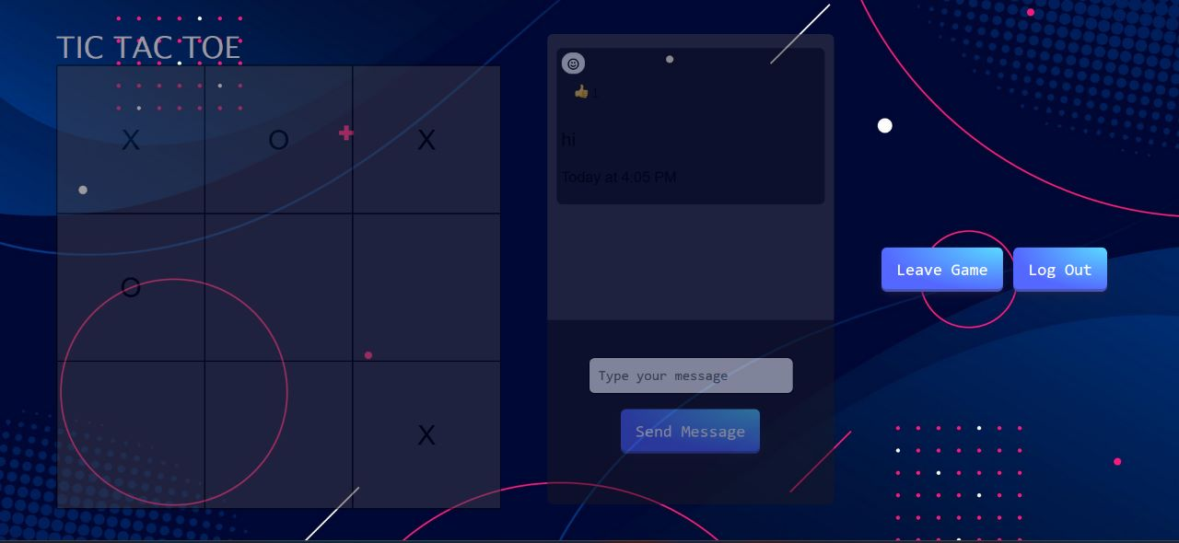
During the game

Slide 12
Conclusion
The Game Room Project provides a great way for friends to connect and play online games
, chat, and play tic tac toe. The only problem is that it doesn't provide a good user interface.
Hopefully, this will be fixed in a future update.

Slide 13


