Slide 1
Appropriate Neighbourhood for Immigrants

Slide 2
Finding an Appropriate Neighbourhood is Valuable to Immigrants
Immigrants Need help in finding a suitable Neighbourhood, during Initial days of settlement
Current means of Selection is based on Contacts.
Some Immigration Services offer this kind of Information, for a considerable amout of Fee.
No Facilities available to Explore and Choose for themselves.
Idea is to provide an online service for self exploration.

Slide 3
The Solution

Slide 4
Online service
Data Sources
Data Wrangling
Data Exploration & Analysis
Clustering and Suggestions
Explore your Neighbourhood!

Slide 5
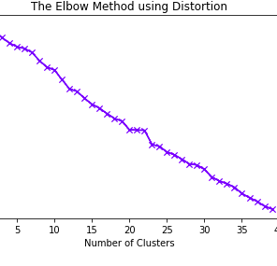
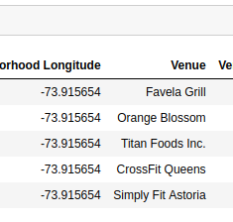
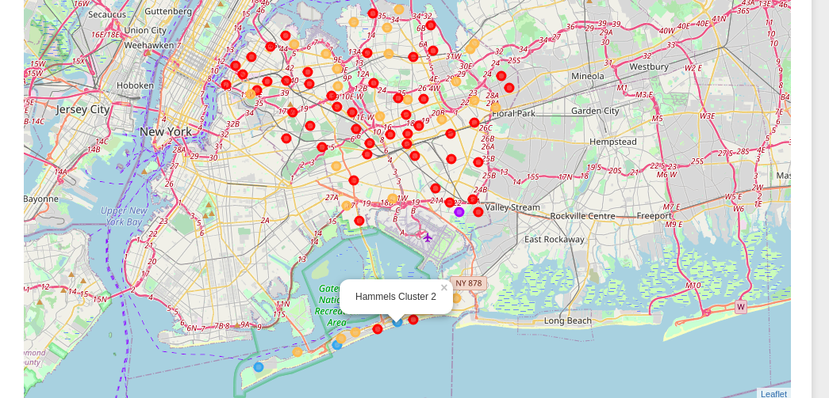
Data Sources
Borough and Neighborhood information in the form of json file form https://geo.nyu.edu
Foursquare APIs to explore Neighbourhood based on Latitude and Longitude.
Folium and Geopy for generating Maps and gathering Geo location information.

Slide 6
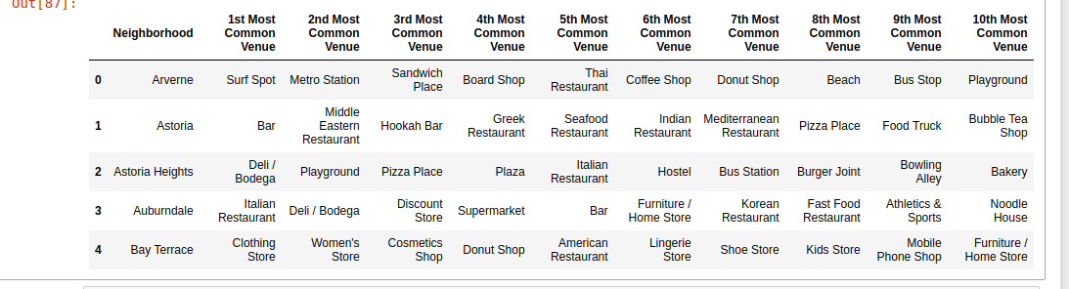
Data Preprocessing
Data acquired has 5 Boroughs and 306 Neighbourhoods
Considered “Queens”, one of densely populated Boroughs
Foursquare API is used to gather Venue/Venue Category of Neighborhoods
80 Neighbourhoods and 268 Venues, Top 10 considered.

Slide 7
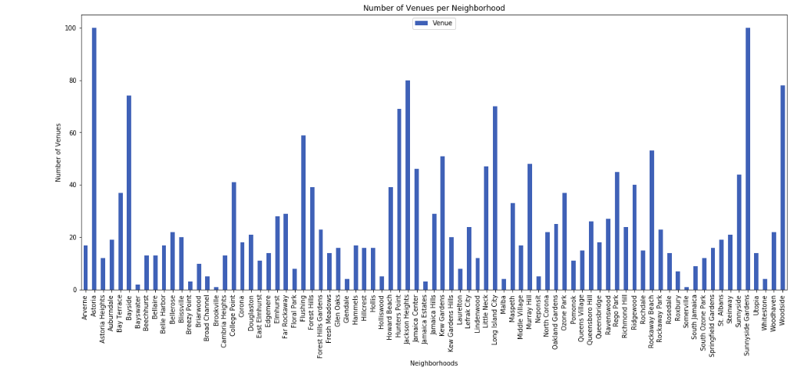
Data Exploration
Quiet Neighbourhoods are preferred.
Neighbourhoods with less than 20 Venues are chosen.
Top 10 Venue Categories were considered for Further processing.
Elbow method used for Cluster Selection.
K-means is implemented for clustering.

Slide 8
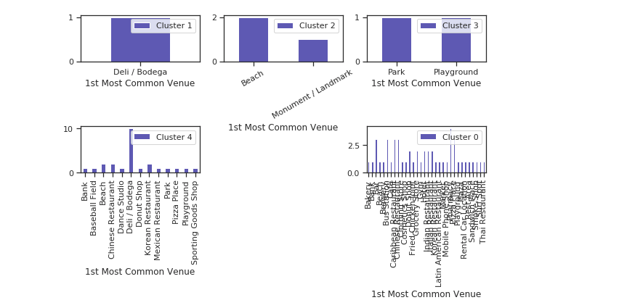
Clustering
Elbow method did not yield a good cluster number.
Arbitrary, Manually observable number 5 is choosen.
Clusters Generated, in pictorial form and Data Form.
Data of Clusters is presented in Visual format.
3 Quiet Clusters(Visiting places)
2 Vibrant Clusters

Slide 9
Conclusion
Cluster 0 seems to have more presence from latin American Countries with Sporadic presence from China, India and Korea.
Cluster 4 seems to have more presence from Asian & Mediterranian Countries with sporadic presence from Latin American countries.
Cluster 3 seems to have Park and Playgroud which would be of interest to Students.
We could succeed to some extent of classifying the Neighborhoods into Vibrant and quiet places and also generalize the Clustered attributes.
Further studies could narrow down to more clusters with stringent information and additional features to be able to classify at least to the level of Country specific congruence.

