Slide 1

MySql
Syed

Slide 2
Data and Database
Data is a collection of facts, such as numbers, words, measurements, observations or just descriptions of things.
A database is an organized collection of structured information, or data, typically stored electronically in a computer system.

Slide 3

Data management
What is data management?
Data management refers to the professional practice of constructing and maintaining a framework for ingesting, storing, mining, and archiving the data integral to a modern business.
Data management is the spine that connects all segments of the information lifecycle.

Slide 4
Data Management Approaches:
Books & Papers
Flat file / Text files (File Management System)
DBMS / Database (Software)

Slide 5
Database Management systems(DBMS)
Database management system is a software which is used to manage the database.
For example: MySQL, Oracle, etc are a very popular commercial database which is used in different applications.

Slide 6
DBMS contd..
DBMS provides an interface to perform various operations like database creation, storing data in it, updating data, creating a table in the database and a lot more.
It provides protection and security to the database. In the case of multiple users, it also maintains data consistency.

Slide 7
DBMS allows users the following tasks:
Data Definition: It is used for creation, modification, and removal of definition that defines the organization of data in the database.
Data Updation: It is used for the insertion, modification, and deletion of the actual data in the database.
Data Retrieval: It is used to retrieve the data from the database which can be used by applications for various purposes.
User Administration: It is used for registering and monitoring users, maintain data integrity, enforcing data security, dealing with concurrency control, monitoring performance and recovering information corrupted by unexpected failure.

Slide 8
Types of data models.
Relational model
Hierarchical database model
Network model
Object-oriented database model
Entity-relationship model
Document model
Entity-attribute-value model
Star schema
The object-relational model, which combines the two that make up its name

Slide 9

Relational Database
A relational database management system (RDBMS) is a system where data is organized in two-dimensional tables using rows and columns.
This is one of the most popular data models which is used in industries. It is based on SQL.
Every table in a database has a key field which uniquely identifies each record.
This type of system is the most widely used DBMS.
Relational database management system software is available for personal computers, workstation and large mainframe systems.

Slide 10
For example − Oracle Database, MySQL, Microsoft SQL Server etc.
Std ID | Name | City
201 | Bob | Hyderabad
204 | Lucky | Chennai
205 | Pinky | Bangalore
In the above student table Std ID, Name and city are called as attributes and their values. Std ID is a primary key attribute which uniquely identifies each record in the student table.

Slide 11
Object Oriented Database
It is a system where information or data is represented in the form of objects which is used in object-oriented programming.
It is a combination of relational database concepts and object-oriented principles.
Relational database concepts are concurrency control, transactions, etc.
OOPs principles are data encapsulation, inheritance, and polymorphism.
It requires less code and is easy to maintain.

Slide 12
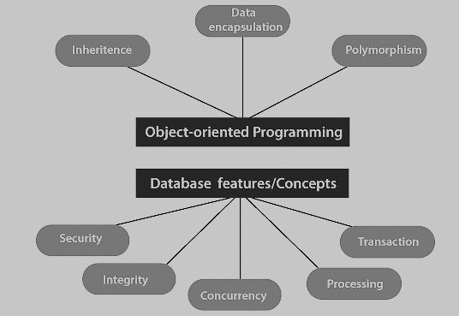
For example − Object DB software.
The object oriented database is represented in diagram format below:

Slide 13
Hierarchical Database
It is a system where the data elements have a one to many relationship (1: N). Here data is organized like a tree which is similar to a folder structure in your computer system.
The hierarchy starts from the root node, connecting all the child nodes to the parent node.
It is used in industry on mainframe platforms.
For example− IMS(IBM), Windows registry (Microsoft).

Slide 14
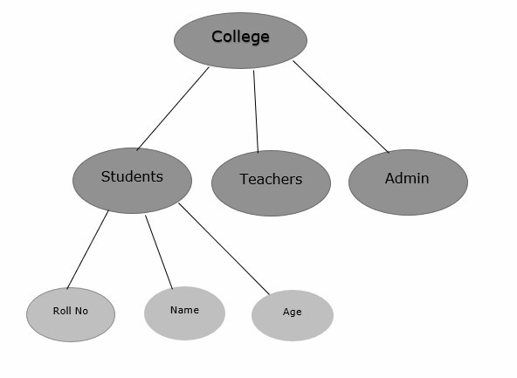
An example of a hierarchical database is given below −

Slide 15
Network database
A Network database management system is a system where the data elements maintain one to one relationship (1: 1) or many to many relationship (N: N).
It also has a hierarchical structure, but the data is organized like a graph and it is allowed to have more than one parent for one child record.
Example: Teachers can teach in multiple departments.

Slide 16
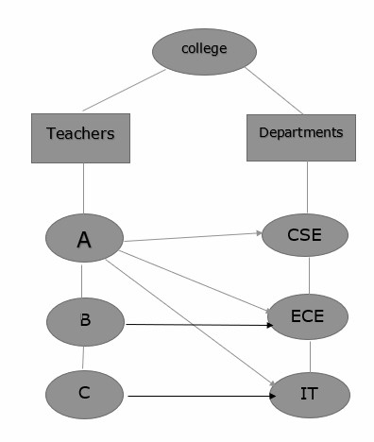
Teachers teaching in multiple departments

Slide 17

What is a Relational Database (RDBMS)?
A relational database is a type of database that stores and provides access to data points that are related to one another.
Relational databases are based on the relational model, an intuitive, straightforward way of representing data in tables

Slide 18
In a relational database, each row in the table is a record with a unique ID called the key.
The columns of the table hold attributes of the data, and each record usually has a value for each attribute, making it easy to establish the relationships among data points.

Slide 19
ACID properties and RDBMS
Four crucial properties define relational database transactions: atomicity, consistency, isolation, and durability—typically referred to as ACID.
Atomicity defines all the elements that make up a complete database transaction.
Consistency defines the rules for maintaining data points in a correct state after a transaction.
Isolation keeps the effect of a transaction invisible to others until it is committed, to avoid confusion.
Durability ensures that data changes become permanent once the transaction is committed.

Slide 20
Entities, tables and their characteristic
a) an entity :An entity is a thing which is recognised as being capable of an independent existence and which can be uniquely identified and about which data can be stored. It can be a physical object e.g. a car, person, student, book or it can be a concept e.g. a customer transaction.
(b) attributes: Attributes are the set of properties used to describe instances of the entity. It is an item of data that can be stored about the entity. For example, a student entity could have attributes such as surname, first name, date of birth, tutor group etc.

Slide 21
(c) a table A table is a collection of rows and columns forming cells which are used to store data and user information in a structured and organised manner. The tables are created from the entities identified and each column of the table represents the entity attributes that were identified. The columns are called fields. Each row of the table represents a record.
(d) a record A record is a row in the table. It contains a single data value in each column (field).

Slide 22
Difference between DBMS and RDBMS
No. | DBMS | RDBMS
1) | DBMS applications store data as file. | RDBMS applications store data in a tabular form.
2) | In DBMS, data is generally stored in either a hierarchical form or a navigational form. | In RDBMS, the tables have an identifier called primary key and the data values are stored in the form of tables.
3) | Normalization is not present in DBMS. | Normalization is present in RDBMS.
4) | DBMS does not apply any security with regards to data manipulation. | RDBMS defines the integrity constraint for the purpose of ACID (Atomocity, Consistency, Isolation and Durability) property.

Slide 23
Difference between DBMS and RDBMS-contd
5) | DBMS uses file system to store data, so there will be no relation between the tables. | in RDBMS, data values are stored in the form of tables, so a relationship between these data values will be stored in the form of a table as well.
6) | DBMS has to provide some uniform methods to access the stored information. | RDBMS system supports a tabular structure of the data and a relationship between them to access the stored information.
7) | DBMS does not support distributed database. | RDBMS supports distributed database.
8) | DBMS is meant to be for small organization and deal with small data. it supports single user. | RDBMS is designed to handle large amount of data. it supports multiple users.
9) | Examples of DBMS are file systems, xml etc. | Example of RDBMS are mysql, postgre, sql server, oracle etc.

Slide 24

Normalization
A large database defined as a single relation may result in data duplication.
This repetition of data may result in:
-Making relations very large.
-It isn't easy to maintain and update data as it would involve searching many records in relation.
-Wastage and poor utilization of disk space and resources.
-The likelihood of errors and inconsistencies increases.

Slide 25
So to handle these problems, we should analyze and decompose the relations with redundant data into smaller, simpler, and well-structured relations that are satisfy desirable properties.
Normalization is a process of decomposing the relations into relations with fewer attributes.

Slide 26
Why do we need Normalization?
The main reason for normalizing the relations is removing these anomalies.
Failure to eliminate anomalies leads to data redundancy and can cause data integrity and other problems as the database grows.
Normalization consists of a series of guidelines that helps to guide you in creating a good database structure.

Slide 27
Data modification anomalies can be categorized into three types:
Insertion Anomaly: Insertion Anomaly refers to when one cannot insert a new tuple into a relationship due to lack of data.
Deletion Anomaly: The delete anomaly refers to the situation where the deletion of data results in the unintended loss of some other important data.
Updation Anomaly: The update anomaly is when an update of a single data value requires multiple rows of data to be updated.

Slide 28
Advantages of Normalization
Normalization helps to minimize data redundancy.
Greater overall database organization.
Data consistency within the database.
Much more flexible database design.
Enforces the concept of relational integrity.

Slide 29
Types of Normal Forms:
Normalization works through a series of stages called Normal forms. The normal forms apply to individual relations. The relation is said to be in particular normal form if it satisfies constraints.

Slide 30
Normal Form | Description
1NF | A relation is in 1NF if it contains an atomic value.
2NF | A relation will be in 2NF if it is in 1NF and all non-key attributes are fully functional dependent on the primary key.
3NF | A relation will be in 3NF if it is in 2NF and no transition dependency exists.
BCNF | A stronger definition of 3NF is known as Boyce Codd's normal form.
4NF | A relation will be in 4NF if it is in Boyce Codd's normal form and has no multi-valued dependency.
5NF | A relation is in 5NF. If it is in 4NF and does not contain any join dependency, joining should be lossless.

Slide 31
Normal Forms
1NF:Each table cell should contain only one value and each record should be unique.
2NF:Table should be in first normal form and it should not have partial dependency.

Slide 32
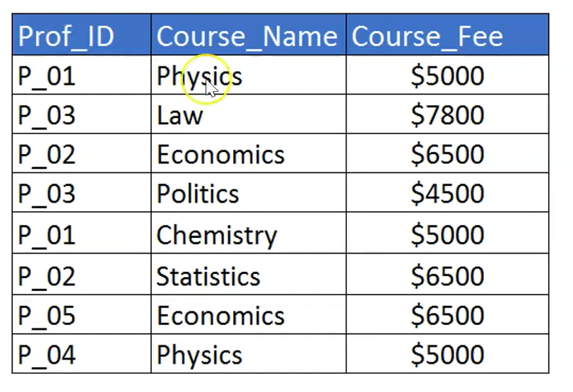
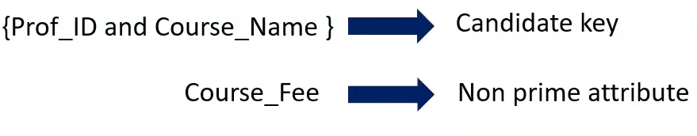

Slide 33
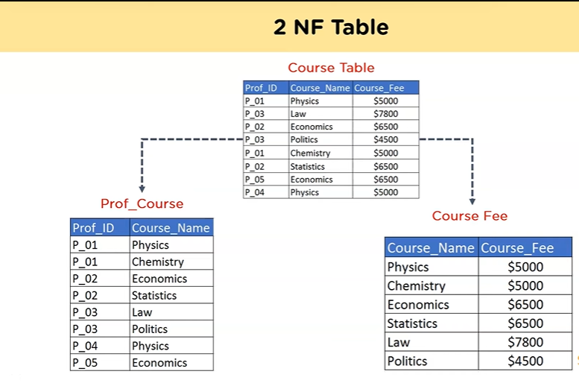

Slide 34
3NF
-Table should be in second normal form
-It should not have transitive functional dependency.

Slide 35
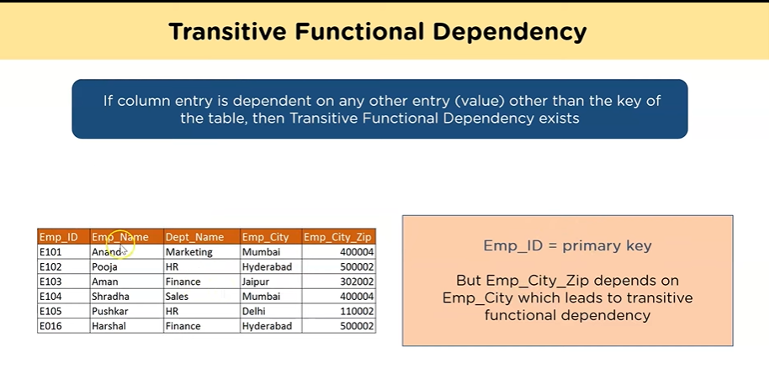

Slide 36
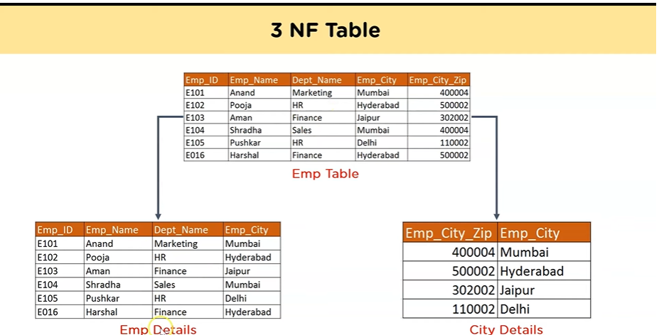

Slide 37
BCNF: Boyce code normal form
-Can be seen as a special case of third normal form
-Table should be in third normal form
-A relation is in BCNF if for every functional dependency X--->,where X is a super key.

Slide 38
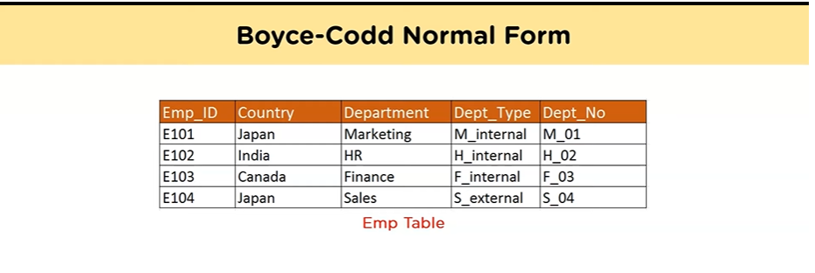
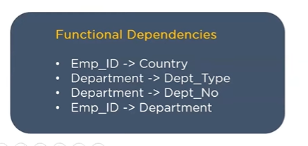


Slide 39
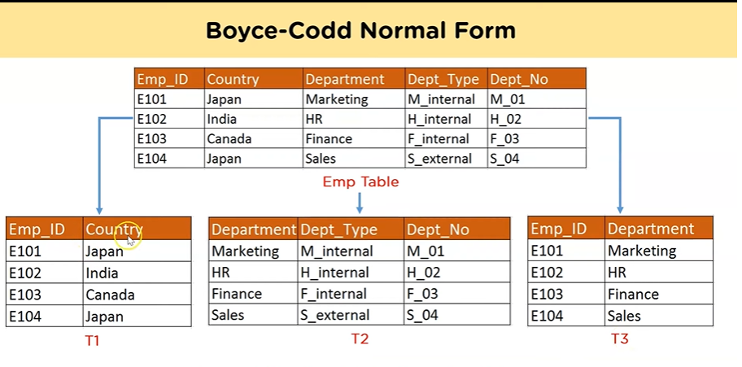


Slide 40
Disadvantages of Normalization
You cannot start building the database before knowing what the user needs.
01
The performance degrades when normalizing the relations to higher normal forms, i.e., 4NF, 5NF.
02
It is very time-consuming and difficult to normalize relations of a higher degree.
03
Careless decomposition may lead to a bad database design, leading to serious problems.
04

Slide 41
References:
https://www.lucidchart.com/pages/database-diagram/database-models

Slide 42













