Slide 1


Face Mask Detection using Deep Learning Techniques
Under the Guidance of
Ms Y Divya Bharathi
Asst. Professor,
Dept of CSE
Batch-06
K Lokesh Kumar
K Swaroopa Rani
M Mounica Sai
J Lahasya
K Rakesh

Slide 2
ABSTRACT
Now-a-days many people are suffering with COVID-19, Ultimately it is leading people to death. In order to overcome this problem, we should initially detect whether the person is wearing mask or not.
Many Face Detection models have been designed using several deep learning techniques which can read faces and mask straight from the data provided by the user.
Basically, this problem is divided into two stages: (1) Single Face and mask can be identified by using CNN. (2) The multiple faces are identified by using MTCNN(Multi-task Cascaded Convolutional Neural Networks).
The suggested approach in this project uses deep learning and frameworks like TensorFlow, Keras, and OpenCV to detect face masks.
Moreover, it can be employed for safety purposes since it is very resource-effective to deploy. The dataset has been presenting in this project, was collected from Kaggle.
It can be adopted by other researchers for further advanced models such as those of Face Recognition, Facial landmarks and Facial part detection process.

Slide 3
INTRODUCTION
Now-a-days Covid19 pandemic has huge impact on the world. It is declared as the deadly disease which affected more than 114 countries. wearing a mask is one of the necessary precaution to protect ourself from the virus .
virus spreads through air when an infected person sneezes or communicate with the other person, the water droplets from their nose or mouth passes through the air and affect other people.
Wearing a mask is essential, particularly for those people who are at a greater risk of severe illness from COVID-19 diseases. It recommended all people to wear a mask in public areas especially when social distancing is difficult.
we are developing a system to identify the people with mask. The suggested approach in this project uses deep learning and frameworks like TensorFlow, Keras, and OpenCV to detect face masks.
For Mask Detection we can DeepLearning Techniques like CNN for feature extraction while a group of faces can be identified using MTCNN(Multi-Task Cascaded Convolutional Neural Networks) .

Slide 4
Literature Survey
1.Bosheng Qin,Dongxiao Li., et.al[2020] “Identifying facemask-wearing condition using image super-resolution” proposed an approach (SRCNet) for classifying face-mask wearing. The model is trained and evaluated on a dataset that contained a total of 3835 images, Out of the 3835 images, 671 contain faces without masks, 134 images contain faces with incorrectly worn masks and 3030 images contain faces with correctly worn face-masks. An accuracy of 98.70% is reported for the proposed model. But, the disadvantage of this model was it do not focus on low-resolution faces and gives the accuracy of 73.5%.
2.Vinitha.V1, Velantina.V2., et al[2020] “FACEMASK DETECTION WITH DEEP LEARNING AND COMPUTER VISION” proposed system focuses on how to identify the person on image/video stream wearing face mask with the help of computer vision and deep learning algorithm by using the OpenCV, Tensor flow, Keras. An accuracy of 93.12% is reported for the proposed model. The drawback of using only MobileNetV2 is it takes more training time when compared to other approach.

Slide 5
3.Md.Sabbir Ejaz.,et al[2020] “ Face Mask Detection using Deep Learning Techniques” proposed that the method Principal Component Analysis (PCA) algorithm for masked and un-masked facial recognition. It was noticed that PCA is efficient in recognizing faces without a mask with an accuracy of 96.25% but its accuracy is decreased to 68.75% in identifying faces with a mask. There are some problems in the time of data processing and extracting feature of face mask images.
4. C.Jagadeeswari, M. Uday Theja., et al[2020] “Performance Evaluation of Intelligent Face Mask Detection System with various Deep Learning Classifiers” used to detect faces in the images/video stream. MobileNetV2, ResNet50, and VGG16 are used to generate a trained model. It performs a prediction with in about 0.12s with an accuracy of 68.4%.
5. Insure B venkateswaralu, Jagadesh kakrla et al, [2020]” Face mask detection using Mobilenet and global pooling” in this paper they have proposed a pre trained mobileNet with a global pooling block for face detection. MobileNet takes image and create multidimensional feature map.global pooling layer convert this into feature vector. This method is trained with dataset consists of 3833 color images. Out of which 1918 images are without a mask and the remaining 1915 images are with a mask. this proposed method archive high accuracy but cannot be implemented on images with multiple faces.

Slide 6
6. Amit Chavda, Jason Dsouza et al,[2019]”Face mask detection using multi stage CNN” in this paper author praposed a r, a two-stage Face Mask Detector The first stage uses a pretrained RetinaFace model for robust face detection the NASNetMobile based model was selected for classifying faces as masked or non-masked. this Stage 1 and Stage 2 models can be easily replaced with improved models in the future, that would give better accuracy and lower latency.
7. Abdellah oumina et ai,[2020]”face mask detector using Transfer learning”in this paper they used deep convolutional neural network to extract deep features from images of the faces. These features are processed using SVM for classification of masked and un masked faces. This method achived good accuracy of 97.1%but it is not trained with the large dataset,it is dataset contains1736 images.
8.Mohammad Marufur Rahman, Md. Motaleb Hossen Manik et al,[2020].” An Automated System to Limit COVID-19 Using Facial Mask Detection in Smart City Network”.In this paper, they had proposed the deep learning architecture. This architecture highly depends on convolutional neural network for feature extraction. The extracted features are used by dense neural networks for classification purposes. The proposed system having high accuracy of 98.7%. The future work in this paper is, the people near to the person who is not wearing mask may be alerted by an alaram signal on that location to maintain a safe distance.

Slide 7
9.Samuel Ady Sanjaya, Suryo Adi Rakhmawan [2020]. “Face Mask Detection Using MobileNetV2 in The Era of COVID-19 Pandemic”.In this paper, the face mask recognition is developed with an machine learning algorithm via image classification method mobileNetV2. It is based on the convolutional neural networks. The proposed model having the high accuracy of 96.8%. The future scope of this paper is, this model may integrate with a system which is implementing the social distancing.
10.Sunil Singh, Umang Ahuja et al, [2020]. “Face mask detection using YOLOv3 and faster R-CNN models: COVID-19 environment”.In this paper the F-RCNN and YOLOV3 algorithm is compared by the average precision. As the F-RCNN has the better precision. But the YOLO algorithm is used for the real world as it performs the single shot detection. As it also gives the high accuracy. The future scope of this paper is to improve the model by training on the large datasets.
11.Sneha Sen,Dr.Harish Patidar et al,[2020] "Face Mask detection System for COVID_19 Pandemic Precautions using Deep Learning Method“. In this paper author proposed a mask detection system that is able to detect anytype of mask and masks of different shapes from the video streams. Deep learning algorithm and framework of MObileNetV2is used here and the PyTorch library and OPENCV of python is used for mask detection from images/video streams.The accuracy for the training and validation set is compared and found to be of 79.24%.

Slide 8
12. Zekun Wang,Pengwei Wang,Peter C,Louis,Lee E,Wheless, and Yuankai Huo et al,[2020] "WearMask: Fast In-browser Face Mask Detection with Serverless Edge Computing for COVID-19“. In this paper author proposed a Web based efficient AI recognition of masks.The contribution is to provide a holistic edge-computing framework in integrating (1)deep learning models (2)neural network inference computing network (3)a stack-based virtual machine.For end users (1)installation free deployment (2)low computing requirements (3)high detection speed.This would give high accuracy.The drawback is insufficient support of deep learning from javascript by agrregating NCNN and WASM.
13. Preeti Nagrath,Rachna Jain,Agam madan,Rohan Arora,Piyush Kataria, and Jude Hemanth et al,[2020] "SSDMNV2: A real time DNN-based face mask detection system using single shot multibox detector and MobileNetV2“. In this paper author proposed a Single Shot multibox Detector as a face detector and MobilenetV2 architecture as a framework for the classifier, which is very lightweight and can even be used in embedded devices to perform real-time mask detection. This paper gives accuracy of 0.9264 and an FI score of 0.93. It generates better accuracy but has faced various wrong predictions.

Slide 9
Dataset
The data set used for Face mask detection is taken from Kaggle.
It contains a total of 11,042 images which is used for the model.
The images consists of 2 different types i.e. mask, without mask.
We divide the entire dataset into training and testing data.
The training and testing data are divided in the ratio of 7:3 where 7729 images are used for training and 3313 images for testing.

Slide 10
Existing and proposed method
The existing method of Face Mask Detection is done for single images.
This method is not helpful for detecting faced mask with in a group of people.
The proposed method can be used for detecting multiple faces and they are wearing mask or not can be detected.

Slide 11
Methodology
Training data
MTCNN Algorithm
Detect Multiple faces
Bounding Box of face
Identifying key features
(eyes, nose, mouth, ears)
Detected faces from image

Slide 12
Convolution Neural Network
Convolution Layers
Max Pool layer
(Activation fun= RELU)
Dense layer
Output layer
(Activation fun=Sigmoid)
Output
With Mask
Without Mask

Slide 13
ALGORITHM
INPUT: Image
OUPUT: Detecting Face Mask
STEP1: Load Images.
STEP2: Process the images, Resizing.
STEP3: Load the Filenames and respective labels.
STEP4: Shuffling the images.
STEP5: Split data into Training and Testing batches.
STEP6: Load CNN model and adding Kernel layers, Max pooling, Dropouts, Flatten.
STEP7: Compiling using Adam optimizer.
STEP8: Prediction.
STEP9: Save the Model.

Slide 14
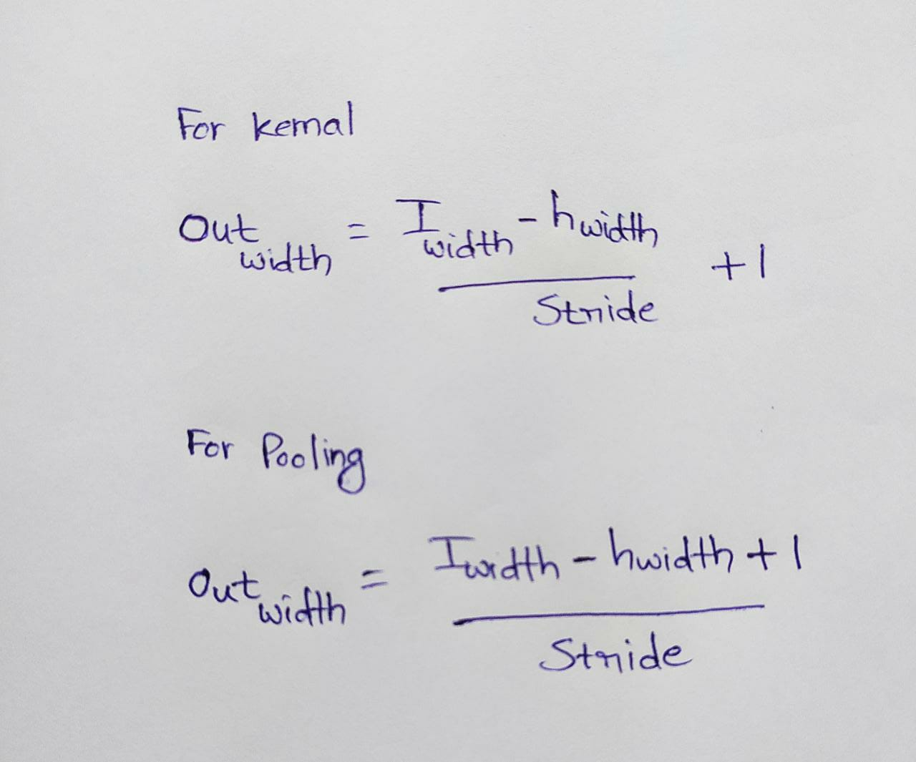
Architecture of CNN
Conv2d 3x3 ,32 Stride(1, 1)
Conv2d 3x3 ,64 Stride(1, 1)
Input
Dropout=0.2
64x64x3
62x62
31x31
29x29
14x14
14x14
Max pooling Stride(2,2)
Max pooling Stride(2,2)
Flatten
Dense,300
12544
Activation=Sigmoid
Dense,2000
Dense,7000
Dropout=0.2
Dense,15000
Output

Slide 15

SUMMARY

Slide 16
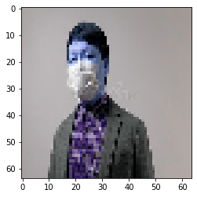
OUTPUT
Output For CNN Model

Slide 17
MTCNN :
MTCNN which is mostly used for detecting multiple faces in the image.
It recognizes the faces and also land mark locations such as eyes, nose, mouth.
The MTCNN uses a cascade structure with three networks:
1. Proposal Network(P-NET)
2. Refine Network (R-Net)
3. Output Network (O-Net)

Slide 18
Flow chart for MTCNN
Load the Model
Input the images
Identify the multiple faces
Draw the bounding box
Input to the model
Predicting output
With mask
Without mask

Slide 19
ALGORITHM
INPUT: Image
OUTPUT: No of faces in an image
STEP1: Load the Model from the disk.
STEP2: Install MTCNN.
STEP3: Label the Classes.
STEP4: Process the images, Resizing.
STEP5: Detecting the Faces.
STEP6: Predict the Image.
STEP7: Drawing a Rectangular Box around the face.
STEP8: Result.

Slide 20
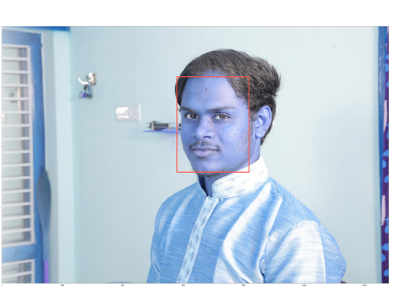
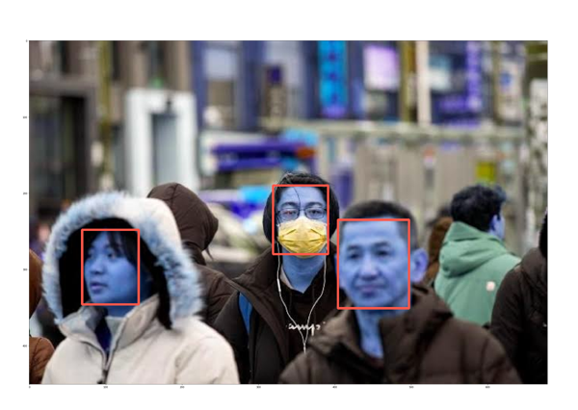
OUTPUT
For Single Person in an Image For Multiple Person’s In an Image

Slide 21
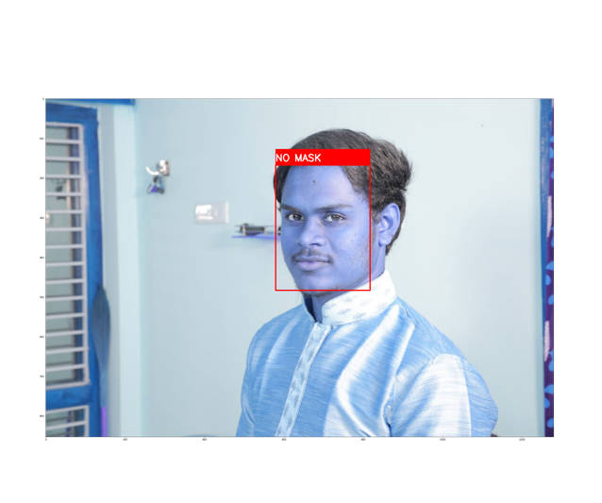
FINAL OUTPUT
For Single Person in an Image

Slide 22
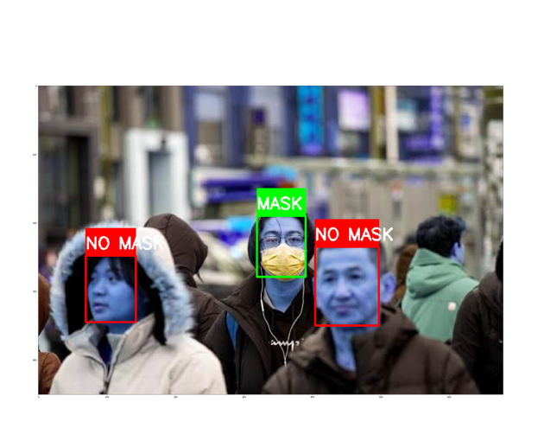
FINAL OUTPUT
For Multiple Person’s in an Image

Slide 23
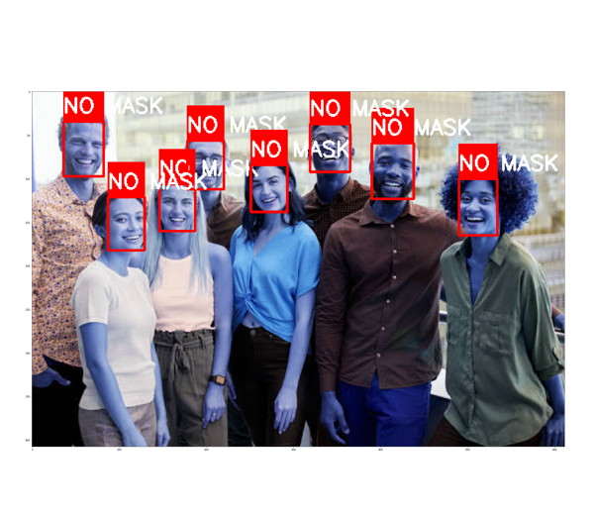
FINAL OUTPUT
For Multiple Person’s in an Image

Slide 24
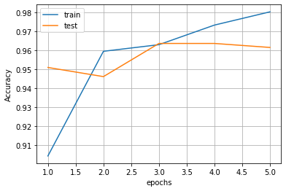
RESULT
Accuracy Graph

Slide 25
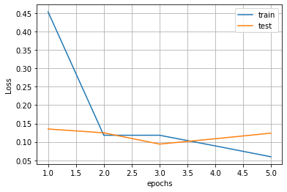
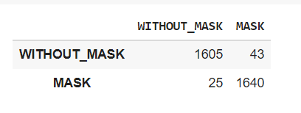
RESULT
Loss Graph
Confusion Matrix

Slide 26
Different Models and their Accuracy
MODEL | ACCURACY
CNN | 96.80
Alexnet | 89.2%
Ssdmnv2 | 92.64%
ResNET | 68.4%
MobileNetV2 | 93.12%
PCA | 68.75%
VGG16 | 68.4%

Slide 27
FUTURE SCOPE
A smart city means an urban area that consists of many IoT sensors to collect data.
Firstly, CCTV cameras are used to capture real-time video footage of different public places in the city to find out whether a person is using a mask or not.
This information is transferred through the city network to the corresponding authority to take necessary actions. The information about the violator is sent via SMS.
People near to the other person not wearing a mask may be alerted by an alarm signal on that location. In further our model can be elaborated in this way.

Slide 28
CONCLUSION
Covid19 virus has been spreading rapidly across all the countries. Face mask and social distancing can prevent spreading of virus.
So we are proposing face mask detection method using data mining techniques. For this method we have taken data set from kaggle which consists of 5521 images having face mask and 5521 images without face mask.
In our method we used CNN for single face detection and MTCNN for multiple face detection. CNN is used for the mask detection.
Our data set is divided in to 7:3 ratio .70%is used for training and 30% is used for testing. Data set is trained against CNN model.
First we are giving image to MTCNN model for face detection. Output from this model is given as input to the CNN model which classifies faces with mask and without masks.
Red rectangular will show around face with mask and green box is shown around face with mask. Training accuracy of this method is 97.18 and testing accuracy is 96.80

Slide 29
References
[1] B. QIN and D. Li, Identifying facemask-wearing condition using image super-resolution with classification network to prevent COVID-19, May 2020, doi: 10.21203/rs.3.rs-28668/v1.
[2] Vinitha.V1, Velantina.V2, Covid-19 facemask detection with deep learning and computer vision International Research Journal of Engineering and Technology (IRJET), Volume: 07, pp.1-6, Aug 2020.
[3] M.S. Ejaz, M.R. Islam, M. Sifatullah, A. SarkerImplementation of principal component analysis on masked and non-masked face recognition 2019 1st International Conference on Advances in Science, Engineering and Robotics Technology (ICASERT) (2019), pp. 15, 10.1109/ICASERT.2019.8934543
[4] C.Jagadeeswari, M.Uday Theja, “Performance Evaluation of Intelligent Face Mask Detection System with various Deep Learning Classifiers”, International Journal of Advanced Science and Technology Vol. 29, No. 11s, (2020), pp. 3074-3082.
[5] Venkateswarlu, I. B., Kakarla, J., & Prakash, S. (2020, December). Face mask detection using MobileNet and Global Pooling Block. In 2020 IEEE 4th Conference on Information &Communication Technology (CICT) (pp. 1-5). IEEE.
[6] Chavda, A., Dsouza, J., Badgujar, S., & Damani, A. (2021, April). Multi-stage cnn architecture for face mask detection. In 2021 6th International Conference for Convergence in Technology (I2CT) (pp. 1-8). IEEE.

Slide 30
[7] Oumina, A., El Makhfi, N., & Hamdi, M. (2020, December). Control The COVID-19 Pandemic: Face Mask Detection Using Transfer Learning. In 2020 IEEE 2nd International Conference on Electronics, Control, Optimization and Computer Science (ICECOCS) (pp. 1-5). IEEE.
[8] Rahman, M. M., Manik, M. M. H., Islam, M. M., Mahmud, S., & Kim, J. H. (2020, September). An Automated System to Limit COVID-19 Using Facial Mask Detection in Smart City Network. In 2020 IEEE International IOT, Electronics and Mechatronics Conference (IEMTRONICS) (pp. 1-5). IEEE.
[9] Sanjaya, S. A., & Rakhmawan, S. A. (2020, October). Face Mask Detection Using MobileNetV2 in The Era of COVID-19 Pandemic. In 2020 International Conference on Data Analytics for Business and Industry: Way Towards a Sustainable Economy (ICDABI) (pp. 1-5). IEEE.
[10] Singh, S., Ahuja, U., Kumar, M., Kumar, K., & Sachdeva, M. (2021). Face mask detection using YOLOv3 and faster R-CNN models: COVID-19 environment. Multimedia Tools and Applications,1-16.
[11] Sen, S., & Sawant, K. (2021, February). Face mask detection for covid_19 pandemic using pytorch in deep learning. In IOP Conference Series: Materials Science and Engineering (Vol. 1070, No. 1, p. 012061). IOP Publishing.
[12] Wang, Z., Wang, P., Louis, P. C., Wheless, L. E., & Huo, Y. (2021). WearMask: Fast In-browser Face Mask Detection with Serverless Edge Computing for COVID-19. arXiv preprint arXiv:2101.00784.

Slide 31
[13] Nagrath, P., Jain, R., Madan, A., Arora, R., Kataria, P., & Hemanth, J. (2021). SSDMNV2: A real time DNN-based face mask detection system using single shot multibox detector and MobileNetV2. Sustainable cities and society, 66, 102692.

Slide 32
THANK YOU

