Slide 1
Chapter 25: JavaServer Pages
Outline
25.1 Introduction
25.2 JavaServer Pages Overview
25.3 First JavaServer Page Example
25.4 Implicit Objects
25.5 Scripting
25.5.1 Scripting Components
25.5.2 Scripting Example
25.6 Standard Actions
25.6.1 <jsp:include> Action
25.6.2 <jsp:forward> Action
25.6.3 <jsp:useBean> Action

Slide 2
25.1 Introduction
JavaServer Pages
  Extension of Servlet technology
Simplify delivery of dynamic Web content
Reuse existing Java components
  Without programming Java
  Use scripts embedded in HTML files
Classes and interfaces specific to JSP
  Package javax.servlet.jsp
  Package javax.servlet.jsp.tagext

Slide 3
25.2 JavaServer Pages Overview
Key components
  Directives
  Actions
  Scriptlets
  Tag libraries

Slide 4
25.2 JavaServer Pages Overview (cont.)
Directive
  Message to JSP container
    i.e., program that compiles/executes JSPs
  Enable programmers to specify
    Page settings
    Content to include from other resources

Slide 5
25.2 JavaServer Pages Overview (cont.)
Action
  Predefined JSP tags that encapsulate functionality
  Can be embedded in JSP
  Often performed based on information from client request
  Can be used to create Java objects for use in scriptlets

Slide 6
25.2 JavaServer Pages Overview (cont.)
Scriptlet
  Also called “Scripting Elements”
  Enable programmers to insert Java code in JSPs
  Performs request processing
    Interacts with page elements and other components to implement dynamic pages

Slide 7
25.2 JavaServer Pages Overview (cont.)
Custom Tag Library
  JSP’s tag extension mechanism
  Enables programmers to define new tags
    Tags encapsulate complex functionality
  Tags can manipulate JSP content

Slide 8
25.2 JavaServer Pages Overview (cont.)
JSPs
  Look like standard HTML or XHTML
    Normally include HTML or XHTML markup
      Known as fixed-template data
  Used when content is mostly fixed-template data
    Small amounts of content generated dynamically
Servlets
  Used when small amount of content is fixed-template data
    Most content generated dynamically

Slide 9
25.2 JavaServer Pages Overview (cont.)
Some servlets do not produce content
  Invoke other servlets and JSPs
JSPs execute as part of a Web server
  JSP container
JSP first request
  JSP container translates a JSP into a servlet
    Handle the current and future requests
Code that represents the JSP
  Placed in servlet’s _jspService method

Slide 10
25.2 JavaServer Pages Overview (cont.)
JSP errors
  Translation-time errors
    Occur when JSPs are translated into servlets
  Request-time errors
    Occur during request processing
Methods jspInit and jspDestroy
  Container invokes when initializing and terminating a JSP
Methods are defined in JSP declarations
  Part of the JSP scripting mechanism

Slide 11
25.3 A First JavaServer Page Example
Simple JSP example (Fig. 25.1)
  Demonstrates
    Fixed-template data (XHTML markup)
    Creating a Java object (java.util.Date)
    Automatic conversion of JSP expression to a String
    meta element to refresh Web page at specified interval
  First invocation of clock.jsp
    Some delay while:
      JSP container translates the JSP into a servlet
      JSP container compiles the servlet
      JSP container executes the servlet
    Subsequent invocations should not experience the same delay

Slide 12
25.3 A First JavaServer Page Example
Simple JSP example (Fig. 25.1)
  <%= new java.util.Date() %>
    JSP expression, String representation inserted into response to client

Slide 13
clock.jsp
Line 10
Meta element refershes the Web page every 60 seconds.
1 <?xml version = "1.0"?>
2 <!DOCTYPE html PUBLIC "-//W3C//DTD XHTML 1.0 Strict//EN"
3 "http://www.w3.org/TR/xhtml1/DTD/xhtml1-strict.dtd">
4
5 <!-- Fig. 25.1: clock.jsp -->
6
7 <html xmlns = "http://www.w3.org/1999/xhtml">
8
9 <head>
10 <meta http-equiv = "refresh" content = "60" />
11
12 <title>A Simple JSP Example</title>
13
14 <style type = "text/css">
15 .big { font-family: helvetica, arial, sans-serif;
16 font-weight: bold;
17 font-size: 2em; }
18 </style>
19 </head>
20
21 <body>
22 <p class = "big">Simple JSP Example</p>
23
meta element refreshes the Web page every 60 seconds

Slide 14
clock.jsp
Line 30
Creates Date object
24 <table style = "border: 6px outset;">
25 <tr>
26 <td style = "background-color: black;">
27 <p class = "big" style = "color: cyan;">
28
29 <!-- JSP expression to insert date/time -->
30 <%= new java.util.Date() %>
31
32 </p>
33 </td>
34 </tr>
35 </table>
36 </body>
37
38 </html>
Creates Date object that is converted to a String implicitly and displayed in paragraph (p) element

Slide 15
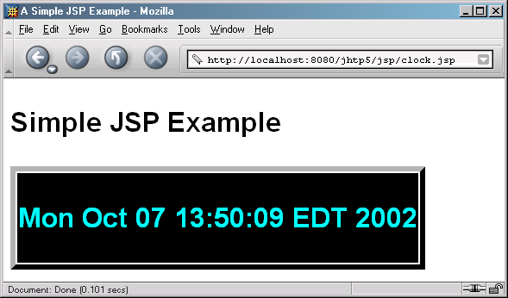
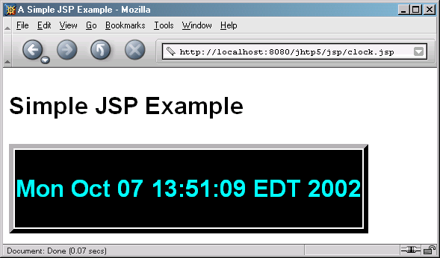
Clock.jsp

Slide 16
25.4 Implicit Objects
Implicit Objects
  Provide access to many servlet capabilities within a JSP
  Four scopes
    Application scope
      Objects owned by the container application
      Any servlet or JSP can manipulate these objects
    Page scope
      Objects that exist only in page in which they are defined
      Each page has its own instance of these objects
    Request scope
      Objects exist for duration of client request
      Objects go out of scope after response sent to client
    Session scope
      Objects exist for duration of client’s browsing session
      Objects go out of scope when client terminates session or when session timeout occurs

Slide 17
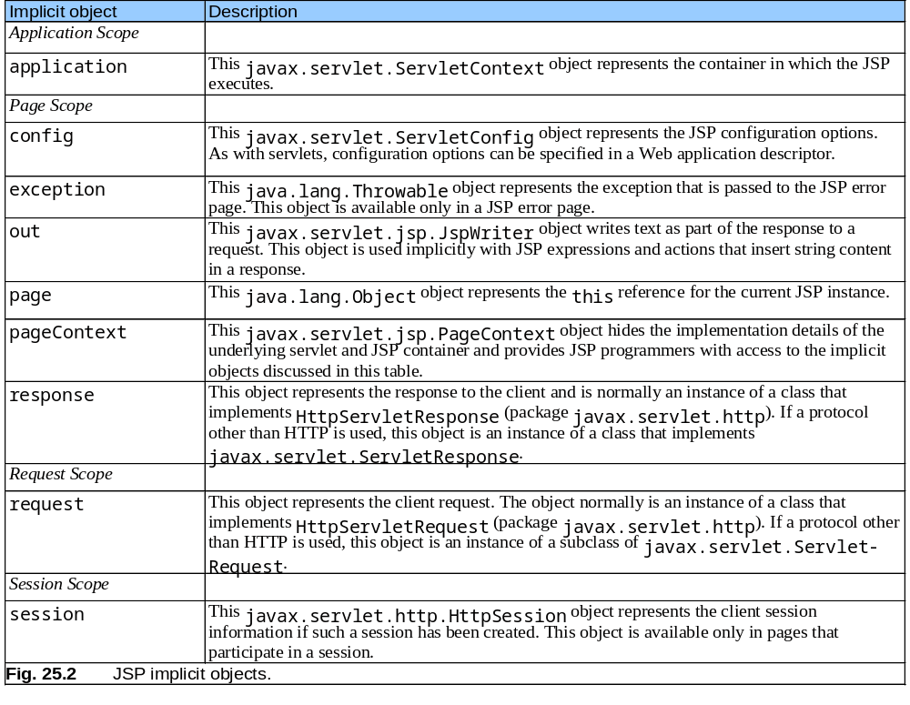

Slide 18
25.5 Scripting
Scripting
  Dynamically generated content
  Insert Java code and logic in JSP using scripting

Slide 19
25.5.1 Scripting Components
JSP scripting components
  Scriptlets (blocks of code containing Java statements delimited by <% and %>)
  Comments
    JSP comments (delimited by <%-- and --%>)
    XHTML comments (delimited by <!-- and -->)
    Java’s comments (delimited by // and /* and */)
  Expressions (delimited by <%= and %>) (evaluated when client requests the JSP, String version sent in response)
  Declarations (delimited by <%! and %>) (define variables for use in JSP
    <%! int counter = 0; %>

Slide 20
25.5.2 Scripting Example
Demonstrate basic scripting capabilities
  Responding to get requests

Slide 21
welcome.jsp
Lines 17-23
Line 19
1 <?xml version = "1.0"?>
2 <!DOCTYPE html PUBLIC "-//W3C//DTD XHTML 1.0 Strict//EN"
3 "http://www.w3.org/TR/xhtml1/DTD/xhtml1-strict.dtd">
4
5 <!-- Fig. 25.4: welcome.jsp -->
6 <!-- JSP that processes a "get" request containing data. -->
7
8 <html xmlns = "http://www.w3.org/1999/xhtml">
9
10 <!-- head section of document -->
11 <head>
12 <title>Processing "get" requests with data</title>
13 </head>
14
15 <!-- body section of document -->
16 <body>
17 <% // begin scriptlet
18
19 String name = request.getParameter( "firstName" );
20
21 if ( name != null ) {
22
23 %> <%-- end scriptlet to insert fixed template data --%>
24
Scriptlets used to insert Java code
Use request implicit object to get parameter

Slide 22
welcome.jsp
Line 26
Lines 30-35 and 45-49
25 <h1>
26 Hello <%= name %>, <br />
27 Welcome to JavaServer Pages!
28 </h1>
29
30 <% // continue scriptlet
31
32 } // end if
33 else {
34
35 %> <%-- end scriptlet to insert fixed template data --%>
36
37 <form action = "welcome.jsp" method = "get">
38 <p>Type your first name and press Submit</p>
39
40 <p><input type = "text" name = "firstName" />
41 <input type = "submit" value = "Submit" />
42 </p>
43 </form>
44
45 <% // continue scriptlet
46
47 } // end else
48
49 %> <%-- end scriptlet --%>
50 </body>
51
52 </html> <!-- end XHTML document -->
JSP expression
Scriptlets used to insert Java code

Slide 23
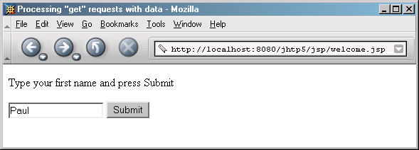
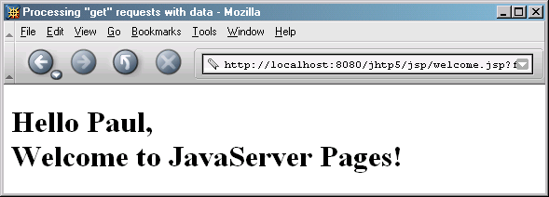
welcome.jsp

Slide 24
25.6 Standard Actions
JSP standard actions (most common tasks)
  Provide access to common tasks performed in a JSP
    Including content from other resources
    Forwarding requests to other resources
    Interacting with JavaBeans
  JSP containers process actions at request time
  Delimited by <jsp:action> and </jsp:action>

Slide 25
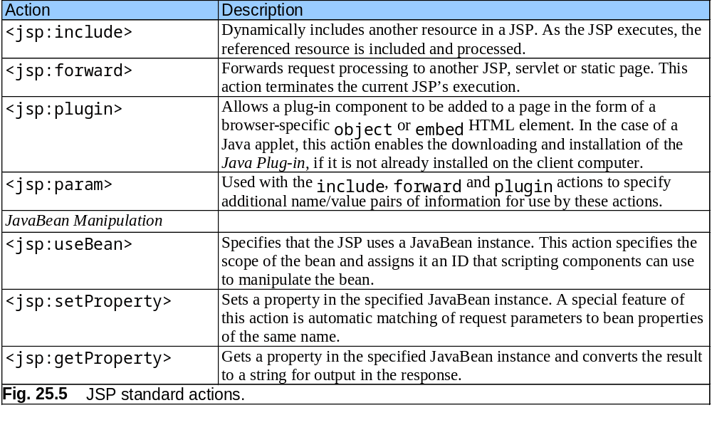
25.6 Standard Actions

Slide 26
25.6.1 <jsp:include> Action
<jsp:include> action
  Enables dynamic content to be included in a JSP at request time
  More flexible than include directive (included at translation time)
    Requires more overhead when page contents change frequently
<jsp:include page = "toc.html" flush = "true" />
  page is the resource to include
  flush must be true to say to flush buffer after including

Slide 27
banner.html
1 <!-- Fig. 25.7: banner.html -->
2 <!-- banner to include in another document -->
3 <div style = "width: 580px">
4 <p>
5 Java(TM), C, C++, Visual Basic(R),
6 Object Technology, and <br /> Internet and
7 World Wide Web Programming Training&nbsp;<br />
8 On-Site Seminars Delivered Worldwide
9 </p>
10
11 <p>
12 <a href = "mailto:deitel@deitel.com">deitel@deitel.com</a>
13 <br />978.461.5880<br />12 Clock Tower Place, Suite 200,
14 Maynard, MA 01754
15 </p>
16 </div>

Slide 28
toc.html
1 <!-- Fig. 25.8: toc.html -->
2 <!-- contents to include in another document -->
3
4 <p><a href = "http://www.deitel.com/books/index.html">
5 Publications/BookStore
6 </a></p>
7
8 <p><a href = "http://www.deitel.com/whatsnew.html">
9 What's New
10 </a></p>
11
12 <p><a href = "http://www.deitel.com/books/downloads.html">
13 Downloads/Resources
14 </a></p>
15
16 <p><a href = "http://www.deitel.com/faq/index.html">
17 FAQ (Frequently Asked Questions)
18 </a></p>
19
20 <p><a href = "http://www.deitel.com/intro.html">
21 Who we are
22 </a></p>
23

Slide 29
toc.html
24 <p><a href = "http://www.deitel.com/index.html">
25 Home Page
26 </a></p>
27
28 <p>Send questions or comments about this site to
29 <a href = "mailto:deitel@deitel.com">
30 deitel@deitel.com
31 </a><br />
32 Copyright 1995-2003 by Deitel &amp; Associates, Inc.
33 All Rights Reserved.
34 </p>

Slide 30
clock2.jsp
Lines 14-20
1 <!-- Fig. 25.9: clock2.jsp -->
2 <!-- date and time to include in another document -->
3
4 <table>
5 <tr>
6 <td style = "background-color: black;">
7 <p class = "big" style = "color: cyan; font-size: 3em;
8 font-weight: bold;">
9
10 <%-- script to determine client local and --%>
11 <%-- format date accordingly --%>
12 <%
13 // get client locale
14 java.util.Locale locale = request.getLocale();
15
16 // get DateFormat for client's Locale
17 java.text.DateFormat dateFormat =
18 java.text.DateFormat.getDateTimeInstance(
19 java.text.DateFormat.LONG,
20 java.text.DateFormat.LONG, locale );
21
22 %> <%-- end script --%>
23
24 <%-- output date --%>
25 <%= dateFormat.format( new java.util.Date() ) %>
26 </p>
27 </td>
28 </tr>
29 </table>
Use Locale to format Date with specified DateFormat

Slide 31
include.jsp
1 <?xml version = "1.0"?>
2 <!DOCTYPE html PUBLIC "-//W3C//DTD XHTML 1.0 Strict//EN"
3 "http://www.w3.org/TR/xhtml1/DTD/xhtml1-strict.dtd">
4
5 <!-- Fig. 25.10: include.jsp -->
6
7 <html xmlns = "http://www.w3.org/1999/xhtml">
8
9 <head>
10 <title>Using jsp:include</title>
11
12 <style type = "text/css">
13 body {
14 font-family: tahoma, helvetica, arial, sans-serif;
15 }
16
17 table, tr, td {
18 font-size: .9em;
19 border: 3px groove;
20 padding: 5px;
21 background-color: #dddddd;
22 }
23 </style>
24 </head>
25

Slide 32
include.jsp
Lines 38-39
Use JSP action to include banner.html.
Line 48
Use JSP action to include toc.html.
26 <body>
27 <table>
28 <tr>
29 <td style = "width: 160px; text-align: center">
30 <img src = "images/logotiny.png"
31 width = "140" height = "93"
32 alt = "Deitel & Associates, Inc. Logo" />
33 </td>
34
35 <td>
36
37 <%-- include banner.html in this JSP --%>
38 <jsp:include page = "banner.html"
39 flush = "true" />
40
41 </td>
42 </tr>
43
44 <tr>
45 <td style = "width: 160px">
46
47 <%-- include toc.html in this JSP --%>
48 <jsp:include page = "toc.html" flush = "true" />
49
50 </td>
51
Use JSP action to include banner.html
Use JSP action to include toc.html

Slide 33
include.jsp
Lines 55-56
Use JSP action to include clock2.jsp.
52 <td style = "vertical-align: top">
53
54 <%-- include clock2.jsp in this JSP --%>
55 <jsp:include page = "clock2.jsp"
56 flush = "true" />
57
58 </td>
59 </tr>
60 </table>
61 </body>
62 </html>
Use JSP action to include clock2.jsp

Slide 34
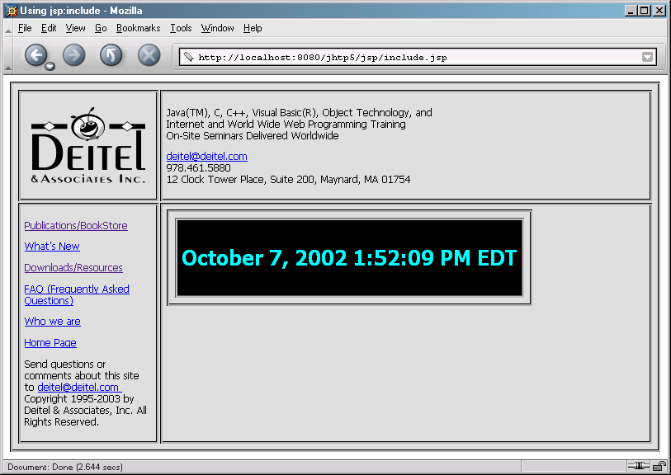
include.jsp

Slide 35
25.6.2 <jsp:forward> Action
<jsp:forward> action
  Enables JSP to forward request to different resources
    Can forward requests only to resources in same context
    Original JSP terminates
<jsp:param> action
  Specifies name/value pairs of information
    Name/Value pairs are passed to other actions

Slide 36
forward1.jsp
Lines 22-25
1 <?xml version = "1.0"?>
2 <!DOCTYPE html PUBLIC "-//W3C//DTD XHTML 1.0 Strict//EN"
3 "http://www.w3.org/TR/xhtml1/DTD/xhtml1-strict.dtd">
4
5 <!-- Fig. 25.11: forward1.jsp -->
6
7 <html xmlns = "http://www.w3.org/1999/xhtml">
8
9 <head>
10 <title>Forward request to another JSP</title>
11 </head>
12
13 <body>
14 <% // begin scriptlet
15
16 String name = request.getParameter( "firstName" );
17
18 if ( name != null ) {
19
20 %> <%-- end scriptlet to insert fixed template data --%>
21
22 <jsp:forward page = "forward2.jsp">
23 <jsp:param name = "date"
24 value = "<%= new java.util.Date() %>" />
25 </jsp:forward>
26
Forward request to forward2.jsp

Slide 37
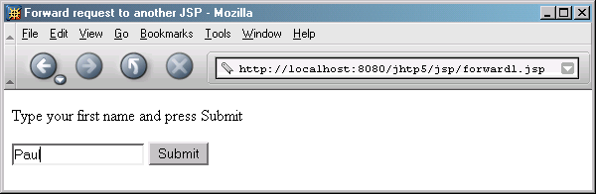
forward1.jsp
27 <% // continue scriptlet
28
29 } // end if
30 else {
31
32 %> <%-- end scriptlet to insert fixed template data --%>
33
34 <form action = "forward1.jsp" method = "get">
35 <p>Type your first name and press Submit</p>
36
37 <p><input type = "text" name = "firstName" />
38 <input type = "submit" value = "Submit" />
39 </p>
40 </form>
41
42 <% // continue scriptlet
43
44 } // end else
45
46 %> <%-- end scriptlet --%>
47 </body>
48
49 </html> <!-- end XHTML document -->

Slide 38
forward2.jsp
Lines 23-24
1 <?xml version = "1.0"?>
2 <!DOCTYPE html PUBLIC "-//W3C//DTD XHTML 1.0 Strict//EN"
3 "http://www.w3.org/TR/xhtml1/DTD/xhtml1-strict.dtd">
4
5 <!-- forward2.jsp -->
6
7 <html xmlns = "http://www.w3.org/1999/xhtml"v
8
9 <head>
10 <title>Processing a forwarded request</title>
11
12 <style type = "text/css">
13 .big {
14 font-family: tahoma, helvetica, arial, sans-serif;
15 font-weight: bold;
16 font-size: 2em;
17 }
18 </style>
19 </head>
20
21 <body>
22 <p class = "big">
23 Hello <%= request.getParameter( "firstName" ) %>, <br />
24 Your request was received <br /> and forwarded at
25 </p>
26
Receive request from forward1.jsp, then get firstName parameter from request

Slide 39
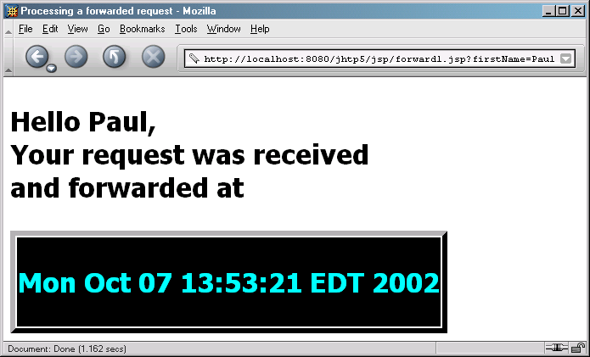
forward2.jsp
Line 31
27 <table style = "border: 6px outset;">
28 <tr>
29 <td style = "background-color: black;">
30 <p class = "big" style = "color: cyan;">
31 <%= request.getParameter( "date" ) %>
32 </p>
33 </td>
34 </tr>
35 </table>
36 </body>
37
38 </html>
Get date parameter from request

Slide 40
25.6.3 <jsp:useBean> Action
<jsp:useBean> action
  Enables JSP to manipulate Java object
    Creates Java object or locates an existing object for use in JSP
  <jsp:getProperty name = "rotator" property = "link“ /> same as
  <%= rotator.getLink() %>

Slide 41
Rotator.java
1 // Fig. 25.14: Rotator.java
2 // A JavaBean that rotates advertisements.
3 package com.deitel.jhtp5.jsp;
4
5 public class Rotator {
6 private String images[] = { "images/advjHTP1.jpg",
7 "images/cppHTP4.jpg", "images/iw3HTP2.jpg",
8 "images/jwsFEP1.jpg", "images/vbnetHTP2.jpg" };
9
10 private String links[] = {
11 "http://www.amazon.com/exec/obidos/ASIN/0130895601/" +
12 "deitelassociatin",
13 "http://www.amazon.com/exec/obidos/ASIN/0130384747/" +
14 "deitelassociatin",
15 "http://www.amazon.com/exec/obidos/ASIN/0130308978/" +
16 "deitelassociatin",
17 "http://www.amazon.com/exec/obidos/ASIN/0130461342/" +
18 "deitelassociatin",
19 "http://www.amazon.com/exec/obidos/ASIN/0130293636/" +
20 "deitelassociatin" };
21
22 private int selectedIndex = 0;
23

Slide 42
Rotator.java
Lines 25-28
Lines 31-34
Lines 38-41
24 // returns image file name for current ad
25 public String getImage()
26 {
27 return images[ selectedIndex ];
28 }
29
30 // returns the URL for ad's corresponding Web site
31 public String getLink()
32 {
33 return links[ selectedIndex ];
34 }
35
36 // update selectedIndex so next calls to getImage and
37 // getLink return a different advertisement
38 public void nextAd()
39 {
40 selectedIndex = ( selectedIndex + 1 ) % images.length;
41 }
42 }
Return image file name for book cover image
Return hyperlink to book at Amazon.com
Update Rotator so subsequent calls to getImage and getLink return information for different advertisements

Slide 43
adrotator.jsp
Lines 7-8
Line 22
1 <?xml version = "1.0"?>
2 <!DOCTYPE html PUBLIC "-//W3C//DTD XHTML 1.0 Strict//EN"
3 "http://www.w3.org/TR/xhtml1/DTD/xhtml1-strict.dtd">
4
5 <!-- Fig. 25.15: adrotator.jsp -->
6
7 <jsp:useBean id = "rotator" scope = "application"
8 class = "com.deitel.jhtp5.jsp.Rotator" />
9
10 <html xmlns = "http://www.w3.org/1999/xhtml">
11
12 <head>
13 <title>AdRotator Example</title>
14
15 <style type = "text/css">
16 .big { font-family: helvetica, arial, sans-serif;
17 font-weight: bold;
18 font-size: 2em }
19 </style>
20
21 <%-- update advertisement --%>
22 <% rotator.nextAd(); %>
23 </head>
24
Use jsp:useBean action to obtain reference to Rotator object
Invoke Rotator’s nextAd method

Slide 44
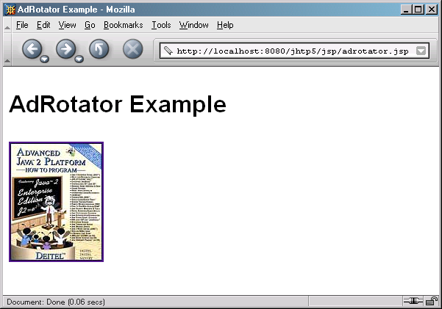
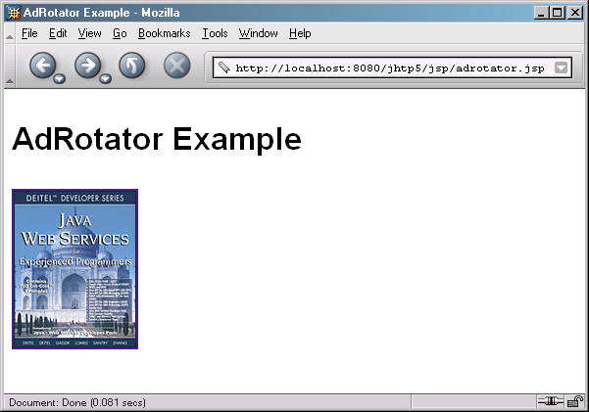
adrotator.jsp
Lines 29-33
25 <body>
26 <p class = "big">AdRotator Example</p>
27
28 <p>
29 <a href = "<jsp:getProperty name = "rotator"
30 property = "link" />">
31
32 <img src = "<jsp:getProperty name = "rotator"
33 property = "image" />" alt = "advertisement" />
34 </a>
35 </p>
36 </body>
37 </html>
Define hyperlink to Amazon.com site

