Slide 1
Session Tracking
Core Servlets & JSP book: www.coreservlets.com
More Servlets & JSP book: www.moreservlets.com
Servlet and JSP Training Courses: courses.coreservlets.com

Slide 2
Agenda
The purpose of session tracking
Rolling your own session tracking
The session tracking API
Per-client access counts
Shopping carts and online stores

Slide 3
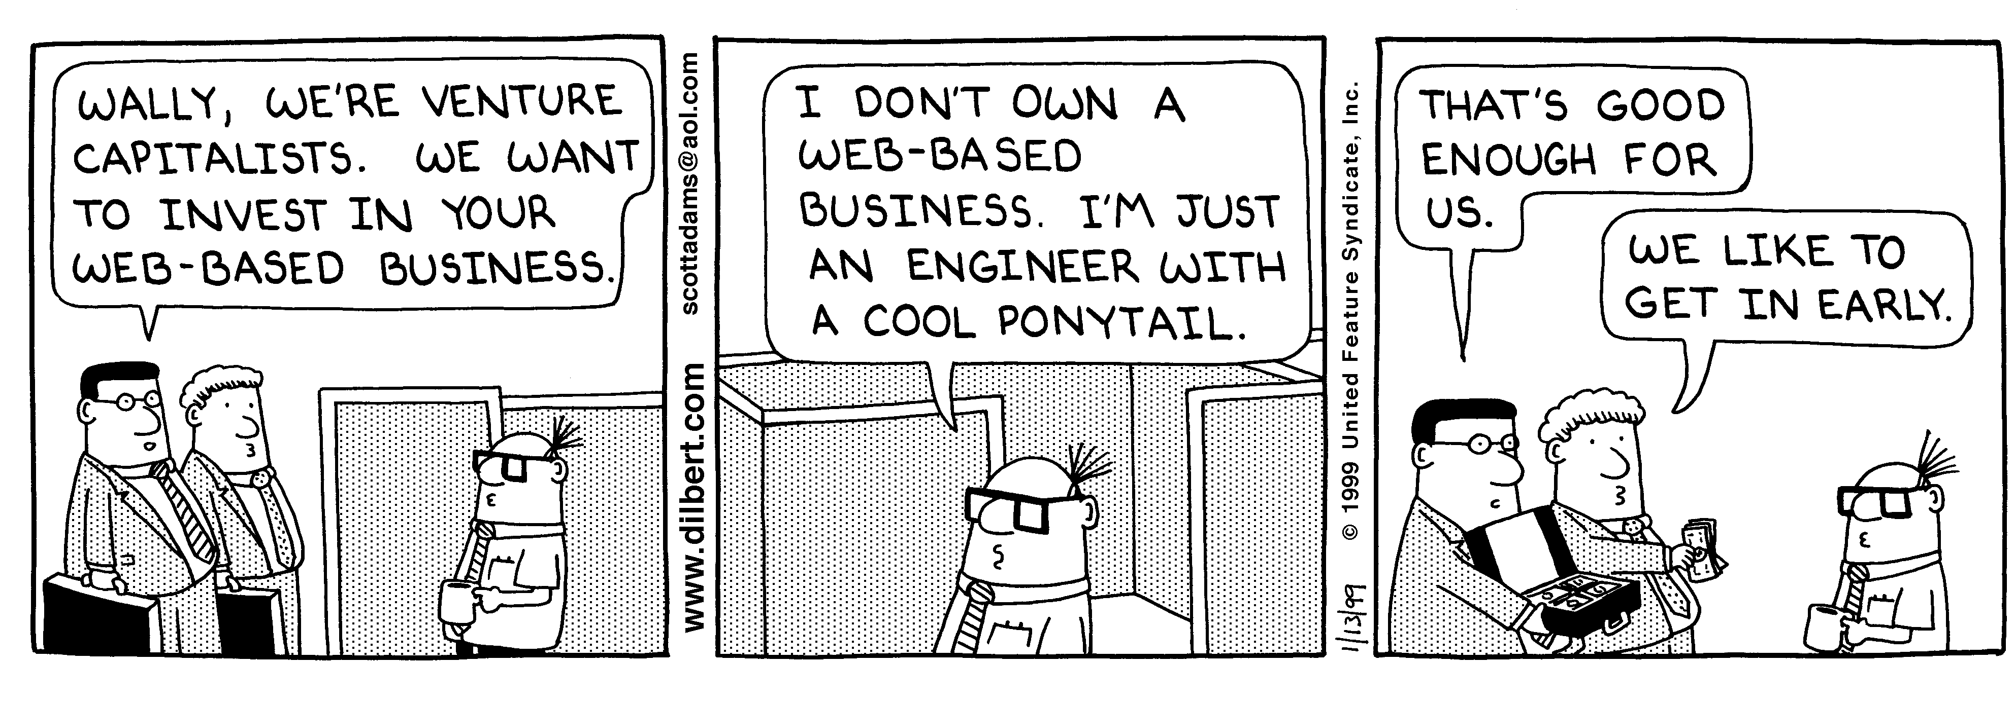
Session Tracking and E-Commerce
Why session tracking?
  When clients at on-line store add item to their shopping cart, how does server know what’s already in cart?
  When clients decide to proceed to checkout, how can server determine which previously created cart is theirs?
Dilbert used with permission of United Syndicates Inc.

Slide 4
Rolling Your Own Session Tracking: Cookies
Idea: associate cookie with data on server
  String sessionID = makeUniqueString();
  Hashtable sessionInfo = new Hashtable();
  Hashtable globalTable = findTableStoringSessions();
  globalTable.put(sessionID, sessionInfo);
  Cookie sessionCookie =
  new Cookie("JSESSIONID", sessionID);
  sessionCookie.setPath("/");
  response.addCookie(sessionCookie);
Still to be done:
  Extracting cookie that stores session identifier
  Setting appropriate expiration time for cookie
  Associating the hash tables with each request
  Generating the unique session identifiers

Slide 5
Rolling Your Own Session Tracking: URL-Rewriting
Idea
  Client appends some extra data on the end of each URL that identifies the session
  Server associates that identifier with data it has stored about that session
  E.g., http://host/path/file.html;jsessionid=1234
Advantage
  Works even if cookies are disabled or unsupported
Disadvantages
  Lots of tedious processing
  Must encode all URLs that refer to your own site
  Links from other sites and bookmarks can fail

Slide 6
Rolling Your Own Session Tracking: Hidden Form Fields
Idea:
  <INPUT TYPE="HIDDEN" NAME="session" VALUE="...">
Advantage
  Works even if cookies are disabled or unsupported
Disadvantages
  Lots of tedious processing
  All pages must be the result of form submissions

Slide 7
The Session Tracking API
Session objects live on the server
Automatically associated with client via cookies or URL-rewriting
  Use request.getSession(true) to get either existing or
  new session
    Behind the scenes, the system looks at cookie or URL extra info and sees if it matches the key to some previously stored session object. If so, it returns that object. If not, it creates a new one, assigns a cookie or URL info as its key, and returns that new session object.
Hashtable-like mechanism lets you store arbitrary objects inside session
  setAttribute (putValue in 2.1) stores values
  getAttribute (getValue in 2.1) retrieves values

Slide 8
Accessing Session Data
HttpSession session = request.getSession(true);
ShoppingCart cart =
(ShoppingCart)session.getAttribute("shoppingCart");
if (cart == null) { // No cart already in session
cart = new ShoppingCart();
session.setAttribute("shoppingCart", cart);
}
doSomethingWith(cart);

Slide 9
HttpSession Methods
getAttribute (getValue in old servlet spec 2.1)
  Extracts a previously stored value from a session object. Returns null if no value is associated with given name.
setAttribute (putValue in ver. 2.1)
  Associates a value with a name. Monitor changes: values implement HttpSessionBindingListener.
removeAttribute (removeValue in ver. 2.1)
  Removes values associated with name.
getAttributeNames (getValueNames in 2.1)
  Returns names of all attributes in the session.
getId
  Returns the unique identifier.

Slide 10
HttpSession Methods (Continued)
isNew
  Determines if session is new to client (not to page)
getCreationTime
  Returns time at which session was first created
getLastAccessedTime
  Returns time at which session was last sent from client
getMaxInactiveInterval, setMaxInactiveInterval
  Gets or sets the amount of time session should go without access before being invalidated
invalidate
  Invalidates the session and unbinds all
  objects associated with it

Slide 11
A Servlet Showing Per-Client Access Counts
public void doGet(HttpServletRequest request,
HttpServletResponse response)
throws ServletException, IOException {
response.setContentType("text/html");
PrintWriter out = response.getWriter();
String title = "Session Tracking Example";
HttpSession session = request.getSession(true);
String heading;
Integer accessCount =
(Integer)session.getAttribute("accessCount");
if (accessCount == null) {
accessCount = new Integer(0);
heading = "Welcome, Newcomer";
} else {
heading = "Welcome Back";
accessCount = new Integer(accessCount.intValue() + 1);
}
session.setAttribute("accessCount", accessCount);

Slide 12
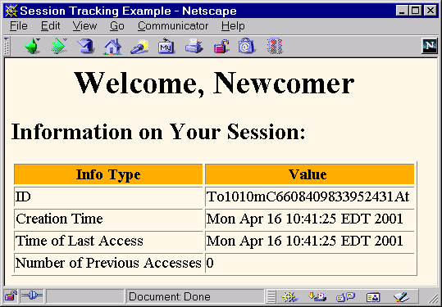
First Visit to ShowSession Servlet

Slide 13
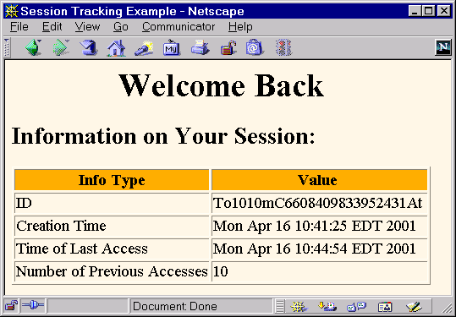
Eleventh Visit to ShowSession Servlet

Slide 14
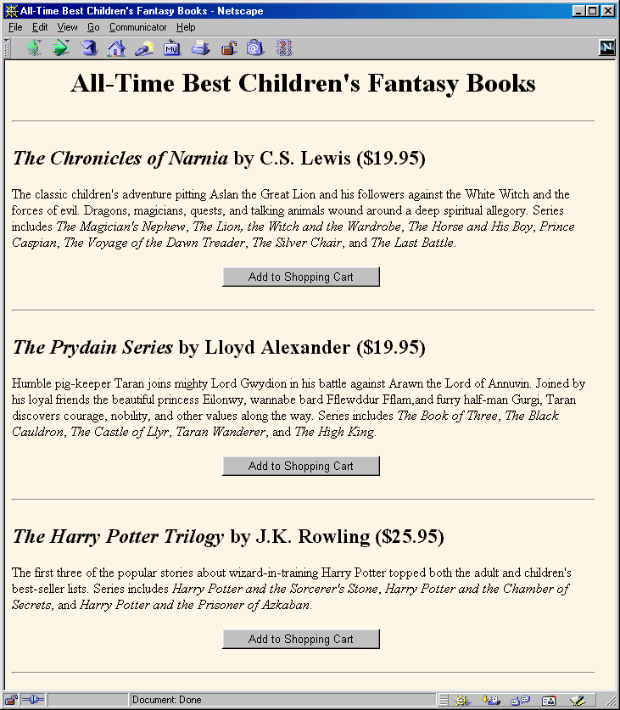
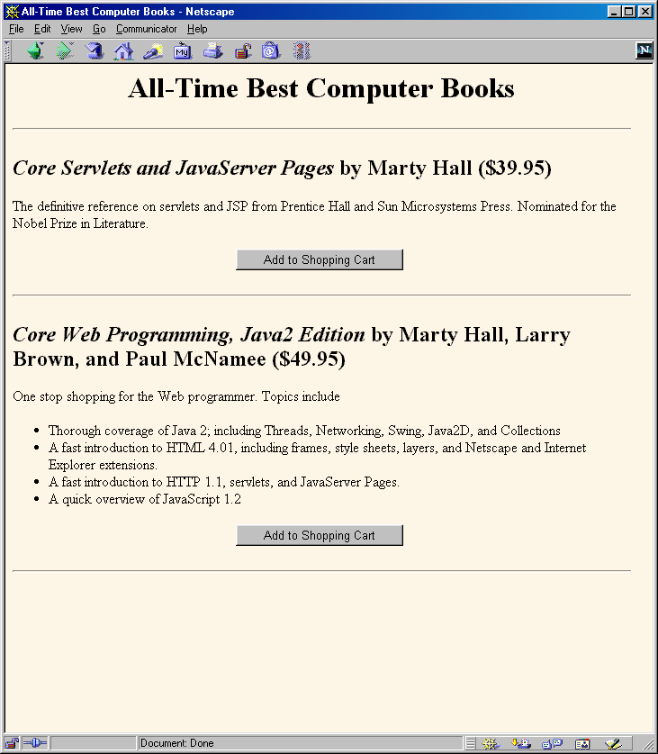
Session Tracking and Shopping Carts

Slide 15
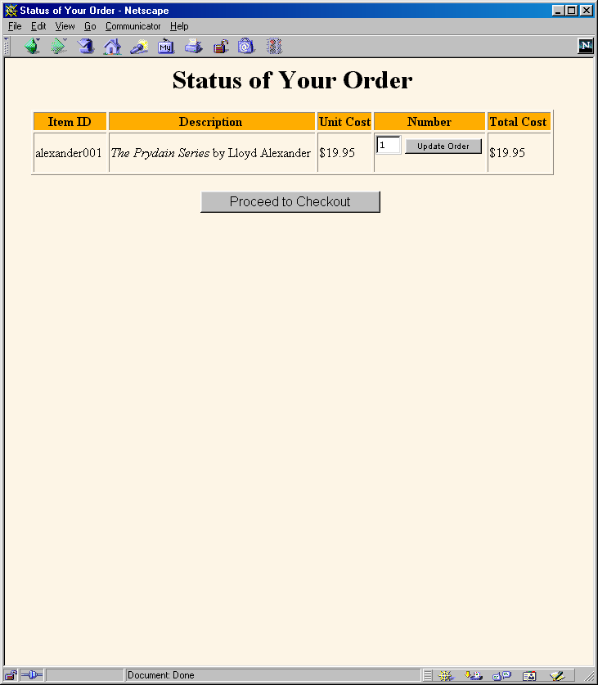
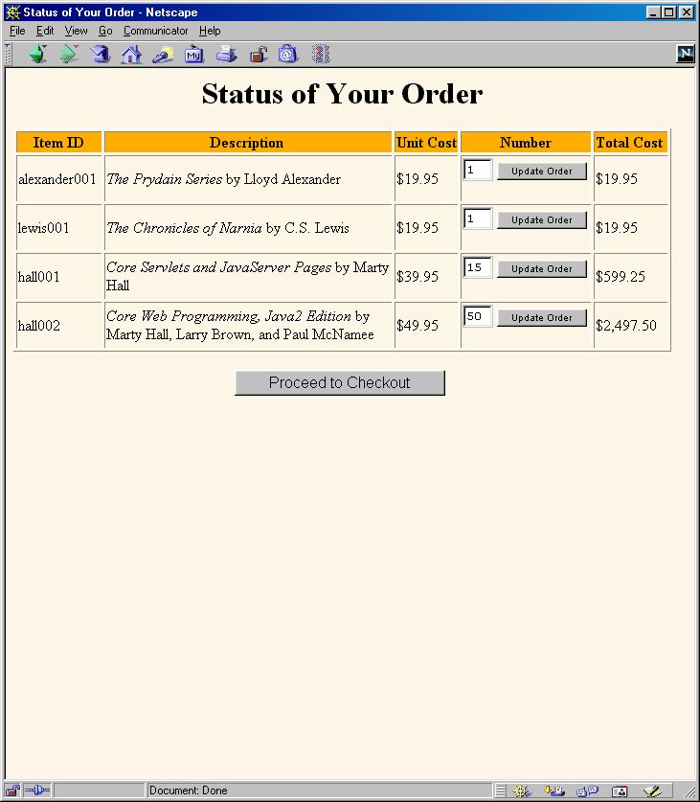
Session Tracking and Shopping Carts (Continued)

Slide 16
What Changes if Server Uses URL Rewriting?
Session tracking code:
  No change
Code that generates hypertext links back to same site:
  Pass URL through response.encodeURL.
    If server is using cookies, this returns URL unchanged
    If server is using URL rewriting, this appends the session info to the URL
    E.g.:
    String url = "order-page.html";
    url = response.encodeURL(url);
Code that does sendRedirect to same site:
  Pass URL through response.encodeRedirectURL

Slide 17
Summary
Although it usually uses cookies behind the scenes, the session tracking API is higher-level and easier to use than the cookie API
  If server supports URL-rewriting, your code unchanged
Session information lives on server
  Cookie or extra URL info associates it with a user
Obtaining session
  request.getSession(true)
Associating values with keys
  session.setAttribute (or session.putValue)
Finding values associated with keys
  session.getAttribute (or session.getValue)
    Always check if this value is null

Slide 18
Questions?
Core Servlets & JSP book: www.coreservlets.com
More Servlets & JSP book: www.moreservlets.com
Servlet and JSP Training Courses: courses.coreservlets.com

