Slide 1
SoA – Service oriented architecture

Slide 2
Web Services
WSDL – web services description language (describes the service itself)
Strongly typed
Remote method invocation in principal
Statefull
SOAP – Simple Object Access Protocol (transforms the request, parameters, and retunr value)
XML-RPC

Slide 3
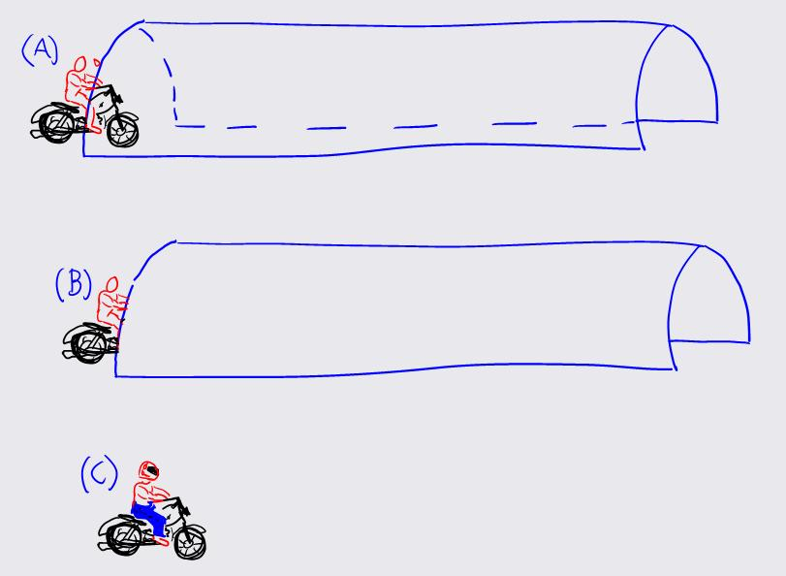
http://www.cloudidentity.com/blog/2005/04/25/END-TO-END-SECURITY-OR-WHY-YOU-SHOULDN-T-DRIVE-YOUR-MOTORCYCLE-NAKED/

Slide 4
WS-Security
WS-Security standard
Compliant with XML Signature
http://www.ibm.com/developerworks/webservices/library/ws-security.html
How to sign SOAP messages to assure integrity. Signed messages also provide non-repudiation (nepopiratelnost) and signer’s identity
How to encrypt SOAP messages to assure confidentiality.

Slide 5
WS-Security

Slide 6
WS-Security

Slide 7
WS-Security
WS-Security standard
Compliant with XML Signature
http://www.ibm.com/developerworks/webservices/library/ws-security.html
How to sign SOAP messages to assure integrity. Signed messages also provide non-repudiation (nepopiratelnost) and signer’s identity ????
How to encrypt SOAP messages to assure confidentiality.

Slide 8
REST
REST = Representational State Transfer
Data oriented – not procedure (RPC) oriented
Resources
Identified by URI
Accessed by HTTP methods
GET
PUT
POST
DELETE

Slide 9
RESTful services
 | Collection URI | Element URI
GET | List the URIs of collection members | Retrieves the resource (collection member) represented by the requested media type
PUT | Replace the collection with another collection | Replace the collection member with the given resource. If the collection does not contain a resource with given URI, create a new collection element
POST | Create a new entry in the collection (its URL created automatically and usually returned as return value) | Typically not used Treat the addressed resource as a collection and create a new entry in it
DELETE | Delete the whole collection | Delete the resource (collection member)
See http://en.wikipedia.org/wiki/Representational_state_transfer

Slide 10
RESTful services
Identification of resources by URI
Representation of resources – typically XML, JSON, HTML
PUT and DELETE – idempotent methods
GET – safe method (or nullipotent) w.r.t. no side-effects
Stateless between requests
Caching

Slide 11
RESTful services
Easy to test (using http clients) like curl (command line), RESTClient (Firefox plugin)
Security – typically through http
end-to-end
point-to-point

Slide 12
JAX-RS RESTful Web Services Java API
JAX-RS: Java API for RESTful Web Services
JAX-RS - official part of Java EE 6 (version 1.1 +).
For non-Java EE 6 environments a (small) entry in the web.xml deployment descriptor is required.
Jersey: one of JAX-RS implementation
Jersey, the reference implementation from Sun (now Oracle).
One of jersey tutorials:
http://jersey.java.net/nonav/documentation/latest/index.html

Slide 13
JERSEY - REST framework
Maven configuration – pom.xml

Slide 14
JERSEY - REST framework
web.xml

Slide 15
Resource URL structure
http://localhost:8080/context/webresources/resourcepath
Context defined in META-INF/context.xml
Servlet mapping url-pattern defined in web.xml
Resource path and parameters

Slide 16
Simple resource class

Slide 17
SimplePOJO

Slide 18
Simple JAX-RS client

Slide 19
Simple JAX-RS client
FEATURE_POJO_MAPPING
public static final java.lang.String FEATURE_POJO_MAPPING
A ResourceConfig feature, which allows you to enable JSON/POJO mapping functionality
in Jersey. If set to true, your application will be capable of transforming JSON data to
and out of POJOs. This also includes any JAXB beans existing in your application.
i.e. all those beans would not be processed via XML, but rather directly marshaled and
un-marshaled to and from JSON using the POJO mapping functionality.

Slide 20
Simple JAX-RS client
PROPERTY_FOLLOW_REDIRECTS
static final java.lang.String PROPERTY_FOLLOW_REDIRECTS Redirection property.
A value of "true" declares that the client will automatically redirect to the URI declared
in 3xx responses. The value MUST be an instance of Boolean.
If the property is absent then the default value is "true".

