Slide 1


Branching
in
GIT
Presented By: LOKESH KUMAR
Notes:
Note: First “Right Click” on the Gradient background, go to “Order” option and “Send it to Back”, then insert your picture into “Image Placeholder”, “Right Click” on the picture and again go to “Order” option and “Send it to Back” to get the “Gradient” effect.

Slide 2





Task
Create and collaborate on a new empty repository on GitHub.
Each member should make one commit each.
This group needs to learn and discuss on the following topic - branch
You need to push the slides or the doc you create to this repository.
Share it with the other class members.

Slide 3
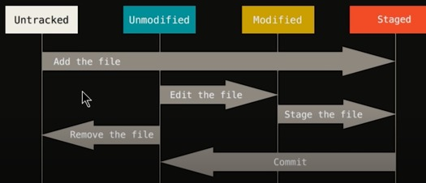
Stages of a file

Slide 4

Branch in GIT
GIT branches are effectively a pointer to a snapshot of we changes. When we want to add a new feature or fix a bug—no matter how big or how small— we spawn a new branch to encapsulate our changes.

Slide 5
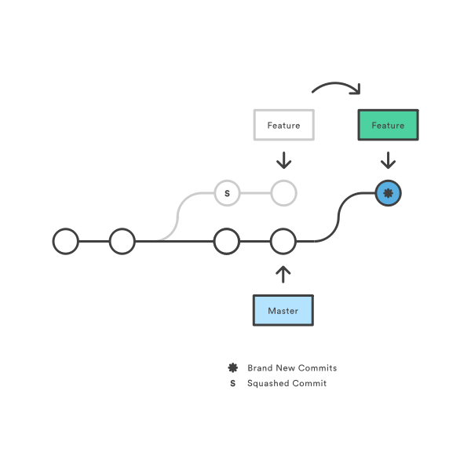
Branch Diagram

Slide 6
How it works
A branch represents an independent line of development. Branches serve as an abstraction for the edit/stage/commit process. You can think of them as a way to request a brand new working directory, staging area, and project history. New commits are recorded in the history for the current branch, which results in a fork in the history of the project.
The git branch command lets you create, list, rename, and delete branches. It doesn’t let you switch between branches or put a forked history back together again. For this reason, git branch is tightly integrated with the git checkout anad git merge commands.

Slide 7
GIT commands
git branch
List all of the branches in your repository. This is synonymous with git branch --list.
git branch <branch_name>
Create a new branch called ＜branch＞. This does not check out the new branch.
git branch -d <branch>
Delete the specified branch. This is a “safe” operation in that Git prevents you from deleting the branch if it has unmerged changes.

Slide 8
git branch -D <branch>
Force delete the specified branch, even if it has unmerged changes. This is the command to use if you want to permanently throw away all of the commits associated with a particular line of development.
git branch -m <branch>
Rename the current branch to ＜branch＞.
git branch -a
List all remote branches.

Slide 9
Creating Branches
Create a folder on local system
mkdir lokesh
open terminal in same directory or change path to the directory
cd lokesh
initialise git
git init
iniitialise user name and user email
git config --global user.name “lokesh_kumar”
git config --global user.email lokesh.kumar@knoldus.com
to check git status
git status
lets create html file
touch index.html
move the file into staged file
git add index.html

Slide 10
make changes in the file
commit the changes in file
git commit -m “first commit “
create branch
git branch navigation
chech all available branches
git branch
change to navigation branch
git checkout navigation
makes changes in the file under navigation branch
merge changes of navigation branch to the master branch
git merge <branch_name> to current branch

Slide 11
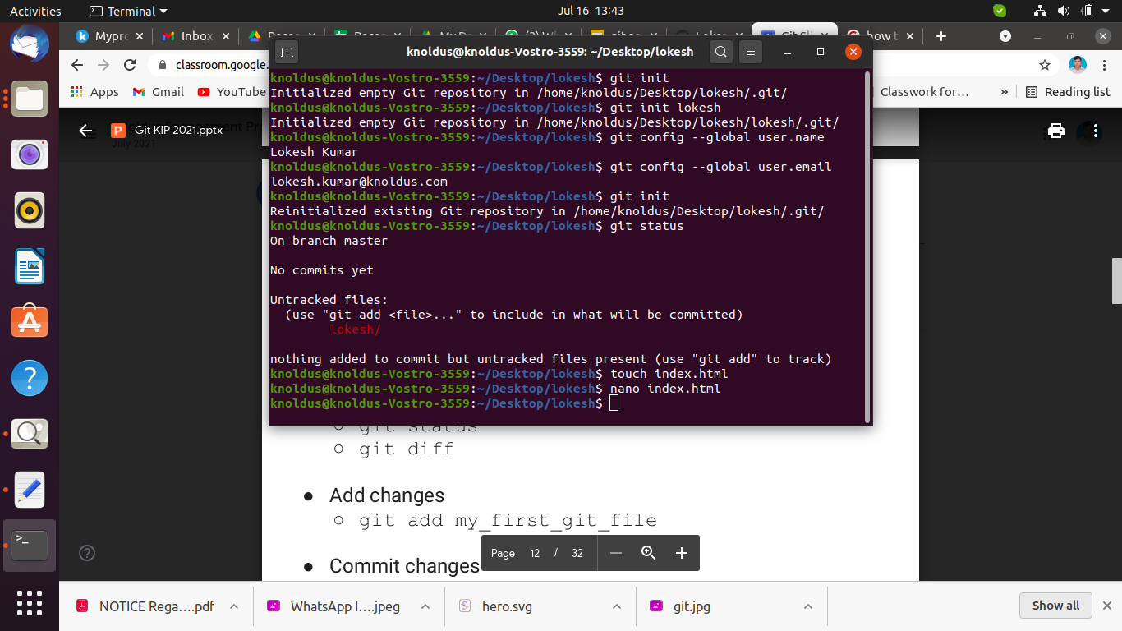
Snapshots of Actual code

Slide 12
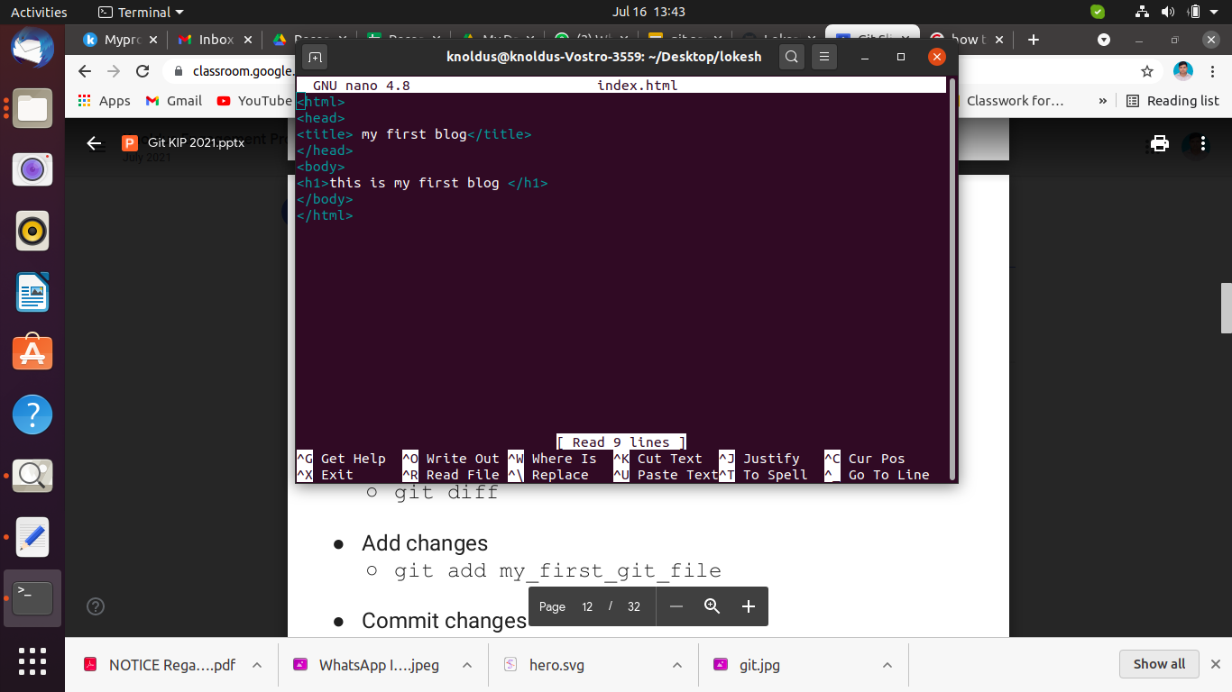

Slide 13
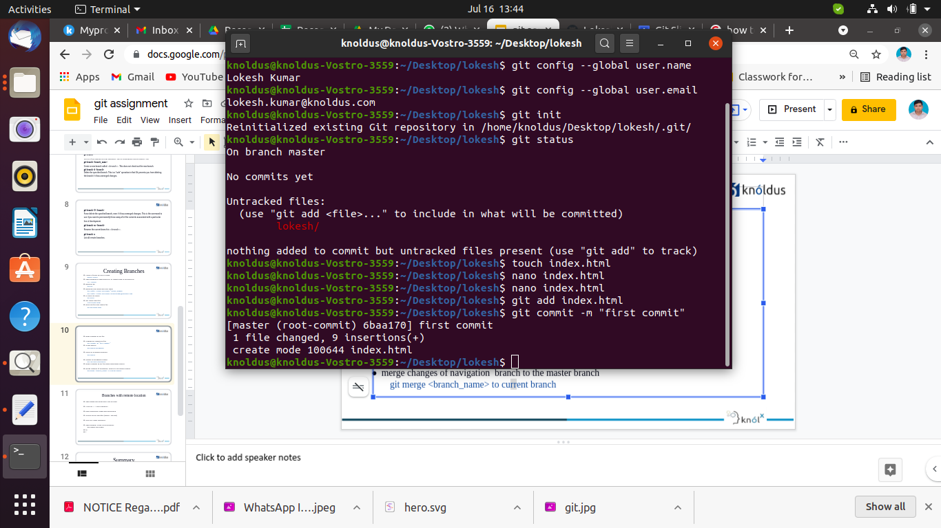

Slide 14
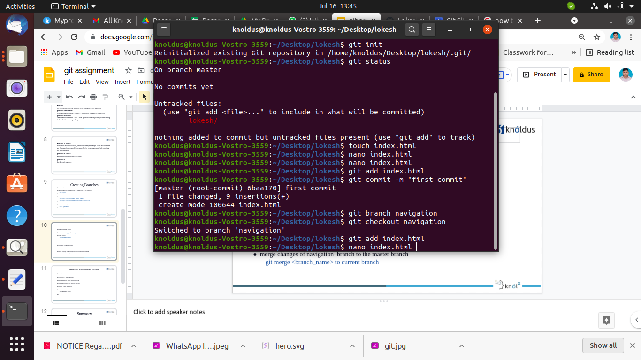

Slide 15
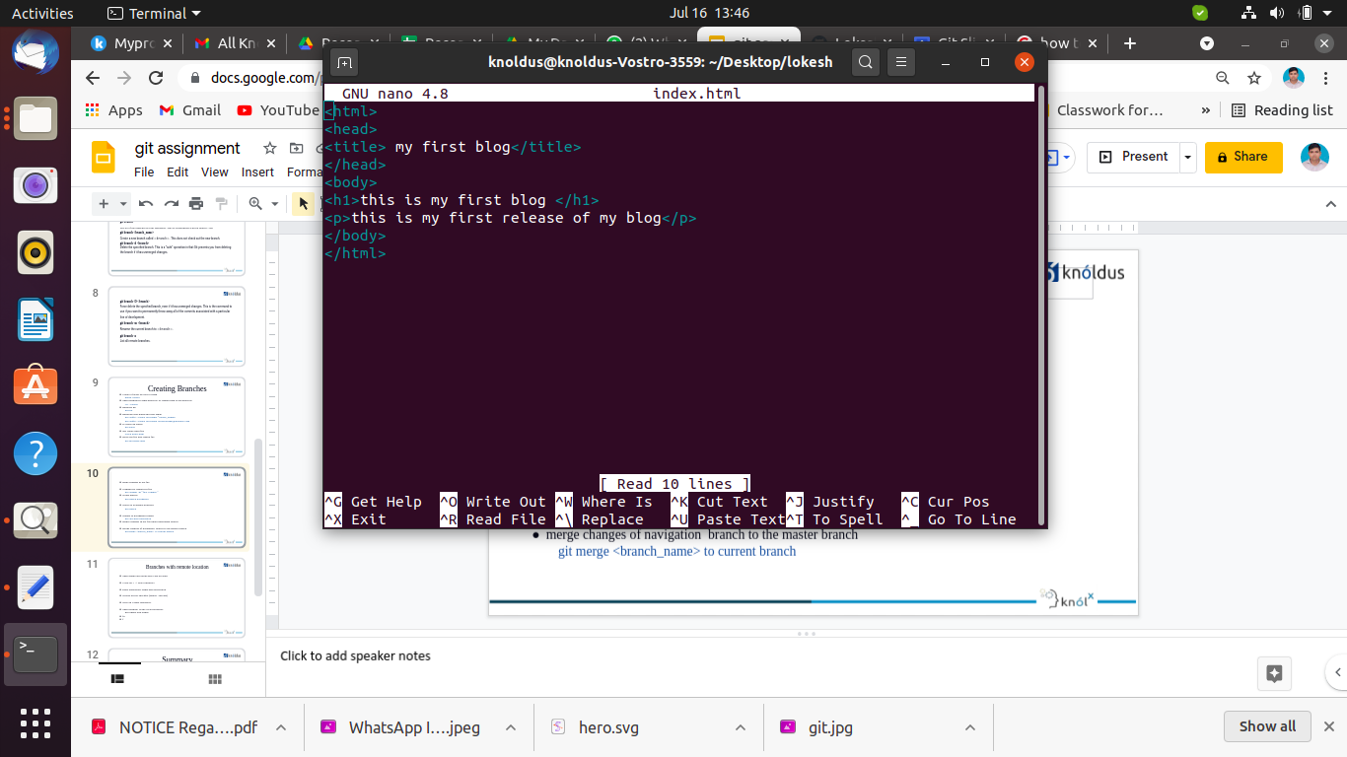

Slide 16
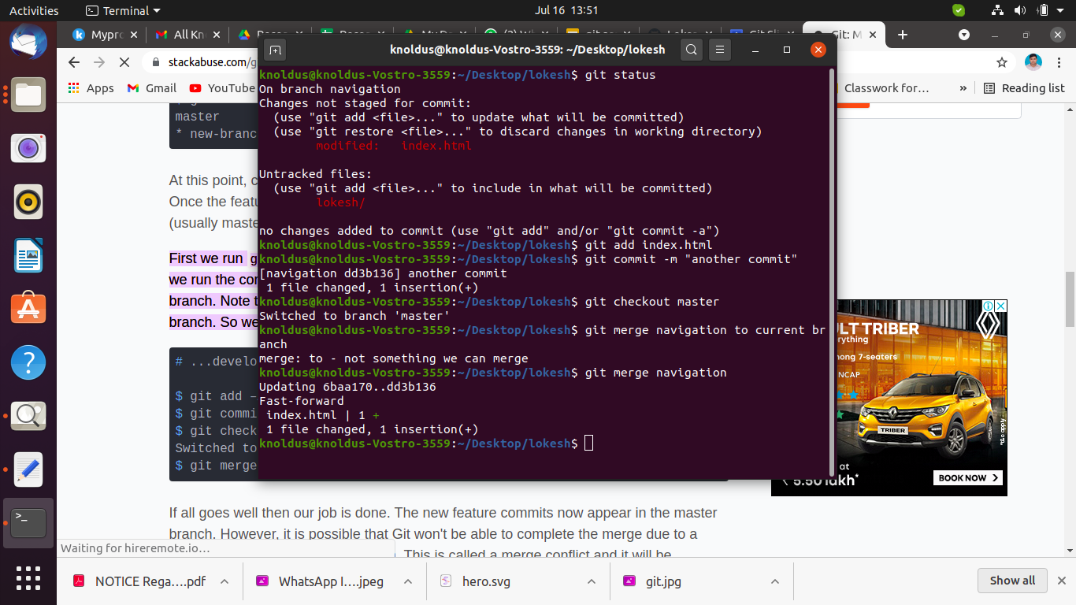

Slide 17
Branches with remote location
open github and login with your account
Click on + -> new repository
Enter Repository name and description
choose access specifier (public / private)
click on Create repository
open terminal in the local repository
git remote add origin https://github.com/lkknoldus/lokesh
check all variable address
git remote
push repos on remote repository
git push origin master

Slide 18
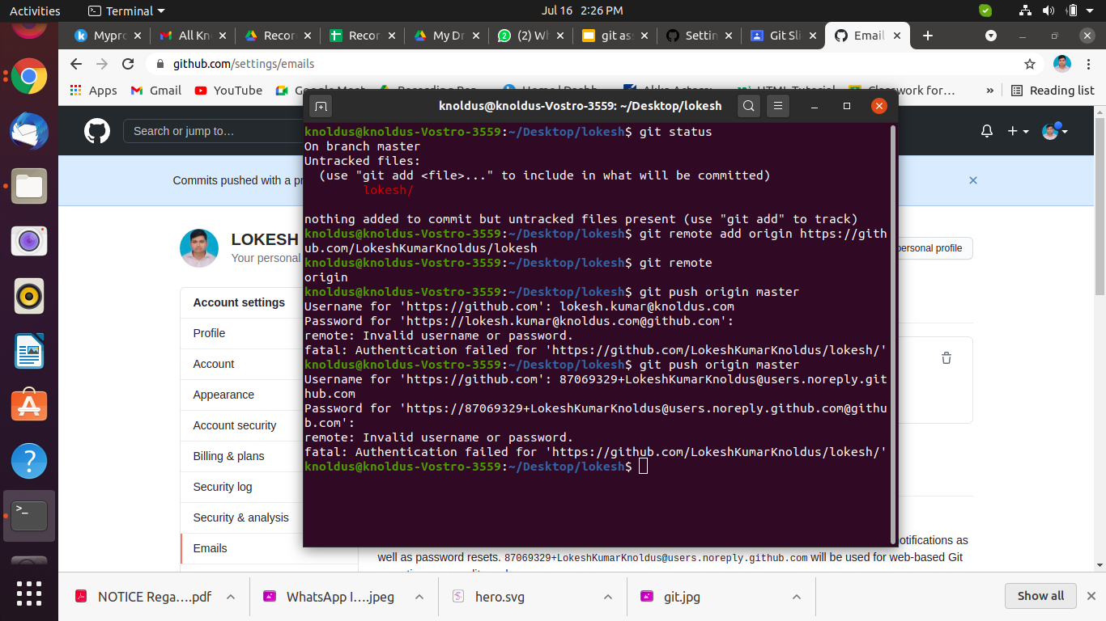

Slide 19
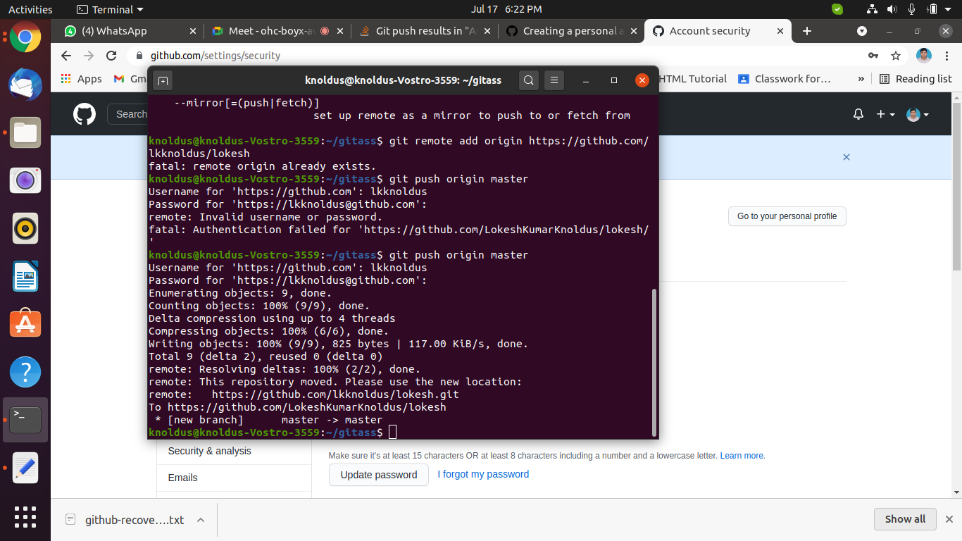
pushing data to remote repository

Slide 20
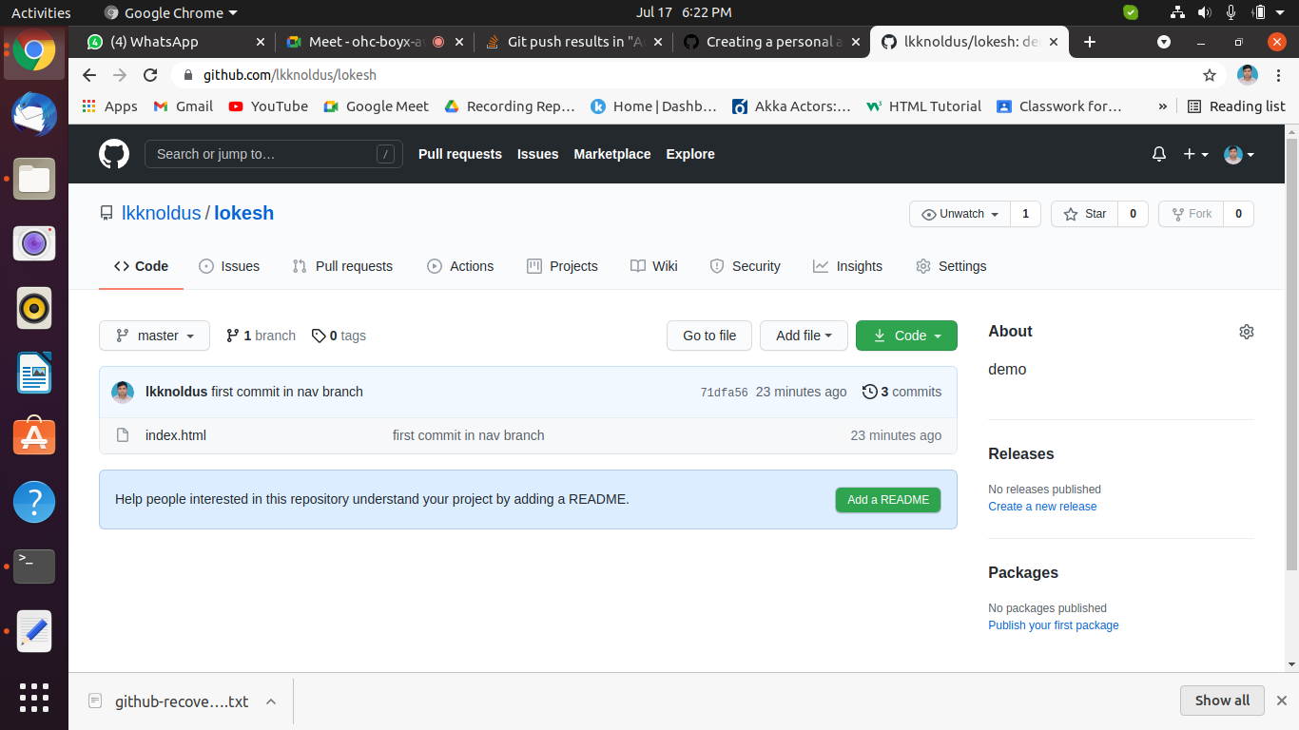

Slide 21
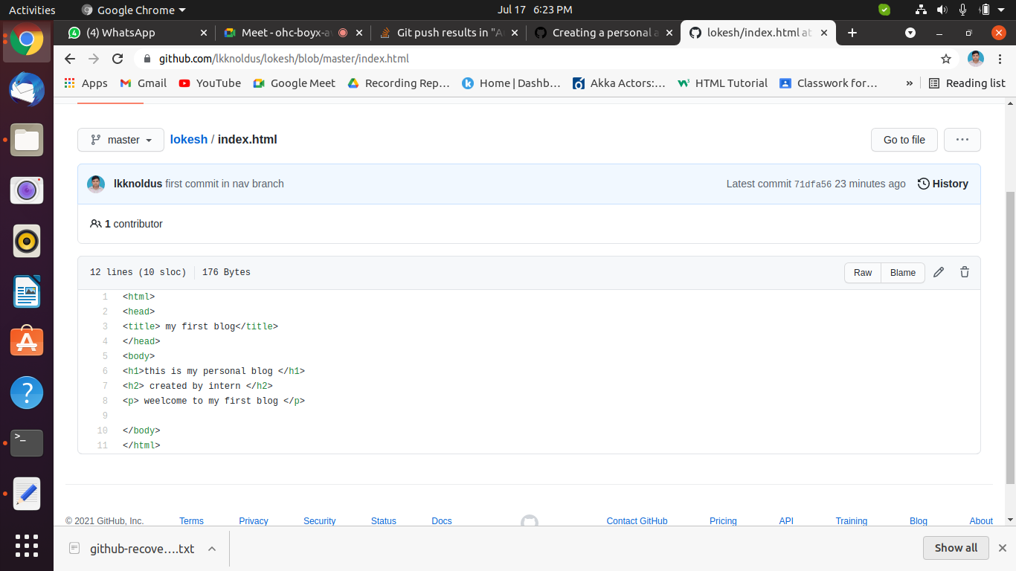

Slide 22
Summary
In this document we discussed Git's branching behavior and the git branch command. The git branch commands primary functions are to create, list, rename and delete branches. To operate further on the resulting branches the command is commonly used with other commands like git checkout . finally we have uploaded our work on remote system using push command.

Slide 23
Thank You !
Get in touch with us:
Lorem Studio, Lord Building
D4456, LA, USA

