Slide 1

EDA On Impact On Generative AI
On Student Academic Performance
By Lokesh Narkhede
Batch No: 509

Slide 2
ABOUT ME
About Me
1
Educational Background
Pursuing B-tech Degree in 4th year of Electronics and Telecommunication Engineering
2
Why Data Science?
I chose Data Science because I enjoy working with data and finding meaningful insights from it. It combines programming, problem-solving, and analytical thinking, which I find interesting. It also provides great opportunities to work in AI and solve real-world problems.
3
Online Profiles
LinkedIn: www.linkedin.com/in/lokeshnarkhede
4
Innomatics Research Labs | EDA Project
2

Slide 3
INTRODUCTION
Problem Statement & Objective
THE PROBLEM
The increasing use of Generative AI tools is changing how students learn and complete academic tasks. However, its impact on academic performance, study habits, and learning outcomes is not clearly understood.
Generative AI tools are increasingly being used by students for learning, completing assignments, conducting research, and improving productivity. While these tools offer several benefits, their overall impact on students' academic performance, study habits, and learning outcomes remains uncertain. This project aims to analyze student-related data to understand how the use of Generative AI influences education and whether it contributes positively or negatively to the learning process.
Innomatics Research Labs | EDA Project
4

Slide 4
AGENDA
Agenda
1
Problem Statement
8
Vizualization Overview
Objectives
9
Exploratory Data Analysis — Univariate
2
3
Why This Project / Dataset?
10
Exploratory Data Analysis — Bivariate
4
Dataset Information: Uncleaned Data
11
Exploratory Data Analysis — Multivariate
5
Overview of Data Handling
12
Challenges Faced
6
Data Cleaning
13
Conclusion & Learnings
7
Type Casting
Innomatics Research Labs | EDA Project
3

Slide 5
Objectives:
Objectives of the Study:
To analyze the usage patterns of Generative AI among students, including usage time, tools used, and level of dependency.
To examine the impact of Generative AI usage on students' academic performance and GPA.
To study how Generative AI influences students' study habits and learning behavior.
To evaluate the effect of AI usage on skill retention and understanding of concepts.
To assess the relationship between Generative AI usage and student burnout levels.
Innomatics Research Labs | EDA Project
5

Slide 6
WHY THIS PROJECT
Why This Project & Dataset?
Generative AI tools (ChatGPT, Copilot, Gemini, etc.) have become part of everyday student life — this is a highly relevant, real-world topic.
As a learner myself, I wanted to explore whether AI usage truly improves or harms academic outcomes — an area with mixed opinions and limited concrete data.
The dataset combines behavioural data (hours, tool diversity, dependency) with academic outcomes (GPA, retention, burnout) — ideal for rich univariate, bivariate, and multivariate analysis.
Relevant to my interest in Data Science / EdTech analytics, where understanding human behaviour around technology adoption is a growing field.
Innomatics Research Labs | EDA Project
6

Slide 7
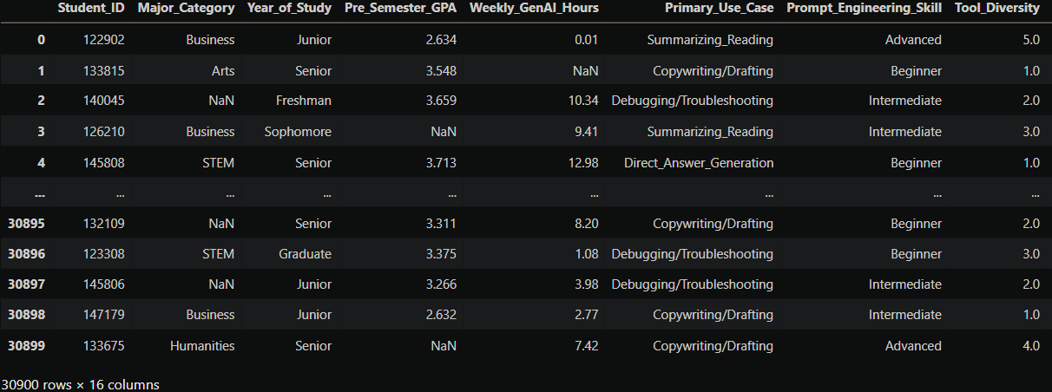
DATASET
30,900
Dataset Information: Uncleaned Data
Total Rows (Students)
16
Total Columns
7
Numerical Columns
9
Categorical Columns
Captures how students use Generative AI tools alongside their academic performance and wellbeing.
Includes behavioural fields (weekly GenAI hours, tool diversity, dependency) and outcome fields (Pre/Post-semester GPA, skill retention, burnout, anxiety).
Source: Public dataset collected for educational EDA practice (Kaggle-style structured CSV).
Innomatics Research Labs | EDA Project
7

Slide 8
OVERVIEW
Data Cleaning & Preparation
Missing Values
Duplicate Records
Categorical columns filled with mode; numerical columns filled with median (robust to outliers).
123 duplicate rows found and removed using drop_duplicates().
Type Correction
Type Casting
Anxiety_Level_During_Exams and Post_Semester_GPA had text/mixed entries — converted to numeric using pd.to_numeric().
Anxiety_Level_During_Exams cast to int; Post_Semester_GPA cast to float for consistent analysis.
Innomatics Research Labs | EDA Project
8

Slide 9
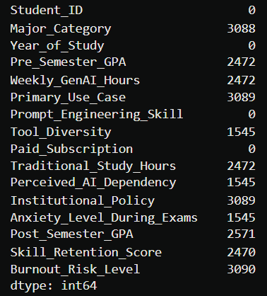
DATA CLEANING
Missing Values & Duplicates — Before / After
30,900
123
30,777
0
Original Rows
Duplicate Rows Removed
Rows After Cleaning
Duplicates Remaining
Missing Values by Column (before imputation)
Innomatics Research Labs | EDA Project
9

Slide 10
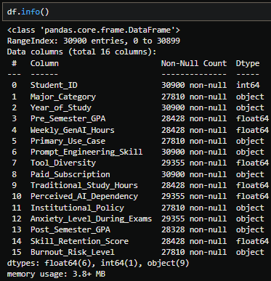
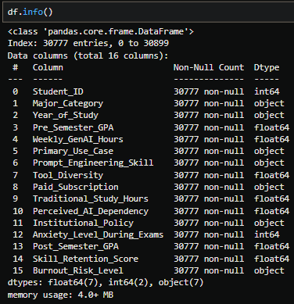
Type Casting
Converted Anxiety_Level_During_Exams from string/object to integer (int) for numerical analysis.
Converted st_Semester_GPA from string/object to float to perform accurate calculations and statistical
operations.
Before Type Casting After type Casting
Innomatics Research Labs | EDA Project
10

Slide 11
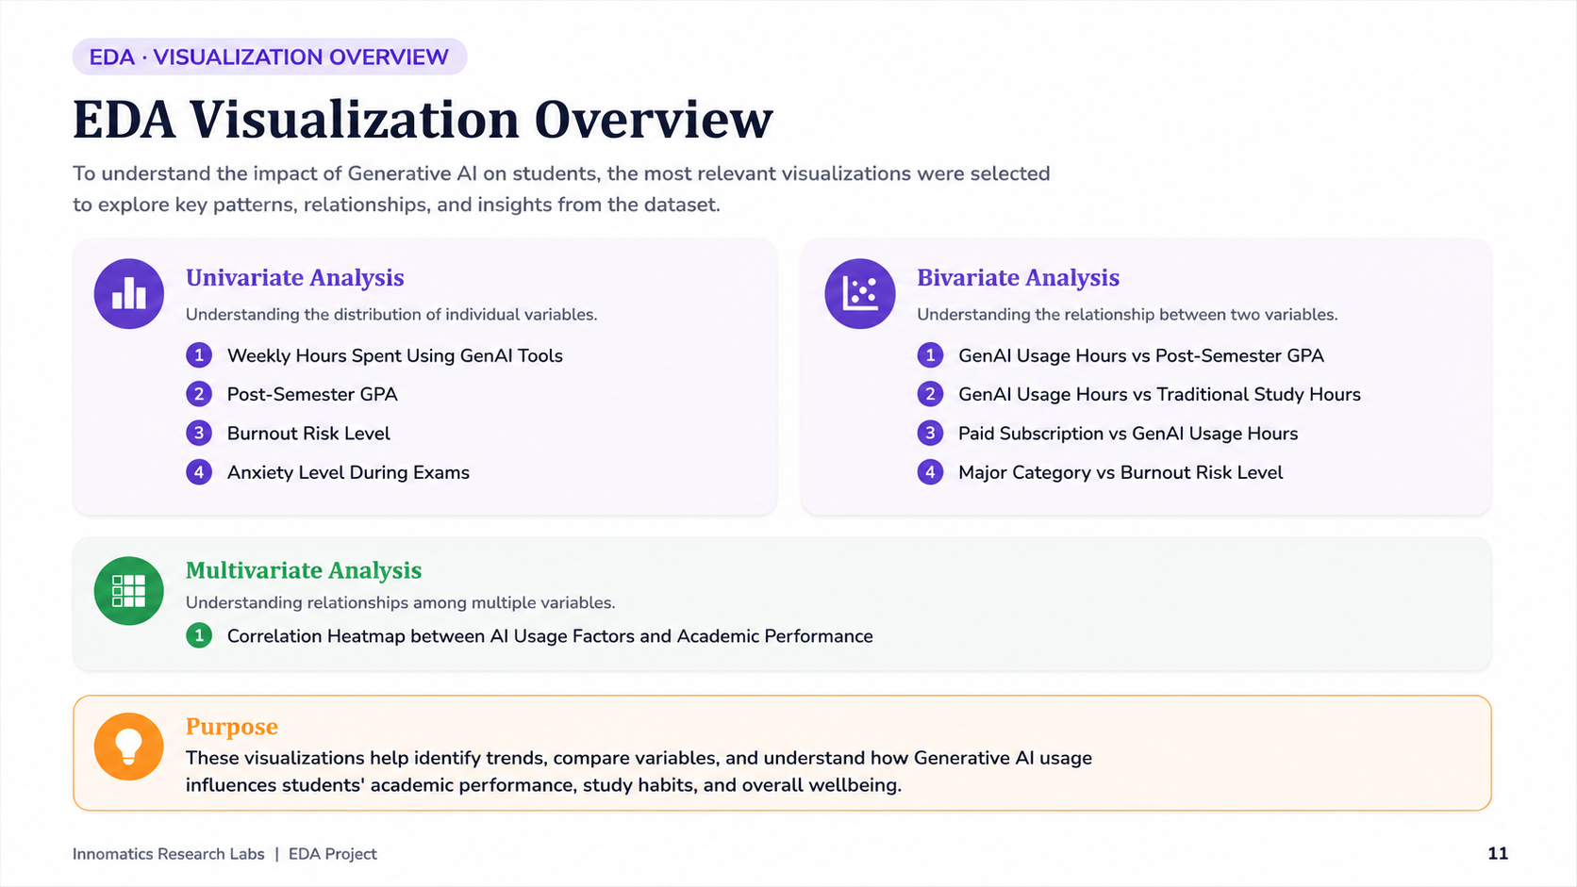

Slide 12
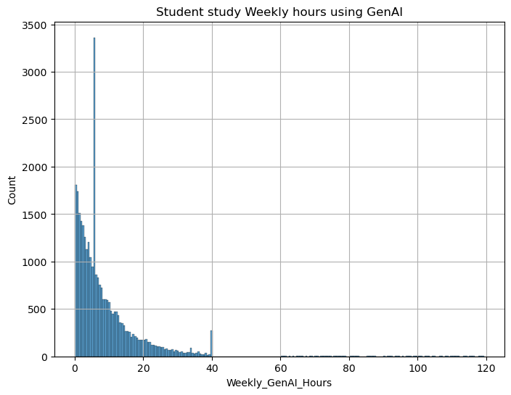
EDA · UNIVARIATE
Weekly Hours Spent Using GenAI Tools
OBSERVATION
This histogram represents the weekly hours students spend using Generative AI.
We can observe that around 3,300 to 3,400 students use AI for approximately 5 to 6 hours per week.
As the number of hours increases, the number of students gradually decreases.
This tells us that most students use AI in moderation, while only a small number are heavy AI users.
Innomatics Research Labs | EDA Project
12

Slide 13
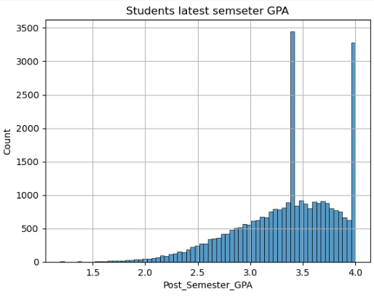
EDA · UNIVARIATE
Post-Semester GPA Distribution
OBSERVATION
This histogram shows the distribution of Post-Semester GPA.
We can observe that around 3,300 to 3,400 students have a GPA close to 3.4.
This indicates that most students achieve good academic performance.
Very few students have extremely low or extremely high GPAs.
Innomatics Research Labs | EDA Project
13

Slide 14
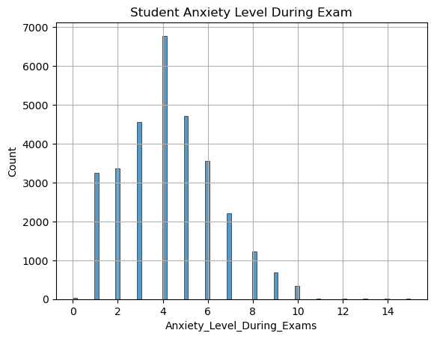
EDA · UNIVARIATE
Anxiety Level During Exams
OBSERVATION
This bar chart represents students' anxiety levels during exams.
We can observe that approximately 6,800 to 6,900 students fall into Anxiety Level 4, which is the highest level.
This tells us that exam stress is common among students, regardless of AI usage.
Innomatics Research Labs | EDA Project
14

Slide 15
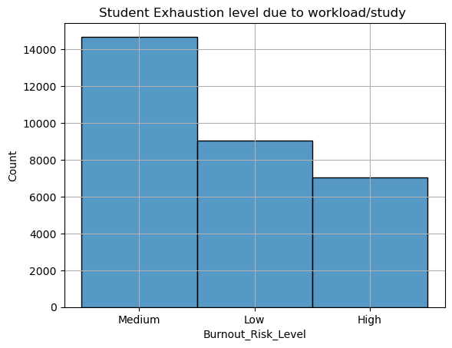
EDA · UNIVARIATE
Burnout Risk Level
OBSERVATION
This graph shows students' burnout risk levels.
We can observe that more than 14,000 students belong to the Medium Burnout category.
This is much higher than the Low and High categories.
Therefore, moderate burnout is the most common among students.
Innomatics Research Labs | EDA Project
15

Slide 16
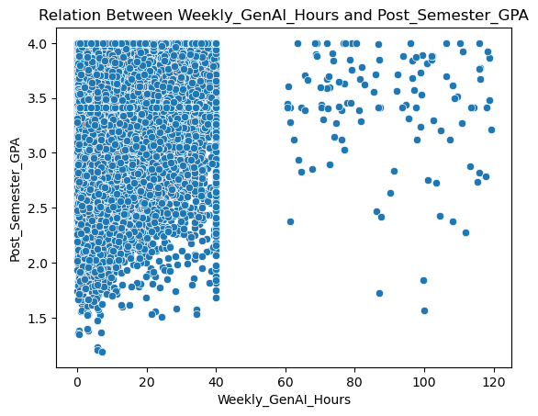
EDA · BIVARIATE
Weekly GenAI Hours vs. Post-Semester GPA
OBSERVATION
This scatter plot compares Weekly GenAI Hours with Post-Semester GPA.
We can observe that students who use AI for around 40 hours as well as students who use AI for around 120 hours are able to achieve GPAs close to 4.0.
Since the points are spread across the graph, there is no clear increasing or decreasing trend.
Innomatics Research Labs | EDA Project
16

Slide 17
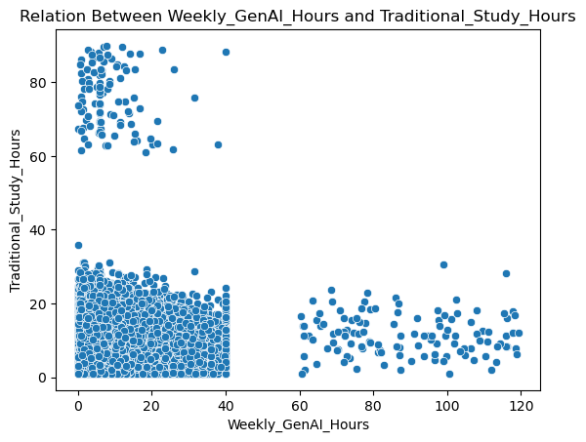
EDA · BIVARIATE
Weekly GenAI Hours vs. Traditional Study Hours
OBSERVATION
This scatter plot compares Weekly GenAI Hours with Traditional Study Hours.
From this graph, we can identify three groups of students.
The first group spends around 40 hours on both AI and traditional study, showing a balanced approach.
The second group spends more time on AI and less on traditional study.
The third group spends more time on traditional study and less on AI.
Innomatics Research Labs | EDA Project
17

Slide 18
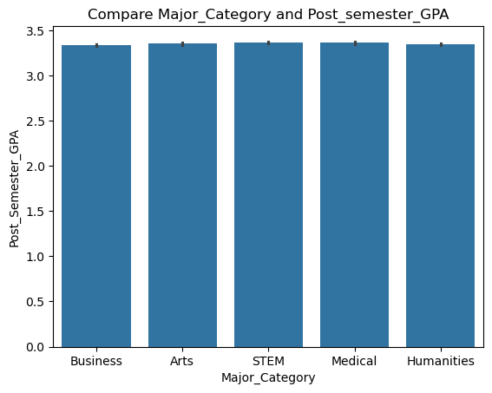
EDA · BIVARIATE
Major Category vs. Post-Semester GPA
OBSERVATION
This graph compares different academic majors with their average Post-Semester GPA.
We can observe that almost every major has an average GPA between 3.0 and 3.5.
Since the GPA range is similar across all majors, we can conclude that academic performance is not strongly influenced by the student's field of study.
Innomatics Research Labs | EDA Project
18

Slide 19
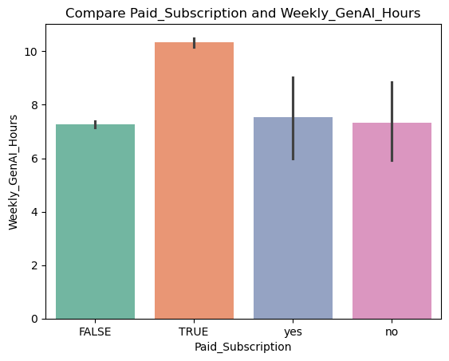
EDA · BIVARIATE
Paid Subscription vs. GenAI Hours
OBSERVATION
This graph compares students with paid AI subscriptions and those using free AI tools.
We can observe that students with paid subscriptions spend more average hours per week using Generative AI compared to students using free versions.
This indicates that paid users tend to rely more on AI tools
Innomatics Research Labs | EDA Project
19

Slide 20
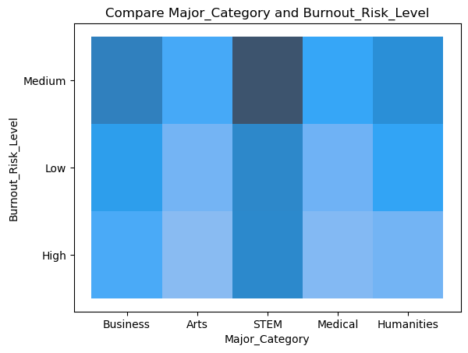
EDA · BIVARIATE
Major Category vs. Burnout Risk Level
OBSERVATION
This graph compares Burnout Risk Levels across different academic majors.
We can observe that every major contains students with Low, Medium, and High burnout levels.
Among them, STEM has the largest number of students in the Medium Burnout category, but this is mainly because there are more STEM students in the dataset.
Innomatics Research Labs | EDA Project
20

Slide 21
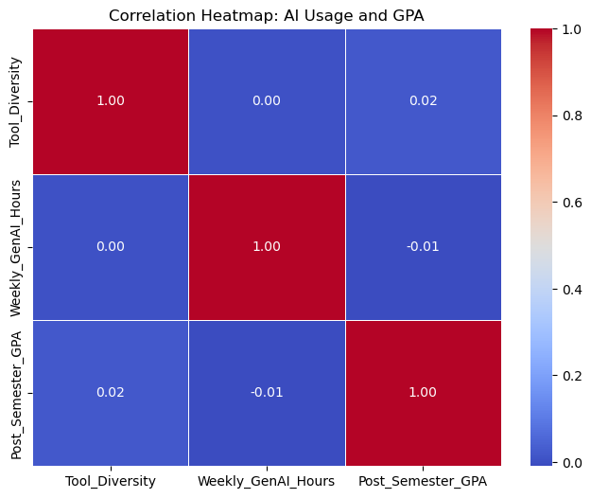
EDA · MULTIVARIATE
Correlation Heatmap: AI Usage vs. GPA
OBSERVATION
The correlation between Tool Diversity and Post-Semester GPA is 0.02, while the correlation between Weekly GenAI Hours and Post-Semester GPA is -0.01.
Since both values are very close to zero, there is almost no linear relationship between AI usage and students' GPA.
Therefore, AI usage alone does not significantly affect students' GPA. Study habits and consistency play a greater role in academic performance.
Innomatics Research Labs | EDA Project
21

Slide 22
REFLECTION
My Experience & Challenges
Messy Data Types
Significant Missing Data
Anxiety_Level_During_Exams and Post_Semester_GPA mixed text labels ("High", "low") with numbers — required careful conversion using pd.to_numeric() before analysis.
Several columns had 5–10% missing values; chose mode for categorical and median for numerical to avoid distorting the distribution.
Counter-Intuitive Results
Choosing the Right Plot
Expected GenAI hours to correlate with GPA, but found ~0 correlation — learned to trust the data over assumptions.
Selecting the right chart type (histplot vs. scatterplot vs. barplot vs. heatmap) for each variable pair took practice and iteration.
Innomatics Research Labs | EDA Project
23

Slide 23
CONCLUSION
Key Findings, Overall
GenAI usage has very little impact on students' GPA. Students who use AI more do not necessarily get better or worse grades.
A large number of students experience medium burnout levels and high exam anxiety, regardless of their field of study.
Students with paid AI subscriptions tend to use AI tools more frequently than students using free versions.
Academic performance remains similar across different majors, suggesting that factors such as study habits and consistency may influence grades more than AI usage alone.
Innomatics Research Labs | EDA Project
22

Slide 24
THANK YOU
Innomatics Research Labs · Innovation. Automation. Analytics.

