Slide 1
Excel Final Assessment
Lokesh
LVADSUSR164

Slide 2
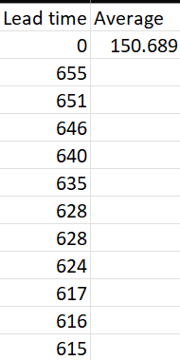
Q1
In the given data there are 3 types of work date available, the work date after the req date, work date done before req date and no work date i.e, no labour has taken the work.
In this case, the work date before the req date has been take and then the total difference between them i.e the lead time has been calculate and recorded in a new column.
Then using the =Averag(A:A) ,the average lead time has calculated.

Slide 3
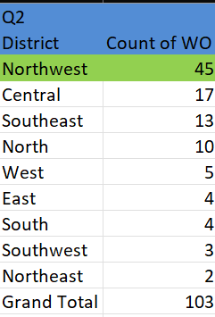
Q2
The northeast district has the most rush jobs. Used the rush hours in filter.

Slide 4
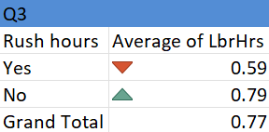
Q3
From the data we can see that there is huge difference on the average labour hours when compared between rush and non-rush jobs.
The non-rush jobs have more labour hours compared to rush jobs.

Slide 5
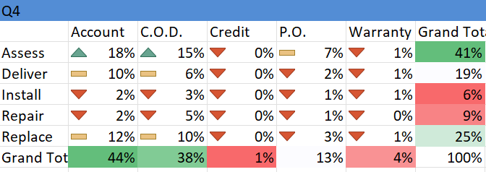
Q4
From this we can see a basic distribution among the service and payment.
In this most of the services are Assess and deliver and the common payment among those is the Account and C.O.D

Slide 6
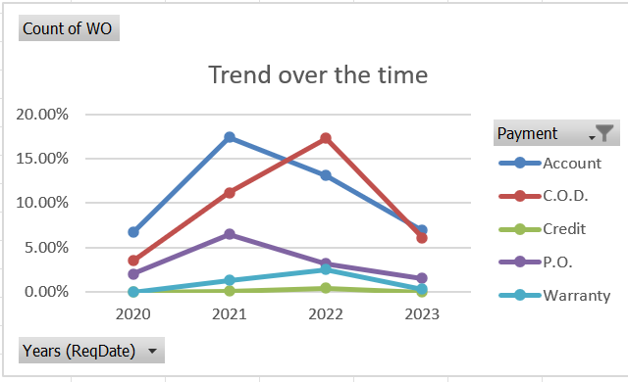
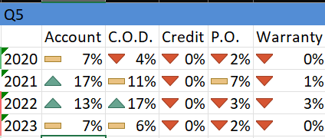
Q5
From the graph we can see that the payments has been increased over the time and again started to decrease over the time as well.

Slide 7
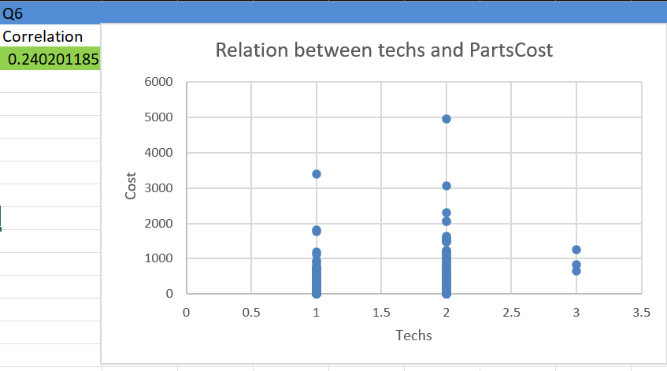
Q6
There is a mild positive correlation i,e a small relationship between the techs required and the parts cost.
So we can say that the techs required slightly affects the parts cost

Slide 8
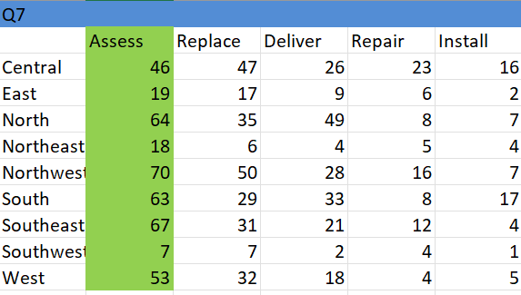
Q7
From the table we can see that Assess is the most commonly required service in each district.

Slide 9
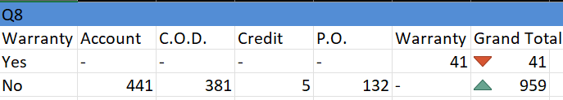
Q8
Yes, there is a relatively huge difference on the payment types on the work orders, when compared to the payments with the warranty labour and without it. Since all the payments on the work order is done by the warranty and all without those are done by the other payments.

Slide 10
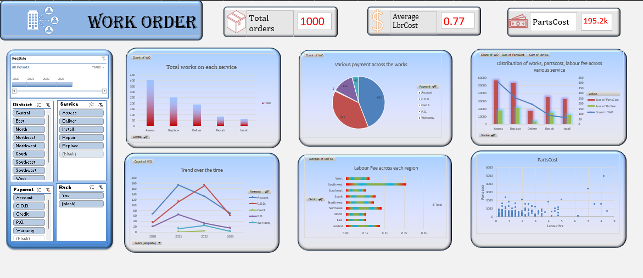
Dashboard

