Slide 1
HELLO EVERYONE !!!
WELCOME TO PYTHON
WORKSHOP

Slide 2
PROJECT TITLE
HIT MAN

Slide 3
ACADEMIC MENTOR
MR.JOEL ANANDRAJ

Slide 4
Industrial mentor
MS.SUBHASHINI.U
ASSOCIATE
KGISL GSS

Slide 5
TEAM MATES
● LOKESH.R
● MANEESHA.S
● KEERTHANA.K

Slide 6
TEAM NAME
YELLOW BLUE

Slide 7
TEAM NUMBER
22

Slide 8
SHORT NOTE
The program works on graphical user interface (GUI),it can process on basic computer. It can be performed by python using pygame module .this program is applicable only in python.

Slide 9
ABSTRACTS
This game Hitman is a fun-oriented game . This game is played by a single player . This game is all about escaping from all the obstacles . Here the player loses the match when he hits a blue man . When the player jumps upon the blue man , he will be awarded 1 point . The player can control the movements using left , right , up and down arrow keys . Multiple enemies will be coming , the player must escape from those obstacles .The player can also hit the enemies by pressing the space bar. When you hit the enemies probably the score will be rewarded, The player should jump or hit the enemies to move for the next level .The background of this game is created with multiple pictures that appears to be in motion . Special effects are added in this game for better gaming experience . The player should not fall in the pit , if he falls then the game ends. Depending upon the player’s performance points will be rewarded.

Slide 10
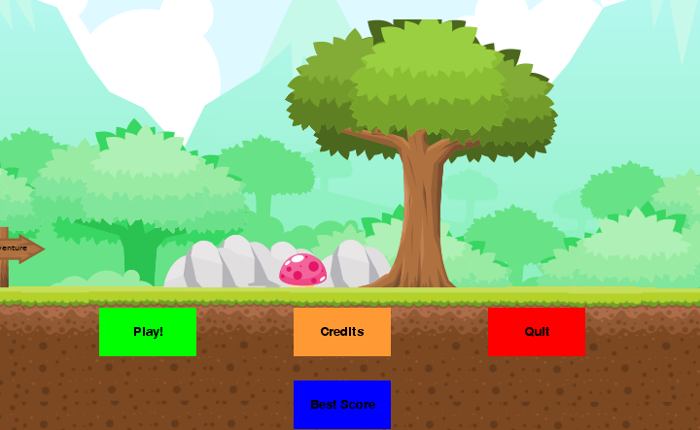
HITMAN

Slide 11
MODULE
INSERT CODE
DOWNLOAD PICTURES
MODIFY THE PICTURES
ADD EFFECT
ADD MUSIC
KEY CONTROLS →UPWARD ARROW
→RIGHTWARD ARROW
→LEFTWARD ARROW

Slide 12
REQUIREMENTS
PROCESSOR : INTELCORE I3
RAM : 2 GB
PACKAGE : PYGAME
LANGUAGE : PYTHON

Slide 13
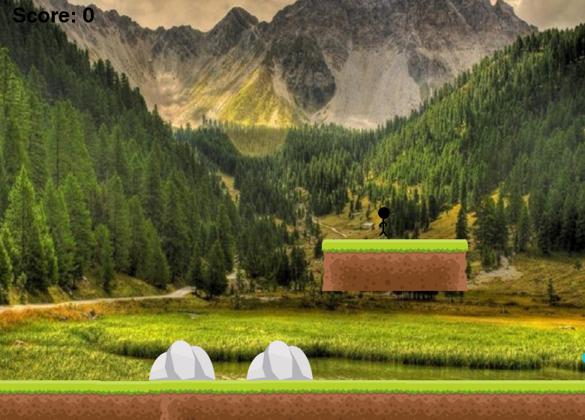
BACKGROUND

Slide 14
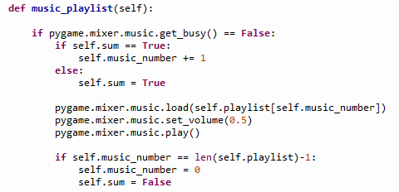
SAMPLE CODE

Slide 15
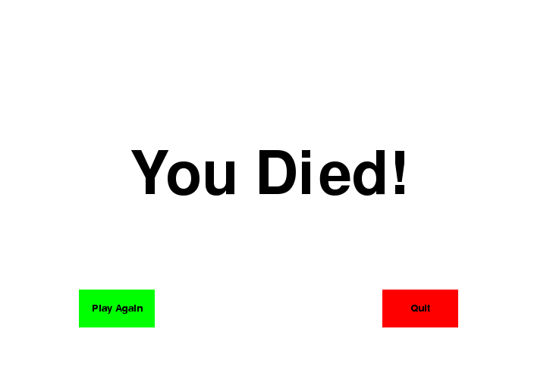
END

Slide 16
THANK YOU

