Slide 1

Minor Project Presentation: Customer Purchase Behavior
Presented by : Lokesh Rawal
Date: 26th April 2024

Slide 2
Introduction
The Customer Purchase Behavior is a dataset that contains data representing customer purchase behavior
It provides knowledge about customer preferences, spending habits, and satisfaction levels.
This project aims to analyze customer purchase behavior data to gain insights into customer preferences, purchase patterns, and satisfaction levels.
The objective is to understand and predict customer behavior to improve marketing strategies and enhance customer satisfaction.

Slide 3
Project Overview
This project involves the analysis of a dataset containing customer purchase behavior data.
Key features include age, gender, income, education, region, loyalty status, purchase frequency, purchase amount, product category, promotion usage, and satisfaction score.
Technologies used include Python, machine learning algorithms, and data visualization tools.

Slide 4
Methodology
This project use CRISP DM methodology approach.
The project used a supervised learning approach to develop predictive models for customer purchase behavior.
Various machine learning algorithms such as linear regression, were employed to analyze the data.
We use different parameters such as Random Forest, Decision Tree to predict training score.

Slide 5
Implementation
The project was implemented using Python programming language.
The project followed a structured approach, including data understanding, preparation, model training, and evaluation.
Libraries such as numpy, pandas, scikit-learn, and matplotlib were used for data manipulation, modeling, and visualization.
This project uses different predictive models like linear regression, decision tree, and random forest.

Slide 6
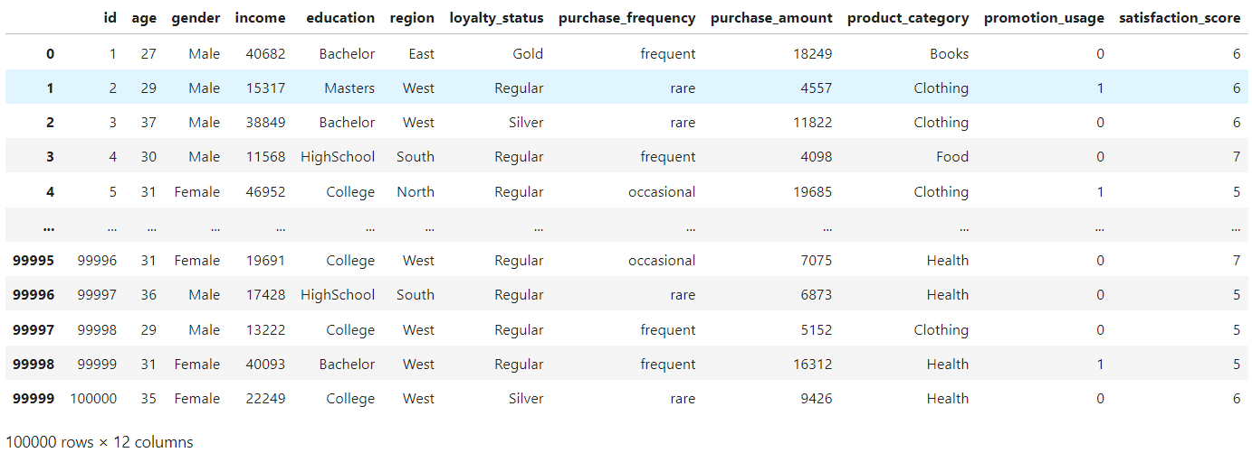
Key Features
This project include 100000 rows and 12 columns in the dataset.
Half of the dataset include numerical features and rest includes categorical dataset.
Satisfaction score is considered as target variable.

Slide 7
Results
Predictive models achieved an training score of 85% in predicting customer purchase behavior using Random Forest.
Accuracy and F1 score of 99% is obtained during model evaluation. Similarly,
Insights into customer preferences and satisfaction levels were obtained.

Slide 8
Challenges Faced
The dataset have an uneven distribution of data which leads to biasness towards majority class. I use SMOTE technique to overcome.
The categorical features needs correct encoding technique before model training. Incorrect encoding introduce noise and impact model performance. To overcome this issue, I use label encoding and one-hot encoding technique.
Outliers in the dataset skew the model’s prediction and affect accuracy. So, identifying and handling outliers is essential. For this, I use Interquartile range to overcome the issue.

Slide 9
Future Work
Incorporating real-time data for more accurate predictions
Enhancing the model with advanced machine learning techniques
Integrating additional features for a comprehensive analysis

Slide 10
Questions and Answers
Feel free to ask any questions you may have about the project!

Slide 11
Contact Information
Name : Lokesh Rawal
Email : lokeshrawal092@gmail.com
Phone : 9869664758

Slide 12
Thank you
Thank you all for taking the time to listen me today and for your attention throughout the presentation.

