Slide 1
Crops Data Analysis
An overview of data insights on crop production and trends

Slide 2
Introduction
This dataset provides a huge amount of information on crop production in India ranging from several years. Based on the Information the ultimate goal would be to predict crop production and find important insights highlighting key indicators and metrics that influence crop production.

Slide 3
Data Details
State Name
Districts Name
Crop Year
Crops
Area
Production
Zone

Slide 4
Key Performance Indicators (KPIs)
Total Production
Total Area
Total States
Total Crops
Total Districts
Total Yield

Slide 5
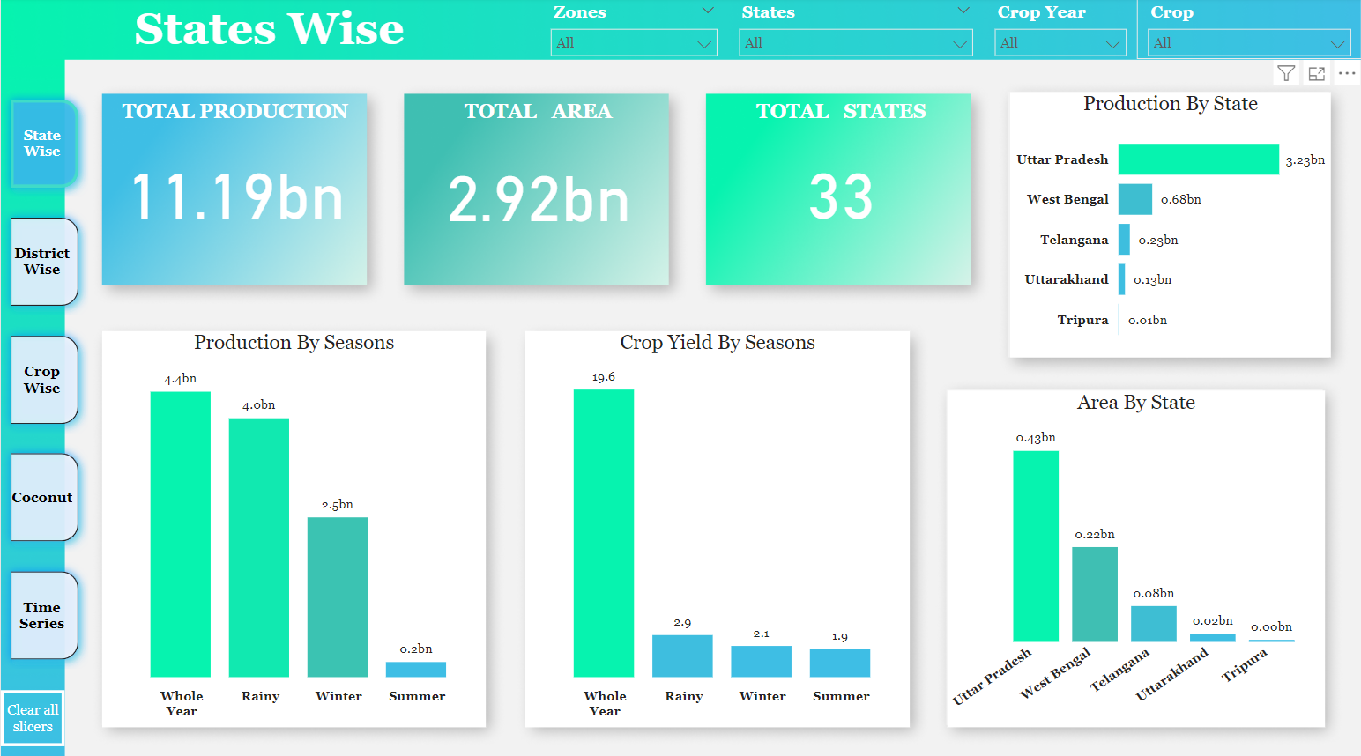
My Design

Slide 6
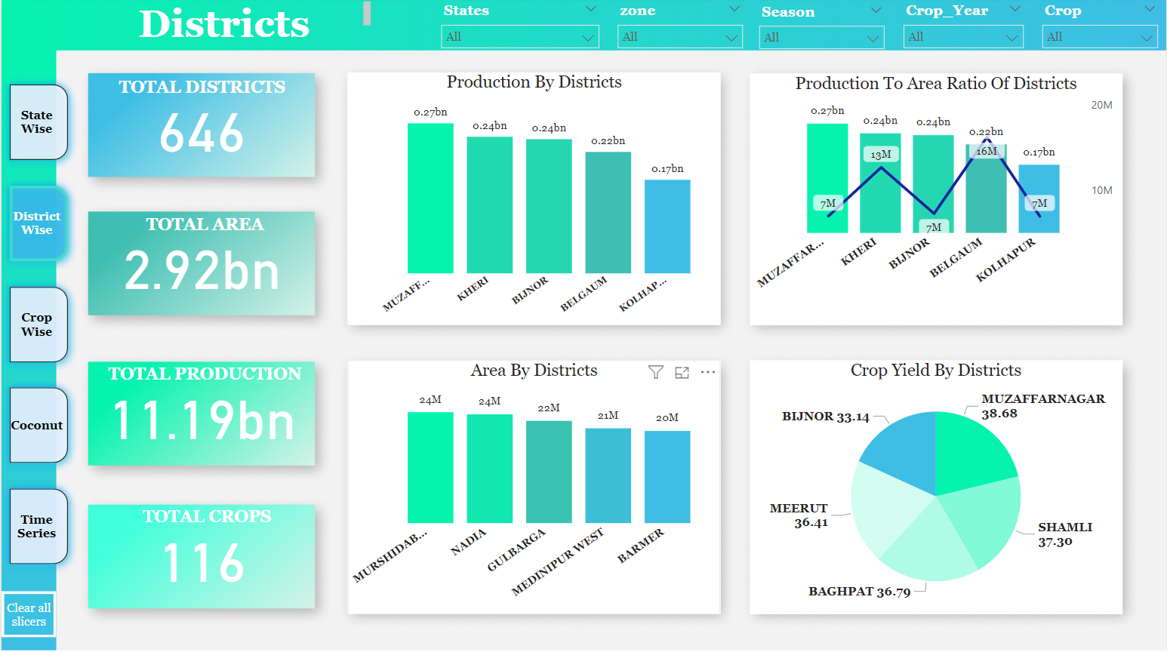
My Design

Slide 7
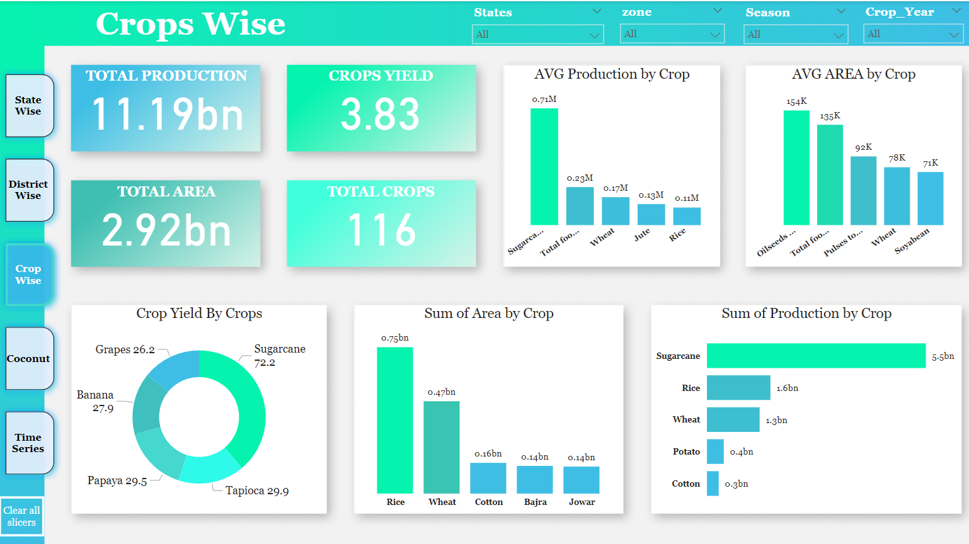
My Design

Slide 8
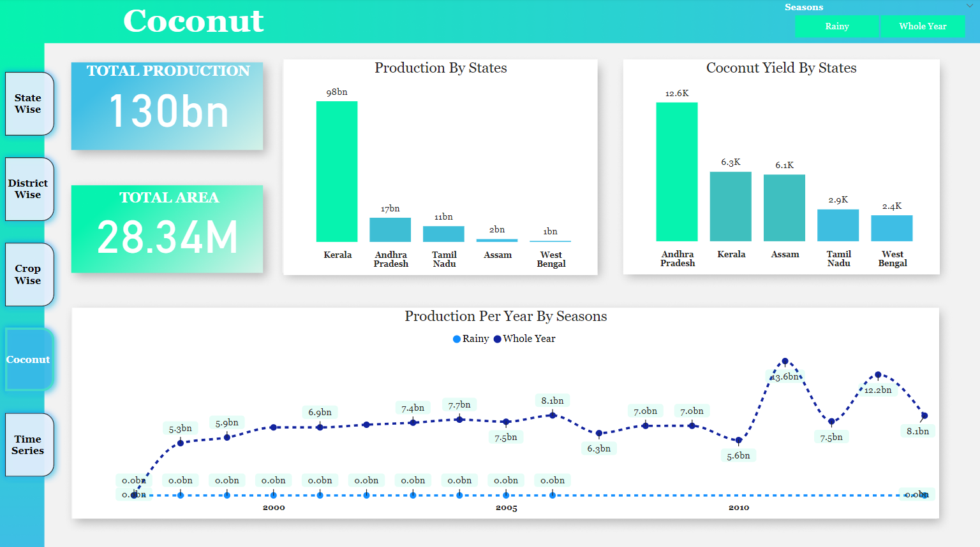
My Design

Slide 9
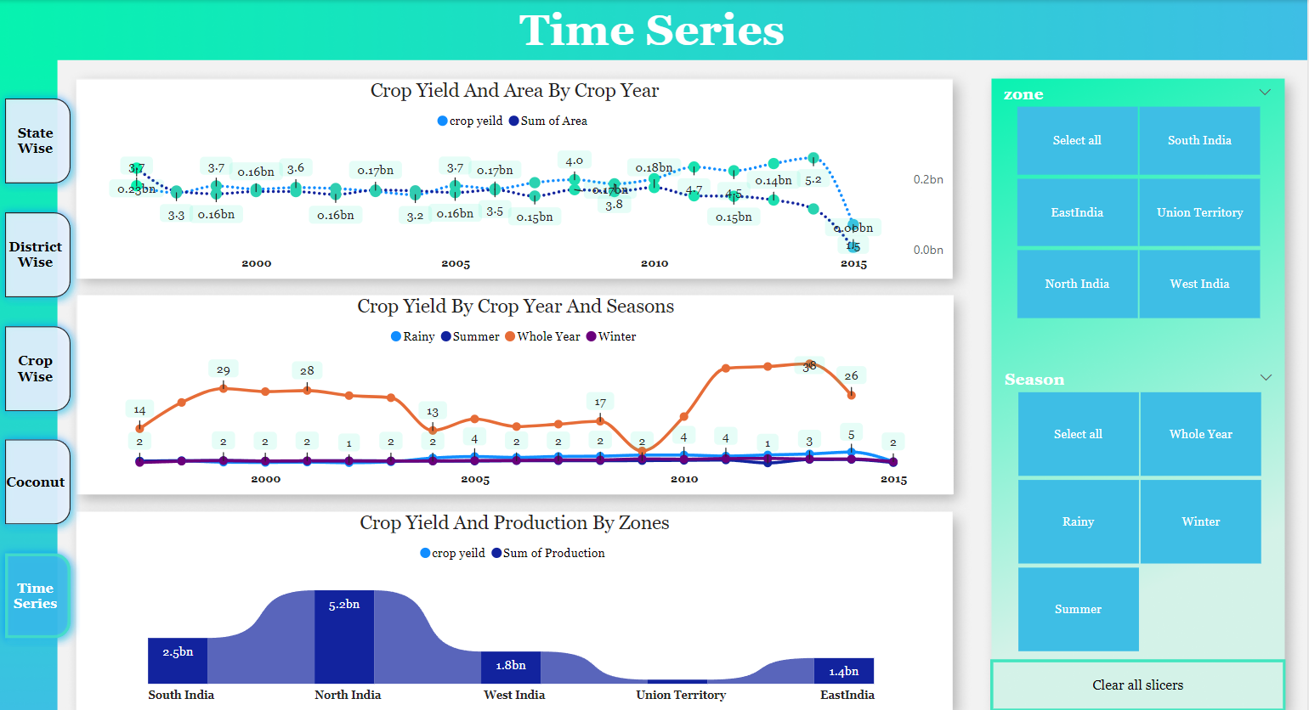
My Design

Slide 10
Analyzed Insights
top 3 crops as per production in india.
total production of sugarcane is highest among all crops
Uttar Pradesh is having highest production and cultivation area among all the states
Maximum production of sugarcane comes throughout the Whole Season
Total production offer rise is second highest among all the crops
West Bengal is having highest production but cultivation area is higher in Uttar Pradesh
Maximum production of rice comes with its sown in rainy season
Total production of wheat is 3rd highest among crops
Uttar Pradesh is having highest production and cultivation area among all the states
Maximum production of wheat comes when it is winter season
Sugercane
Rice
Wheat

Slide 11
Analyzed Insights
North India is having magazine production among all those zones
Top three district to production and cultivation area belongs to Uttar Pradesh
In every state some district are dominating in production and cultivation area like
In West Bengal - Murshidadad, Midnapur west, bardaman
in utter predesh - muzzfer nagar, kheri, Bijnor
if variety of crops are higher in state doesn't mean Maximum production comes from the same state
Karnataka is having highest count of crops but maximum production comes from other state lower variety of cross belongs from Chhattisgarh
Thirty 8 different types of crops are cultivating in 646 districts of India

Slide 12
Analyzed Insights
coconut is having highest production of India
North zone is having zero production of coconut
South Zone is the highest production of coconut
Kerala is having maximum production in South zone which is approximately 75% of total coconut production
Aassam is having maximum production in East Zone

Slide 13
Analyzed Insights
coconut is having highest production of India
North zone is having zero production of coconut
South Zone is the highest production of coconut
Kerala is having maximum production in South zone which is approximately 75% of total coconut production
Aassam is having maximum production in East Zone

Slide 14
Analyzed Insights
Sugarcane potato coconut is having highest yield among all crops
coconut is having highest production of India
North zone is having zero production of coconut
South Zone is the highest production of coconut
Kerala is having maximum production in South zone which is approximately 75% of total coconut production
Aassam is having maximum production in East Zone
Goa is having maximum production in West zone
Sugarcane potato coconut is having highest yield among all crops
Total production and total cultivation area of India is decreasing continuously after 2010
Crop who yield is maximum those crop generally shown in whole year season

Slide 15
Analyzed Insights
Sugarcane potato coconut is having highest yield among all crops
North Zone has highest production in all year among all zones
Indian territory is having lowest production in all areas over all the zone
South zone is having maximum production in whole year season
North Zone is having maximum production from 1997 to 2003 in whole year season and from year 2003 to 2014 in rainy season
West zone is having highest production in whole year season and west zone is having highest in winter season
Wheat Rice Pulses are the most cultivated crop among all crop yield of sugarcane banana in high all seasons
Sugarcane has high yield in rabbi and whole year season
crop yield of sugarcane is high among all crops
cultivation of sugar cane is less but production is high

Slide 16
Analyzed Insights
Sugarcane potato coconut is having highest yield among all crops
Rice production and cultivation is high approximately 84% in rainy season among all crops rice cultivation is high in rainny season but production is second to the sugarcane
Weight production is high approximately 57% in summer season among all the crops
Sugar cane rice wheat has highest production and cultivation in northern zone
Cultivation of Bajrang pulsar soya bin is also good in north zone
rice production and cultivation is high potato jute sugar cane also has good production in east zone
Sugarcane and cotton has highest cultivation and production in west zone
Maze rise and weight has highest production and cultivated in union teritorys

Slide 17
Thank You
Thank you for your attention. We look forward to your questions and feedback.

