Slide 1
Entertainer Data Analysis
An overview of data insights on entertainers

Slide 2
Introduction
Normal life can be stressful, and people need to relax. Being entertained by others is a wonderful way to take some time out of life. It can reduce stress and make life's issues easier to face
Applications of SkillsThe media and entertainment industry consists of film, television, radio and print. These segments include movies, TV shows, radio shows, news, music, newspapers, magazines, and books. The entertainment industry is a group of sub-industries devoted to entertainment.

Slide 3
Data Details
.
Entertainer
Birth Year
Year Of Breakthrough
Year Of First Award
Year Of First Award
Name Of Breakthrough
Gender
Year Of Death
Year Of Last Major Work
Total Award Won
Profession
Total Nominees
Other Awards
Oscar Won
Award From Breakthrough
Grammy Awards
Emmy Awards

Slide 4
KPIs
Total Awards Won :-
The amount of awards and individual entertainer won
Total Nominees:-
The amount of time individual entertainer is nominated for an award
Career Longitivity :-
The number of years the entertainer was in entertainment industries

Slide 5
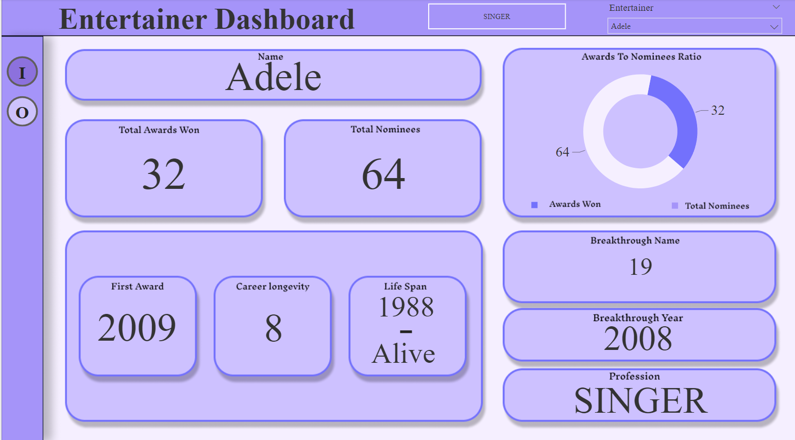
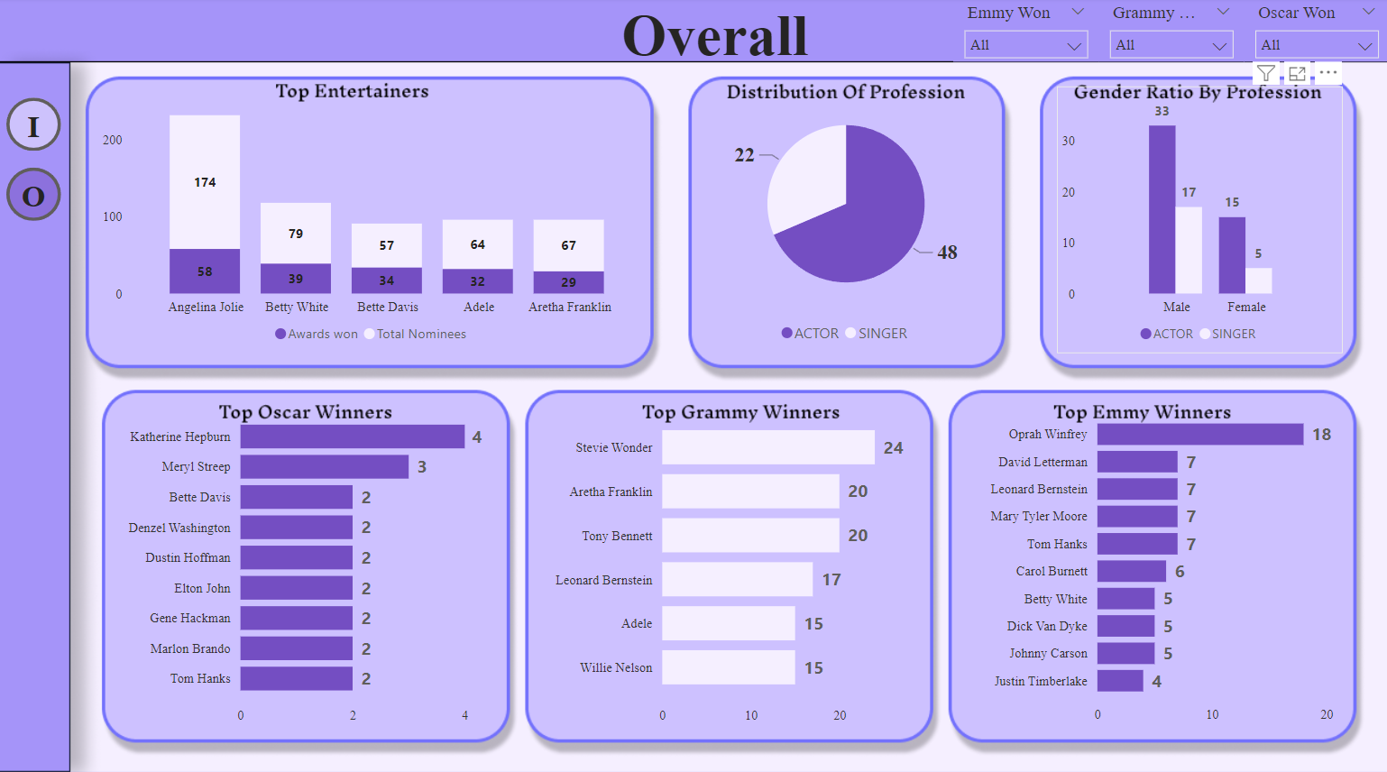
My Design
.

Slide 6
Analyzed Insights
Insight 1: The profession distribution is 22:48 where 31 .5% of are singers and 68.5% of actors.
Insight 2: Gender ratio Distribution is 5:2 that is 71.5% of male and 28.5% of female.
Insight 3: Gender profession distribution are as follows :-
There are 50 males in which 17 are singers and 33 are actors which means 34.5% are singers and 65.5% are actors
There are 20 females in which 5 are singers 15 are actors which means 25% are singers and 75% are actors
Insight 4: The maximum number of Oscar Award is won by Katherine Hepburn which are 4 Oscars.
Insight 5: The maximum number of Grammy Award is won by Steve Water which are 24 Grammy

Slide 7
Insight 6: The maximum number of Emmy Award is won by Opran Winfrey which are 18 Emmy
Insight 7: The top entertainer is Angelina Jolie she is 174 times nominated and won 58 awards in total with career spam of 17 years
Insight 8: Debbie Reynolds and Cary Grant does not want a single Oscar Grammy and Emmy Award they have won 20 and 12 other awards
Insight 9: Mikey Jagger is the only singer to watch an Oscar award

Slide 8
Thank You
Thank you for your attention.

