Slide 1

Tin Machine (Automating Tinder Swipes) Deep Learning Project
By -
Lokesh Vadlamudi
Nupur Yadav

Slide 2

Content
Introduction
Deployment Design
Steps Followed
Data Collection and Preprocessing
Models Trained
Training summary for CNN model 2 architecture
Tensorboard Visualization
Model Deployment
Application Screenshots
Conclusion

Slide 3
Introduction
This project is based on Image feature recognition.
We have tried to automate swiping to left or right on Tinder platform using our trained models based on one’s preferences.
We have built two models one in Fastai and the other in Keras to see which one fared better for our task. We have also fine tuned these models based on hyperparameters to improve their accuracies.
We have used several evaluation metrices to compare performances of these models and tensorboard visualization.
The final model has been deployed on AWS, which is taking images from our tinder account in real time and displaying the images on UI (3 at a time), and whether they have been liked or disliked based on the already trained model on our preferences.
Link to application : http://ec2-54-176-2-190.us-west-1.compute.amazonaws.com/

Slide 4
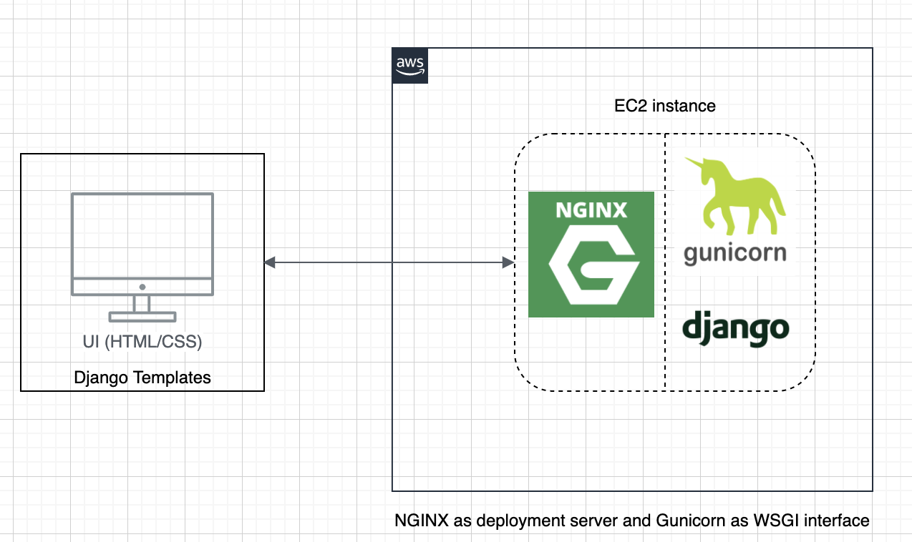
Deployment Design

Slide 5
Steps Followed
Analysing Tinder Api calls
Collecting images from Tinder as part of Data Collection process
Preprocessing the Data (includes resizing data, grayscaling, data augmentation)
Annotating the images manually as “Like (=1)” and “Dislike (=0)” based on our choice of preference using ImageClassifier script
Training FastAi and Keras models based on annotated images
Fine tuning the models based on several hyperparameters to improve their accuracies
Evaluating the models based on different evaluation metrices to come up with the best model
Saving the final model for deployment
Deploying the model on AWS using Django framework (Created an application in Django where we are loading the trained model , getting live images using Tinder “nearby_persons” API and classifying those as like or dislike in real time based on inference from trained model)

Slide 6
Data Collection and Preprocessing
For data collection we have used Tinder API <https://api.gotinder.com> with Facebook auth token for authentication.
We stored the data collected to our google drive and manually annotated the collected images as “like (=1)” and “dislike (=0)” based on our choice of preference into two separate folders using our ImageClassifier script.
As part of data preprocessing, we then resized the images, grayscaled them, and also used data augmentation techniques for enrichment.
For train-test split, we chose the ratio of 3:1 after several observations while training models to get the max accuracy.

Slide 7
Models Trained
Once we had the labelled data based on our choice of preference, we trained two separate models one in FastAi and the other in Keras.
We trained Resnet34, Resnet50 and CNN models with different architectures.
We fined tuned these models on several hyperparameters such as learning rate, no of hidden layers, activation functions at different layers, using various dropout rates, batch normalization layers, max-pooling etc.
The CNN model 2 architecture (can be seen in colab) gave the best accuracy of approx. 86%
We then saved the best model weights for generating future inferences.

Slide 8
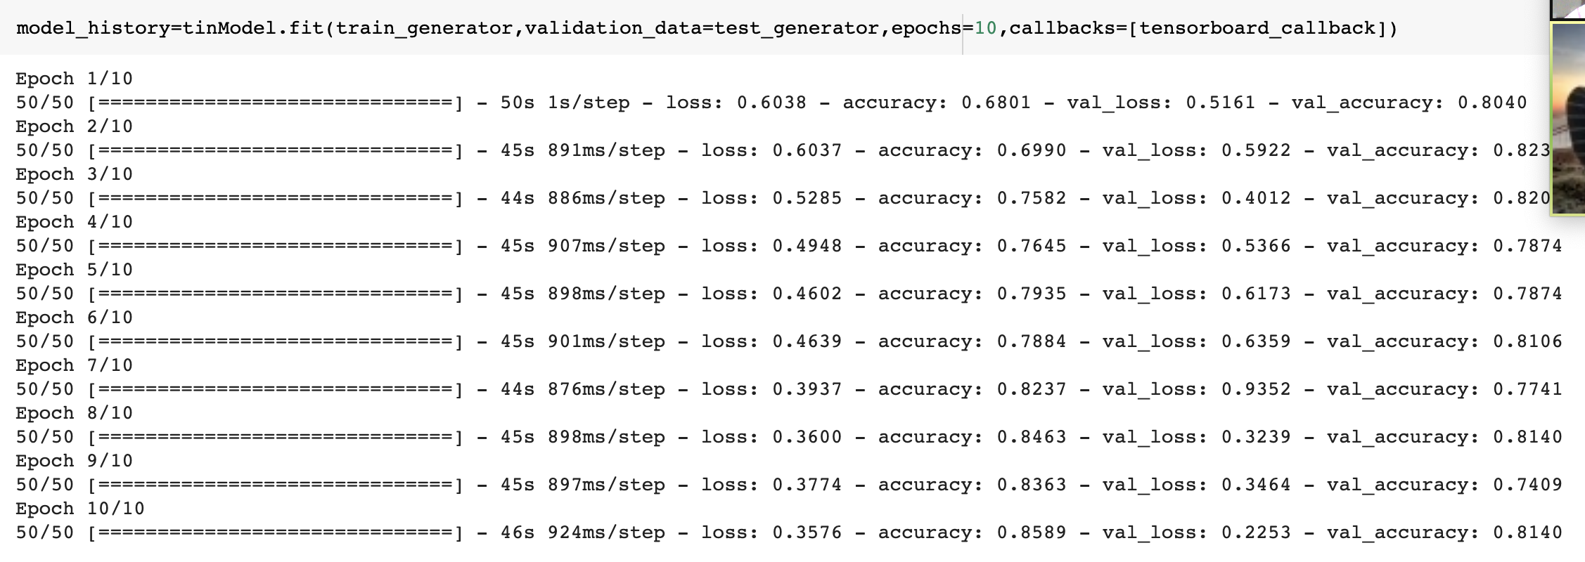
Training summary for CNN model 2 architecture

Slide 9
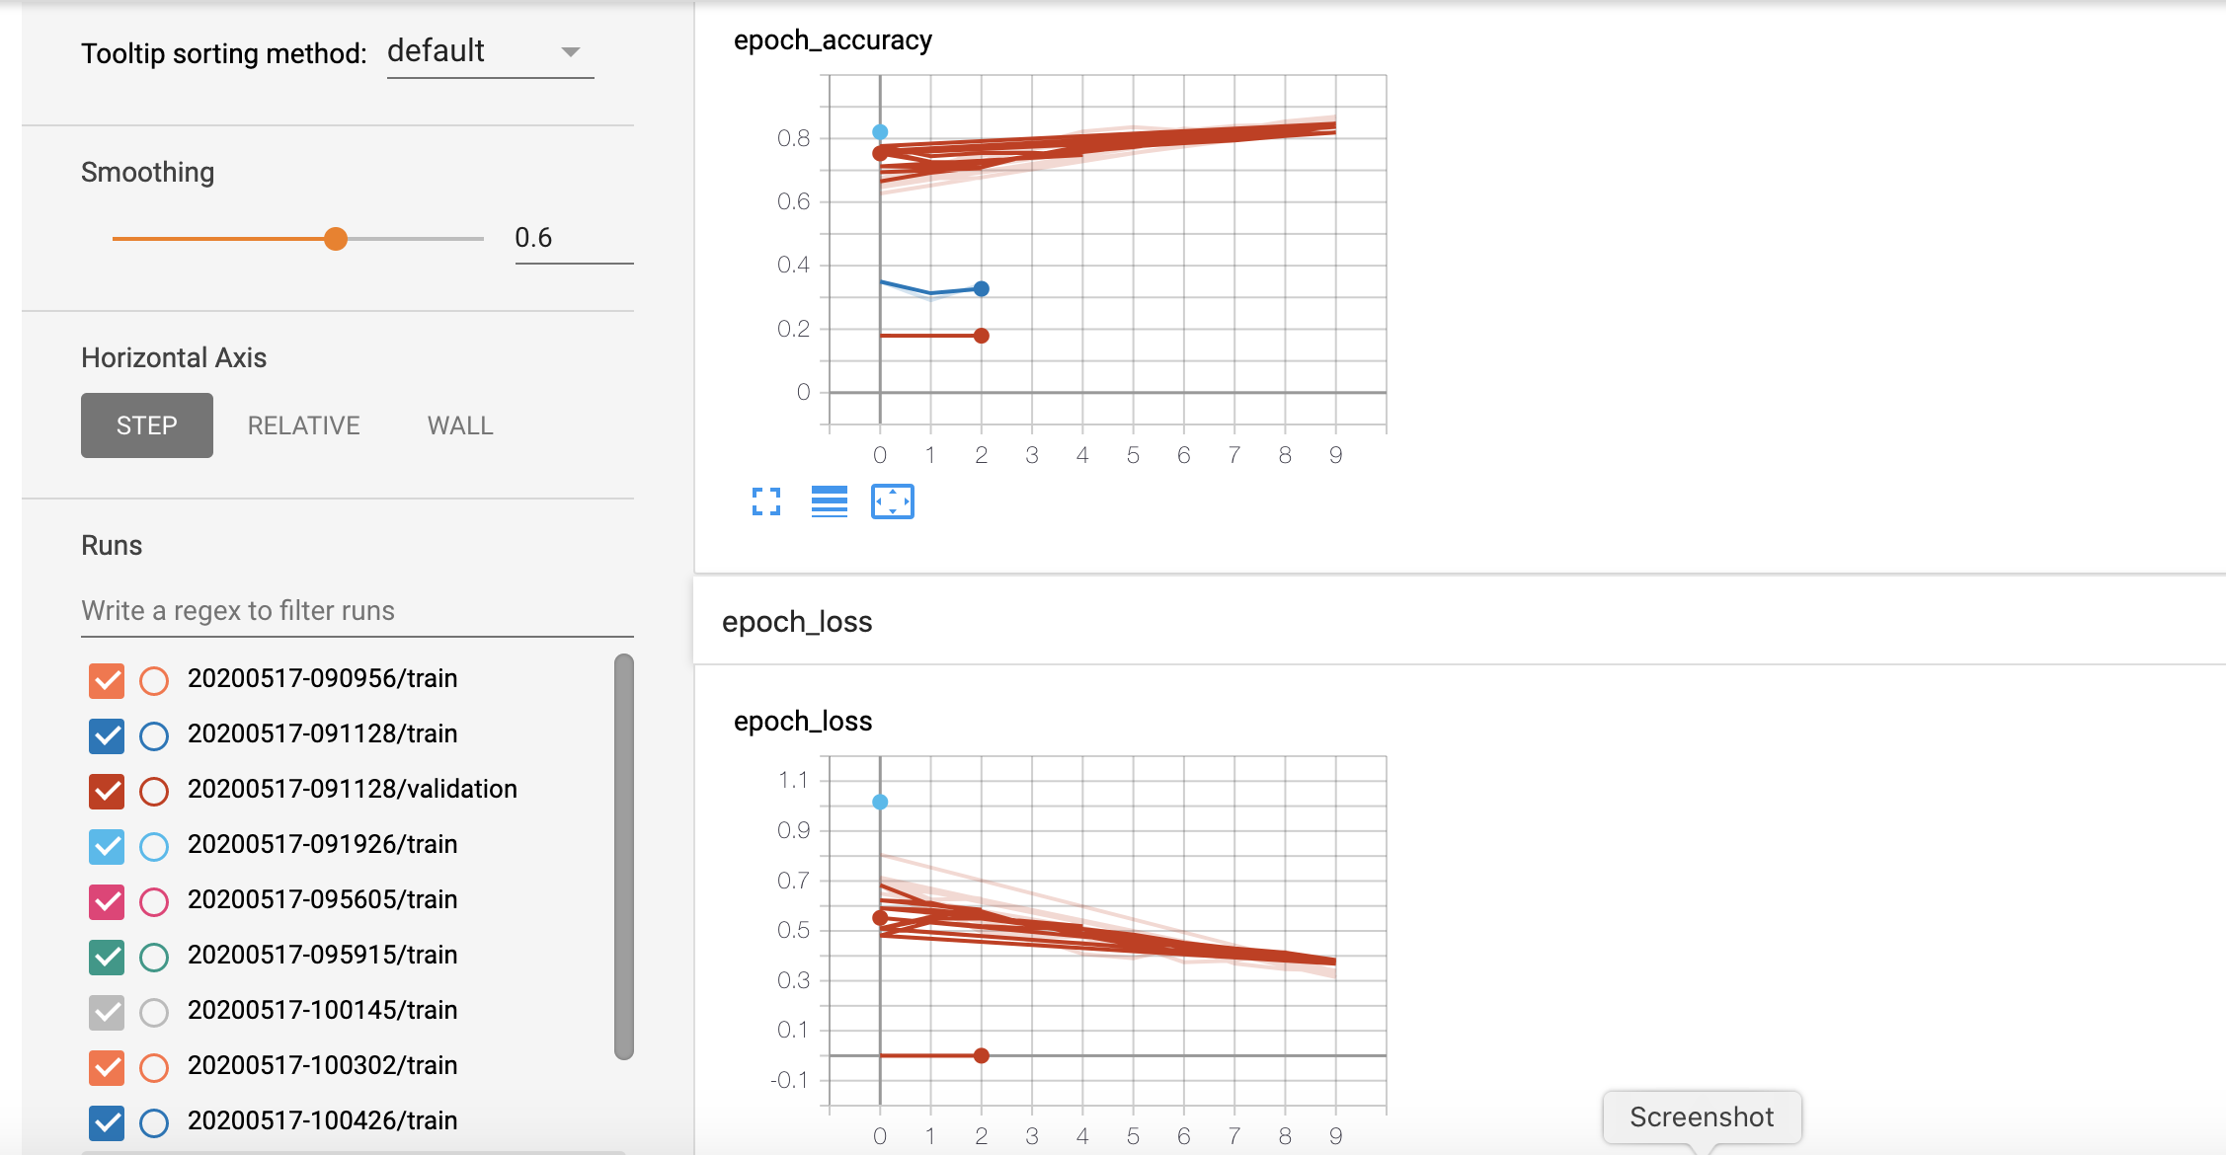
Tensorboard Visualization

Slide 10
Model Deployment
We built a python application using Django Framework to deploy our model on AWS. Following is the link : http://ec2-54-176-2-190.us-west-1.compute.amazonaws.com/
The UI is implemented in HTML/CSS using Django templates
On the server side we have used NGINX as our production deployment server with Gunicorn as WSGI interface between NGINX and Django framework.
Whenever a user hits the URL, it is loading the already trained model.
And when a user clicks on “Click to Start Magic” button, it is getting the images from the Tinder account using the auth token id and “nearby_persons” API in real time, running the inference model on these images and displaying the images on the UI (3 at a time) with name and inferred labels as “Like” or ”Dislike”.

Slide 11
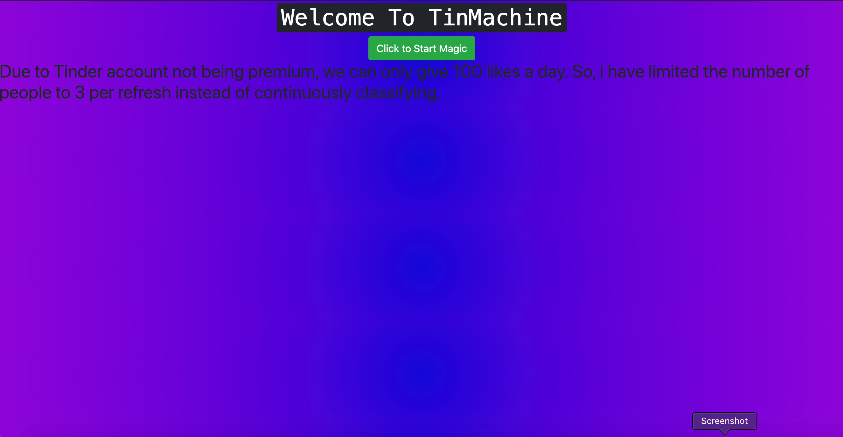
Application Screenshots

Slide 12
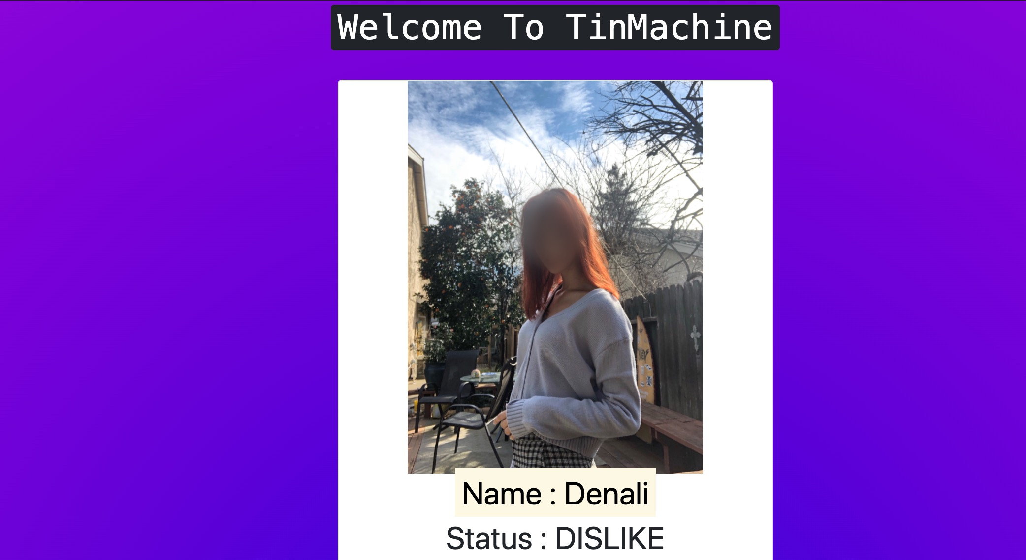
Application Screenshots

Slide 13
Conclusion
We tried to automate Tinder swipes and used CNN model for the image classification task which was trained on one’s choice of preferences.
The accuracy we achieved was approx. 86% , but we are sure this can be improved with further model tuning, better annotation and large datasets
As future work, we will allow any Tinder user to train model based on his/her choice of preference using their xauth token id to automate Tinder swipes instead of doing it manually.

