Slide 1
Img2Mol -Converts molecule images to SMILES
Team 37:
Sri Anvith Dosapati
Avyukta Manjunatha
Lokesh V.
Mugundan Kottur Suresh

Slide 2
Goal Of Paper
01
02
Scan Molecules
Generate SMILES
The molecule is scanned and stored in an intermediary form
The intermediary is coverted to Canonical SMILES form

Slide 3
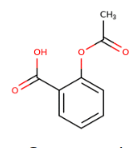
What is SMILES?
Chemical File Format
Machine understandable encoding of a molecule
SMILES
Human Readable
One of the few encodings that are also human readable
CC(=O)OC1=CC=CC=C1C(O)=O
Many Encodings Possible
Same Molecule – Different SMILES – Based on Algo
Canonical SMILES
Same representation for all molecule representations

Slide 4
Why convert images to SMILES?
Papers often store important molecules as images rather than the actual sequence for immediate use by other papers or research
Thus, there is a lot of time wasted on understanding the paper and decoding images in papers
This model helps automate that process

Slide 5
Previous Work
The authors of the paper reuse a model from a previous paper of theirs in this paper, and they do not go deep into the workings of that model
The previous paper converts any SMILES representation to a canonical SMILES representation
It did so using an autoencoder that had 2 parts. An encoder that converts SMILES to an intermediate CDDD embedding, and a decoder that converts the CDDD embedding to canonical SMILES.
The current Img2Mol model reuses the decoder that was initially used and merely trains a new CNN model that converts images to the CDDD embedding

Slide 6
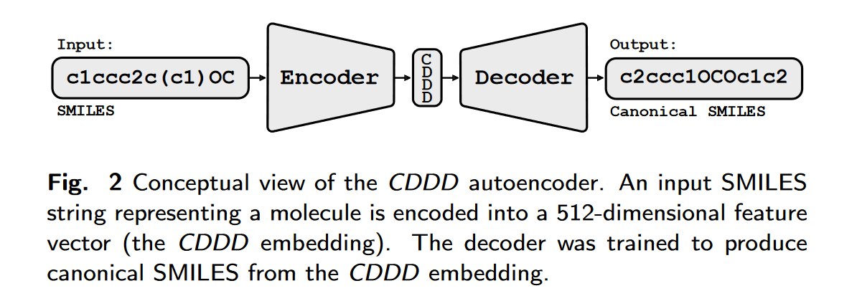
Previous Model

Slide 7
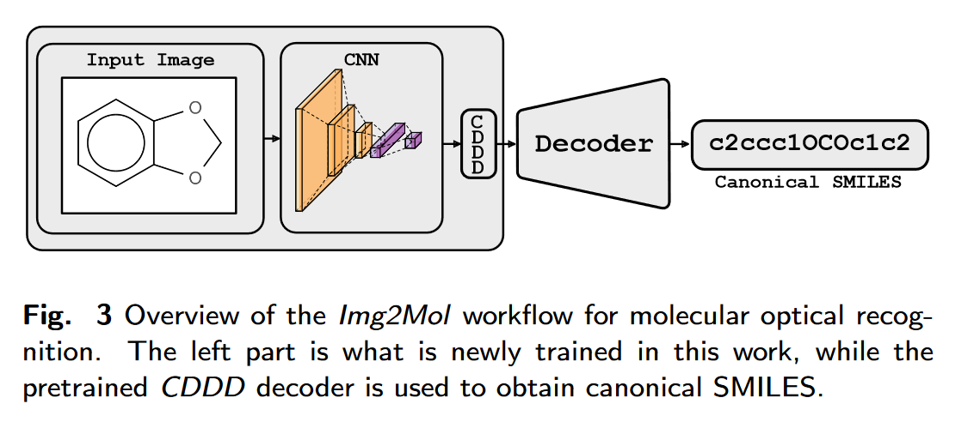
Img2Mol Model

Slide 8
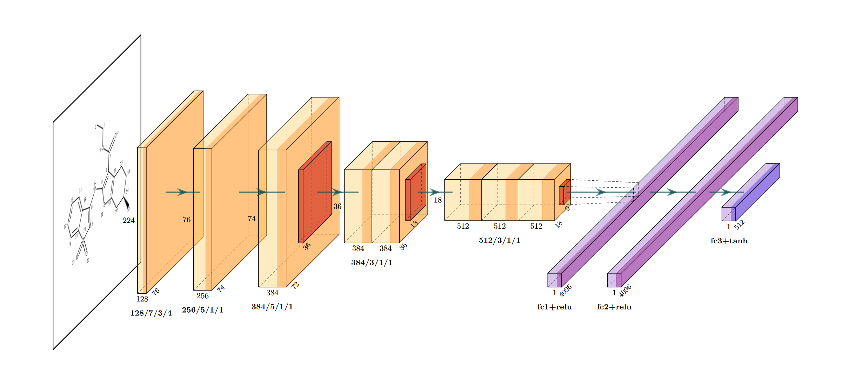
The CNN used

Slide 9
Datasets used during training in the Paper
01
Img2Mol
AI
UoB
02
25000 images
224x224 pixels
5716 images
762x412 pixels
Training and Testing Data
03
STAKER
CLEF
04
30000 images
256x256 pixels
711 images
1243x392 pixels
05
USPTO
JPO
06
4852 images
649x417 pixels
365 images
607x373 pixels

Slide 10
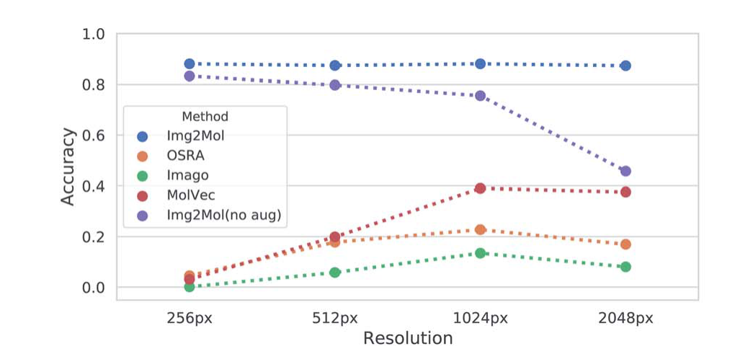
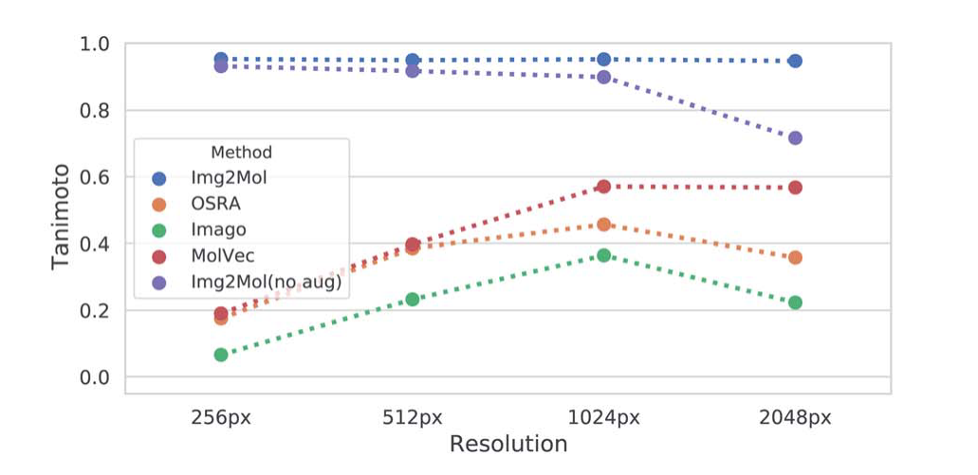
Accuracy compared to other Models

Slide 11
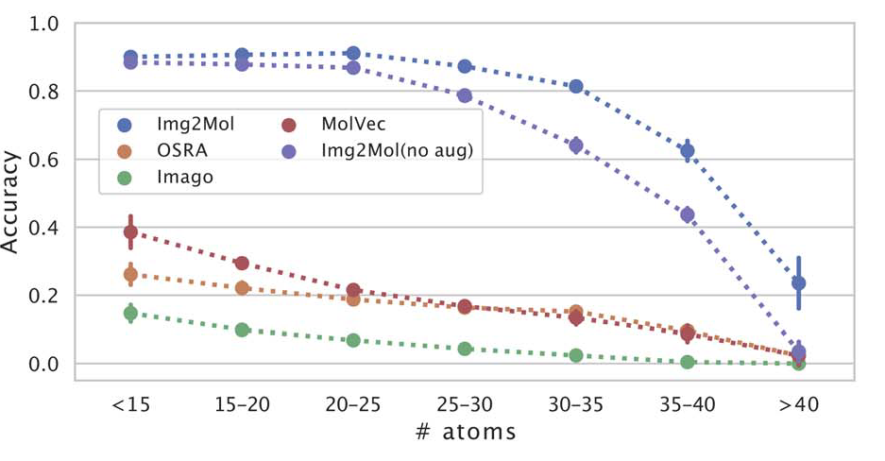
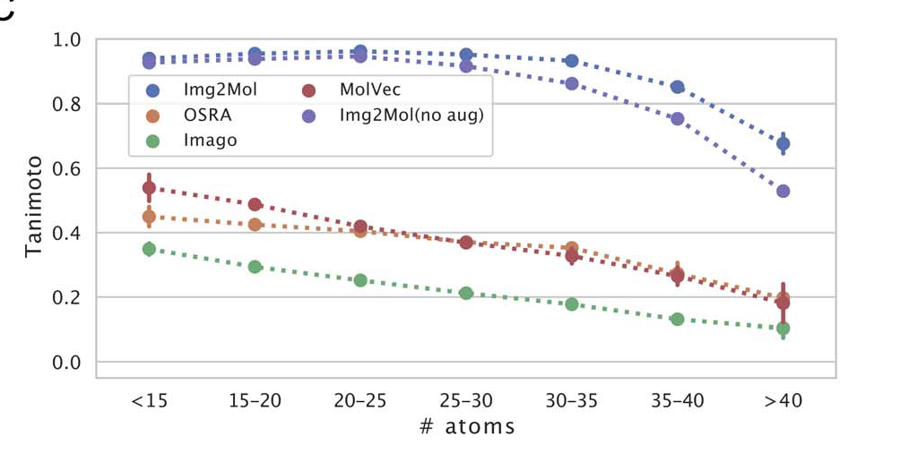
Accuracy compared to other Models

Slide 12
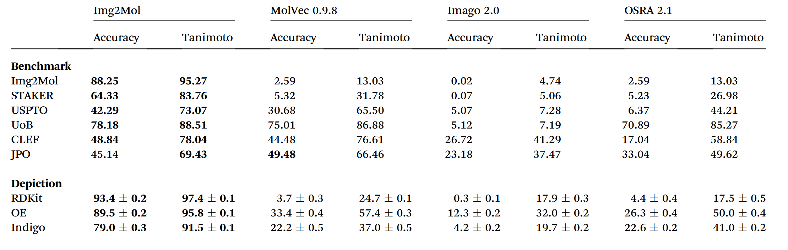
Accuracy Table

Slide 13
Timeline
7th November – 15th November Theory and Understanding the Paper
15th – 19th Implementation of Paper
19th – 21st Training
22nd - Confirming results and Miscellaneous

