Slide 1
CAPSTONE PROJECT
Mutual Fund Analytics
Bluestock FinTech Internship
Student: ALLA LOKESH
College: Ellenki College of Engineering and Technology
Department: CSE (AI & ML)

Slide 2
Table of Contents
01
Project Overview
07
Project Setup
02
Problem Statement
08
Data Cleaning
03
Objectives
09
Exploratory Data Analysis (EDA)
04
Tools & Technologies
10
Performance Analytics & Power BI
05
Project Workflow
11
Results & Conclusion
06
Dataset Description
Mutual Fund Analytics | Bluestock FinTech Internship
2

Slide 3



Project Overview
Mutual funds are a popular way to invest with professional management. This capstone analyzes mutual fund datasets to reveal investment trends, investor behavior, and fund performance. The goal is practical: prepare cleaned data, compute performance metrics, and present findings in an interactive Power BI dashboard for easy decision-making.
What We Analyze
End Product
Tools
NAV history, scheme performance metrics, and investor transactions.
Interactive Power BI dashboard with KPIs and filters for exploration.
Python, SQLite, and Power BI for analysis and visualization.
Mutual Fund Analytics | Bluestock FinTech Internship
3

Slide 4


Problem Statement
Investors struggle to compare mutual funds because large, scattered financial information makes direct comparison hard. This project aims to clean, organize, analyze, and visualize mutual fund data so investment choices become clearer and quicker for users.
Focus: make comparisons simple through metrics and interactive visuals.
Scattered data makes
comparison hard.
Clear metrics make it simple.
Mutual Fund Analytics | Bluestock FinTech Internship
4

Slide 5




Objectives
Understand Data
Clean Datasets
EDA & Metrics
Dashboard
Explore NAV, performance metrics, and investor transactions.
Remove duplicates, fix types, and format dates.
Perform EDA, compute CAGR, Sharpe, Alpha/Beta, drawdown.
Build an interactive Power BI dashboard with KPIs and slicers.
Mutual Fund Analytics | Bluestock FinTech Internship
5

Slide 6
Tools & Technologies
Python (Pandas, NumPy)
Power BI for interactive dashboards
Matplotlib, Seaborn
CSV / SQL for storage and interchange
SQLite
Design note: white background, blue headings, simple icons used across the report.
Development: VS Code, Jupyter Notebook, Git & GitHub.
Mutual Fund Analytics | Bluestock FinTech Internship
6

Slide 7



Dataset Description
The project uses three datasets: NAV History (daily NAVs), Scheme Performance (returns, Sharpe, Alpha, Beta, CAGR, Max Drawdown), and Investor Transactions (age group, gender, city, state, transaction type, amount). These datasets enable time-series analysis, fund comparisons, and investor-segmentation insights.
NAV History
Scheme Performance
Investor Transactions
amfi_code, date, nav — daily NAV records used for time-series analysis.
fund house, category, plan, 1yr/3yr/5yr return, Sharpe, Alpha, Beta.
investor id, transaction type, amount, city, state, age group, gender.
Mutual Fund Analytics | Bluestock FinTech Internship
7

Slide 8
Project Setup & Data Cleaning
1
→
2
→
3
Project Setup
Data Cleaning
Database
Created folders, installed libraries, configured Jupyter, loaded datasets, and verified structure.
Removed duplicates, handled missing values, fixed types, renamed columns, formatted dates, and saved cleaned CSVs.
Imported cleaned data into a SQLite database for efficient queries.
Mutual Fund Analytics | Bluestock FinTech Internship
8

Slide 9
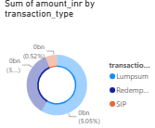
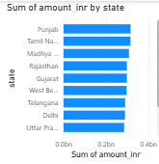
Exploratory Data Analysis (EDA)
EDA explored investor behavior and fund patterns: age group, gender split, state-wise investment, transaction types, monthly trends, and city-tier activity. Key observations: most investments came from the 26–35 age group, SIP was the common investment type, and metro cities showed higher activity.
Age Group
Transaction Type
State-wise
26–35 is the dominant investor group.
SIP is the most common investment method.
Some states contribute higher total investments.
Mutual Fund Analytics | Bluestock FinTech Internship
9

Slide 10
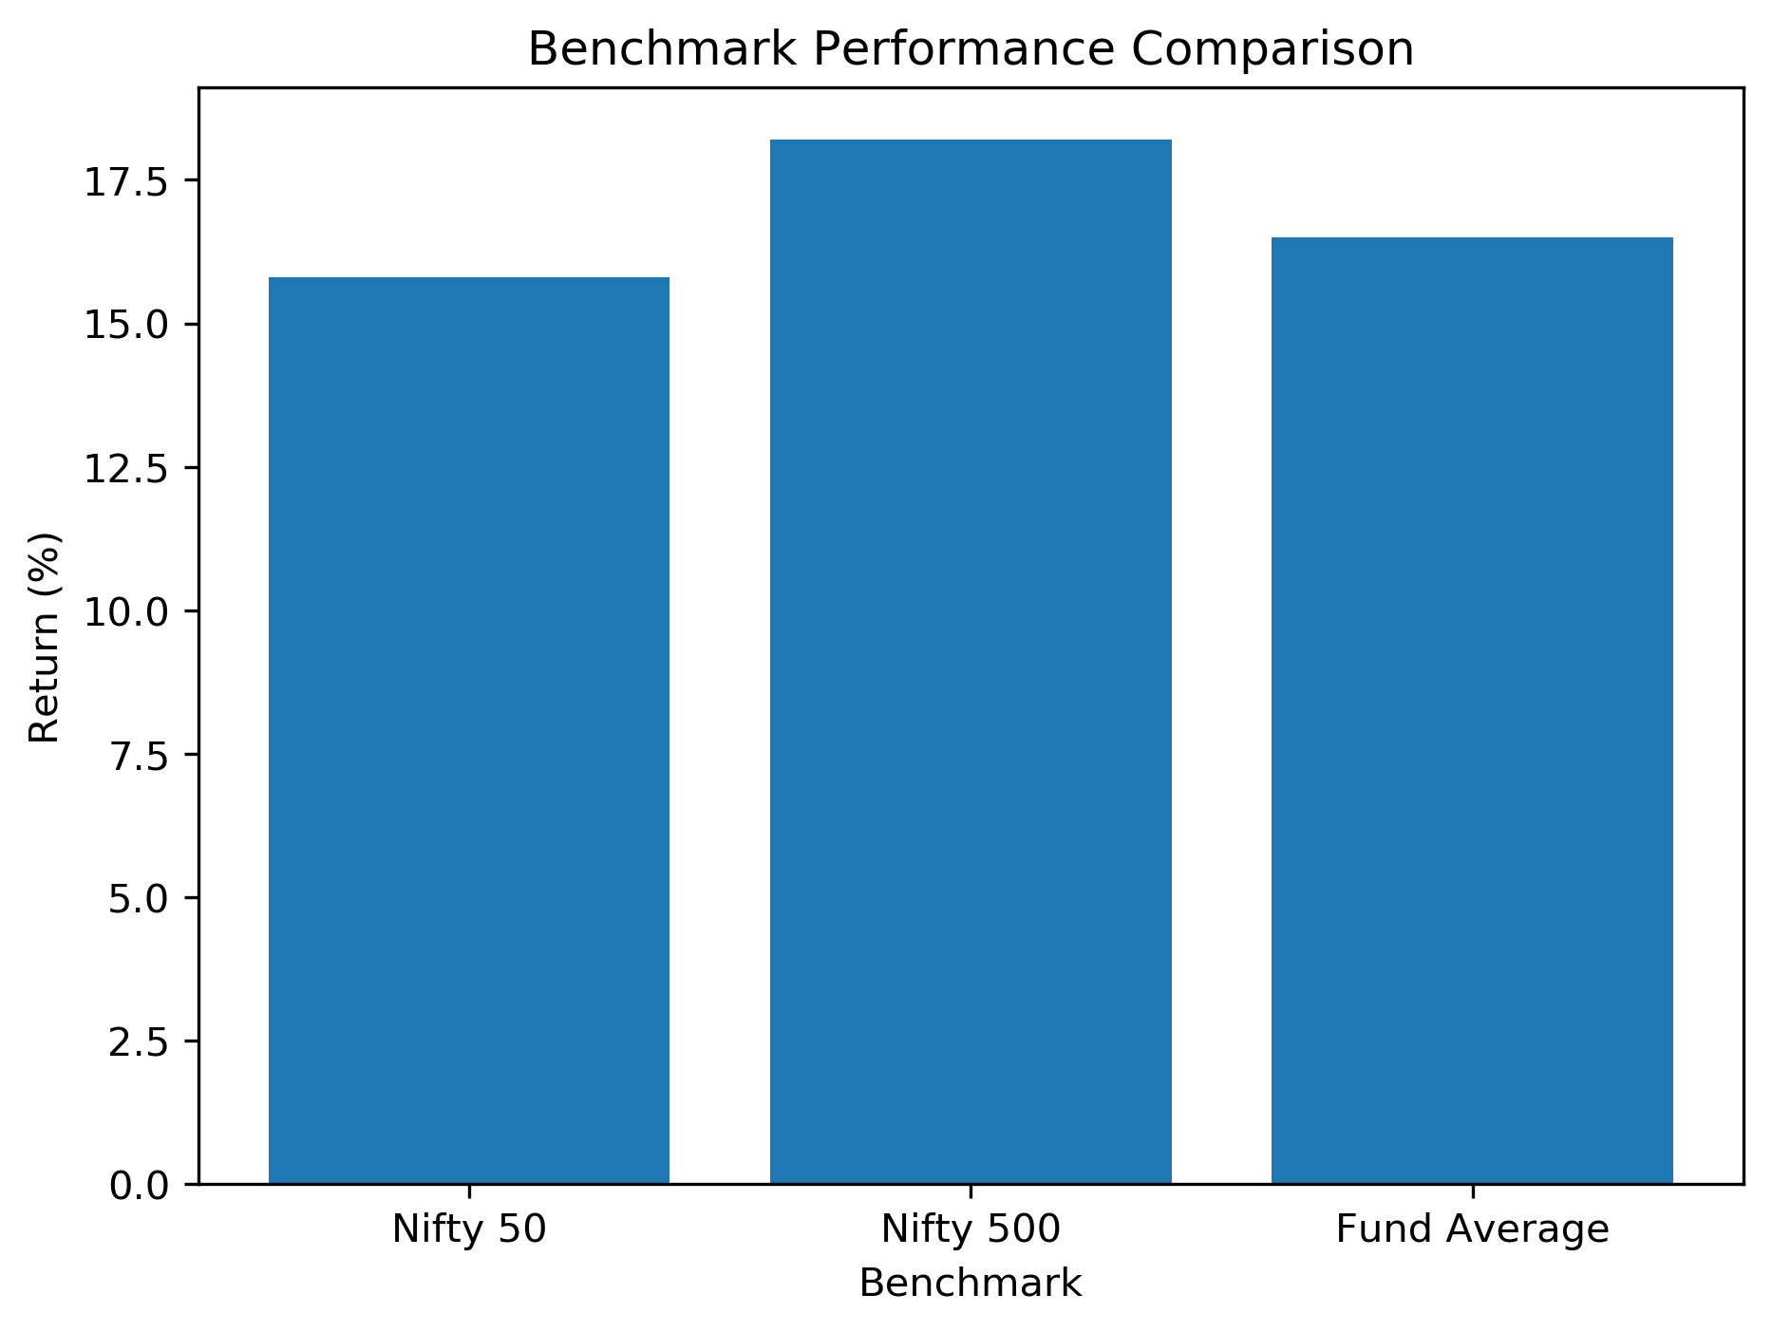
Performance Analytics
Performance metrics computed: daily returns, CAGR, Sharpe Ratio, Sortino Ratio, Alpha, Beta, and Maximum Drawdown. These metrics were used to compare risk/return and identify top funds against market benchmarks.
CAGR
Compound annual growth rate of each fund.
Sharpe Ratio
Risk-adjusted return versus volatility.
Sortino Ratio
Return adjusted for downside risk only.
Alpha / Beta
Excess return and market sensitivity.
Max Drawdown
Largest peak-to-trough decline observed.
Mutual Fund Analytics | Bluestock FinTech Internship
10

Slide 11


Power BI Dashboard
Results were pushed into Power BI where KPI cards, NAV trends, state and age-group analyses, and fund comparisons were implemented with interactive slicers.
KPI Cards
NAV Trends
State & Age-Group Analysis
Fund Comparisons
Quick-glance summary metrics at the top of the dashboard.
Time-series view of NAV movement across funds.
Investment breakdowns by geography and investor age.
Side-by-side comparison with interactive slicers.
Mutual Fund Analytics | Bluestock FinTech Internship
11

Slide 12
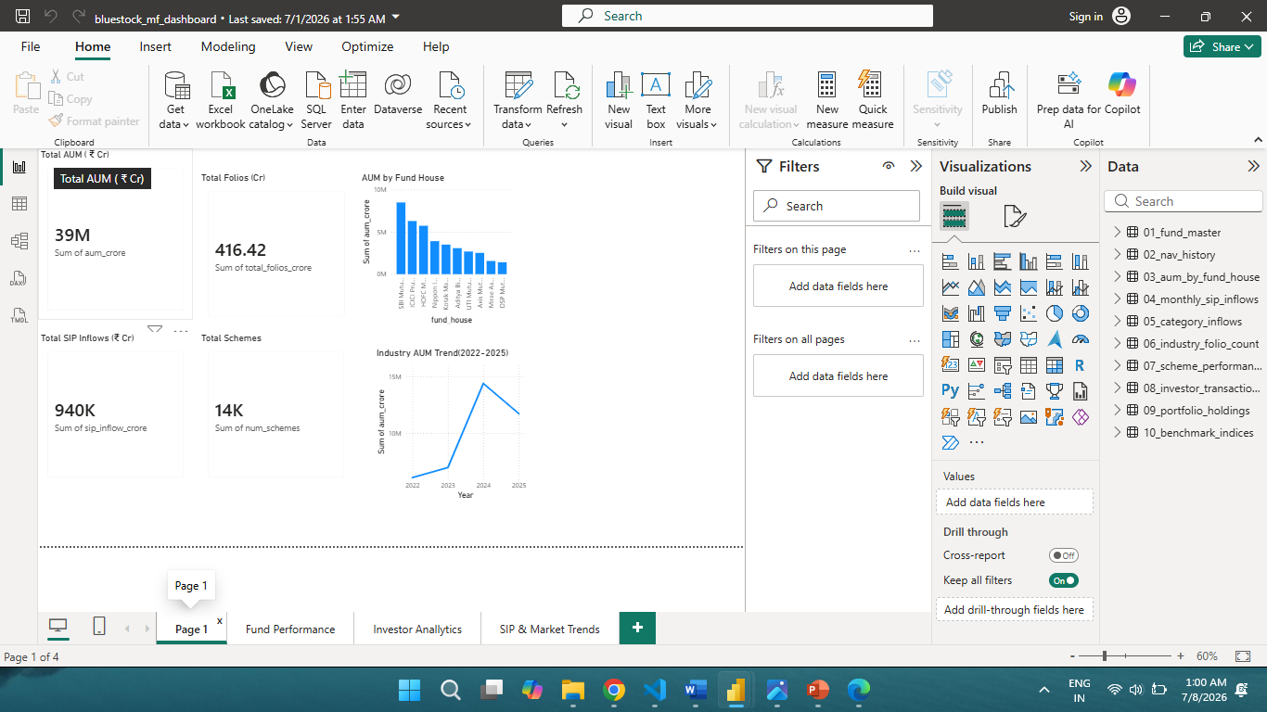
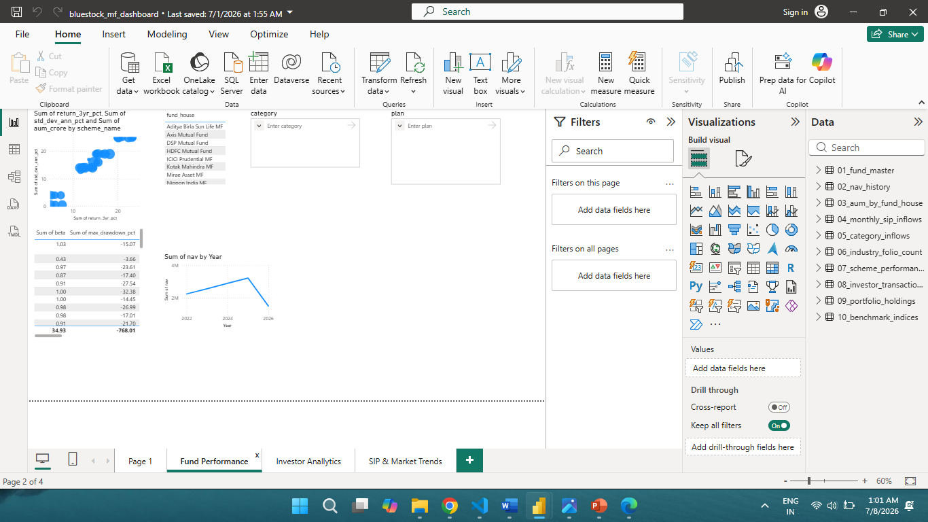
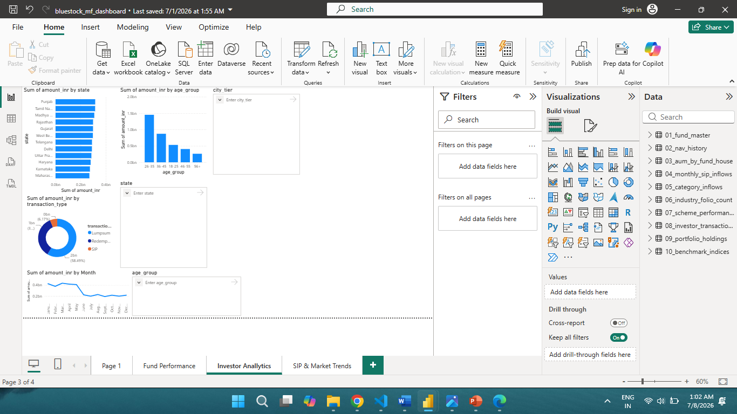
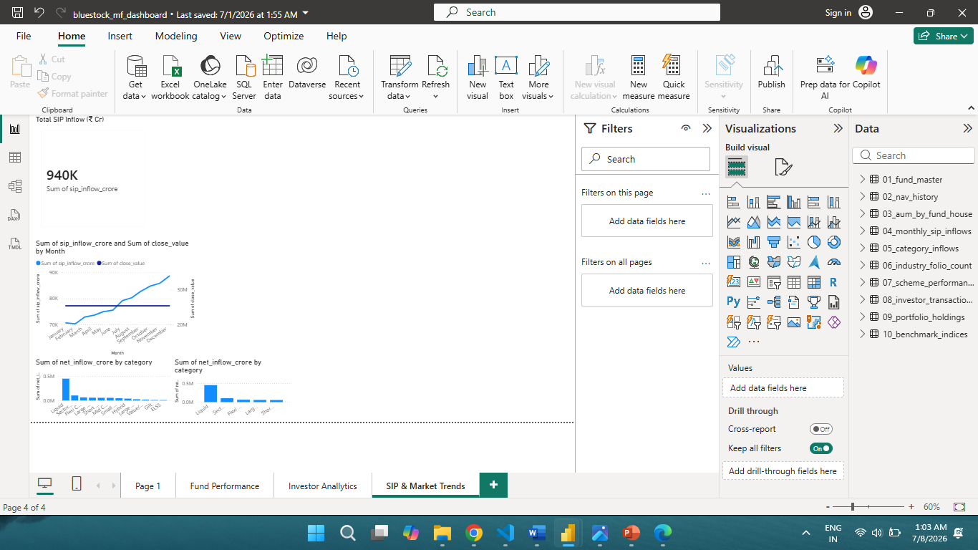
Power BI Dashboard
KPI Overview
Fund Performance
Investor Analytics
SIP & Market Trends
Mutual Fund Analytics | Bluestock FinTech Internship
12

Slide 13

Results & Conclusion
Final Findings
Datasets cleaned and stored in SQLite, EDA revealed investor patterns, top funds were identified by risk-adjusted returns, and Power BI made exploration easy for users. The project shows how these tools help better investment decisions.
13

