Slide 1
Deep Learning based TUBERCULOSIS Detection using Cough Analysis
Supervisor
Dr. D. Subitha
(Associate professor)
Department of Ece
Team members
Vtu 13069 - MEDA ANIL KUMAR
Vtu 13507 - Atla Lokesh
Vtu 14515 - Gundu bharadwaj

Slide 2
Agenda
Objective
Abstract
Introduction
Literature Survey
Methodology
Block diagram
Software used
References

Slide 3
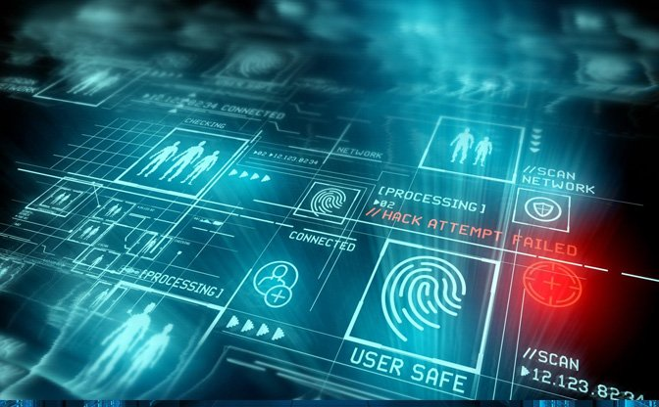
Objective
Studying the input samples like cough sound in different cases for various people and making a database to train the AI model.
We had used CNN algorithm to implement the model.

Slide 4
Abstract
Tuberculosis is a significant global health issue that affects an estimated 10 million people each year. Automatic tuberculosis detection using cough analysis provides a valuable tool for diagnosing and managing this disease.
While humans especially doctors has to indulge in providing environment ,there is a need of something which can take the decisions on its own and can detect the disease efficiently . There comes the concept of Artificial Intelligence(AI).
This project, is about a web application which can detect the presence of Tuberculosis .The possible symptoms mode which involves in providing symptoms like Cough sound mode which involves in audio recording of cough as the input. When the user data will be sent to deep learning model using internet ,the deep learning algorithm then returns the Tuberculosis infection probability.
This model can identify Tuberculosis patients with cough sound. This model may not completely avoid the interference of mankind in stopping the spread of Tuberculosis,but definitely provides immense assistance to man kind.

Slide 5
Literature survey
JOURNAL​ | AUTHOR​ ​ | TITLE OF PAPER​ ​ | OUTCOMES​ ​
2020​ | Sarkar Siddique and James C. L. Chow​ | Machine Learning in Healthcare Communication​ | In this paper , the author used ANN algorithm ,with the continuous advancement in technology, it is expected to have more influence in the future. AI can reduce healthcare costs and make research tasks more efficient by introducing the latest advanced algorithm.
2020​ | Qurat-ul-Ain Arshad, et.al, | Deep Learning Based Tuberculosis Detection: Challenges and Future Directions ​ | In this paper, DL algorithms more suitably CNN and its variants have been successfully applied for screening, diagnosis, prediction, severity checking, drug discovery and treatment of Tuberculosis.​
2021​ | Yu-Ting Shen1, et.al. | Digital Technology-Based Telemedicine for the Tuberculosis Pandemic​ ​ | In this paper Telemedicine provides a great opportunity to fully take advantage of modern technologies and simultaneously leverage the progressive push toward value and efficiency.

Slide 6
JOURNAL​ | AUTHOR​ ​ | TITLE OF PAPER​ ​ | OUTCOMES​ ​
2021​ | Wentao Zhao 1,2, Wei Jiang1 & Xinguo Qiu 1​ | Deep learning for Tuberculosis detection based on CT images​ | In this paper author used automatic cropping algorithm.These ensure that Tuberculosis-negative patients are correctly diagnosed as negative in the vast majority of cases, reduce probability of diagnosing Tuberculosis-negative cases as positive and reduce the burden on the health.
2021​ | Abdullah Bin Shams, Md. Mohsin Sarker Raihan.​ | Telehealthcare and Tuberculosis:A Non invasive & Low Cost Invasive, Scalable and Multimodal Real-Time Smartphone. | This paper uses ml algorithm and provides three modes of diagnosis using symptoms, cough sound and hematological biomarkers with an accuracy of 77.59%, 95.65% and 95.24%. It provide an alternative feasible low-cost method of detection.
2021​ | Samer Ellahham​ | Artificial intelligence in the diagnosis and management of Tuberculosis: a narrative review​ | This paper used data augmentation of radiographic images (DARI) algorithm and early detection of symptoms through chatbot applications. AI can also be used for the remote management .

Slide 7
JOURNAL​ | AUTHOR​ | TITLE OF PAPER​ | OUTCOMES​
2020​ | Dinesh Viswa Gunashekeran, et.al. | Applications of digital health for public health responses to Tuberculosis: a systematic scoping review of artificial intelligence, telehealth and related technologies​ | In this paper RBN(Radial Basis Function Networks) algorithms is used With the continuous advancement in technology, it is expected to have more influence in the future. AI can reduce healthcare costs and make research tasks more efficient by introducing the latest advanced algorithm and is expected to assist clinical in many areas.​
2021​ | Ilana Harrus, Jessica Wyndham​ | Artificial intelligence and Tuberculosis applications and impact assignment​ ​ | In this paper DBN(deep belief networks) algorithm is used AI-based applications have been adapted from pre-pandemic uses for diagnosis and drug development, for forecasting the disease's spread and monitoring population movement.​

Slide 8
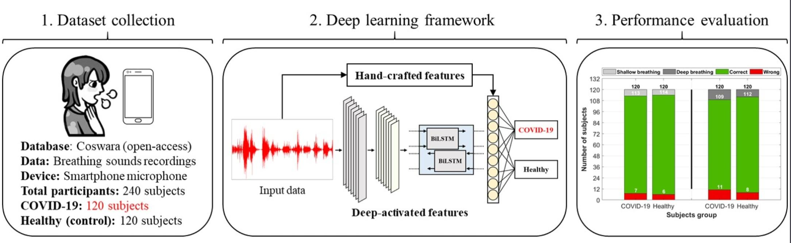
Methodology
The input sound for the Tuberculosis analysis, can be obtained from open source platforms like coswara or it can be hand crafted sounds obtained by recording with smartphone audio. Librosa a python package which is used to work on audio data like music generation and speech recognition.
Data preprocessing is a necessary task for cleaning data from unwanted noises and making it acceptable for a deep learning model, which improves the model’s accuracy and efficiency.

Slide 9
Methodology
After data pre processing the feature extraction is done. Feature extracting is the process of determining the features that will be used to study the model.
Feature extraction refers to the process of transforming raw data into numerical features that can be processed while preserving the information in the original data set. It yields better results than applying machine learning directly to the raw data. Parameters considered input to distinguish sound:
Chroma-STFT
Spectral centroid
Zero Crossing Rate
Spectral bandwidth
Spectral Roll-off

Slide 10
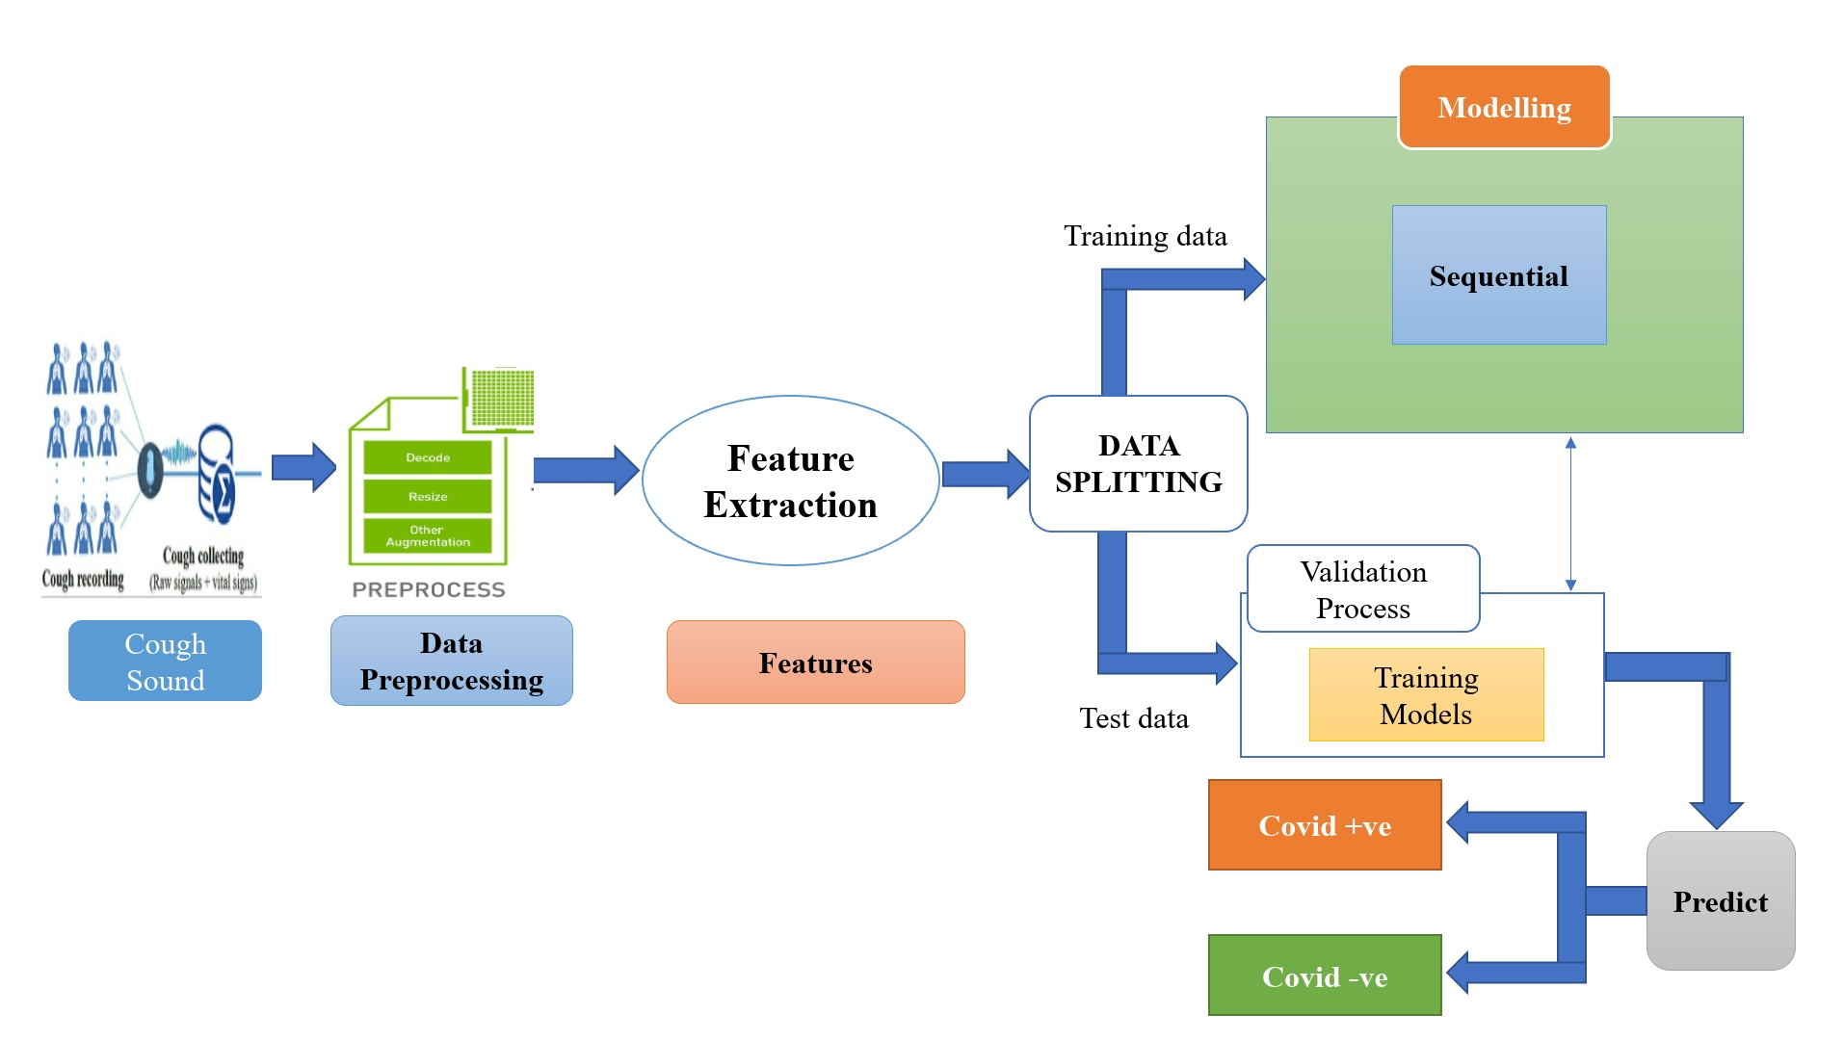
Block diagram

Slide 11
Software Used
Anaconda jupyter notebook : To give the audio input and to import required libraries.

Slide 12
References
Sarkar Siddique and James C. L. Chow proposed a NLP and DNN applied in various components of healthcare without human involvement.: A machine learning based approach during COVID-19 pandemic.Healthcare. 2021;9(2):156.
Yu-Ting Shen1 and Hui-Xiong Xu Patient proposed for Technology that can be used to assist in the application of telemedicine system to augment and improve the traditional community health strategies.. 2017.
Ilana Harrus,Jessica Wyndham Trends in the use of Pre-pandemic AI-based applications for diagnosis and treatment research, as well as forecasting disease transmission and people mobility, have already been adapted.— United States, January–March 2019.
Wentao Zhao , Wei Jiang & Xinguo Qiu The potential for artificial intelligence in Healthcare by using CNN reducing the probability of diagnoising covid-19.. Future Healthcare Journal. 2019;6(2):94–98.

